Slide 1
Ecology 8310 Population (and Community) Ecology
Patch selection (e.g., Marginal Value Theorem)
Prey selection (optimal diet theory)
Moving beyond feeding (energy intake): predation risk (u/g)
Notes:
Foraging theory had it's hay-day in 1970's and early 80's. Not common today, but the basis of the theory remains with us; engrained in how we model systems and think about consumer-resource interactions and spatial dynamics.

Slide 2
Patch selection:
Consider a forager moving among many patches during a foraging bout (rodent among seed caches, pollinator among flowers, etc.)
Which patches does it feed in?
For how long? (when does it leave?)
How are these decisions altered by patch density?
Or the quality of other patches?

Slide 3
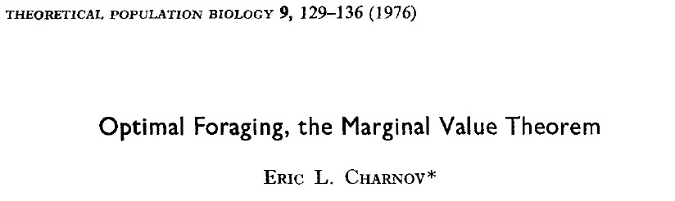
Patch selection:
Notes:
Cited over 2500 times!

Slide 4
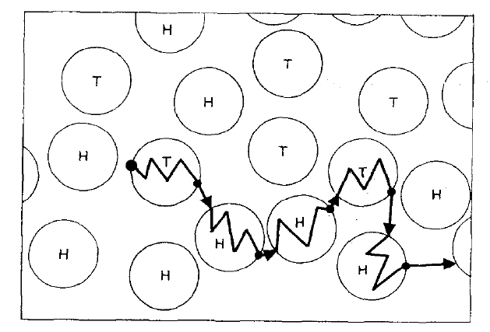
Patch selection:
GOAL: Maximize rate of net energy gain (intake – losses / time)
Notes:
Explain process

Slide 5
Do I feed in this patch?
When do I leave?

Slide 6
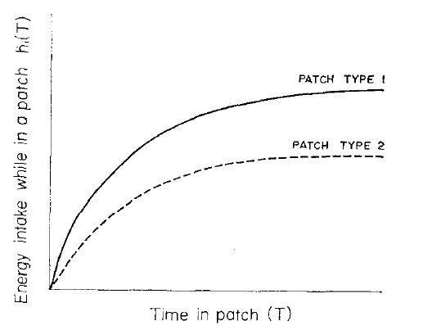
Patch selection:
Cumulative energy intake
Notes:
But this ignores costs of foraging, so we expect these curves to be lower and for the forager to eventually lose energy

Slide 7
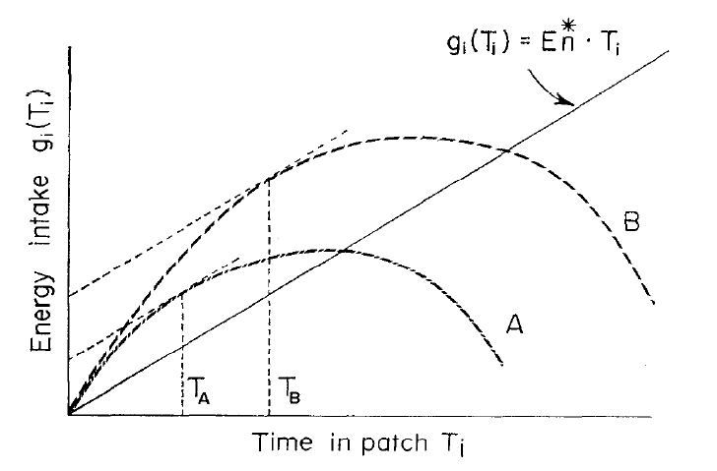
Patch selection:
Expectation of return if you leave the patch (and do the best you can): you get a return rate of R_{n}*:
Marginal Value Theorem:
Leave when: dg/dT = R_{n}*
Marginal Value (this slope)
Notes:
Explain the concept of MV: you leave when the return from the patch you are in, stops to drop below the expectation from the environment as a hole: i.e., when you could do better elsewhere. (but this assume infinite time and an expectation over many patches)…if the forager had only limited time, then it might stay (vs. Risking NOT finding any food: sure thing vs. Uncertain pay off – but these issues aren't dealt with in our simplest models).

Slide 8
Marginal Value Theorem:
Another way to look at this (when there is only 1 patch type)
Slope = Energy gain/Time
Cumulative Energy gain
Point of diminishing returns
Which strategy yields the greatest E/T?
Time to leave!
Travel Time
Search Time in Patch
Time
Notes:
e.g., on average, each patch requires time to find the patch (travel time; to the left of black line)) and then the investment to forage in the patch (to the right). During that time, the forager gains the energy indicated by the blue line. Thus, the average rate of Energy Gain is the Energy / total time (sum of the two time components). And this corresponds to the line with the steepest slope.

Slide 9
Marginal Value Theorem:
What if patches are denser (travel time is less)?
Dense
Sparse
Leave earlier when travel time is shorter.
Cumulative Energy gain
Travel Time
Search Time in Patch
Time

Slide 10
Patch selection:
Predictions of MVT:
Leave at a fixed MV (indep. of patch quality)
Stay in higher quality patches longer
Skip patches in which dg/dt|_{t=0} < R_{n}* (=E/T_{n}*)
As the density of patches increase…
Reduce residency time
Drop low quality patches from diet
Variants:
Giving up density (uniform among patches) – empirical tool
Giving up time (time since last prey taken) – rule of thumb

Slide 11
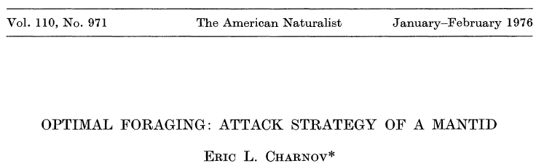
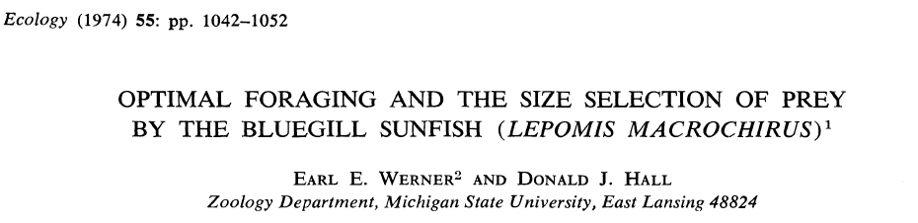
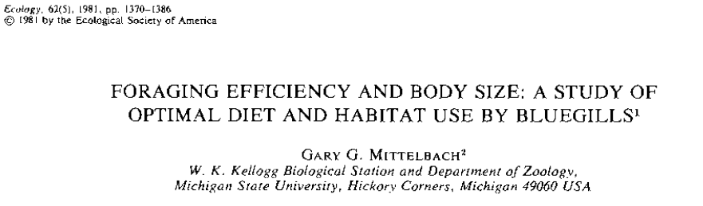
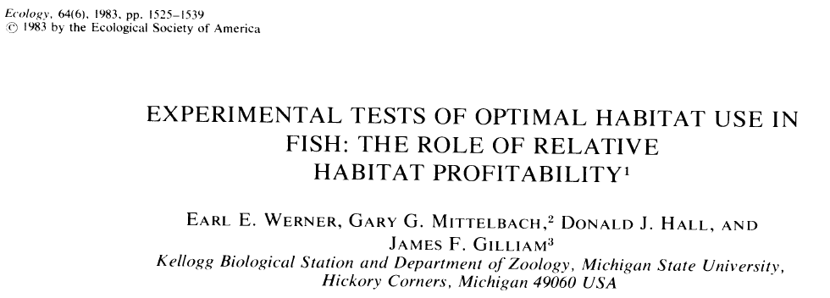

Prey selection:
Notes:
Early work by Schoener, Pulliam and MacArthur and Pianka, Emlen; led to refinements and tests by others. Sunfish became a model system….

Slide 12
Prey selection:
Consider a forager moving WITHIN a patch
What is it’s feeding rate?
Which prey does it attack?
How are these decisions altered by prey density?
…or the types of prey available?
Assume: maximize long-term rate of energy gain

Slide 13
But first, some basics

Slide 14
Feeding rate:
Feeding rate = number of prey consumed per unit time
How can we express the feeding rate of that forager during the foraging bout...
If there is only one prey type in the environment?
And the forager attacks (and captures and consumes) all prey that it finds.

Slide 15
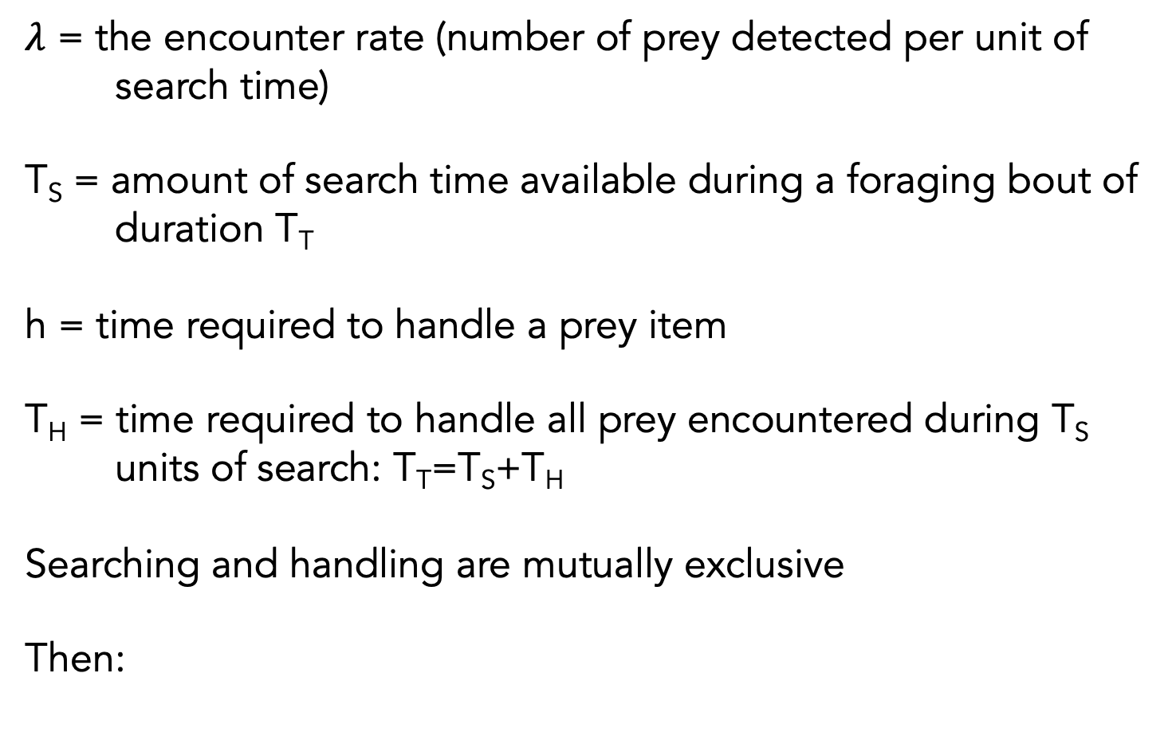
Feeding rate:
$λ$ = the encounter rate (number of prey detected per unit of search time)
T_{S} = amount of search time available during a foraging bout of duration T_{T}
h = time required to handle a prey item
T_{H} = time required to handle all prey encountered during T_{S} units of search: T_{T}=T_{S}+T_{H}
Searching and handling are mutually exclusive
Then:

Slide 16
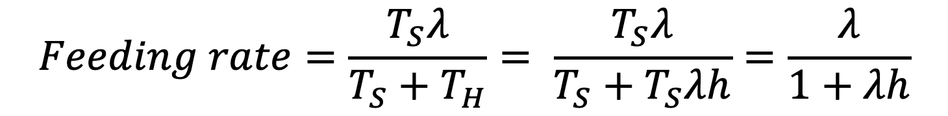
$$Feeding rate=\frac{T_{S}λ}{T_{S}+T_{H}}= \frac{T_{S}λ}{T_{S}+T_{S}λh}=\frac{λ}{1+λh}$$

Slide 17

But what is $λ?$

Slide 18


Functional response:
the feeding rate of a predator as f(prey density)

Slide 19
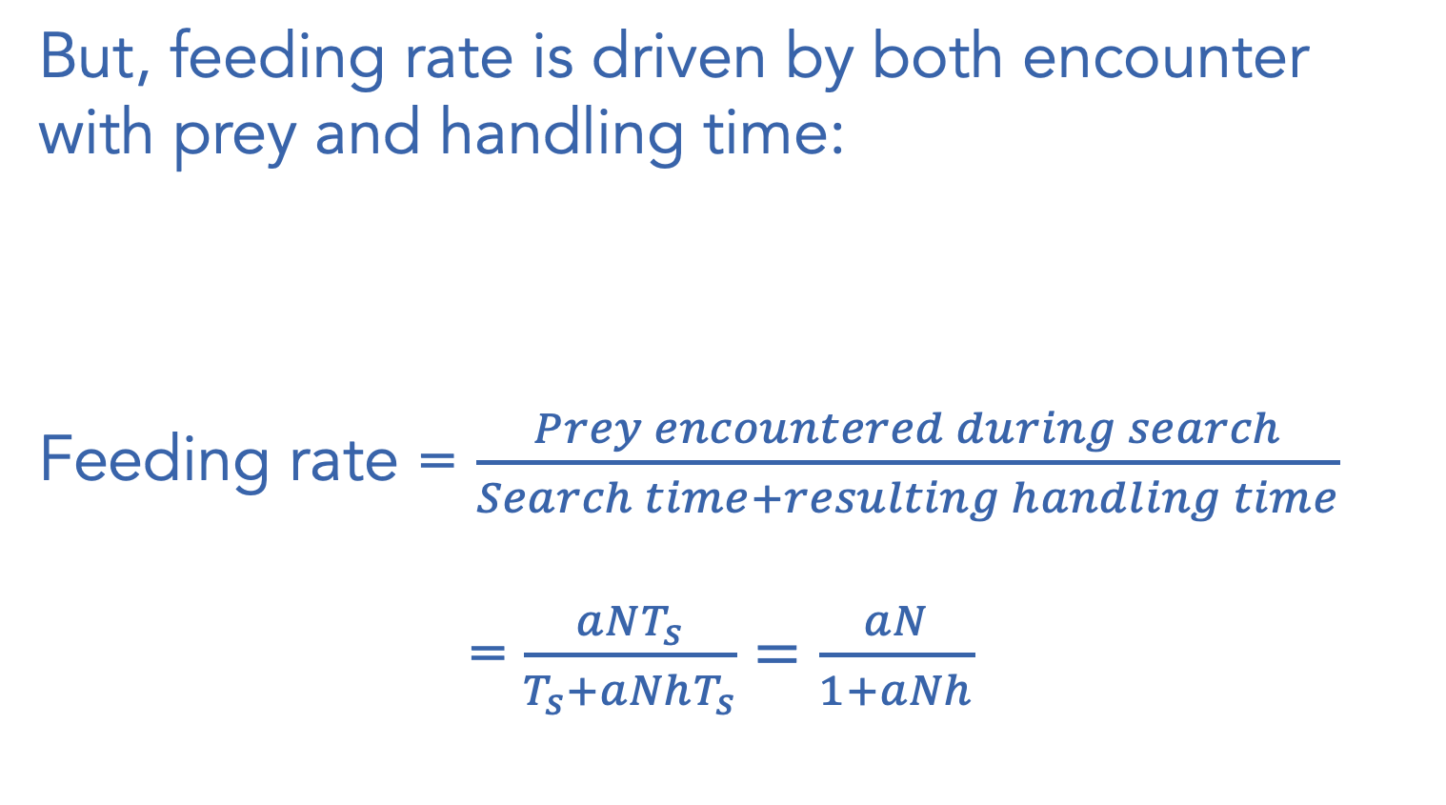
But, feeding rate is driven by both encounter with prey and handling time:
Feeding rate = $\frac{Prey encountered during search}{Search time+resulting handling time}$
= $\frac{aNT_{s}}{T_{s}+aNhT_{s}}=\frac{aN}{1+aNh}$

Slide 20
$$λ=aN$$
Rate of encountering prey
( prey per unit search time)
Slope = a
Prey density , N

Slide 21

Type I functional response:
(all encountered prey are eaten instantly)
$$per predator feeding rate=aN$$
Feeding Rate
( prey per predator per time)
Slope = a
Prey density , N

Slide 22
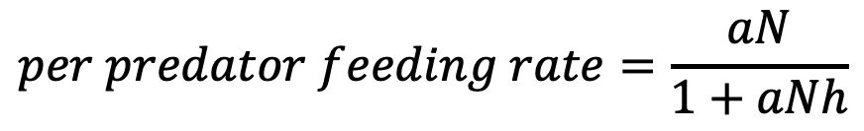
Type II functional response
(includes handling time, h):
$$per predator feeding rate=\frac{aN}{1+aNh}$$
1/h
Slope = a (h=0)
Feeding rate
Prey density , N
Notes:
Recall our discussions from foraging theory…

Slide 23
If h=0

Slide 24

Type I functional response:
$$per predator feeding rate=aN$$
Feeding rate
Slope = a
Prey density , N
Notes:
Assume that predators encounter prey at random – i.e., in proportion to their density in the environment. Thus, this feeding rate is really a rate at which predators encounter prey (because it assumes no handling time).
This is pretty unrealistic (for feeding rate to continue to increase as N increases)…prey require time to capture, consumer, and potentially digest (predators get satiated).

Slide 25
It could be more complicated

Slide 26
Three types of classic functional responses:
Type I
Type II
Type III
Feeding rate
Prey density , N
Notes:
e.g., search image formation..

Slide 27
Let’s generalize to >1 prey type (assuming a Type II functional response)…
Notes:
But this is only for one prey. How do we modify this to incorporate a multi-prey type II functional response:

Slide 28
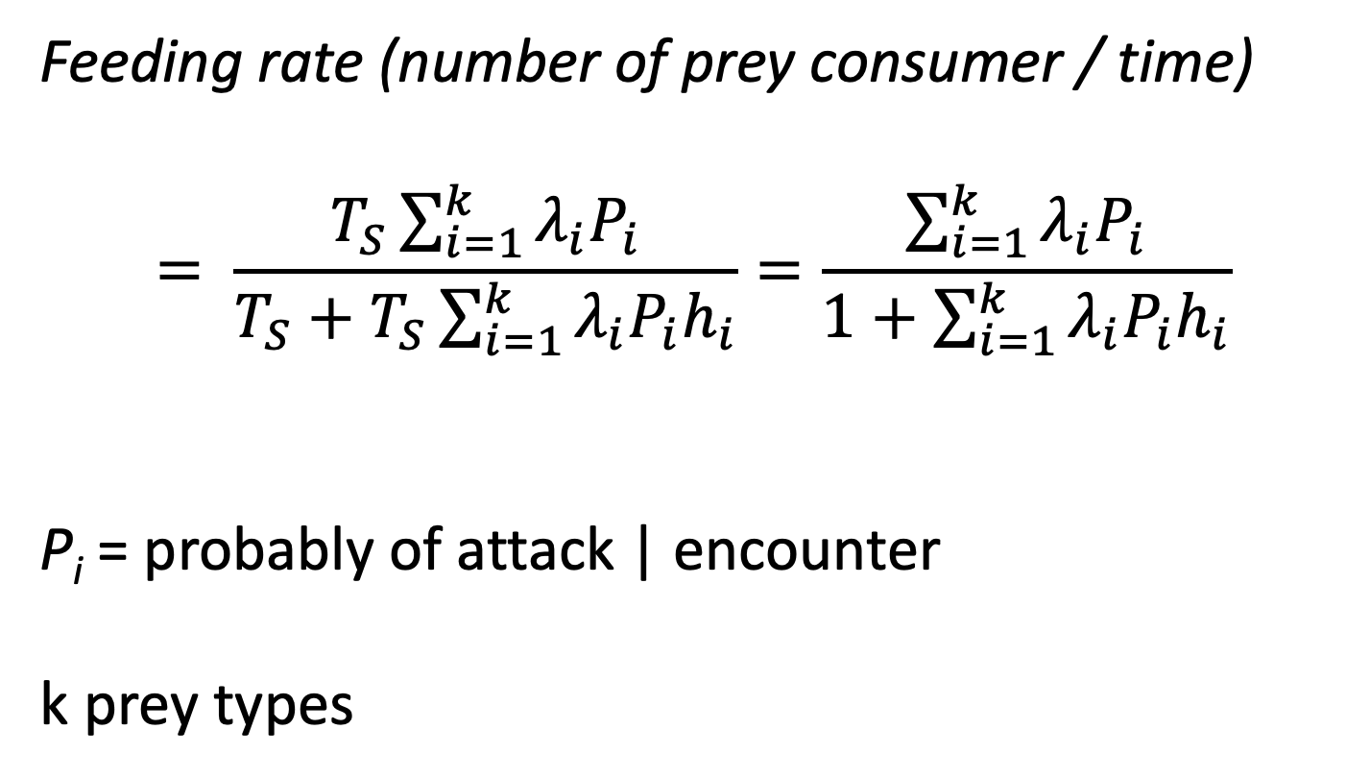
Feeding rate (>1 prey type):
Feeding rate (number of prey consumer / time)
$$= \frac{T_{S}\sum_{i=1}^{k}{λ_{i}P_{i}}}{T_{S}+T_{S}\sum_{i=1}^{k}{λ_{i}P_{i}h_{i}}}=\frac{\sum_{i=1}^{k}{λ_{i}P_{i}}}{1+\sum_{i=1}^{k}{λ_{i}P_{i}h_{i}}}$$
P_{i} = probably of attack | encounter
k prey types

Slide 29
Converting to energy:
E/T = Energy gained / Time expended

Slide 30
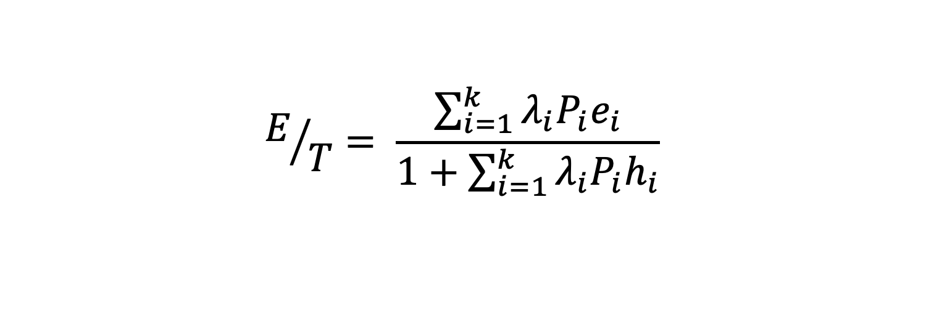
Rate of energy gain:
$$E/T= \frac{\sum_{i=1}^{k}{λ_{i}P_{i}e_{i}}}{1+\sum_{i=1}^{k}{λ_{i}P_{i}h_{i}}}$$
Where e_{i} is the net energy provided by one item of prey type i

Slide 31
Replace $λ$ with aN

Slide 32
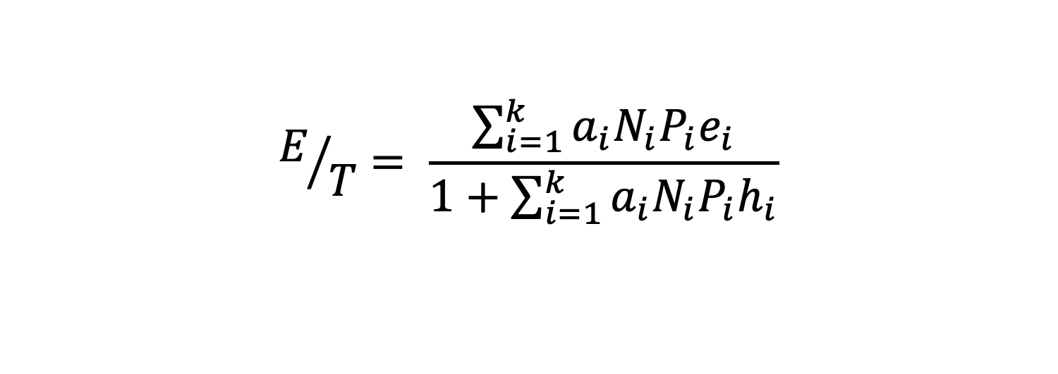
Rate of energy gain:
$$E/T= \frac{\sum_{i=1}^{k}{a_{i}N_{i}P_{i}e_{i}}}{1+\sum_{i=1}^{k}{a_{i}N_{i}P_{i}h_{i}}}$$
Notes:
So e includes assimilation
Ignores metabolic costs…could include, but the basic message is the same.

Slide 33
Prey selection:
The basic logic:
Goal: maximize E/T
Solution: rank prey by e_{i}/h_{i} (=profitability)
Predator can only decide on P_{i}'s (attack, don't attack, sometimes attack).
Optimal P_{i} is either 0 or 1 (attack or don't attack)
Graphical solution…

Slide 34
Graphically:
1:1 line
E/T*
Foraging Return (E/T)
Ignore if e/h<E/T*
Attack if e/h>E/T*
Not choosy
e/h_{crit} = E/T*
Very choosy
Minimum e/h in diet
Notes:
“Best prey” are on the right
“least profitable prey” are on the left
So, think of progressing from being very choosy (don’t get much E/T because you go too long between really great bites of food); E/T increases as you become less choosy. Eventually, you become too indisciminant and now you are spending too much time handling really crappy prey (think, celery wrapped in thick bag and taped shut). The optimum diet can be found by drawing the 1:1 line: i.e., the peak occurs when the least profitable prey item has a profitability = E/T* ---as in the MVT.

Slide 35
Prey selection:
The insights:
RULE: Attack if e_{i}/h_{i}>E*/T; else ignore. [As in MVT]
No partial preferences (when might this be violated?)
Inclusion of a prey type in the diet is only a function of density of MORE valuable prey (e.g., not the density of the prey type itself). Why?
Notes:
Partial pref: if there is variation in e/h within a type (and that can be discerned by the predator)

Slide 36
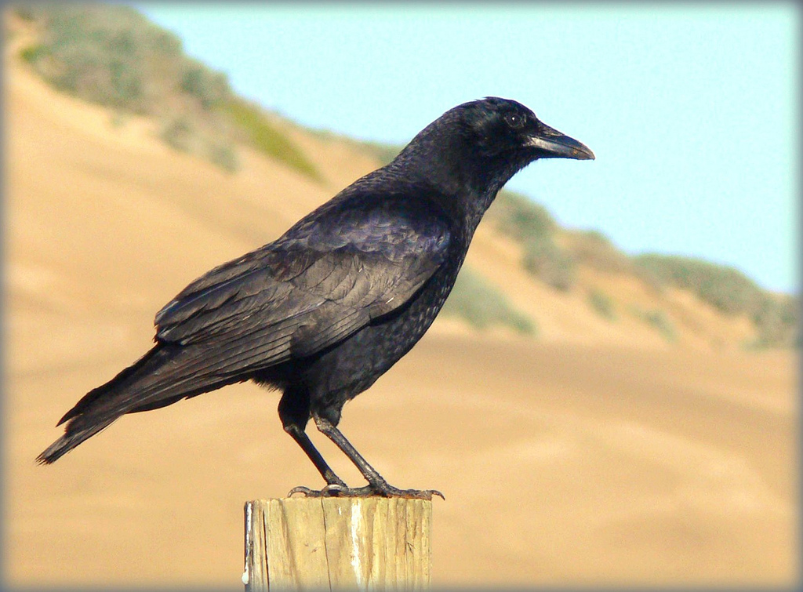
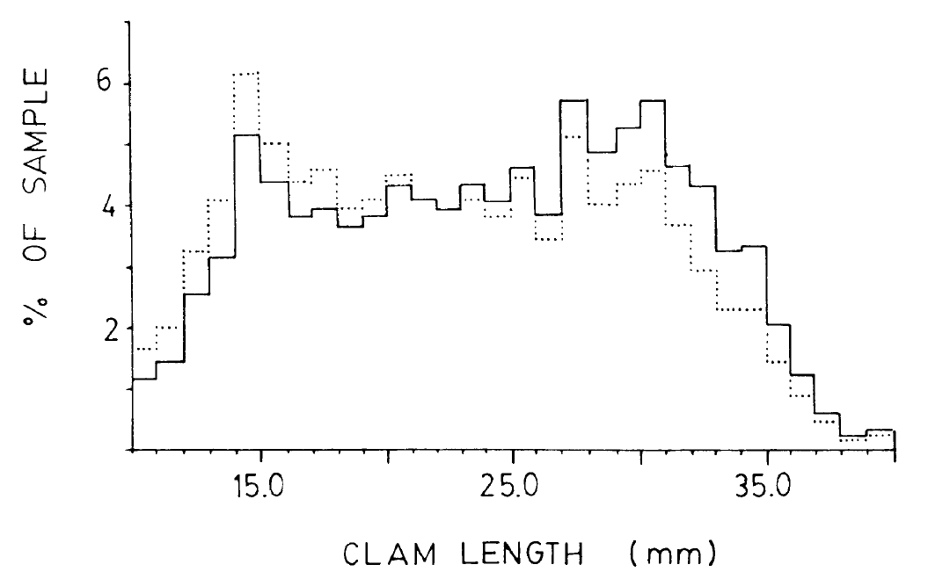
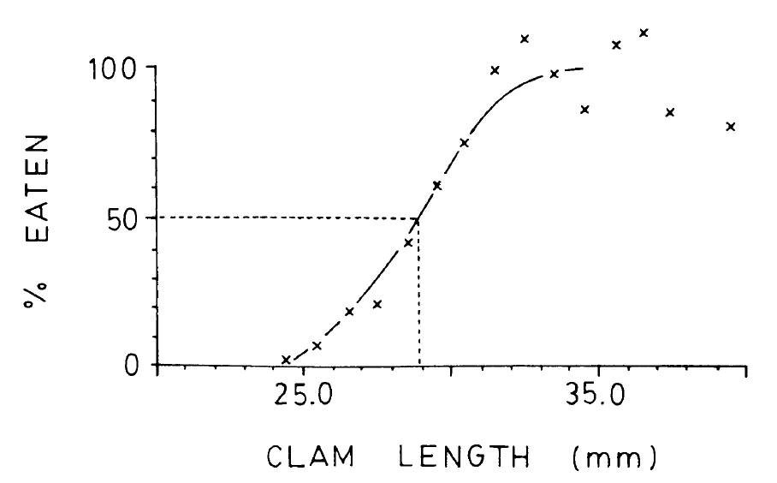
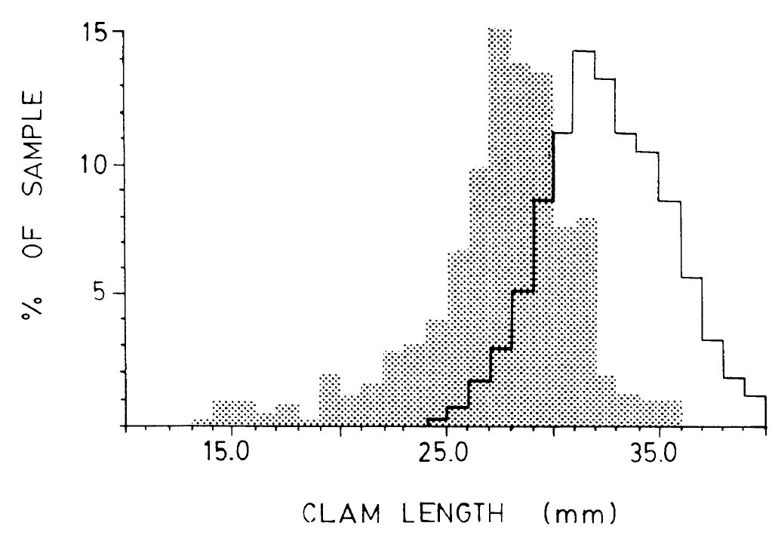
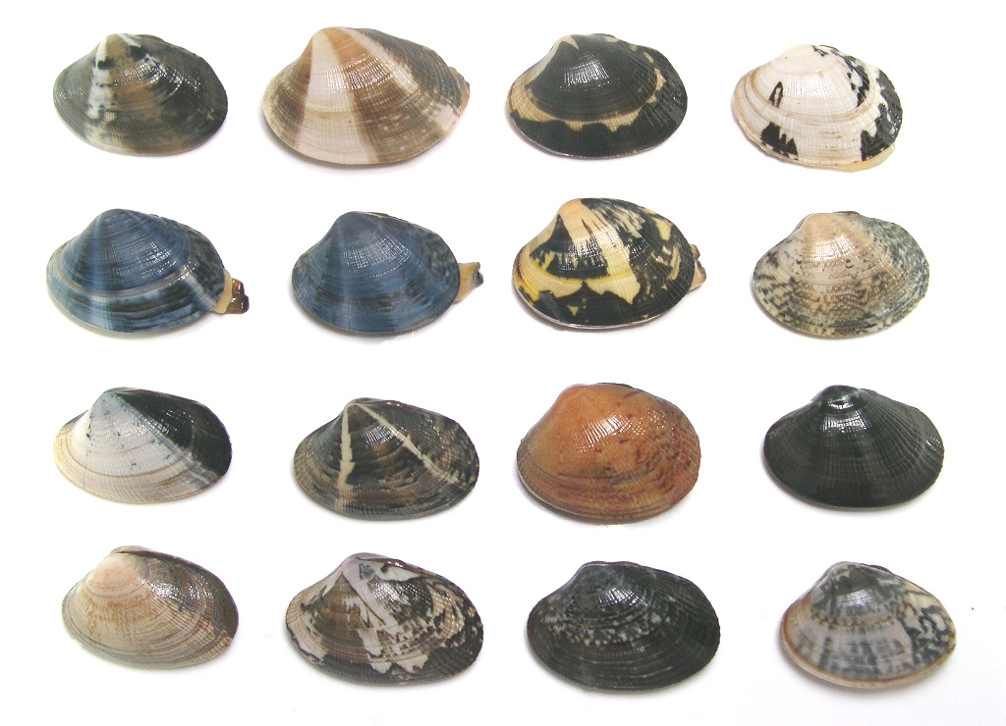
A test:
Optimal diet
Adjusted by “availability”
In environment
Eaten
Attacked but dropped
From Richardson and Verbeek (1986)
Notes:
The two distributions of clams in upper right. Dotted is the actual size-freq distribution; solid is an attempt to adjust for “availability” (larger are easier to find) – but the specific correction isn’t well justified.
My old slide has a note: “Predicted is not actually correct – because it uses the observed diet and not the prediction based on availability”, but I can’t figure out what this meant. R&V are not explicit about how they come up with the optimal diet (i.e., >=28.5)

Slide 37
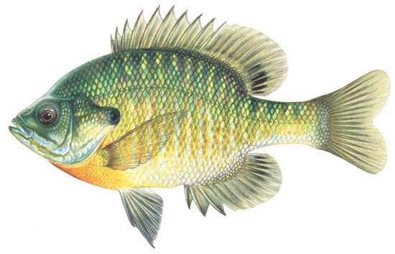
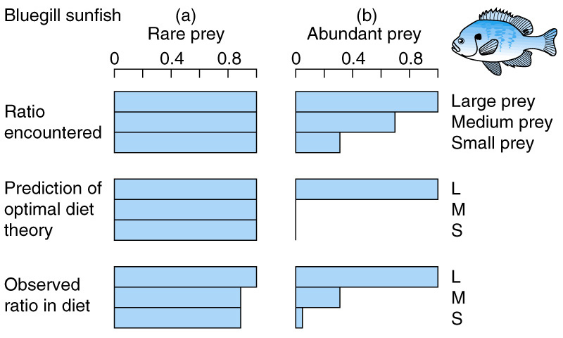
Laboratory test: Bluegill sunfish
Based upon Werner and Hall (1974)
Notes:
Point out the importance of "encounter"

Slide 38
Field test: Bluegill sunfish
Notes:
Some classic early work on OFT was done in the lab with bluegill….take it to the field.

Slide 39

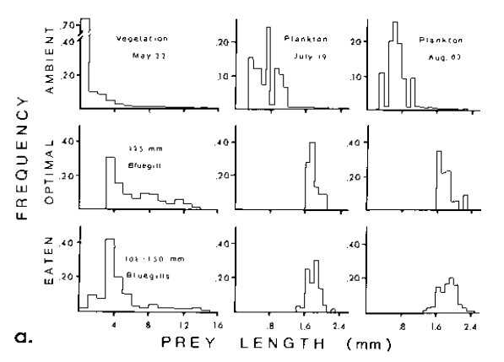
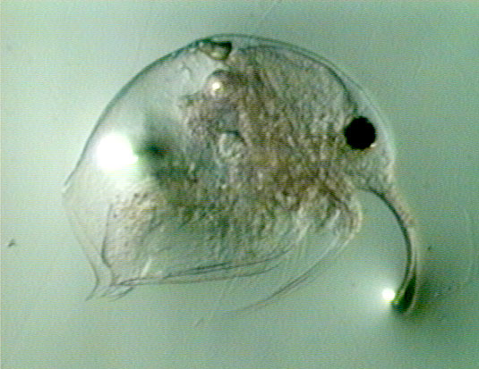
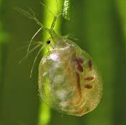
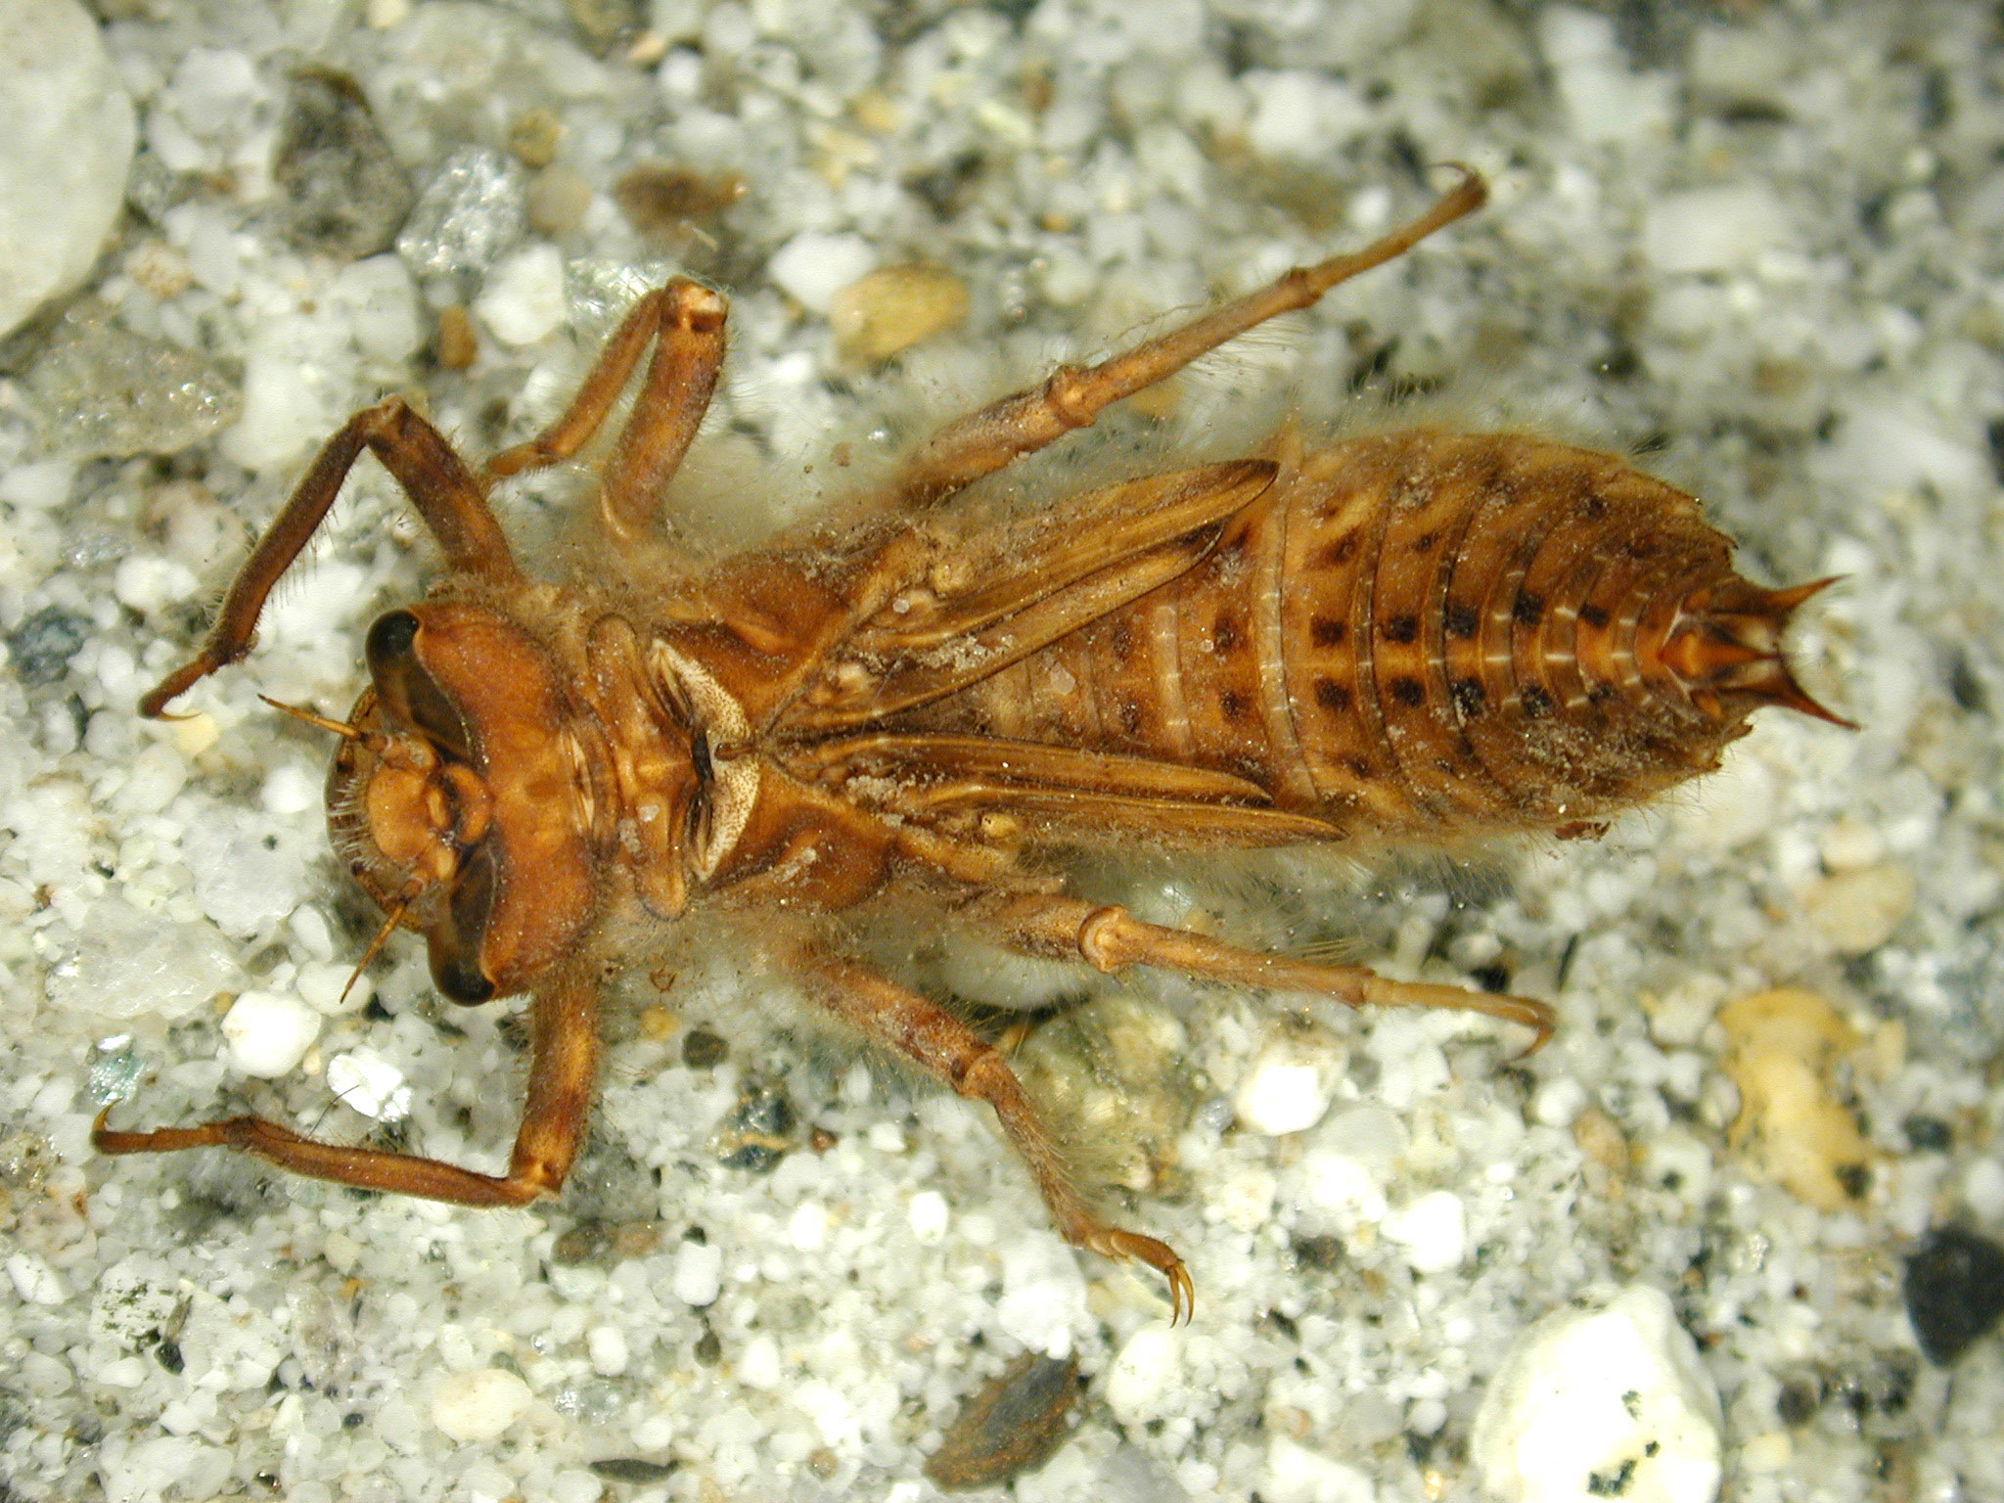
Prey selection: Field (lake)
From Mittelbach (1981)
Notes:
Field data

Slide 40
Can we use the diet model to predict field patterns?

Slide 41
Growth?

Slide 42
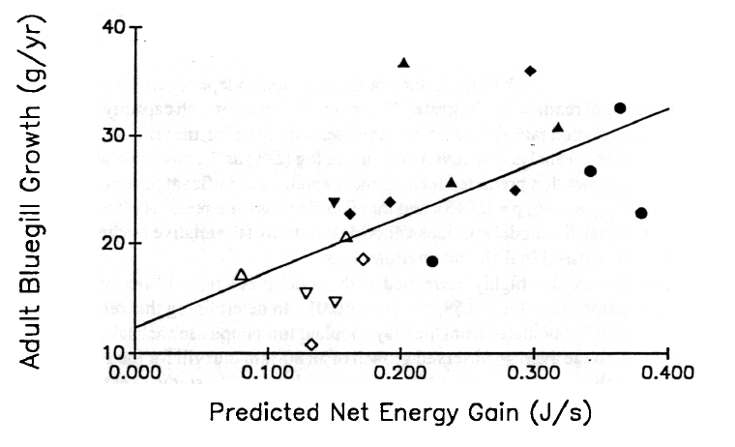
From Mittelbach and Osenberg (1994)

Slide 43
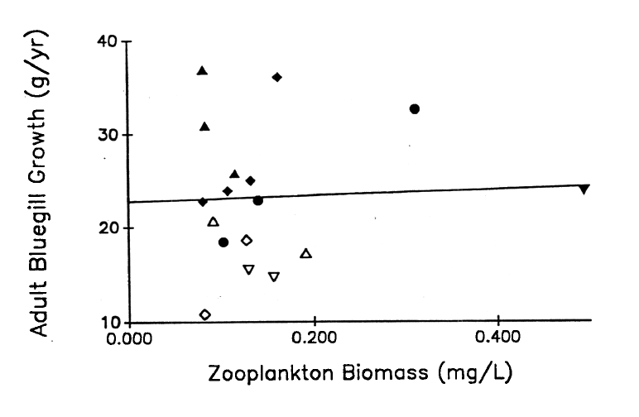
From Mittelbach and Osenberg (1994)
Notes:
Point out the importance of how the biomass is packages – large zoops vs many small.

Slide 44
Habitat use?

Slide 45
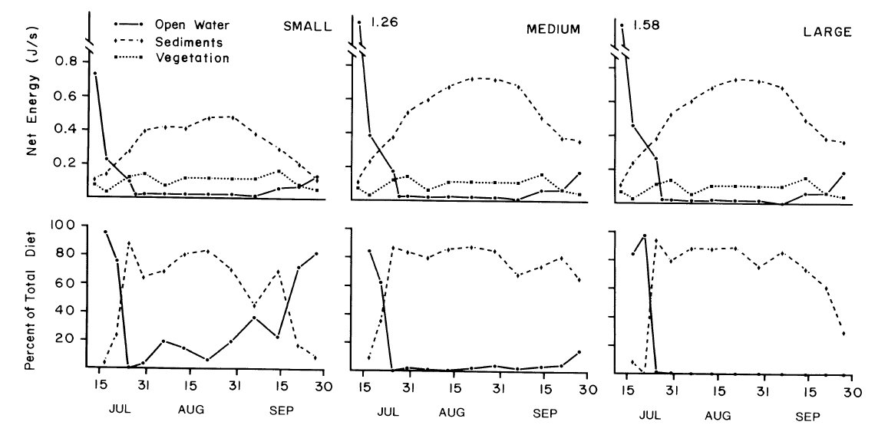
Habitat selection: "Field" (Ponds)
Open water
Vegetation
From Werner et al (1983)
Notes:
Field data

Slide 46
Problems?
Early models were very simple
Ignored complexities (e.g., capture probability, search images, nutrients, etc.)
Other species ….

Slide 47
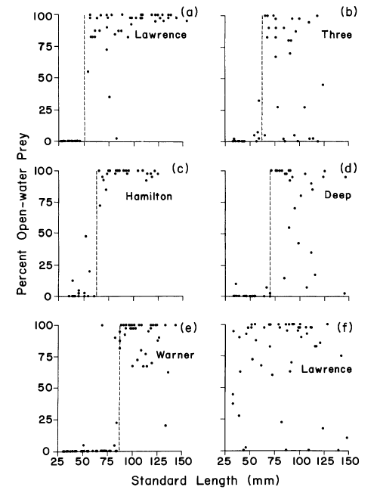
Lakes:
Examine habitat use across size-classes of fish…
Open water often the most profitable (zooplankton)
Used by large bluegill
But not used by small bluegill

Slide 48
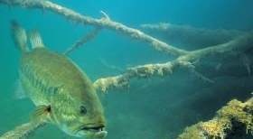
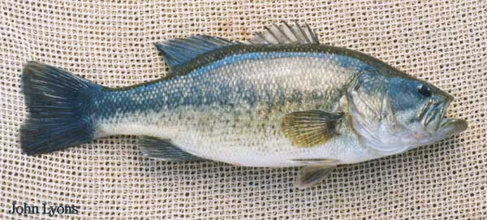
Notes:
Experimental tests in ponds.

Slide 49
Can we incorporate predation risk into our framework?

Slide 50
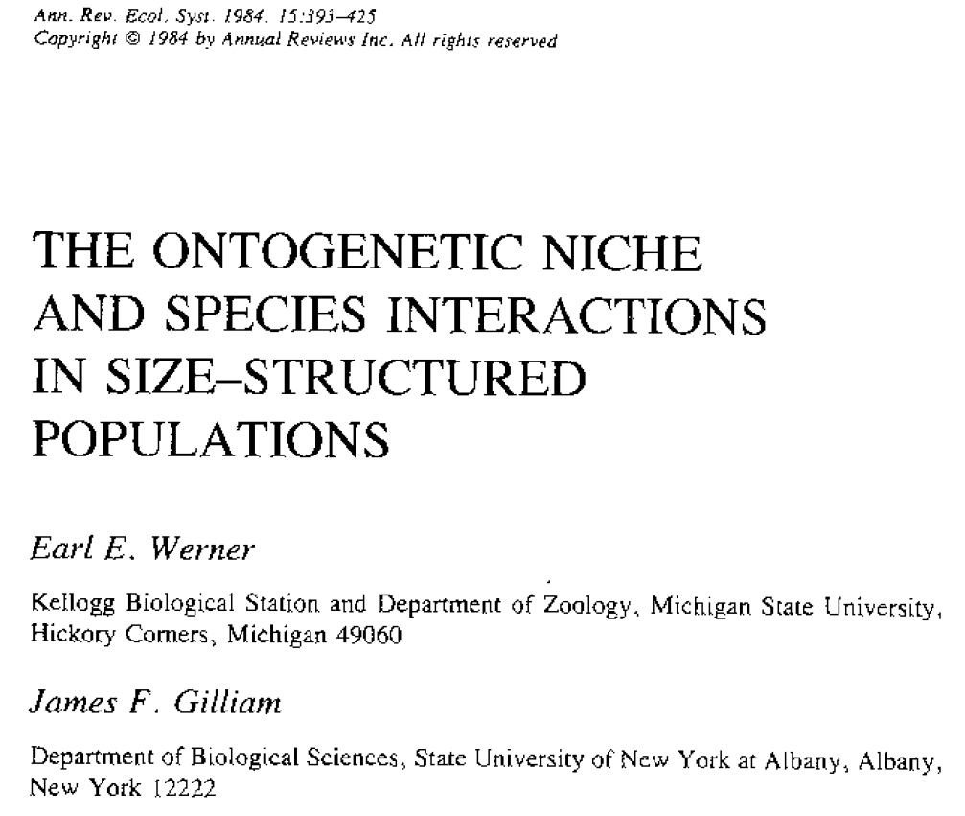

Slide 51
Old rule: maximize energy intake or "g" (growth)
New rule: minimize μ/g (risk to growth)
Why? What does min(μ/g) accomplish?
1/g is the time spent at a size;
So μ * 1/g (i.e., μ/g) is the mortality at a size;
Thus, min(μ/g) maximizes the Pr(survival)!
Only applies to juveniles (ignores reproduction)
Notes:
1/g is the time spent at a size. So u*1/g is the mortality incurred at a size, so min(u/g) maximizes the pr(survival). This rule only applies to juveniles: thus the rule maximized the pr(surv) to maturation: i.e., through stage juvenile survival. If you are looking at adults, then you also have to consider reproduction.

Slide 52
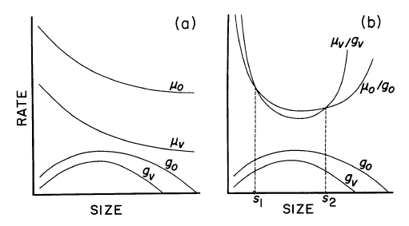
Shift from open water to vegetation
Shift from vegetation to open water

Slide 53
A test (observational; experimental)

Slide 54
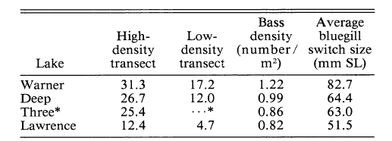
Observational test
Notes:
Experimental tests in ponds.

Slide 55
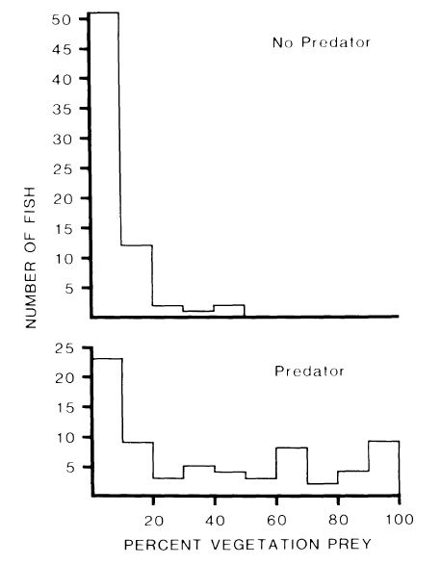
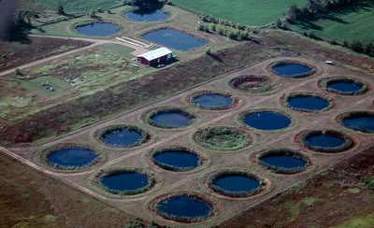
"Field" test
Small bluegill
Notes:
Split a pond; put bass on one side; other side without bass;

Slide 56
Other implications of this work (stage-structure in bluegill)?

Slide 57
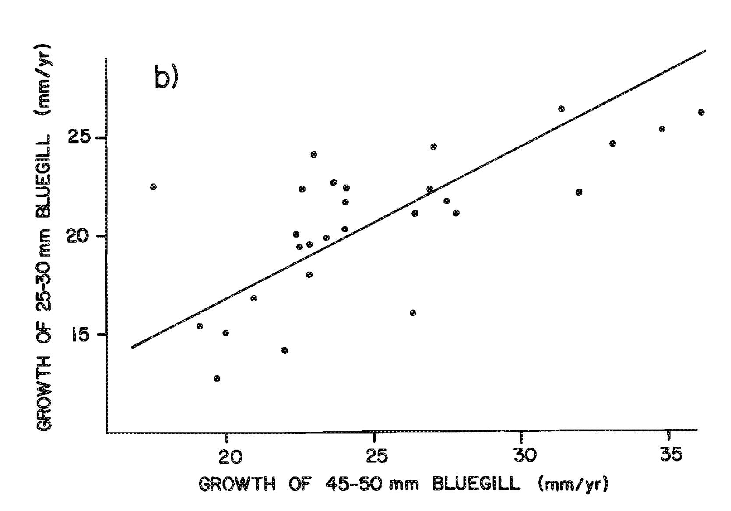

Slide 58
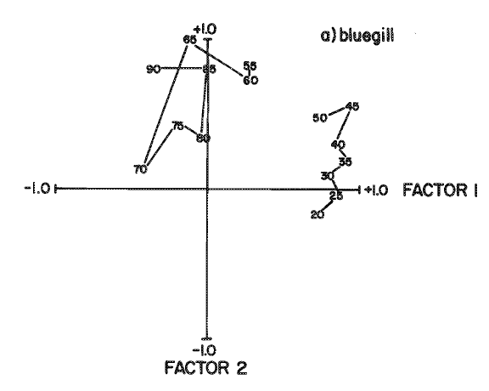

Slide 59
Small Bluegill
Large Bluegill
Littoral Invertebrates
Zooplankton

Slide 60
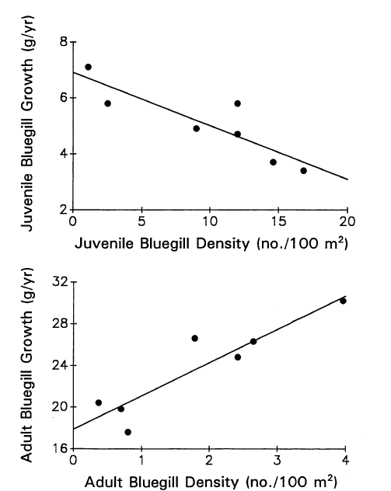

Slide 61
Small Bluegill
Large Bluegill
Littoral Invertebrates
Zooplankton
Notes:
So, "equilibration" arises as a trade-off between juvenile and adult performance.

Slide 62
Demographic compensation …
Notes:
(we used to discuss a paper by doak et al, but we don’t anymore; stil worth it to point out how there can be compensation at different points in the life history: e.g., if you increase the quality of the adult habitat, that may ultimately be “paid for” as a cost in juvenile survival… (traditional expectation is that density will increase until adult performance is reduced by den-dep back to original level). You can also view this through the lens of the Vonesh and de la Cruz study. Imagine that something increases the fecundity of adult frogs…. What affect will that have on adult density and on the performance (survival) of tadpoles?

Slide 63
What we’ve covered (our insights):
Optimal decision-making (in foraging)
Similar rules apply in choosing patches or prey items
Scaling up from foraging behavior:
Growth
Habitat selection
Risk (u/g)
Differential effects on life stages (→ structure)
Population responses

