Slide 1
Ecology 8310 Population (and Community) Ecology
Deterministic vs. stochastic models
Sources of variation
Environmental stochasticity in discrete (and continuous) time models
Demographic stochasticity
Demographic heterogeneity
Melbourne and Hastings (2008)

Slide 2
Deterministic models:
Exactly predict the future state of the system (given starting conditions and parameter values).
If repeated, with same conditions, the outcome will be identical.
This is useful (and easier to analyze), but unrealistic.
Hence, we might use stochastic models…

Slide 3
Stochastic models:
Variation can have effects on:
population size
population growth
spatial and temporal variation in population size
extinction risk

Slide 4
Sources of variation:
Demographic stochasticity
Classically: In its pure form, all individuals have the same death and birth rates. But, births and deaths are discrete and probabilistic, yielding demographic stochasticity. Extinction is caused by low N and "unfortunate coincidences" (Melbourne and Hastings 2008). Most important at small N; high N eliminates this "sampling" error.
Stochastic sex determination = random variation in the production of females vs. males.
Notes:
Easiest to see via simulation….

Slide 5
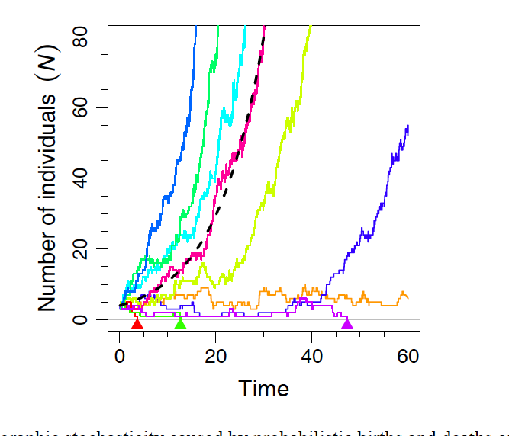
Demographic stochasticity:
- - - - -Deterministic model
Exponential growth with stochastic birth and death process.
N₀ = 4
r = 0.1
62/1000 runs led to extinction
From Melbourne (2012)

Slide 6
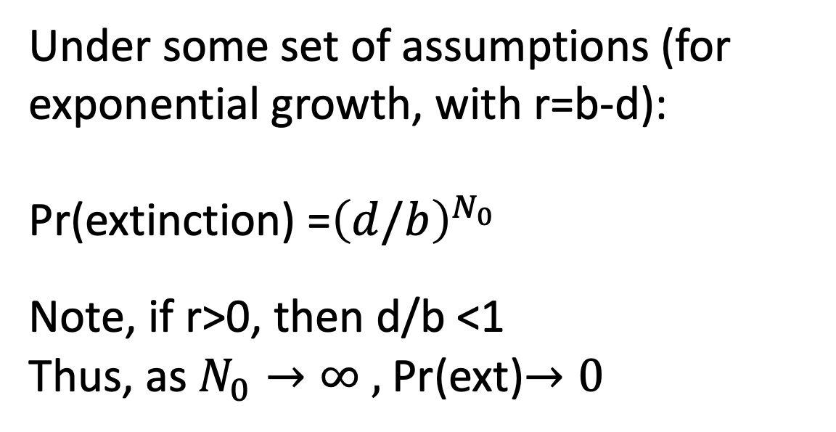
Demographic stochasticity:
Under some set of assumptions (for exponential growth, with r=b-d):
Pr(extinction) =${\left(d/b\right)}^{N_{0}}$
Note, if r>0, then d/b <1
Thus, as $N_{0}→∞ ,$Pr(ext)$→0$

Slide 7
Sources of variation:
Environmental stochasticity
fluctuations in the environment that cause variation in birth and death rates. Extinction caused by large effects (or runs) of bad times (which affect all members of population).

Slide 8
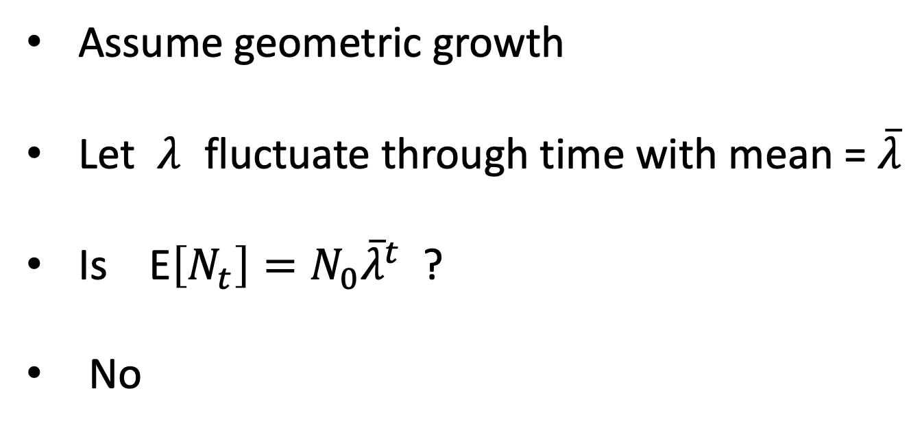
Env. stochasticity in discrete time:
Assume geometric growth
Let $λ$ fluctuate through time with mean = $\overline{λ}$
Is E$\left[N_{t}\right]=N_{0}{\overline{λ}}^{t}$ ?
No

Slide 9
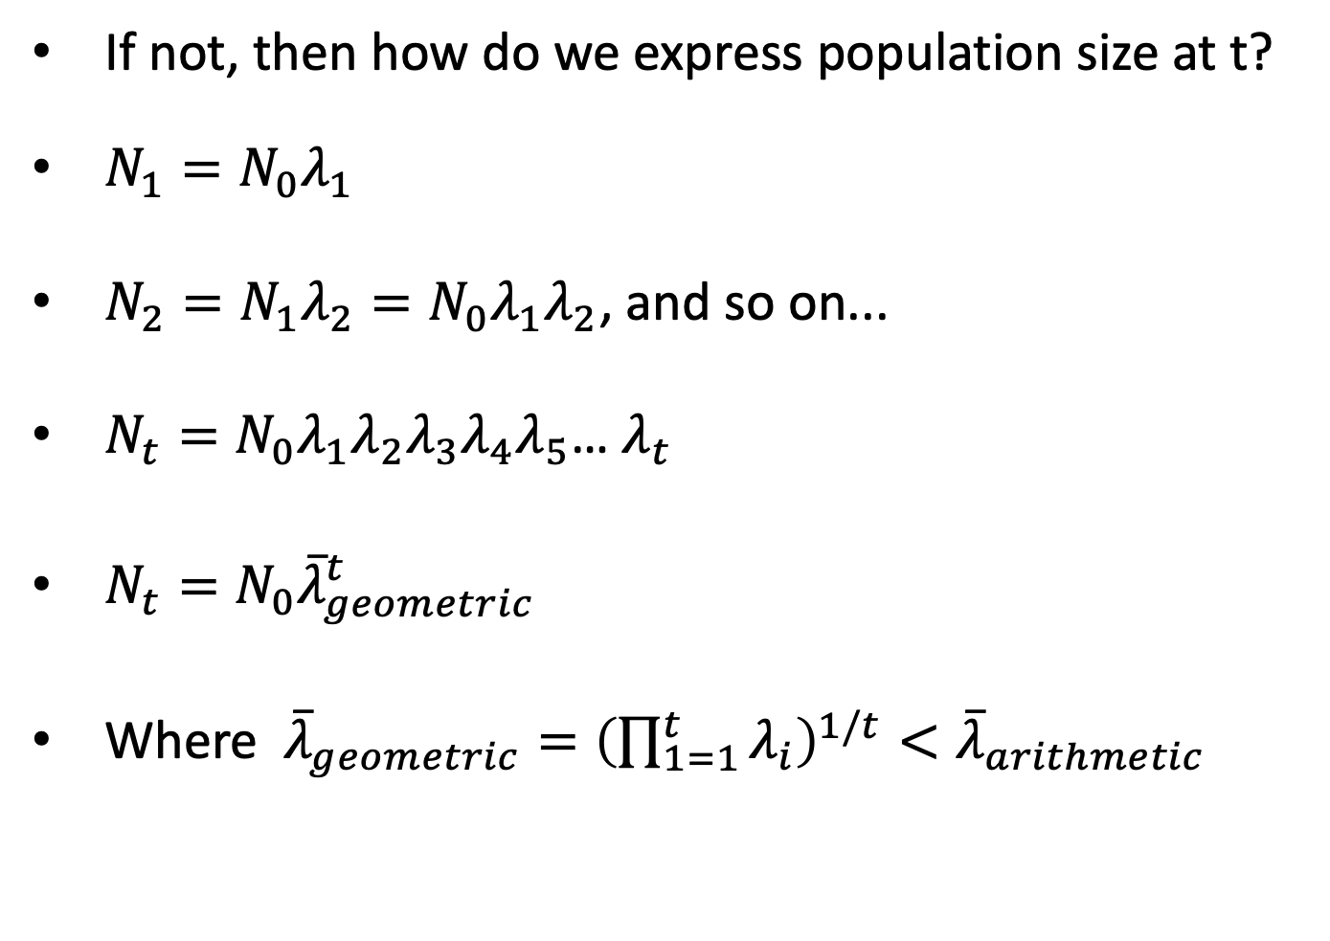
Env. stochasticity in discrete time:
If not, then how do we express population size at t?
$N_{1}=N_{0}λ_{1}$
$N_{2}=N_{1}λ_{2}=N_{0}λ_{1}λ_{2}$, and so on...
$N_{t}=N_{0}λ_{1}λ_{2}λ_{3}λ_{4}λ_{5}$… $λ_{t}$
$N_{t}=N_{0}{\overline{λ}}_{geometric}^{t}$
Where ${\overline{λ}}_{geometric}={\left(\prod_{1=1}^{t}{λ_{i}}\right)}^{1/t}<{\overline{λ}}_{arithmetic}$

Slide 10
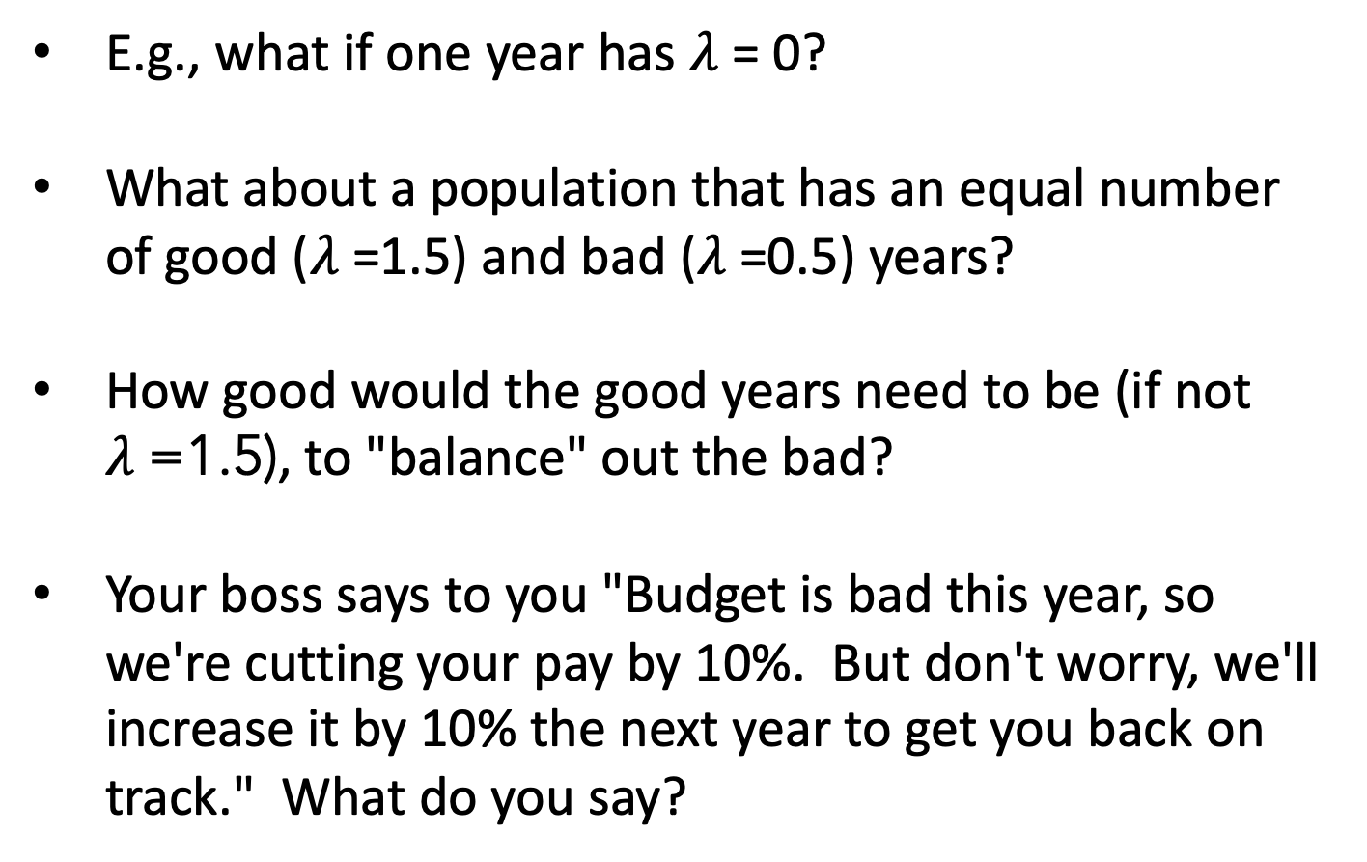
Env. stochasticity in discrete time:
E.g., what if one year has $λ$= 0?
What about a population that has an equal number of good ($λ$=1.5) and bad ($λ$=0.5) years?
How good would the good years need to be (if not $λ$=1.5), to "balance" out the bad?
Your boss says to you "Budget is bad this year, so we're cutting your pay by 10%. But don't worry, we'll increase it by 10% the next year to get you back on track." What do you say?

Slide 11
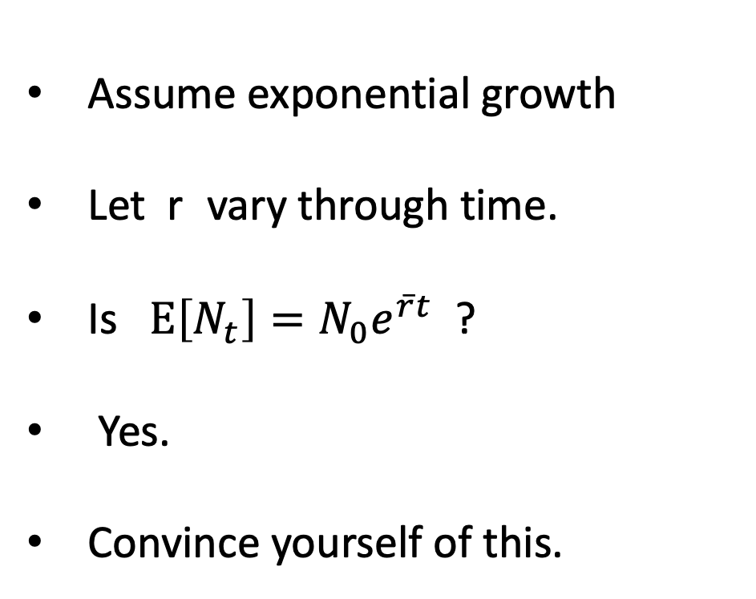
Env. stochasticity in continuous time:
Assume exponential growth
Let r vary through time.
Is $E\left[N_{t}\right]=N_{0}e^{\overline{r}t}$ ?
Yes.
Convince yourself of this.

Slide 12
Discussion 1:
Temporal variance in the environment:
We saw that temporal variance in r (for exponential growth) led to population growth that "averaged" out (i.e., the growth of a population with variable r and one with the average r would be the same, on average).
What would you expect for a population that grows logistically … if there is temporal variance in r (but r_{t}>0)?
What is there is temporal variance in K?
How will the average N compare to average K? Why?
Will N track K? Will this pattern depend on r? What if K changes seasonally (we’ve already seen this in HW0 for a related situation).
Notes:
This is evaluated in Gotelli, Chapter 2, but it's worth discussing in class.

Slide 13
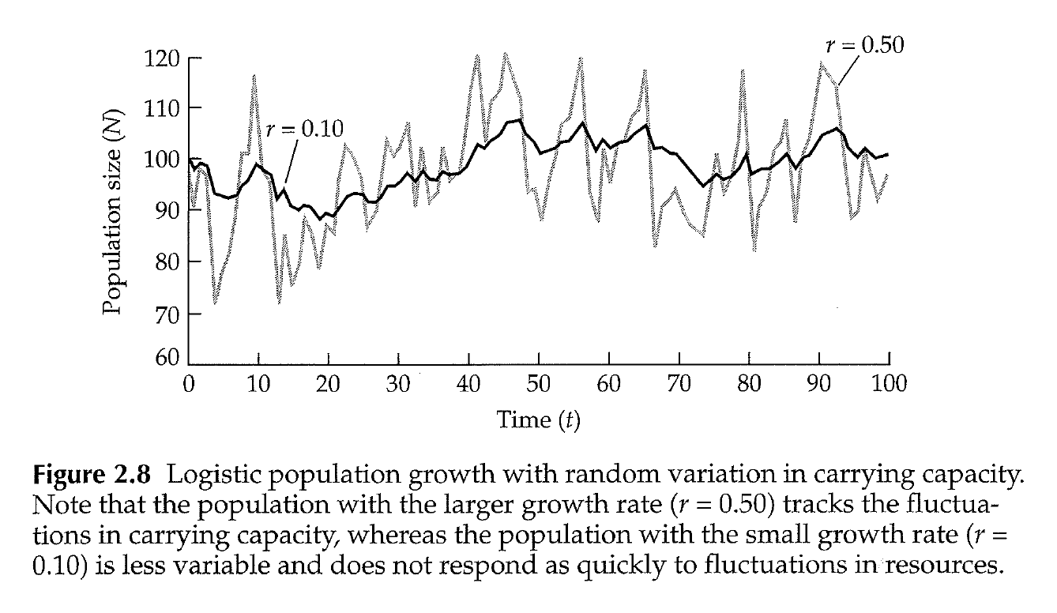

Env. stochasticity with logistic growth:
$$\overline{N}≈\overline{K}−σ_{K}^{2}/2$$
Figure from Gotelli’s Primer
Notes:
So: 1) larger variation in K (uncorrelated), leads to greater reduction in aveN. This is because when N>K declines are faster than are increases when N<K (see Fig 2.2 in Gotelli).
2) this equation is only an approx. The aveN also depends on r – when r is small (slow dynamics) aveN will be slightly reduced compared to a pop with large r (that tracks the fluctuations better).

Slide 14
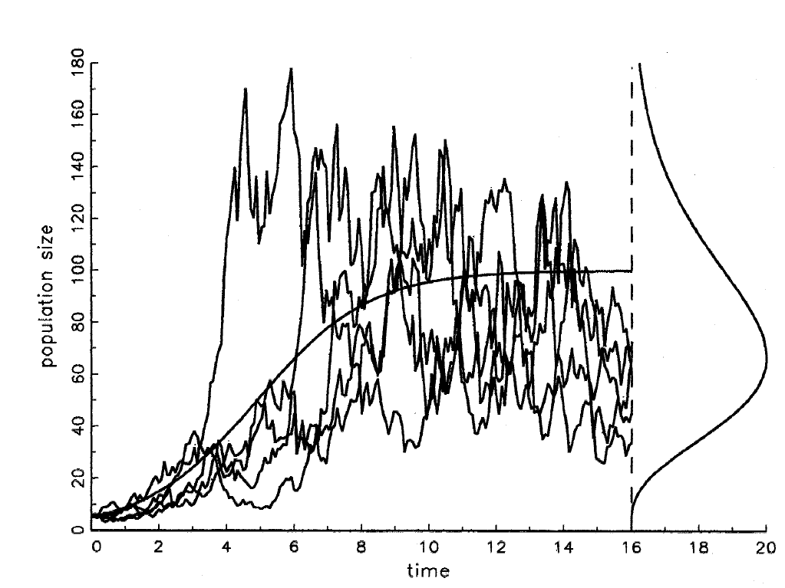
Env. stochasticity with logistic growth:
Figure from Dennis (2002, Oikos)
Notes:
This model is not the same as one with randomly varying K but I think the concept is similar. aveN is below the expectation using mean K and there is a distribution.

Slide 15
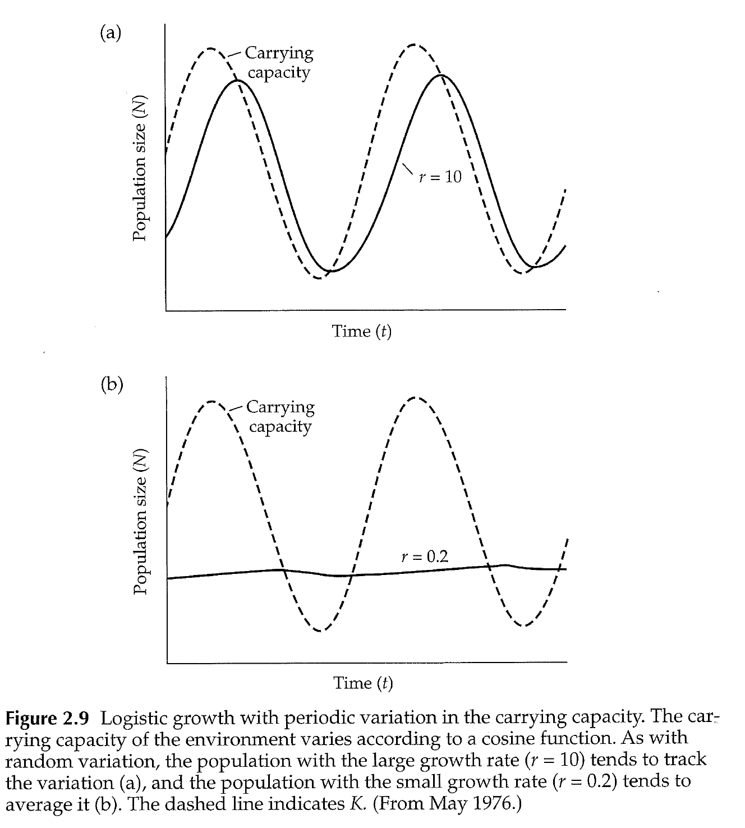
Seasonal fluctuations in K:
Figure from Gotelli’s Primer
Notes:
As we saw in HW0.

Slide 16
Sources of variation:
Demographic heterogeneity
Individuals are not identical (different size, local resource conditions, nutritional state, etc.).
This introduces variation (random or deterministic) among individuals in vital rates.
E.g., imagine individuals vary in their mortality rate ("frailty")? Draw a survivorship curve for populations with the same mean survival, but different variances…
Ln(N)
time

Slide 18
Putting it all together

Slide 19
Melbourne and Hastings 2008:
Ricker model: E[N_{t+1}] = RN_{t}e^{-aNt}
Incorporated variation due to:
Demographic stochasticity (via birth and death)
Environmental stochasticity
Demographic heterogeneity
Sex ratio (kept separate from dem. stoch.)
Simulated and examined effect on time to extinction

Slide 20
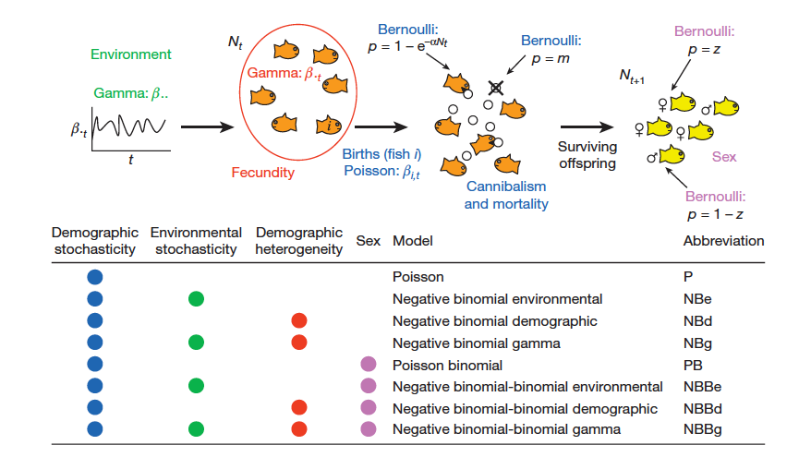
Melbourne and Hastings 2008:
Env. Stoch. Demog. Heterog. Demog. Stoch. Sex ratio
Notes:
Gamma, Poisson and Bernouli just refer to the forms of the variation at each life stage. GAMMA var in env-determined birth rates (GREEN); GAMMA variation in birth rates AMONG individuals (ORANGE/RED); POISSON variation in birth rates WITHIN individuals (through time) (BLUE); BERNOULLI var in mortality WITHIN individuals (BLUE); BERNOULLI var in the sex of an indiv at birth (PINK). Thus the environment varies (GREEN), individuals vary (ORANGE/RED), and there is "sampling" (BLUE and PINK).

Slide 21
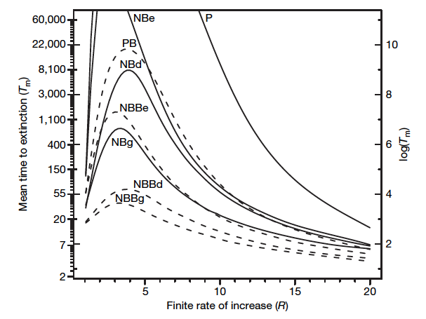
Melbourne and Hastings 2008:
Comparison of effect of adding
environmental stochasticity vs.
demographic heterogeneity
P=Demo. Stoch. only
PB=Demo. Stoch. & Sex ratio
All sources
Each component increases extinction risk (DH has at least as great an effect as ES).
Why does increasing R cause time to extinction to increase? And then decrease?
Notes:
Note that Tm is infinite for case without variation (i.e., R>1, so pop increases and never goes extinct).
Question. [see next slide]

Slide 22
Ricker model, varying R
N_{t+1}
N_{t}
Notes:
Initially (at small N) increasing R gets you away from small population sizes faster, However, eventually, increasing R takes you you into an unstable regime. Hence, there are extreme fluctuations (sometimes small N's) and that now increases extinction again (because more time is spent at

Slide 23
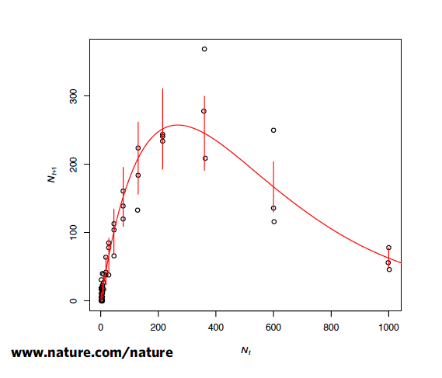
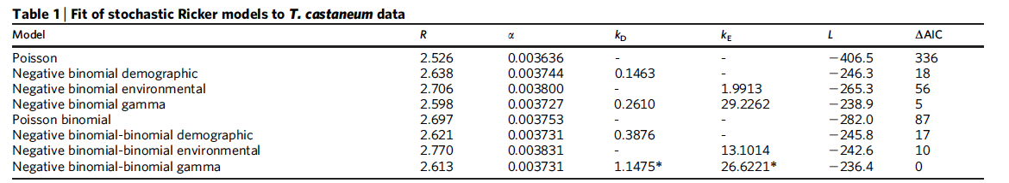
Melbourne and Hastings 2008:
Data from Tribolium
Fit models to Tribolium data:
Demographic or environmental stochasticity alone fail to explain dynamics;
Need ALL sources
➔ Effects of demographic heterog. may have been misinterpreted as env. stochasticity
(Small k = Large variance)
Sources included
DS
DS + ES
DS + DH
DS + ES + DH
DS + Sx
DS + DH + Sx
DS + ES + Sx
DS + ES + DH + Sx
Worst
Best
Notes:
Smaller values of k indicate greater variance in Demographic het (D) and env stoch (E)

Slide 24
Discussion 1:
Spatial and Demographic Heterogeneity:
Imagine two isolated patches with different growth rates (let’s assume geometric growth). What is the long-term growth of the aggregate system? (THERE IS NO MIGRATION)
Imagine two types of individuals ("slow" and "fast"). What is the long-term growth of the population?
Notes:
Patches: Imagine fast patch and slow patch; then Nt=Nf*Lf^t + Ns*Ls^t. Where Lf>Ls. If Lf>1, eventually, then the fast patch outstrips the growth of the small. Thus, the aggregate system eventually is dominated by the fast patch and the growth converges on Lf.
Individuals: if a fast mom gives rise to fast kids (heritability: h2=1), then same as patch model. Fast morph dominates and growth eventually is Lf.
Inidividuals: but if growth is not heritable (e.g., function of microsite the kid lands in), then the growth from one time step to another is simply the weighted average of the L's, where the weight is the proportion of the habitat that is "fast" vs. "slow": i.e., L = Pf*Lf + Ps*Ls. So if the environment is half of each, and Lf=10 and Ls=0, then L(realized)=5. Note how this is different than the temporal case. (if the Env fluctutates between L=0 and L=10, N=0). Spatial variation and temporal variation do not give the same answer. Furthermore, the answer depends on the correlation between the env experienced by the parents and the env experienced by the young (the range goes from isolated patches (complete "heritability") to the well mixed case (no heritability).
Goal is to think about "heritability" --- do young remain in the same patch as parent or are they redistributed? Does a slow mother birth slow kids or a mixture of both?

Slide 25
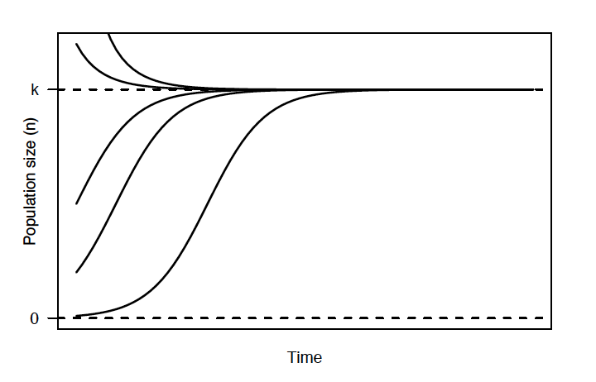
Discussion 3:
Consider a gradually changing environment:
What will happen to a population that grows according to the logistic (and is near its equilibrium) if we gradually reduce K?
What if we reduce r?

Slide 26
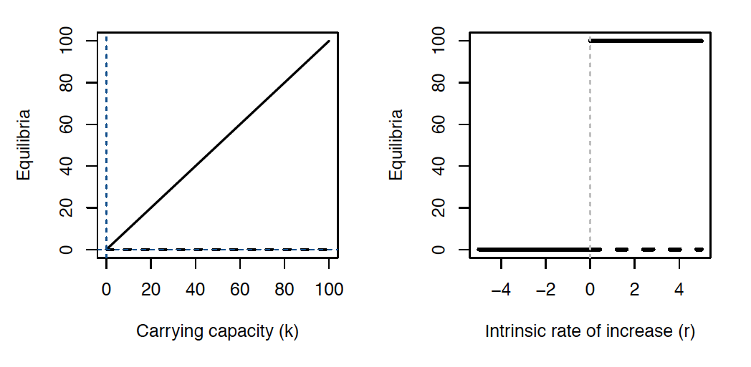
Discussion 3:
Modified from Drake (unpub book)

Slide 27
Discussion 3:
When r declines: are there any indicators of the impending "disaster"?
Consider how the system responds to small perturbations…

Slide 28
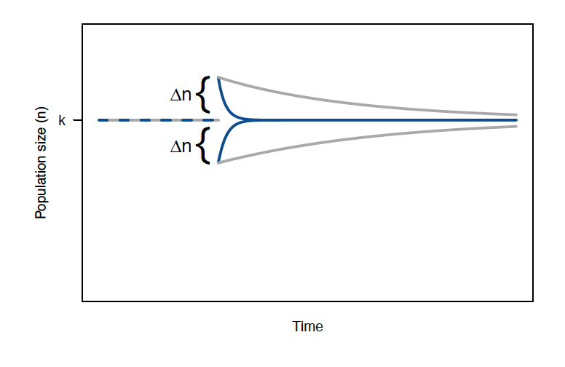
Discussion 3: Decline in resilience
From from Drake (unpub book)
Notes:
Resilience – return time to equilibrium. So, as r declines, pop will spend more time further from equilibrium. So even though the equili isn't changing, the system will not be as "able" to return to equilibrium. This increase in the Var(N) and departures from N* indicates that we're getting closer to the "disaster".
Bear this in mind when we return to ideas of "tipping points" later in the term.

