Slide 1
Ecology 8310 Population (and Community) Ecology
Introductions (Craig, students)
Course website, content, goals, and logistics
Today's lecture
Dynamics (basic terminology)
Population growth (review)
Exponential
Logistic
Discrete (e.g., logistic map)
Equilibrium and stability
Limiting factors vs. regulation

Slide 2
Introductions:
Me:
http://osenberglab.ecology.uga.edu/
You:
. . .

Slide 3
Website:
courses.ecology.uga.edu/ecol8310-fall2023/
Or navigate via Osenberg’s webpage;
Password for readings = Ecol8310

Slide 4
Course structure:
Lectures (1/2 of each class)
Student-led presentation/discussion (Thurs)
Homework (assigned Th, due Tu, discussed Tu)
Exams (n=3)
In-person, unless you are remote or ill
Zoom (room = “osenberg”)
Recordings on eLC (remind me)
Caveat – I talk fairly fast during lectures. So you will have to review your notes. Work through stuff so that you get it. You will NOT walk out of here understanding everything we covered. You’ll have to work at it. Recorded lectures will help. So will working with, talking with, and challenging, other students.

Slide 5
Grades:
Homework (34%)
Exams (36% -- 12% each)
Participation (15%)
Discussion leader (15%)
Note – many consider my exams to be hard. I think of much of the exam as basic (essential knowledge) but with a couple of challenging (aka hard) problems. Old exams are available on the class webpage, as a means to study and assess your knowledge.

Slide 6
Today’s homework:
Homework “0”
Due Tuesday (email to Craig before 9am)
Notes:
Who remember calculus? A few tricks and key things to remind you can be found in references from Bolker’s book (on the course webpage) and other sources.

Slide 7


Readings:
Primary literature
Other sources
Two required books:

Slide 8
Goal:
Understand and evaluate foundational concepts in population and community ecology
Dynamics
Species interactions
Pattern & process
Mathematical constructs
“thinking” / ideas / critical evaluation
Notes:
See readings for some refreshers on calculus….

Slide 9
Dynamics: the basics
Notes:
Expand on why…

Slide 10
Dynamics:
N
N is a state variable (i.e., it describes the state of a dynamical system)
Dynamics is concerned with how N changes (or doesn’t change) through time, t, and across space, x.
Thus, N expressed as a function of time (and space): N(t) or N(x,t)

Slide 11
Dynamics:
+
−
N(t)
N can be affected (positively or negatively) by environmental parameters (or other state variables)
We can write out a model describing how N(t) changes through time (in relation to these parameters and variables).

Slide 12
Dynamics:
+
−
N(t)
Continuous vs. Discrete time models
Deterministic vs. Stochastic models
Solutions can be found analytically or numerically

Slide 13
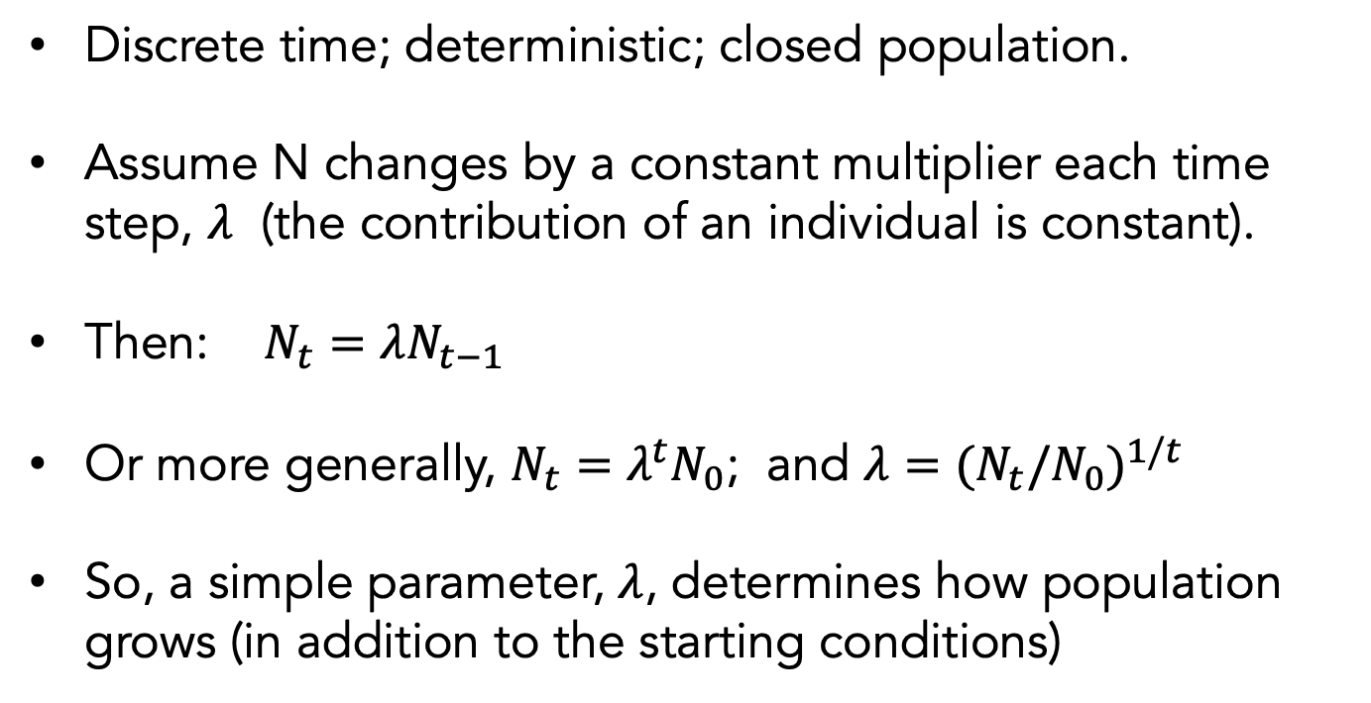
Geometric growth:
N_{t}
Discrete time; deterministic; closed population.
Assume N changes by a constant multiplier each time step, $λ$ (the contribution of an individual is constant).
Then: $N_{t}=λN_{t−1}$
Or more generally, $N_{t}=λ^{t}N_{0}$; and ${λ=(N}_{t}/{N_{0})}^{1/t}$
So, a simple parameter, $λ$, determines how population grows (in addition to the starting conditions)

Slide 14
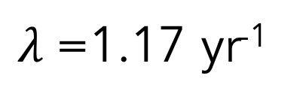
Geometric growth:
$λ$=1.17 yr⁻¹

Slide 15
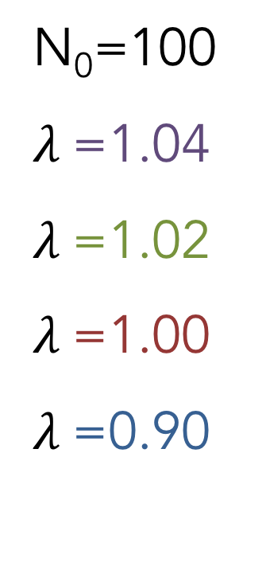
Geometric growth:
N₀=100
$λ$=1.04
$λ$=1.02
$λ$=1.00
$λ$=0.90
$λ$>1 (increase); $λ$=1 (no change); $λ$<1 (decrease)

Slide 16
Geometric growth:
N₀=100
$λ$=1.04
$λ$=1.02
$λ$=1.00
$λ$=0.90
What is the slope of each line?

Slide 17
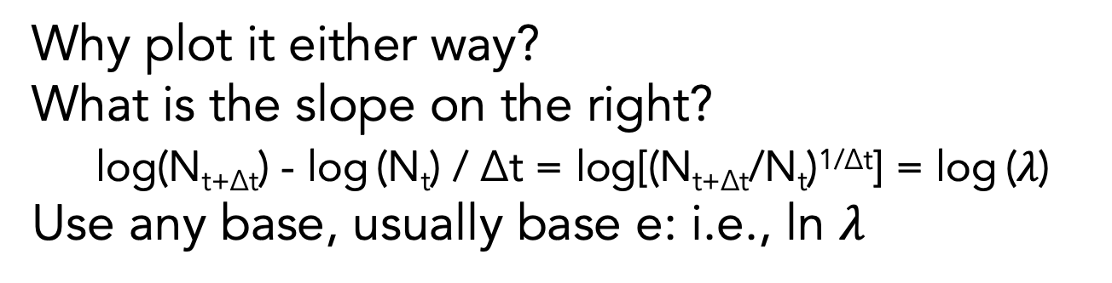
An aside:
3
2
1
0
Why plot it either way?
What is the slope on the right?
log(N_{t+Δt}) - log (N_{t}) / Δt = log[(N_{t+Δt}/N_{t})^{1/Δt}] = log ($λ$)
Use any base, usually base e: i.e., ln $λ$

Slide 18
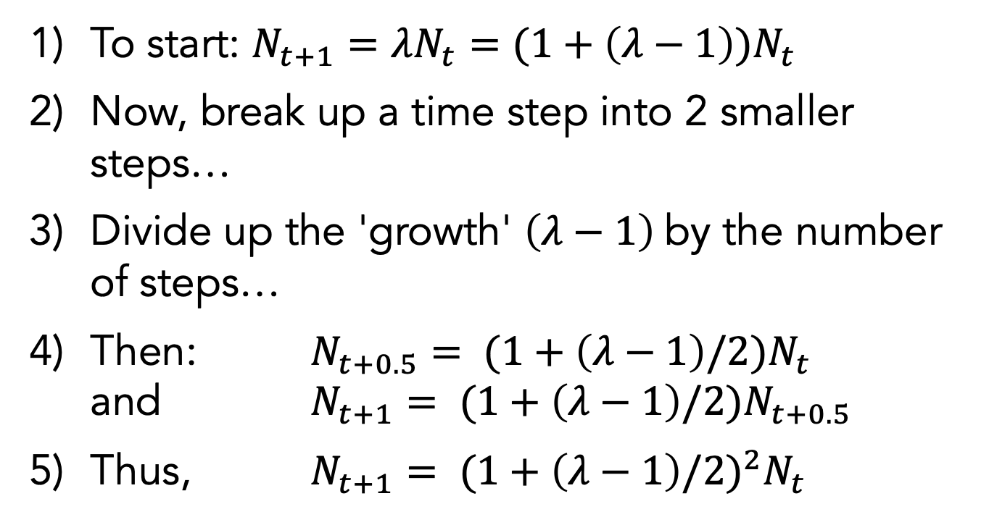
Moving to continuous time:
To start: $N_{t+1}=λN_{t}=(1+\left(λ−1\right))N_{t}$
Now, break up a time step into 2 smaller steps…
Divide up the 'growth' $\left(λ−1\right)$by the number of steps…
Then: $N_{t+0.5}= (1+\left(λ−1\right)/2)N_{t}$ and $N_{t+1}= (1+\left(λ−1\right)/2)N_{t+0.5}$
Thus, $N_{t+1}= ({1+\left(λ−1\right)/2)}^{2}N_{t}$

Slide 19
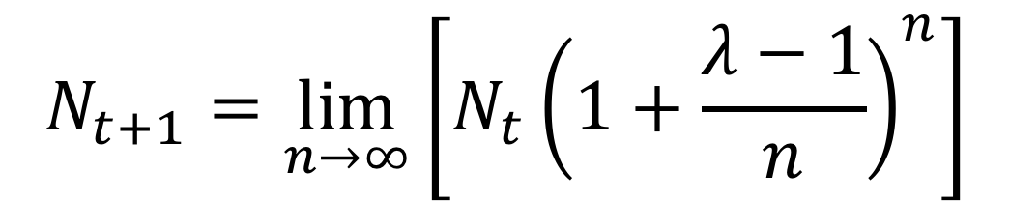
Moving to continuous time:
Let the number of steps increase…
Take the limit of this process as the number of steps increase to infinite:
$$N_{t+1}=\lim_{n→∞}\left[N_{t}{\left(1+\frac{λ−1}{n}\right)}^{n}\right]$$

Slide 20
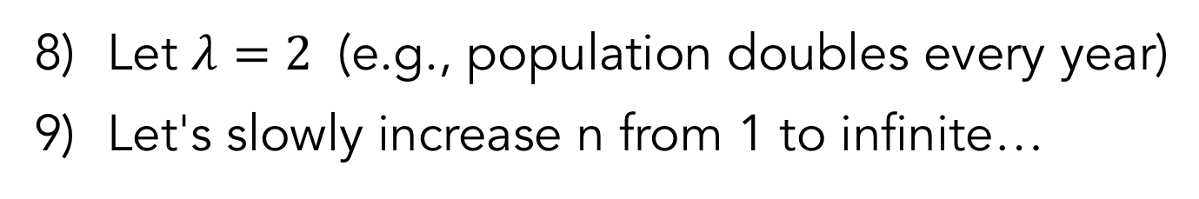
An example:
Let $λ=2$ (e.g., population doubles every year)
Let's slowly increase n from 1 to infinite…
Number of substeps, n | N_{t+1}
1 | 2
2 | 1.5x1.5=2.25
3 | 1.333³=2.37
4 | 1.25⁴=2.44
5 | 1.20⁵=2.49
6 | 1.17⁶=2.52
7 | 1.14⁷=2.55

Slide 21
An example:
Keep going…
Number of substeps, n | N_{t+1}
10 | 1.1¹⁰=2.5937
20 | 1.05²⁰=2.6533
30 | 1.0333³⁰=2.6743
100 | 1.01¹⁰⁰=2.7048
200 | 1.005²⁰⁰=2.7115
500 | 1.002⁵⁰⁰=2.7156
1000 | 1.001¹⁰⁰⁰=2.7169
infinite | 2.7182818284590…
aka e

Slide 22
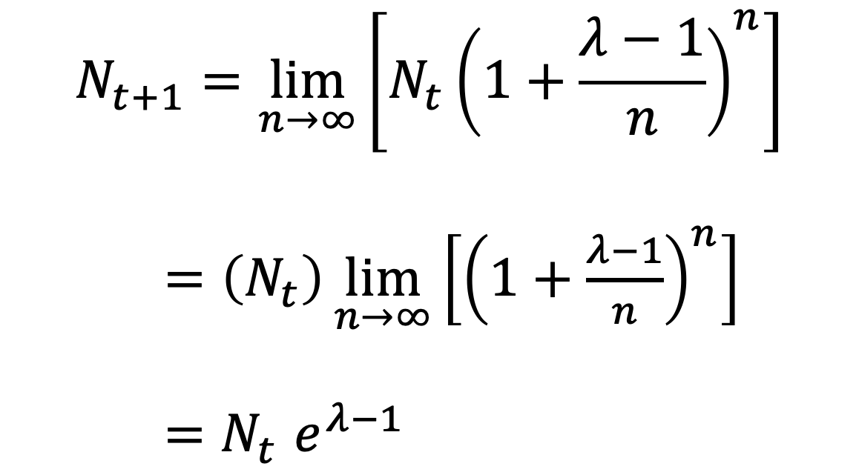
More generally:
$$N_{t+1}=\lim_{n→∞}\left[N_{t}{\left(1+\frac{λ−1}{n}\right)}^{n}\right]$$
$=\left(N_{t}\right)\lim_{n→∞}\left[{\left(1+\frac{λ−1}{n}\right)}^{n}\right]$
${=N}_{t}e^{λ−1}$

Slide 23
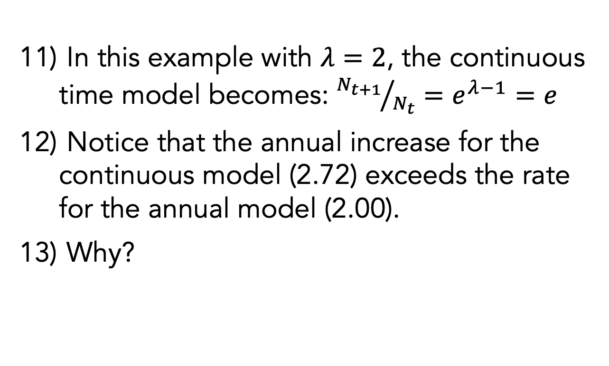
An example:
In this example with $λ=2$, the continuous time model becomes: ${N_{t+1}}/{N_{t}}=e^{λ−1}=e$
Notice that the annual increase for the continuous model (2.72) exceeds the rate for the annual model (2.00).
Why?

Slide 24

More generally:
$${N_{1}=N}_{0}e^{λ−1}$$
$${N_{t}=N}_{0}e^{\left(λ−1\right)t}$$
$${N_{t}=N}_{0}e^{rt}$$
Exponential growth

Slide 25
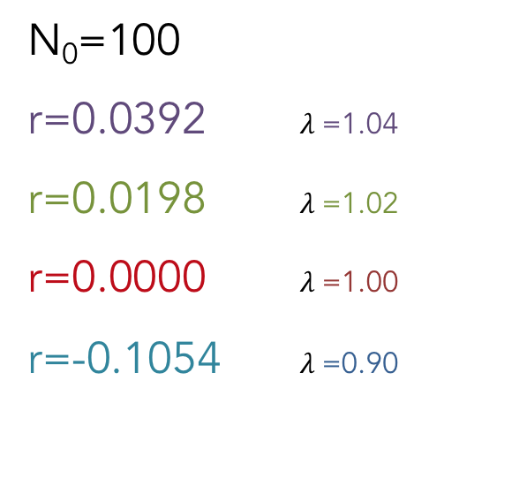
Exponential growth:
N₀=100
r=0.0392 $λ$=1.04
r=0.0198 $λ$=1.02
r=0.0000 $λ$=1.00
r=-0.1054 $λ$=0.90
r>0 (increase); r=0 (no change); r<0 (decrease)

Slide 26
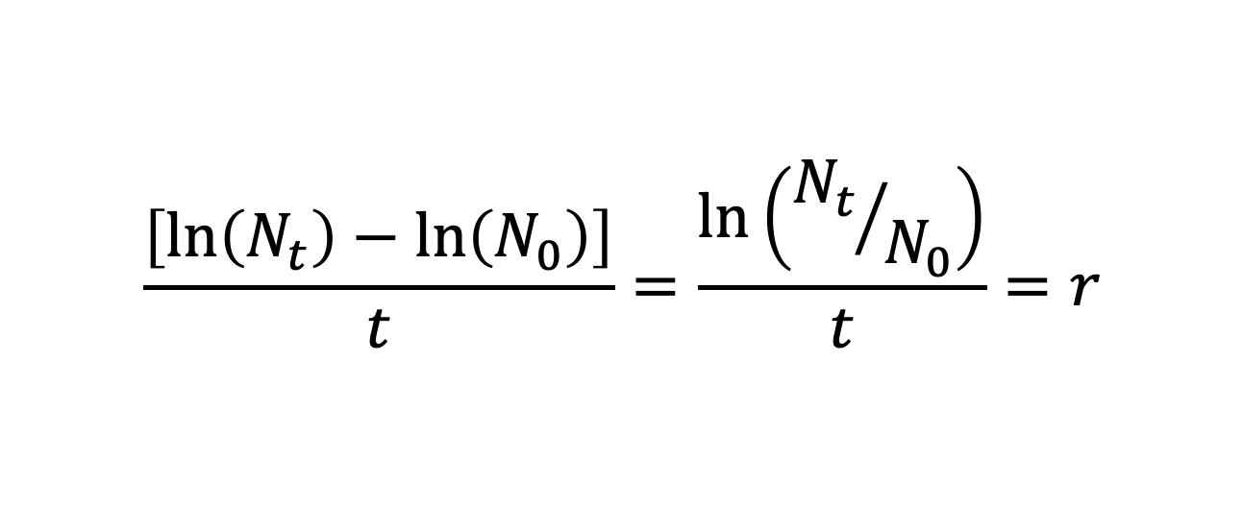
Exponential growth:
Ln(1000)
Ln(100)
Ln(10)
Ln(1)
N₀=100
r=0.0392 $λ$=1.04
r=0.0198 $λ$=1.02
r=0.0000 $λ$=1.00
r=-0.1054 $λ$=0.90
What is the slope of each line?
$$\frac{\left[\ln\left(N_{t}\right)−\ln\left(N_{0}\right)\right]}{t}=\frac{\ln\left({N_{t}}/{N_{0}}\right)}{t}=r$$
Notes:
Fyi. Ln(x)=log10(x)/log10(e)=.230 x log10(x)

Slide 27
But how would we express the rate of change in N?
dN/dt

Slide 28
Derivative?
Slope = dN/dt
ΔN
Abundance, N
Δt
Time, t
dN/dt
What does dN/dt do through time?
0

Slide 29
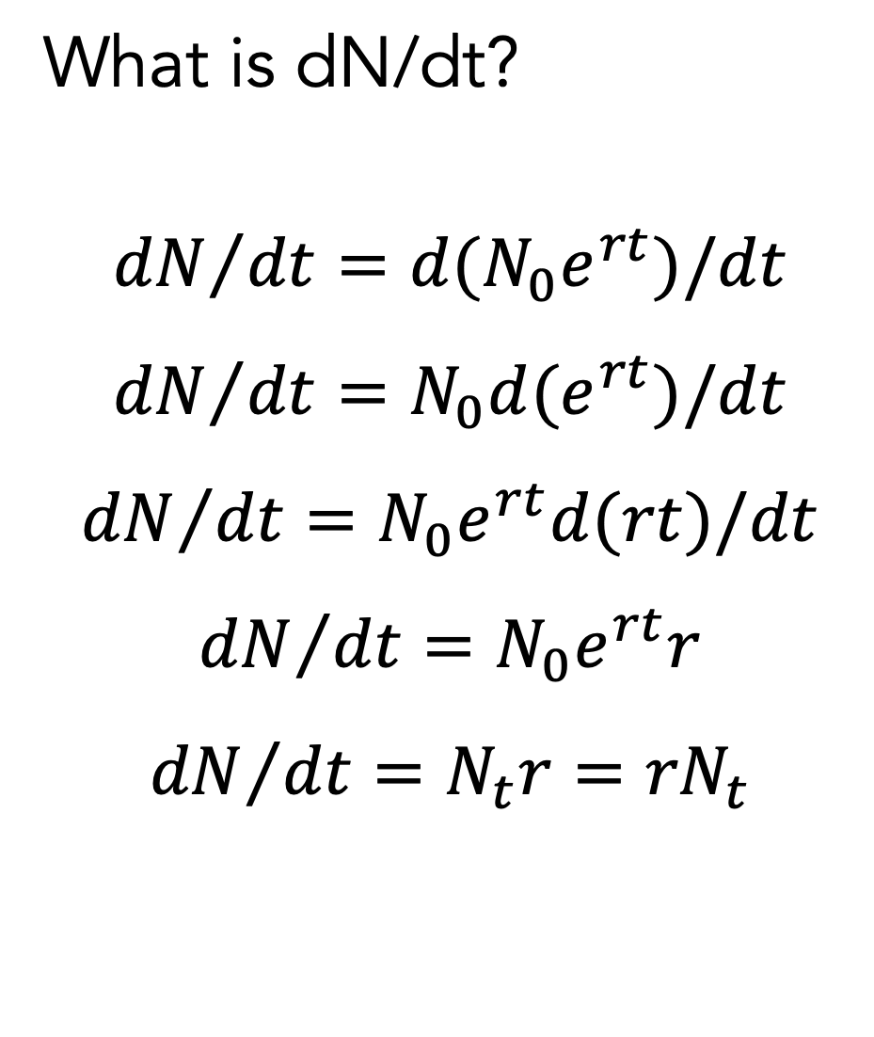
Exponential growth:
What is dN/dt?
$${dN}/{dt}=d(N_{0}e^{rt})/dt$$
$${dN}/{dt}=N_{0}d(e^{rt})/dt$$
$${dN}/{dt}=N_{0}e^{rt}d(rt)/dt$$
$${dN}/{dt}=N_{0}e^{rt}r$$
$${dN}/{dt}={N_{t}r=rN}_{t}$$
Notes:
But we've gone a bit backwards here. This is the analytic solution to the exponential growth model. So, let's differentiate this… to get an expression for dN/dt

Slide 30
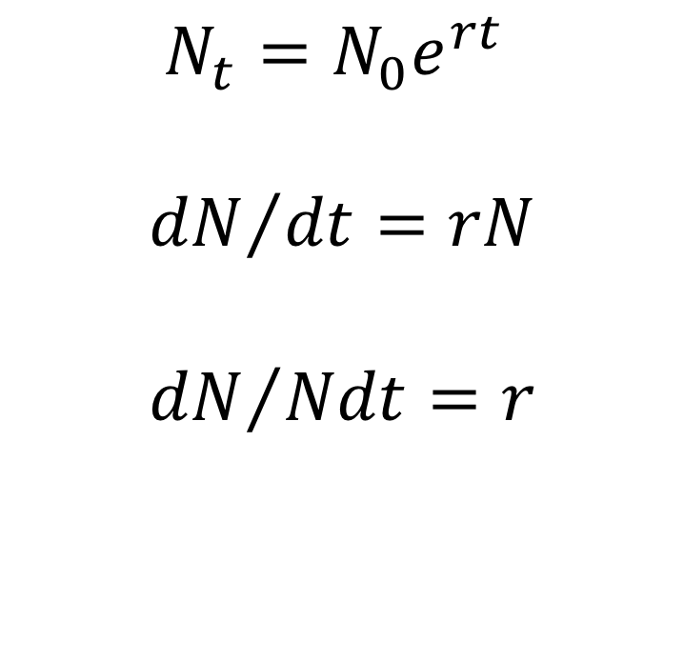
Exponential growth:
$${N_{t}=N}_{0}e^{rt}$$
$${dN}/{dt}=rN$$
$${dN}/{Ndt}=r$$
Notes:
Solution to the differential equation: gives N through time.
dN/dt is the population growth rate: the solution to which yields the first equation
dN/Ndt is the per capita growth rate. It’s a constant (this is the core assumption of the exponential growth model).

Slide 31
Slope of these lines is dN/dt…
N₀=100
r=0.0392 $λ$=1.04
r=0.0198 $λ$=1.02
r=0.0000 $λ$=1.00
r=-0.1054 $λ$=0.90
r>0 (increase); r=0 (no change); r<0 (decrease)

Slide 32
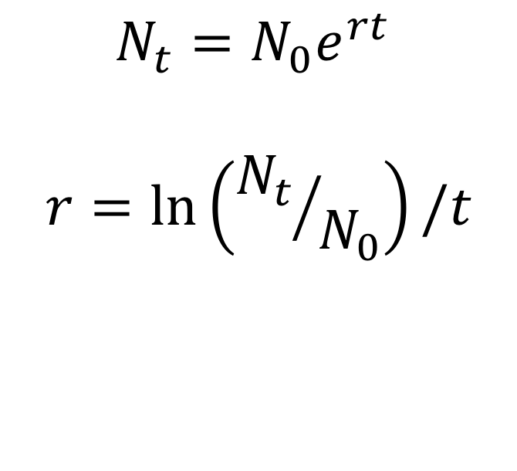
Exponential growth:
$${N_{t}=N}_{0}e^{rt}$$
$$r=\ln\left({N_{t}}/{N_{0}}\right)/t$$

Slide 33
Geometric vs. Exponential Growth:
 | Discrete (Geometric) | Continuous (Exponential)
N_{t} = ? | N₀λ^{t} | N₀e^{rt}
Pop. gro. rate | ΔN/Δt = N(λ-1) | dN/dt = rN
Per capita g.r. | λ-1 | r
No growth | λ = 1 | r = 0
Increases | λ >1 | r > 0
Decreases | λ < 1 | r < 0
Range | 0 < λ < +∞ | -∞ < r < +∞
Units | None (but an implicit time step) | time⁻¹

Slide 34
Doubling Time:
N_{t}/N₀ = 2 = e^{rt}
t = ln(2)/r = 0.69/r
r | Doubling time
0.01 yr⁻¹ | 69 yrs
0.05 yr⁻¹ | 14 yrs
0.10 yr⁻¹ | 6.9 yrs
1.0 yr⁻¹ | .69 yrs
NOT!
100 yrs
20 yrs
10 yrs
1 yr
Notes:
Point out mismatch with expectation that doubling times should be 100, 20, 10, 1 (compound interest).

Slide 35
Doubling time: r vs. λ
r ~ λ – 1
So, which grows faster:
λ = 2
r = 1
Why?
Compound Interest
Notes:
Note: r=ln(lambda) and ln(x+1) ~ x (if x is small); so if lambda=1.01, then it's very similar to r=0.01, but the effect of compounding grows as the growth rate gets larger (hence lambda=2 is not same as r=1).

Slide 36
Does growth rate remain constant?
Notes:
Why not (env changes, interactions with other species, density-dependence)

Slide 37
Darwin:
…Linnaeus has calculated that if an annual plant produced only two seeds - and there is no plant so unproductive as this - and their seedlings next year produced two, and so on, then in twenty years there would be a million plants. The elephant is reckoned to be the slowest breeder of all known animals… assume that it breeds when thirty years old, and goes on breeding till ninety years old, bringing forth three pairs of young in this interval; if this be so, at the end of the fifth century there would be alive fifteen million elephants, descended from the first pair.

Slide 38
Dynamics: density-dependence

Slide 39
Causes of density-dependence:
Competition (reduce birth, incr. death…)
Allee effect (inc. birth, dec. death at low N)
Predator attraction or disease (increase death; decrease birth?)
Predator satiation (decrease death, increase birth?)
Biotic vs. Abiotic

Slide 40
Definitions:
Density independence: dN/Ndt (or its components) are independent of N
Density dependence: dN/Ndt (or its components) vary with N
Via effects on birth, death, emigration, immigration

Slide 41
Per capita rate of increase as function of density:
Density-dependent (positive)
Density-independent (exponential)
dN/Ndt
Density-dependent (negative)
0
Density (N)
Causes?
Implications?

Slide 42
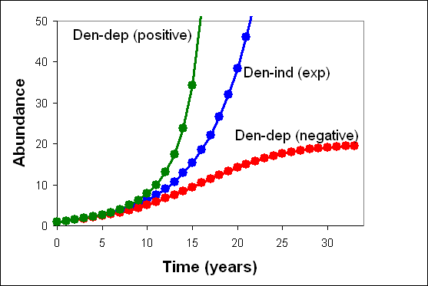
Population growth:

Slide 43
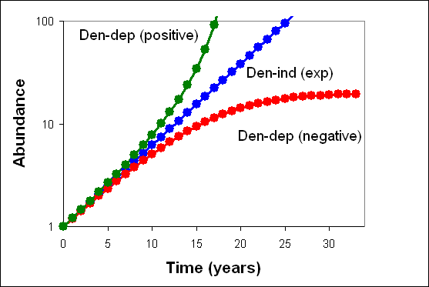
Population growth:

Slide 44
Equilibrium and Stability:
Equilibrium: N at which dN/Ndt = 0
No net growth (dynamic equilibrium)
Stability: does the system return to equilibrium following a small perturbation?
Unstable equil.
Stable equil.
Neutrally stab. eq.

Slide 45
Local vs. Global vs. Regional Stability:
Local: returns following small perturbation
Global: returns following any perturbation
Regional: unstable, but remains in "region" (will discuss again for >1 spp)
Locally stable
Globally Stable
Regionally stable

Slide 46
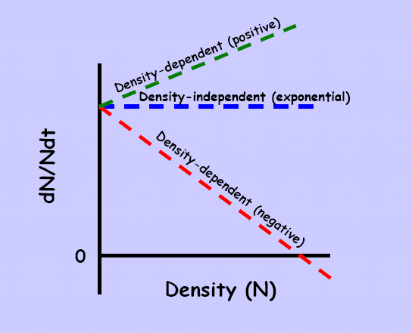
Implications:
Stability
Population regulation: N kept within bounds (tends to increase from low N; decrease at high N)
"Density-vague regulation" (Don Strong)
Notes:
Walk the line: If sober you go right down the line; If drunk; wander more widely, but you don't go too far off the road. There is a tendency to come back to the "center", but it's weaker. This center is an "equilibrium" (more later). Many folks viewed the idea of an equilibrium (which we'll discuss shortly) as a point attractor, where the system had to sit at all times; this isn't necessary. Don Strong introduced the concept of "density vague" regulation in the 80's. You can think of density-vague as very much like the "drunk" vs. the sober walker.

Slide 47
Example:
Positive Density Dependence
Equilibrium?
dN/Ndt
Stable?
0
Density (N)
Unstable equilibrium

Slide 48
Example:
Negative Density Dependence
Equilibrium?
dN/Ndt
Stable?
0
Density (N)
Stable equilibrium

Slide 49
Logistic model:
Linear decrease; each individual reduces per capita growth by ‘a’ units
dN/Ndt = r – aN
dN/Ndt = r(K-N)/K
where a=r/K
r
dN/Ndt
Equilibrium
Slope = -a
0
K (or r/a)
Density (N)
Notes:
Two parameters now (r and K) which control the dynamics (plus starting conditions, N0)

Slide 50
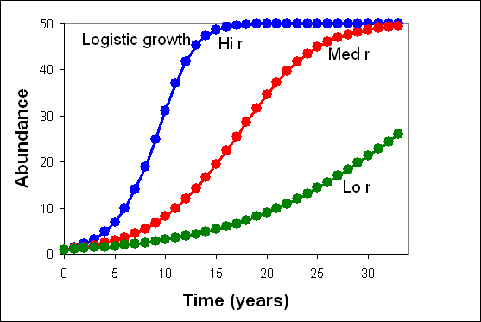
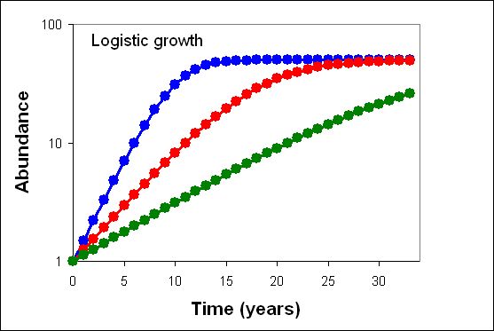
Vary r:
dN/Ndt
0
Density (N)
Notes:
Notice that changing K, but fixing r means that the strength of intraspecific competition has been changed.

Slide 51
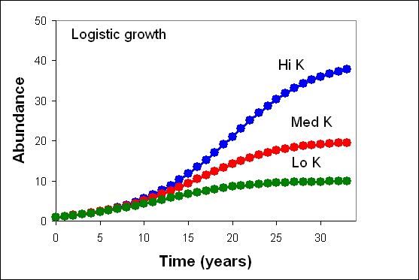
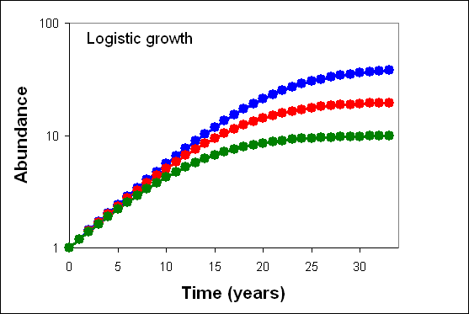
Vary K:
dN/Ndt
0
Density (N)
Notes:
Notice that changing K, but fixing r means that the strength of intraspecific competition has been changed.

Slide 52
Summary:
Exponential vs. Logistic
dN/dt
Exponential
r
0
0
1/2K
K
Density (N)
dN/Ndt
Logistic
0
0
K
Density (N)

Slide 53
More generally:
Equilibria?
[what about 0?]
Stability?
Outcome?
Invasive species?
0
dN/Ndt
30
130
250
0
Density (N)

Slide 54
Decompose growth:
( components of dN/Ndt)
Per capita rates
Death
Birth
0
0
N*
N*
Density (N)

Slide 55
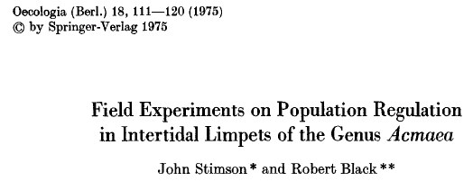
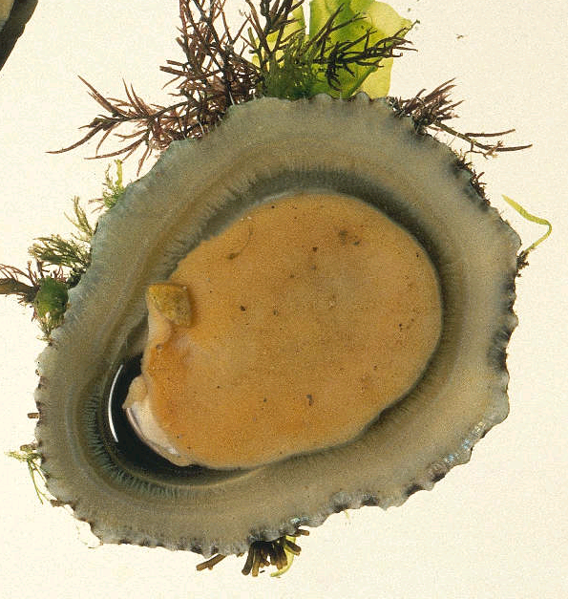
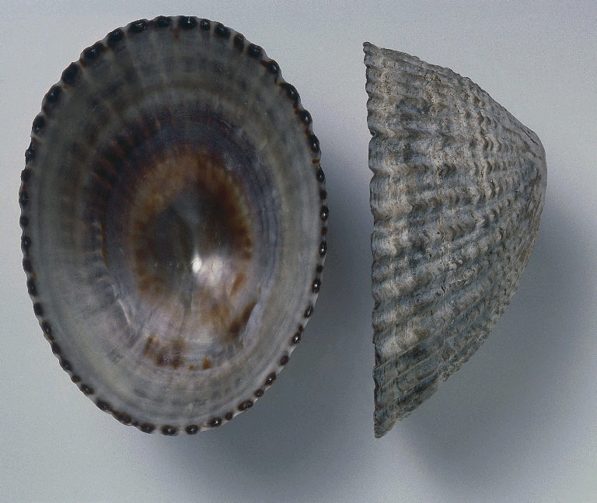
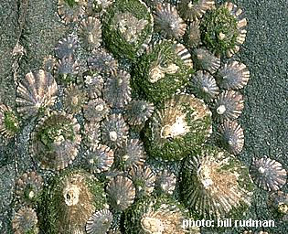
Natural history?
Notes:
Go thru natural history (planktonic larvae)

Slide 56
Stimson and Black (1975):
3 treatments (reduced, increased, ambient N)
Monitored population size
Did they observe convergence?
Why?

Slide 57
Results:
Treatment | N before | N start | N end | Change in N
Decreased | 142 228 | 0 0 | 228 300 | 228 300
Control | 154 145 | 154 145 | 322 345 | 168 200
Increased | 129 122 | 239 207 | 268 257 | 29 50

Slide 58
Discuss:
Is this what we expected?
Why?
It's not because of competition…
Can we create a "model" to depict the system?

Slide 59
Regulation in "Open Systems":
Death
(Components of dN/dt)
Rate
Settlement
0
0
N*
Density (N)

Slide 60
Regulation in "Open Systems":
Death
(Components of dN/Ndt)
Per Capita Rate
Settlement
0
0
N*
Density (N)
Notes:
Point out similar issue in many system – e.g., seed rain into small plots in forest.

Slide 61
Regulation in "Open Systems":
Bottomline:
In an open system, regulation can arise at a local scale simply through migration (or propagule rain), without any “active” form of density-dependence.
Notes:
Point out similar issue in many system – e.g., seed rain into small plots in forest.

Slide 62
But what about discrete time models with density-dependence?
N_{t+1} = F(N_{t})
Where F “maps” N_{t+1} onto N_{t}...

Slide 63
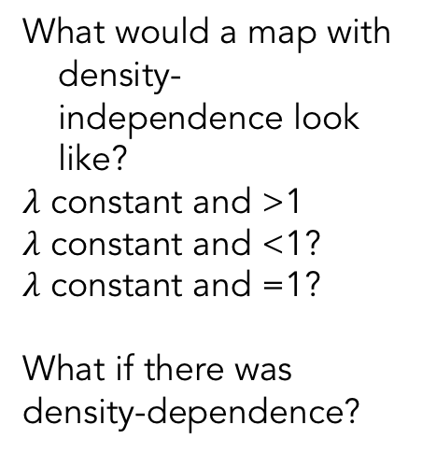
Density-dependence in Discrete Time:
What would a map with density-independence look like?
$λ$ constant and >1
$λ$ constant and <1?
$λ$ constant and =1?
What if there was density-dependence?
N_{t+1}
What would the dynamics look like (go to board)?
0
N_{t}

Slide 64
Density-dependence, Discrete Time: Stability
dF/dN_{t}|_{N*} > 1
Unstable
(geometric growth)
0 < dF/dN_{t}|_{N*} < 1
Stable
(geometric decay)
N_{t+1}
dF/dN_{t}|_{N*} < -1
Unstable
(divergent oscillations)
-1 < dF/dN_{t}|_{N*} < 0
Stable
(damped oscillations)
N_{t}
Stability requires:
-1 < dF/dN_{t}|_{N*} < +1
Oscillations if dF/dN_{t}|_{N*} negative
Notes:
Do the spider-web thing on each of these panels....

Slide 65
Stability analysis: How did we get this?
At equilibrium…
Apply a small perturbation:
n_{t}=N_{t}-N*
How will system respond?
N_{t+1} = F(N*+n_{t})
Rewrite as (substract N*)
n_{t+1} = N_{t+1}-N*=F(N*+n_{t})-N*
But what is F(N*+n_{t})?
An aside…
N_{t+1}
N_{t}
Notes:
So, nt=0 at N*
If Stable, then nt will →0 as time passes after the perturbation.
If unstable then nt will increase in magnitude with time.

Slide 66
Taylor Series Expansion
How can we approximate our function F (at N*) using a polynomial?

Slide 67
Taylor Series Expansion
Taylor series expansion (around N*):
F(N*+n) ≈ F(N*) + F’(N*)(n) + F’’(N*)n²/2! + F’’’(N*)n³/3! …
Drop higher order terms… (because n is small, n² and n³ … are very small compared to n)
What does this mean?
Notes:
Analogy with standing on a hill and projecting your new elevation if you take step in some direction... Point out the different terms.
We can get close to the right answer just knowing the slope of the hill...

Slide 68
Taylor Series: the cartoon
F(N*)+nF'(N*)
F(N)
F(N*+n)
F(N*)
Goal: Estimate F(N*+n)
Guess: Based upon F(N*) and slope (at N*)
Thus: F(N*+n) ≈ F(N*) + nF’(N*)
N*
N*+n
Notes:
The deviation between black and red is due to using only the first order polynomial. Had we used the second, third, fourth, derivatives, we would do progressively better. But this works well for SMALL n.

Slide 69
Stability analysis: How did we get this?
So, now we can rewrite:
n_{t+1} =F(N*+n_{t}) - N*
As:
n_{t+1} ≈ F(N*) + n_{t}F'(N*) - N*
But, at equilibrium,
F(N*)=N*
So
n_{t+1} ≈ n_{t}F'(N*)
N_{t+1}
N_{t}
Notes:
The first equation on this slide comes from an expression that we derived on slide 62. Nt+1=F(N*+nt) and substract N* from each side to get:
Nt+1 – N* =nt+1=F(N* + nt) – N*

Slide 70
Stability analysis: How did we get this?
n_{t+1} ≈ n_{t}F'(N*)
This is just a geometric growth model with a growth parameter given by F'(N*)
So, -1 < F'(N*) < 1 means that the perturbation is SMALLER the next time step
F'(N*) < 0 means that direction of the deviation switches sign (N oscillates)
Hence…

Slide 71
Density-dependence, Discrete Time: Stability
Slope = 1
dF/dN_{t}|_{N*} > 1
Unstable
(geometric growth)
0 < dF/dN_{t}|_{N*} < 1
Stable
(geometric decay)
N_{t+1}
dF/dN_{t}|_{N*} < -1
Unstable
(divergent oscillations)
-1 < dF/dN_{t}|_{N*} < 0
Stable
(damped oscillations)
N_{t}
Stability requires:
-1 < dF/dN_{t}|_{N*} < +1
Oscillations if dF/dN_{t}|_{N*} negative

Slide 72
One specific example…

Slide 73
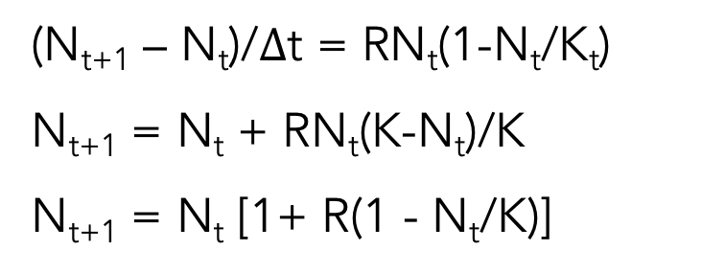
Discrete Logistic (one form):
(N_{t+1} – N_{t})/$∆$t = RN_{t}(1-N_{t}/K_{t})
N_{t+1} = N_{t} + RN_{t}(K-N_{t})/K
N_{t+1} = N_{t} [1+ R(1 - N_{t}/K)]
Three maps with same K, but different R's
What does this look like?
What would the dynamics look like?
N_{t+1}
0
N_{t}

Slide 74
Discrete Logistic: Stability:
N_{t+1} = N_{t} [1+ R(1 - N_{t}/K)]
N_{t+1}
0
N_{t}

Slide 75
Discrete Logistic: Stability:
N_{t+1} = N_{t} [1+ R(1 - N_{t}/K)]
Three maps with same K, but different R's
R>0 for equil.
Stability depends on the slope of the function at N*.
What is the slope at N*? (do it!)
Slope = 1-R
R<2: locally stable
R=2: limit cycle with period 2 begins
R=2.449: limit cycle of period 4 begins
R=2.544: 8
R=2.564: 16
R=2.5687: 32
R>2.57: Chaos
N_{t+1}
0
N_{t}

Slide 76
Discrete Logistic: Stability:
N_{t+1} = N_{t} [1+ R(1 - N_{t}/K)]
Stability depends on the slope of the function at N=K.
What is the slope at N=K? (find it!)
Slope = 1-R
Thus:
R<2: locally stable
R=2: cycle with period 2 begins
R=2.449: cycle of period 4 begins
R=2.544: 8
R=2.564: 16
R=2.5687: 32
R>2.57: Chaos

Slide 77
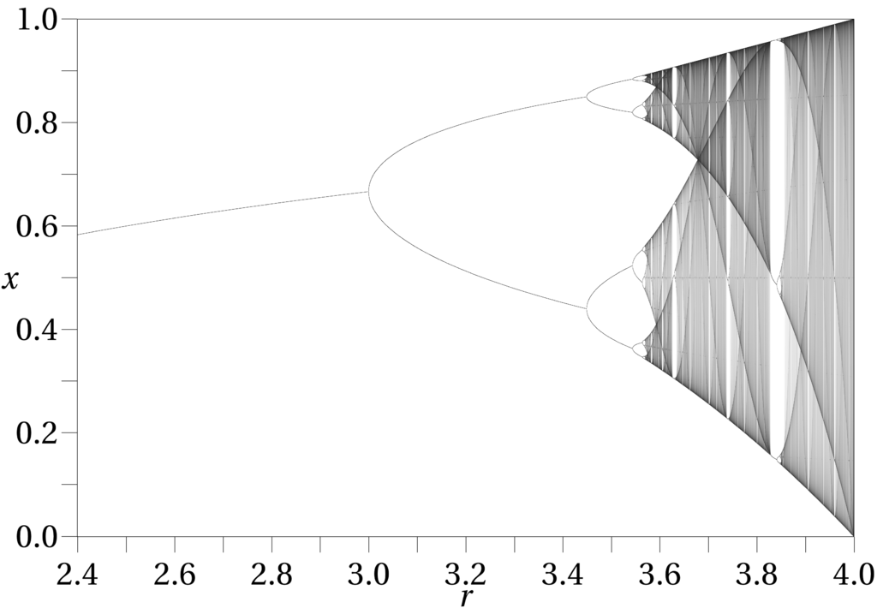
Bifurcation diagram:
Note: this for a slightly different logistic map (May 1976), so parameter has different meaning and transitions occur at different values.
Two-point cycle
Stable,
damped oscill.
4
8
16
32
Chaos--

Slide 78
Link here.

Slide 79
Chaos
Chaos is not "random"
It arises from a purely deterministic model
A point very close to another gives no information about the future position of the adjacent point:
"When the present determines the future, but the approximate present does not approximately determine the future." (Wikipedia)
E.g., if you plot consecutive points in a chaotic time series….
N_{t+1}
0
N_{t}

Slide 80
Homework #1
The Ricker equation is another commonly used discrete time model: N_{t+1}=N_{t}e^{r(1-(Nt/K))}
Plot the equation (aka return map): i.e., N_{t+1} vs. N_{t}. Do this first by inspection and by using derivatives and limits (e.g., to find asymptotes, maxima, minima, intercepts, etc.). Then check your plot by putting the equation into software and plotting it up.
Solve for the equilibria.
What if r<0? Can you make sense of this situation?
Are (is) the equilibria/um locally stable? Do a stability analysis (as we did with the Taylor series expansion).
Simulate the dynamics for r=1.9 and K=100 (plot N vs. t).
Do these dynamics match your expectation from e and f?
Email your answers to Craig by 5pm Monday.
Now, play some (e.g., vary r [e.g., .5, 1.1, 2.0, 2.2, 3] and K)

Slide 81
Discussion:
Persson et al. (1988)
…predator and prey are regulated by different factors. Top carnivores are predicted to be resource-limited, while plants … should be controlled by grazers…
What do we mean by "limited", "controlled" and "regulated"?
See Osenberg and Mittelbach (1996)
Notes:
Precision in language and terminology; operationalization or concepts.

