Slide 1

Parameter Sweep and Resources Scaling Automation in Scalarm Data Farming Platform
J. Liput, M. Paciorek, M. Wrona, M. Orzechowski, R. Slota, and J. Kitowski
ACC Cyfronet AGH
Department of Computer Science, AGH UST
CGW’15 Krakow, Poland
26-28 October 2015
Notes:
1
Good afternoon to everyone.
Today I will be talking about Parameter Sweep and Resources Scaling Automation in Scalarm Data Farming Platform.
Scalarm is a platform developed in PL-Grid Core project within ACC Cyfronet AGH in cooperation with Department of Computer Science on AGH.

Slide 2
Agenda
Data processing in modern science
Problem description
Scalarm overview
Scalarm approach to automation
Results
Conclusions and future work
Notes:
Firstly, I will introduce data processing in modern science
followed by challenges it represents.
Then, I will briefly describe Scalarm data farming platform and, later on, present its approach to challenges mentioned before.
After that I will show evaluation of our work.
To summarize our research, I will present some conclusions and future work.

Slide 3
Data processing in modern science
Scientific research methods often rely on executing numerous simulations each with different input parameter values
One such approach is called data farming
Experiment creation by input space definition
Implementation of simulation
Experiment plan
Creation of simulation model
Change of
input space
Running and monitoring of HPC resources
Grid
Grid
Cloud
Cloud
Simulation idea
Private
?
Analysis and visualisation
Response
or change
Results collection
Initial question
Notes:
3
Scientific research methods often rely on executing numerous simulations each with different input parameter values.
One of such approaches is called data farming.

Slide 4
Data processing in modern science
Scientific research methods often rely on executing numerous simulations each with different input parameter values
One such approach is called data farming
Experiment creation by input space definition
Implementation of simulation
Experiment plan
Creation of simulation model
Change of
input space
Running and monitoring of HPC resources
Grid
Grid
Cloud
Cloud
Simulation idea
Private
?
Analysis and visualisation
Response
or change
Results collection
Initial question
Notes:
4
To conduct data farming experiment on given issue, firstly we need to create model of our simulation.
Having defined model we need to implement it as computer program.

Slide 5
Data processing in modern science
Scientific research methods often rely on executing numerous simulations each with different input parameter values
One such approach is called data farming
Experiment creation by input space definition
Implementation of simulation
Experiment plan
Creation of simulation model
Change of
input space
Running and monitoring of HPC resources
Grid
Grid
Cloud
Cloud
Simulation idea
Private
?
Analysis and visualisation
Response
or change
Results collection
Initial question
Notes:
5
Later, we need to define input space for our simulation and create plan of our experiment. We must take into consideration details like order of simulations execution and computational resources to use.

Slide 6
Data processing in modern science
Scientific research methods often rely on executing numerous simulations each with different input parameter values
One such approach is called data farming
Experiment creation by input space definition
Implementation of simulation
Experiment plan
Creation of simulation model
Change of
input space
Running and monitoring of HPC resources
Grid
Grid
Cloud
Cloud
Simulation idea
Private
?
Analysis and visualisation
Response
or change
Results collection
Initial question
Notes:
6
Next step is to execute simulations with specified input on some computational resources. It can be Grid resources, Clouds or private machines. We also need to monitor execution of these simulations to avoid errors that could delay obtainment of results.

Slide 7
Data processing in modern science
Scientific research methods often rely on executing numerous simulations each with different input parameter values
One such approach is called data farming
Experiment creation by input space definition
Implementation of simulation
Experiment plan
Creation of simulation model
Change of
input space
Running and monitoring of HPC resources
Grid
Grid
Cloud
Cloud
Simulation idea
Private
?
Analysis and visualisation
Response
or change
Results collection
Initial question
Notes:
7
After collecting partial results we can analyse them and make decisions about further execution. We can extend input space and repeat entire process of executing simulations. Another action we can perform is to finish experiment at this stage if we are satisfied with obtained results.

Slide 8
Problem description
Data science computation often requires input space adjustments according to collected partial results
Need of resources management according to changing computational power requirements
Experiment creation by input space definition
Implementation of simulation
Experiment plan
Creation of simulation model
Change of
input space
Running and monitoring of HPC resources
Grid
Grid
Cloud
Cloud
Simulation idea
Private
?
Analysis and visualisation
Response
or change
Results collection
Initial question
Notes:
After initial deployment of experiment there are two main areas where performed task are conducted repeatedly:
One is data analysis of partial results and scheduling additional simulations
Other area is resources management of various computational resources. This can be cumbersome due to differences between access interface to infrastructures
Both these areas can greatly benefit from automation.

Slide 9

Scalarm overview
Scalarm - a platform for data farming, allows user to execute experiments in convenient way
Unified management of heterogeneous resources
Partial results analysis with numerous methods
Input space extension during experiment
Extension
Statistics
Input Space
Execution
Results
Adjustments
User
User
Computational Resources
Notes:
9
Scalarm is a platform for data farming, with allows users to execute experiments described in details on previous slides in convenient way.
Scalarm supports various types of computational resources, like PL-Grid resources, Cloud infrastructures and private servers.
To allow users easy management of these heterogenous resources, Scalarm provides unified interface, where user can schedule simulation on different computational resources using the same graphical user interface.
Scalarm also allows to analyse computed partial data with numerous methods. Some of scalarm visualization methods are k-means and pareto chart.
After analysis user can extend experiment input space during experiment execution based on performed analysis.

Slide 10
Scalarm approach to automation
Two levels of experiment automation:
Input space adjustment
Resources management
Level 1
Level 2
Input Space Extension
Extension
Statistics
Input Space
Resources Management
Extension needed
Waiting for results
Execution
Loop
Results Analysis
Results
Adjustments
Results
Computational Resources
User
Notes:
10
To even further meet the needs of users we introduced two levels of automation in Scalarm:
- One is input space adjustments algorithm, which conducts analysis of partial data and extends input space accordingly.
- The other is resources management algorithm, which ensures experiment execution within limits imposed by user, for example execution time limit.

Slide 11
Input space adjustment
Input space management algorithm:
Input space extension
Analysis of requested data
Dedicated simulated annealing algorithm
Level 1
Level 2
Input Space Extension
Extension
Statistics
Input Space
Resources Management
Extension needed
Waiting for results
Execution
Loop
Results Analysis
Results
Adjustments
Results
Computational Resources
User
Notes:
11
Input space algorithm firstly extends input space with initial simulations. (Pokazać na to laserem)
Then scalarm platform executes these simulations on computational resources and send its results back to algorithm. (Pokazać na to laserem)
In this phase algorithm ANALYSES received simulations results and makes decision about further executions. It can either schedule additional simulations to extend input space (Pokazać na to laserem) or finish execution and deliver analysed results to user (Pokazać na to laserem).
Any algorithm can be used as base for input space management. In scalarm we provided dedicated simulated annealing.
In each iteration simulated annealing algorithm schedules simulations and therefore extends input space, awaits its execution on computational resources and ANALYSES received data. After that algorithm makes decision about further execution.

Slide 12
Resources management
Resources management algorithm:
Pulling metrics about current state
Metrics analysis
Increasing or decreasing amount of workers
Level 1
Level 2
Input Space Extension
Extension
Statistics
Input Space
Resources Management
Extension needed
Waiting for results
Execution
Loop
Results Analysis
Results
Adjustments
Results
Computational Resources
User
Notes:
12
Resources management algorithm works through entire time of experiment execution, maintaining proper resources usage within constraints imposed by user.
In its decision loops algorithm pulls statistics about current state of experiment, which are provided by scalarm in form of metrics.
Next step is analysis of obtained data and decision about further moves.
Algorithm can adjust computational resources by either decreasing or increasing number of workers.
Worker is a computer program send onto infrastructure, and is responsible for sequential execution of simulations. By increasing number of workers we increase computational resources usage.

Slide 13
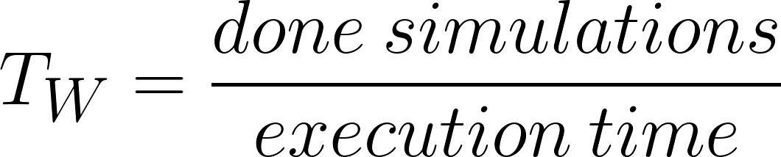

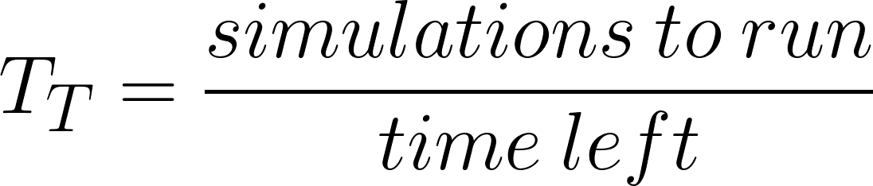
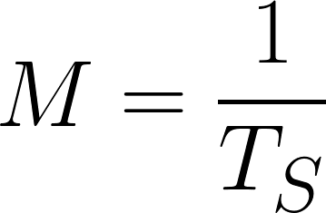
Resources management metrics
Metrics used during resources management
workers throughput
system throughput
target throughput
makespan [time]
Notes:
13
Due to differences between computational resources supported by Scalarm, we provided unified metrics to measure experiment execution.
- Workers throughput that represents computing power of single worker and is calculated by dividing done simulation by worker’s execution time.
- System throughput that shows cumulative computing power of system for given experiment workers.
- Target throughput which shows what computing power is needed to finfish experiment within imposed limits.
- And makespan, useful translation for presenting user how much time he needs to wait until his experiment completes.

Slide 14
Evaluation
Test 1: Automated input space extension evaluation
Input space controlled by simulated annealing algorithm
Fixed time of simulation execution - 10 seconds
Fixed number of workers - 10
Test 2: Automated resources management evaluation
Resources controlled by our resources management algorithm
Fixed time of simulation execution - 20 seconds
Manual input space extensions
Experiment execution time constrained to 10 minutes
Notes:
To evaluate automation implemented in Scalarm we performed two tests - one to evaluate input space adjustments algorithm, and the second one to evaluate resources management algorithm.
In the first test experiment input space extensions was controlled by simulated annealing algorithm. To visibly show its progress, simulation execution time was fixed to 10 seconds. The number of workers was also fixed to 10.
The second test was designed to show resources management algorithm performance. Simulations execution time was fixed to 20 seconds. Experiment execution time was constrained to 10 minutes. During this test input space was extended manually four times to show algorithm’s response to growing input space.

Slide 15
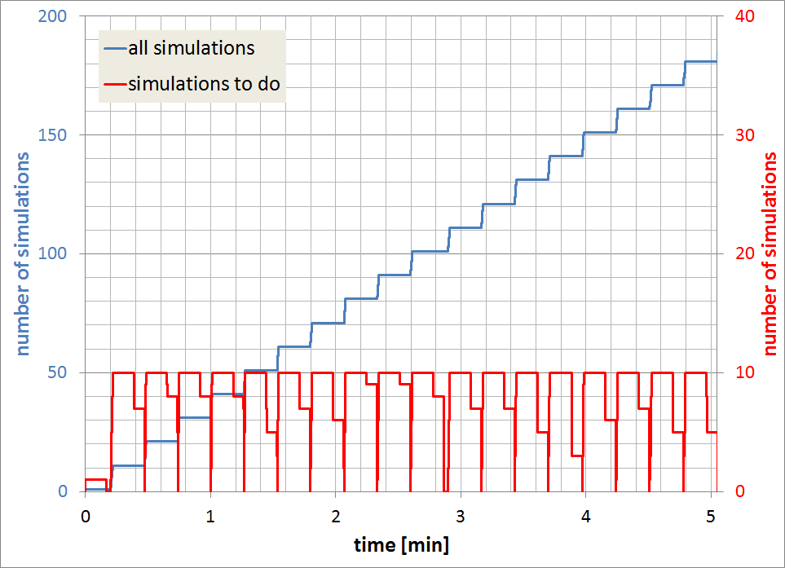
Automated input space extensions
Notes:
On this chart we can see evaluation of simulated annealing input space adjustment algorithm.
The blue line shows cumulative number of simulations at given time, and each step on this plot represents one algorithm iteration. (Pokazać laserem). The red line shows number of simulations to execute at given time. As we can see, algorithm needs to wait to until previous bundle of simulations is finished before scheduling next one (Pokazać laserem). It is essential observation in term of resources management algorithm.

Slide 16
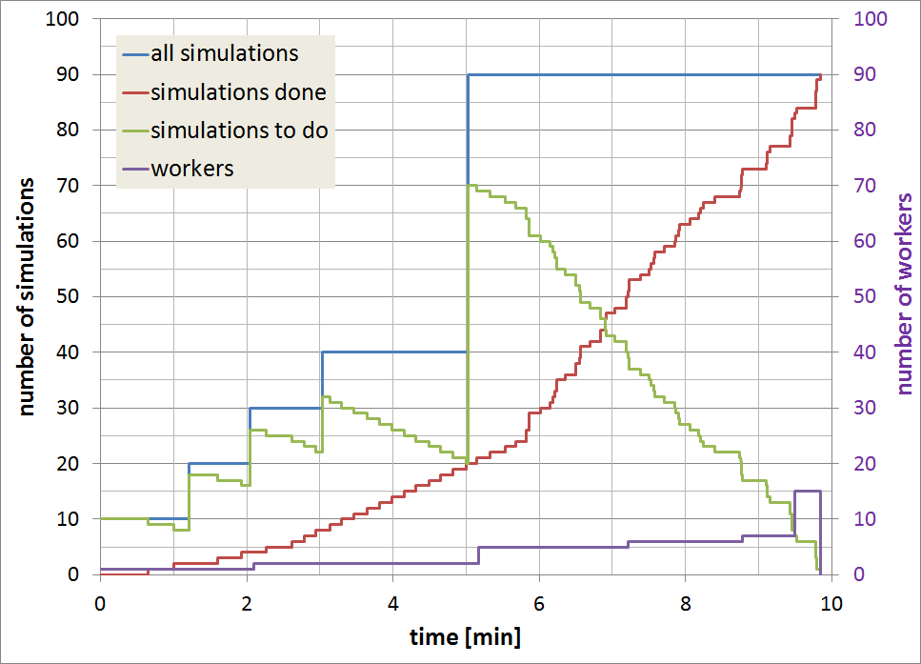
Automated resources management
Notes:
On this chart we can see evaluation of resources management algorithm. On the blue line we can see mentioned before manual input space extensions, that forces algorithm to respond accordingly. The first three times input space was extended by 10 simulations and the last time input space was extended by 50 simulations. On green line we can see number of simulations to do, and on red line how much simulations were finished. We can see that rate of executing simulations grows accordingly to amount of scheduled workers shown by purple line. If needed. algorithm increased number of workers. (Laser) Last major observation is that algorithm fulfilled restriction of 10 minutes experiment execution.

Slide 17
Conclusions
Two levels of automation - input space adjustments and resources management
Plugin-based architecture allows an easy extension with new algorithms
Integration of these levels of automation is challenging
Automated input space extension requires calculation of all simulation from ‘bundle’ before scheduling next one
Resources management algorithm must take into account input space extension by bundle of simulations
Notes:
In conclusion, we extended scalarm platform with two levels of automation - input space adjustment algorithm and resources management algorithm. Thanks to plugin based architecture we used it is easy to extend scalarm platform with additional algorithms.
Integration of automations levels mentioned before will be challenging due to specifics of some of the possible input space adjustment algorithms. As shown by our evaluation, algorithms like simulated annealing need to receive results from all already scheduled simulations before proceeding with execution and scheduling another ones. The resources management algorithms need to take into consideration this type of input space extensions.

Slide 18
Future Work
Resources management algorithm better suited to data farming experiments
Predicting amount of simulation yet to be scheduled based on available data
Metrics extension
Additional dedicated input space management algorithms, e.g. genetic algorithm
Notes:
In future we plan to implement additional resources management algorithms that will be better suited to work with input space adjustment algorithms like simulated annealing. Resources management must be able to predict number of simulations yet to be scheduled in future based on statistics available at the moment. We plan to introduce such possibility by extension of our metrics. Apart from that we also want to implement additional input space management algorithms, currently we are working on genetic algorithm that will be available for our users in near future.
Thank you for your attention, and should you have any questions feel free to ask.

