Slide 1

Predicting medical expenses
MATH 644 – GKERI PEPELASI

Slide 2
Linear Regression on Medical Insurance Costs
-Dataset: Machine Learning with R by Brett Lantz
-1338 observations with 7 variables
age: age of primary beneficiary
sex: insurance contractor gender, female, male
BMI: Body mass index, providing an understanding of body, weights that are relatively high or low relative to height, objective index of body weight (kg / m^2) using the ratio of height to weight, ideally 18.5 to 24.9
children: Number of children covered by health insurance / Number of dependents
smoker: Smoking
region: the beneficiary’s residential area in the US, northeast, southeast, southwest, northwest.
charges: Individual medical costs billed by health insurance

Slide 3
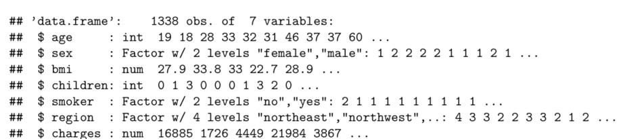
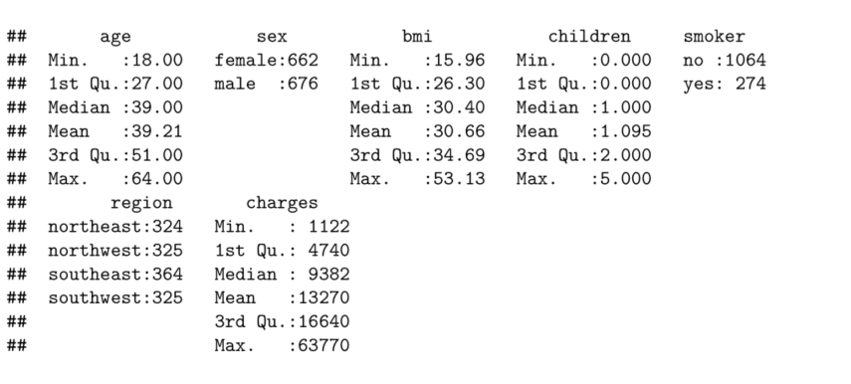
Data exploration
-Older people and smokers are at higher risk of large medical expense
Charges have large variables, possible outliers
Right-skewed
Quantitative reasonable varied

Slide 4
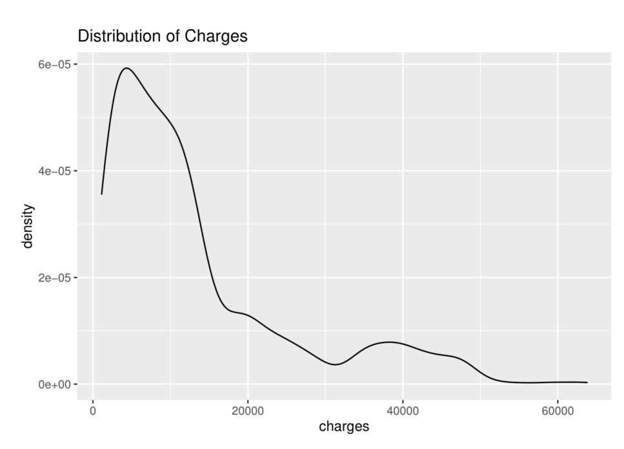

Slide 5
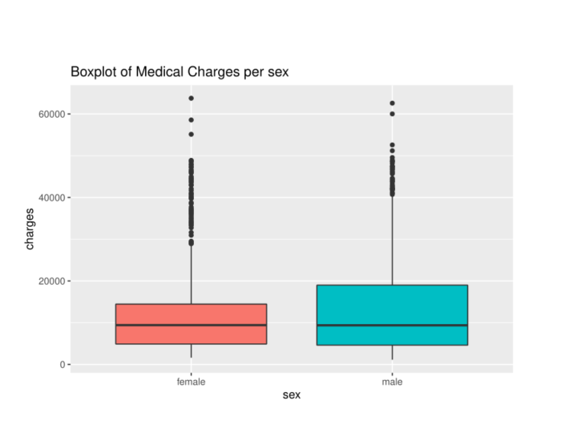
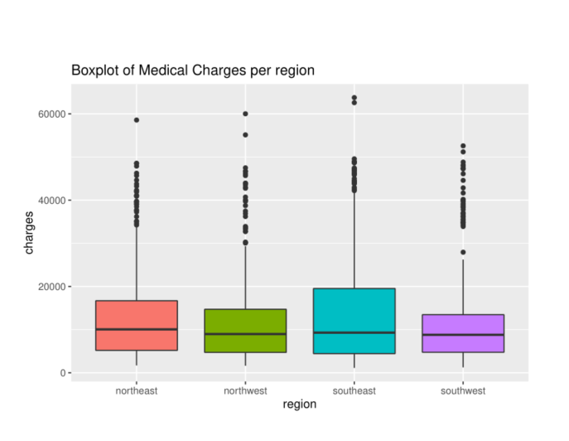
- Sex: Median costs are equal , more variance in male
- Region : No clear trend , almost equal ,slightly decrease from east to west
- Both lot of outliers

Slide 6
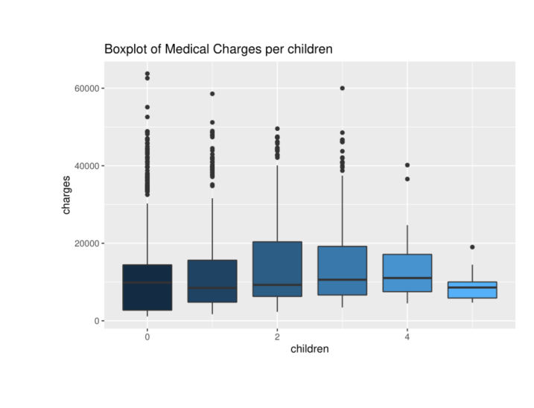
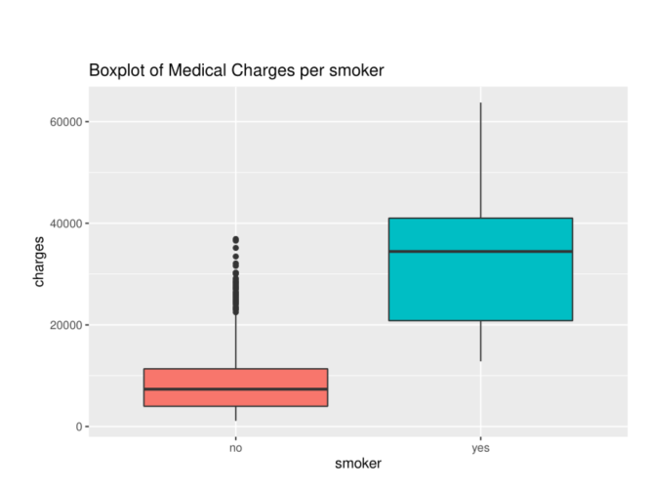
- Children: Costs get higher with more kids then lower (Discount with 0-1 kids and 5)
- Smoker: Much more expenses for smokers
- Both lot of outliers

Slide 7
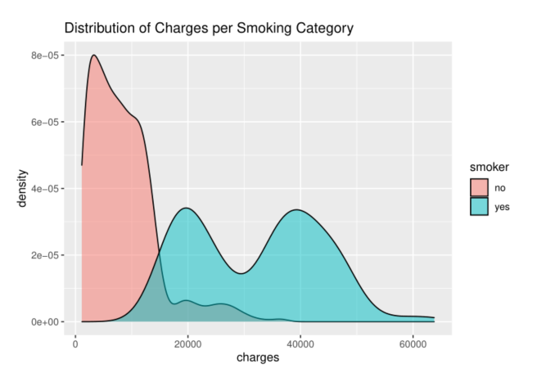

Slide 8
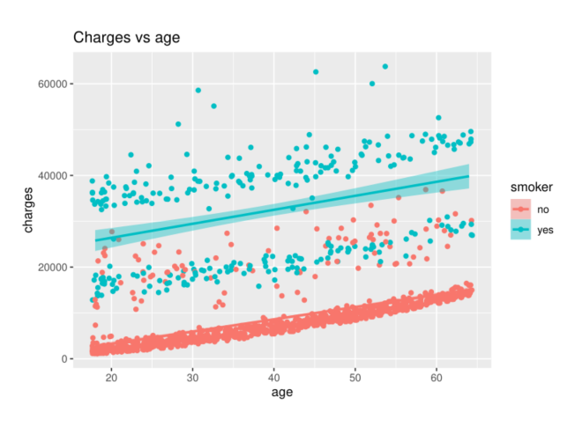
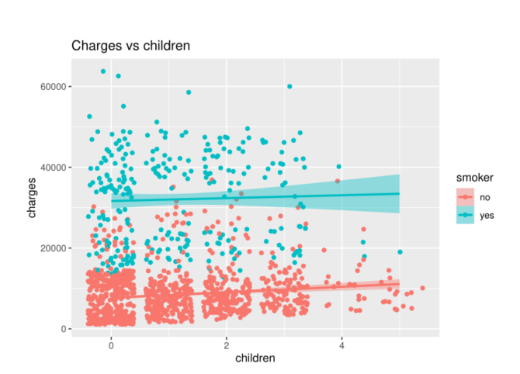
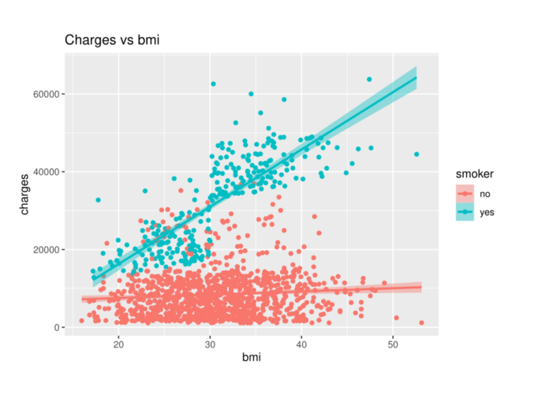
-Smokers have the highest
impact on charges
Charges grows with age,
BMI and children
People with more children
Smoke less

Slide 9
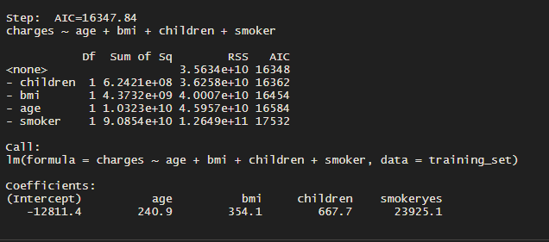
Training a model
Linear regression with backward elimination
model1 <- lm(charges ~. , data = training_set)
step(model1,direction = "backward")

Slide 10
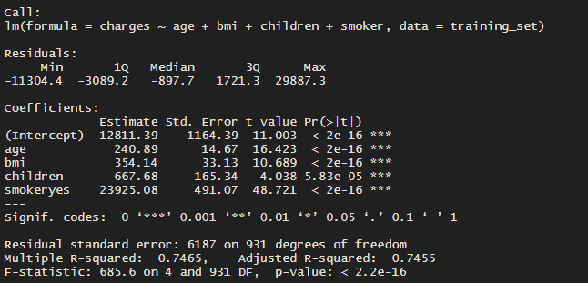
All features significant
Features explains 74% of the total variation in charges
Smoker has the biggest coefficient of all features, a unit change in smoker gives a bigger change in charges than a unit change in other features give, given all other features are fixed. In this case, given all other features are fixed, a non-smoker would have less charge than a smoker by $23,925.

Slide 11
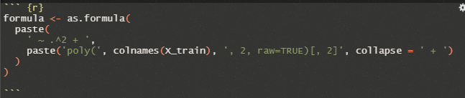
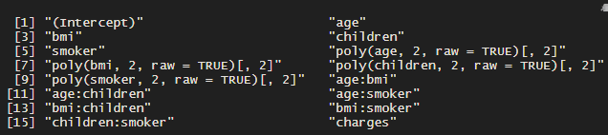
Polynomial regression
Generate a new feature matrix consisting of all polynomial combinations of the features with degrees less than or equal to the specified degree.
Using this formula :
1. (Intercept) is a column consists of constant 1, this is the constant term in the polynomial.
2. age , bmi , children , smoker are the original features.
3. age² , bmi² , children² , smoker² are the square of the original features.
4. age x bmi, age x children , age x smoker , bmi x children , bmi x smoker , children x smoker are six interactions between pairs of four features.
5. charges is the target feature.

Slide 12
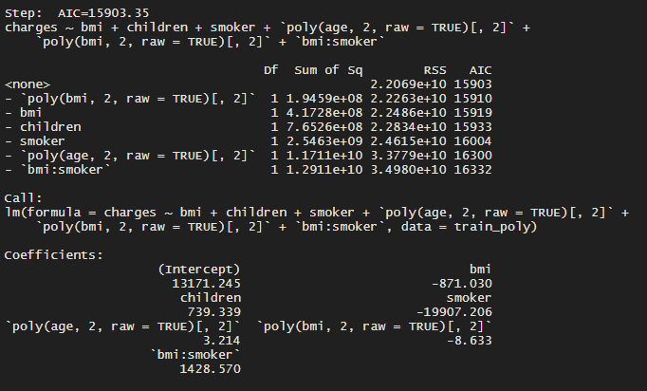
Polynomial regression with backward elimination
polynom_regr <- lm(formula = charges ~ ., data = train_poly)
step(polynom_regr)

Slide 13
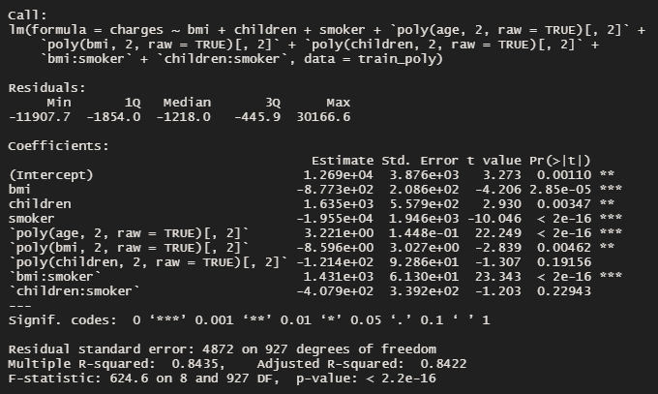
8 features, all significant except children:smoker
Features explains 84% of the total variation in charges.
This model captures more variance of charges than the earlier linear Regression

Slide 14
Improve the model
Age : the older they get ,larger amount of medical expenses needed so we add a square term of the age
BMI: expenses are affected when bmi is more than 30-considered as obese. Categorize the feature into two portions, 0 for bmi<30 and 1 for bmi>30
When someone is smoker and obese more medical expenses needed so an interaction term bmi30*smoker is added .

Slide 15
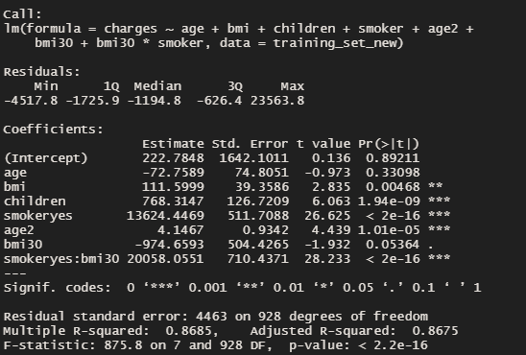
-Model improved to 87%
-The higher-order age2 term is statistically significant, as is the obesity indicator, bmi30.
-The interaction between obesity and smoking suggests a massive effect
-Increasing costs over $13624 for smoking and $20058 for obese smoker.

Slide 16
Comparing models
MODEL | MAE | RMSE | R^2
Linear regression | 3997.499 | 5829.191 | 0.7455
Polynomial regression | 2767.815 | 4680.93 | 0.8422
Improved model | 2454.077 | 4506.261 | 0.8675

Slide 17
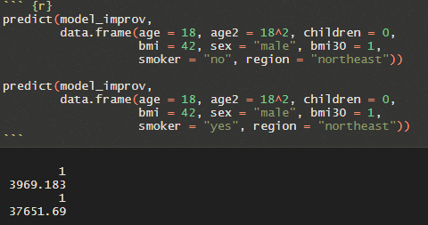
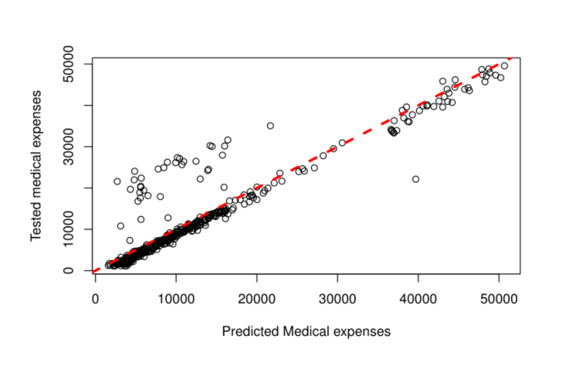
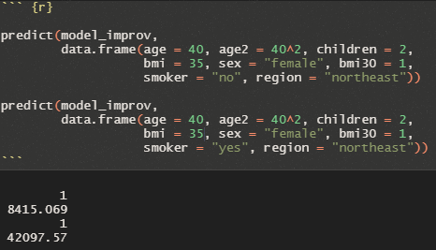
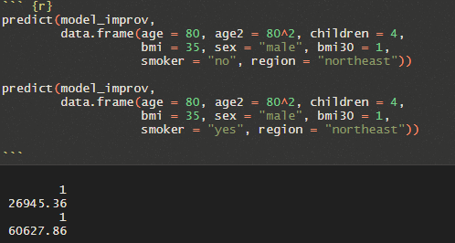
Predictions

Slide 18

THANK YOU

