Slide 1



Home
About us
Portfolio
Info
DIGITAL SIGNAL PROCESSING
SPEAKER RECOGNITION SYSTEM
Notes:
1

Slide 2

Contents
1
Introduction
Speaker Recognition System
2
3
Algorithms
4
Implementation
5
Conclusion

Slide 3

CHAPTER
1
INTRODUCTION

Slide 4


Slide 5

CHAPTER
2
SPEAKER RECOGNITION SYSTEM

Slide 6


Slide 7
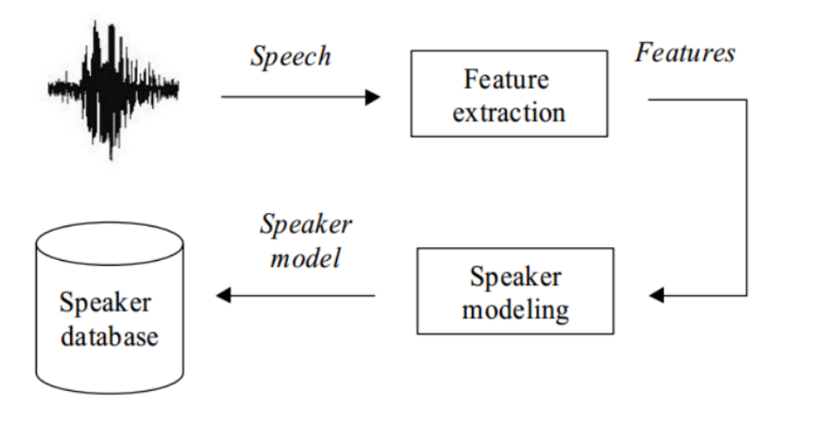
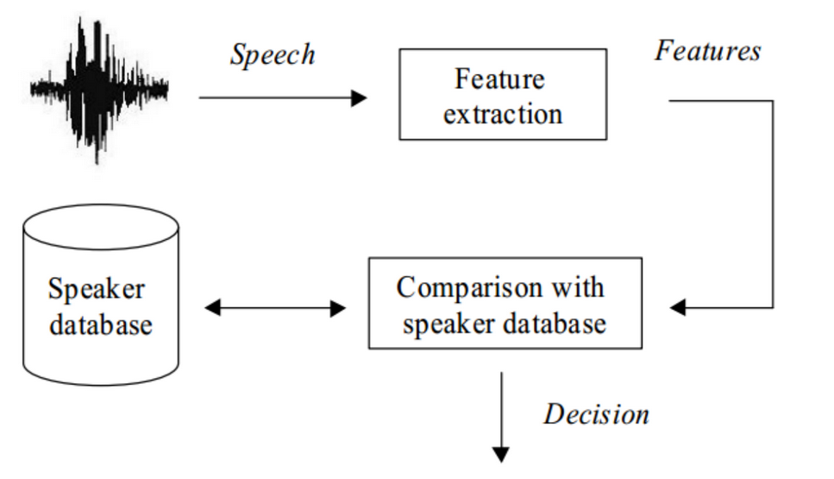
SPEAKER RECOGNITION SYSTEM
There are two phases in our speaker recognition system
Diagram of Enroll Speakers Phase
Diagram of Identifying Speakers Phase
Enroll Speakers
Voice of the speakers are collected and used to training model. The set of models of multiple speakers is also known as the speaker database.
Identifying Speakers
Voice data of an unknown user are put into the system and matched with the models in the speaker database.

Slide 8
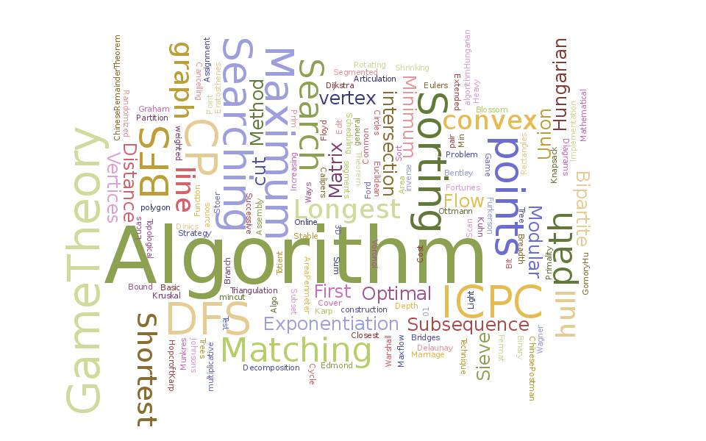
CHAPTER
3
ALGORITHMS

Slide 9
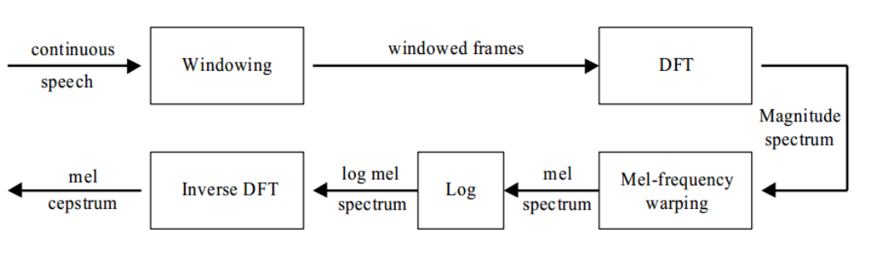
Mel-Frequency Cepstral Coefficient ( MFCC )
Extracting voice features with Mel-Frequency Cepstral Coefficient (MFCC)
The short-term power spectrum of a sound which is based on a linear transform of a log power spectrum on a non linear mel-scale of frequency can be called Mel-Frequency Cepstral Coefficient. It can be used in Speaker Recognition tasks.
MFCC Extraction Process

Slide 10
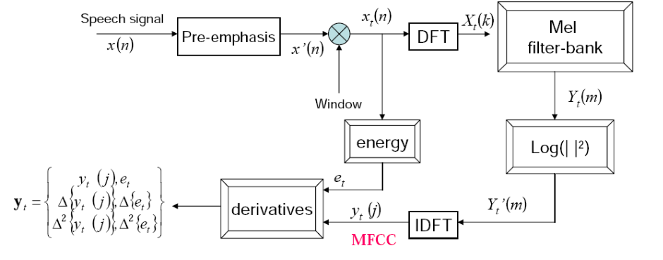
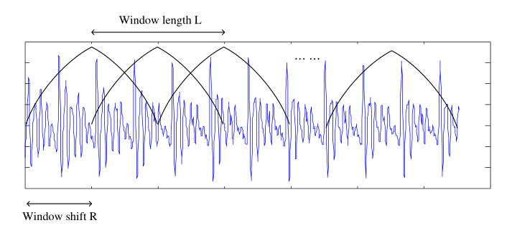
Windowing

Slide 11
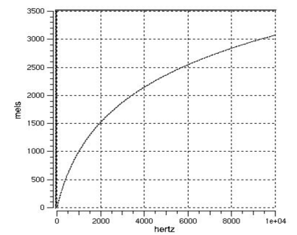
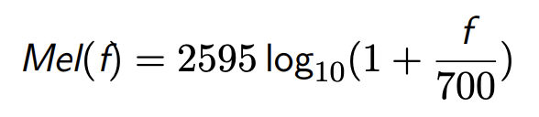
Mel-Scale

Slide 12


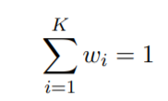
GMM
A Gaussian Mixture Model is a probabilistic model that assumes all the data points are generated from a mixture of a finite number of Gaussian distributions with unknown parameters.
GMM is usually used in acoustic studying assignments such as speaker recognition. GMM assumes that the probability of a vector x from the model is:
where
subject to

Slide 13

CHAPTER
4
IMPLEMENTATION

Slide 14
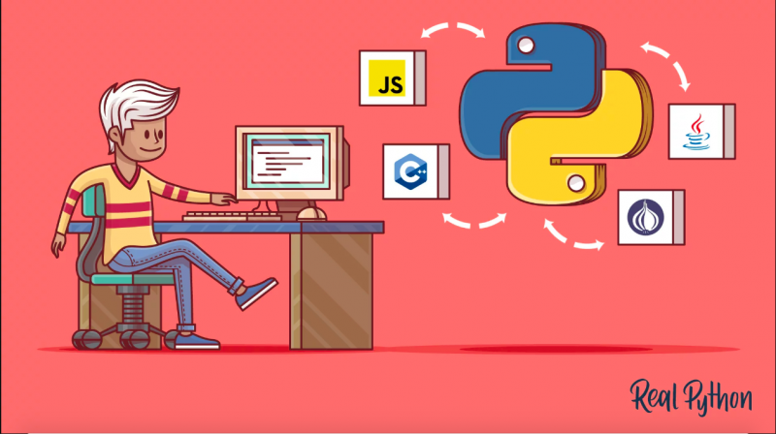
SOURCE CODE
The whole system is written in Python. The system strongly relies on the support of python_speech_features, numpy and scipy library.
MFCC Parameters:
Number of cepstral coefficient: 13
Number of filter banks: 26
The length of the analysis window in seconds: 25 milliseconds (Default)
The step between successive windows in seconds: 10 milliseconds (Default)

Slide 15
TESTING AND RESULT
Speaker | Correctly identified as MFCC percentage (out of 10 files)
Nguyễn Tiến Dũng | 90%
Nguyễn Thành Gia Hiển | 100%
Vũ Văn Huy | 80%
Trần Thanh Long | 80%
Trịnh Tuấn Minh | 90%
Nguyễn Hồng Quang | 100%
Nguyễn Phương Thảo | 80%
Nguyễn Thị Lan Anh | 90%
Nguyễn Thành Vinh | 50%

Slide 16
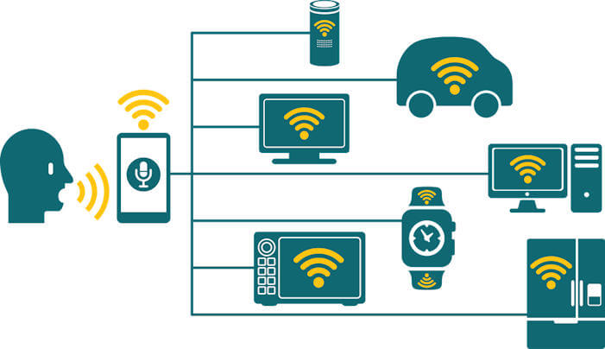
CHAPTER
5
CONCLUSION

Slide 17


THANK YOU
FOR WATCHING

