Slide 1
The Technology Value Stream
Hunter Dale 3/23/2025

Slide 2
What is the Technology Value Stream?
In DevOps "we typically define our technology value stream as the process required to convert a business hypothesis into a technology-enabled service that delivers value to the customer." (Kim et al. p. 46, 2016)
When we need to figure out something for a client or something of that sort we usually refer to this.
It can be another name for the process we take to add something of worth to the program or system

Slide 3
What is Lead Time?
Lead time is the time taken from the start of a project all the way to the end.
This time includes the Process Time
"Lead time in DevOps measures how much time has elapsed between committing code and deploying it to production, tracking the time spent on implementing, testing, and delivering changes to the codebase." (Software.com p. 1, 2025)
This is where we focus our process improvement attention

Slide 4
What is Process Time? Why are these important?
Process time is the time where we begin work on the request specifically.
"However, the proportion of process time to lead time serves as an important measure of efficiency..." (Kim et al. p. 48, 2016)
These times are important to the efficiency of a program, so they are important to us.

Slide 5
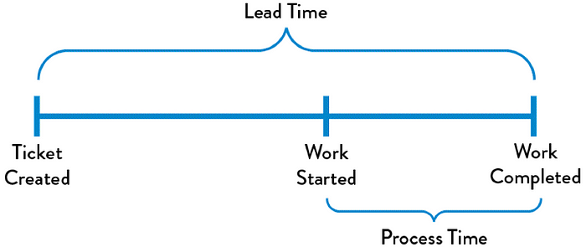
Graphic of Lead Time vs. Process Time

Slide 6
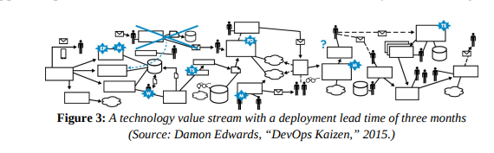
The Common Scenario: Deployment Lead Times Requiring Months
Lead times can be months! Usually this is because large, complex organizations.
This can lead to long test times, long process times, and can rely heavily on manual testing.

Slide 7
Our DevOps Ideal: Deployment Lead Times of Minutes
Of course, we want the lead times to take minutes. The biggest thing that we have learned is that we want to be as efficient as possible.
The way we can achieve this is by "continually checking small code changes into our version control repository, performing automated and exploratory testing against it, and deploying it into production. (Kim et al p. 49, 2016)

Slide 8

References
Kim, Gene, et al. The Devops Handbook How to Create World-Class Agility, Reliability, and Security in Technology Organizations. It Revolution Pr, 2015.
“Lead Time and How to Measure It in DevOps | DevOps Metrics.” Www.software.com, www.software.com/devops-guides/lead-time.
Navarrete, Richard. “Fire Your Engineering Team - the Startup - Medium.” Medium, The Startup, 22 July 2020, medium.com/swlh/fire-your-engineering-team-e3f74f380cc9. Accessed 23 Mar. 2025.

