Slide 1
New York City Water Quality
By
Drew Adamski

Slide 2
The Problem:
Poor water quality is rarely an isolated incident
Notes:
It’s no great discovery that water flows into itself. The issues of one part of the harbor are not entirely isolated from the issues of another. By better understanding how this water quality network works, water quality issues can be treated systematically rather than on a case by case basis.
Understanding the system requires constant and broad monitoring which is costly and time consuming.

Slide 3
The Solution:
Reduce monitoring costs by reducing number of parameters measured and sites tested.
Notes:
My proposed solution is to use geospatial statistics, network analysis, and machine learning to reduce monitoring costs without sacrificing accuracy
I looked at Chlorophyll A because it signals harmful algae blooms that can cause cascading effects damaging the natural ecosystem and public health alike

Slide 4
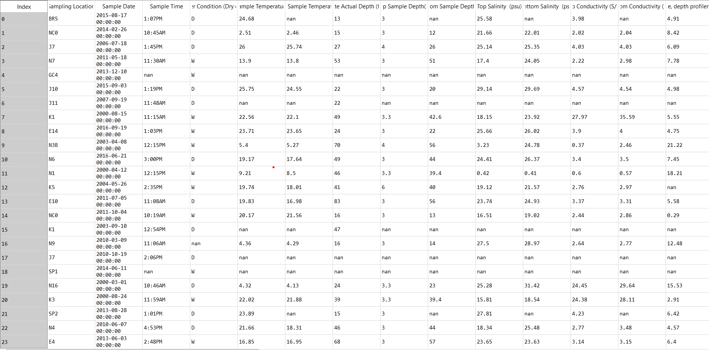
The Data
Data Source: https://data.cityofnewyork.us/Environment/Harbor-Water-Quality/5uug-f49n
Notes:
Dataset was 88,000 rows and 100 columns
Measurements from 1909
250 total sites

Slide 5
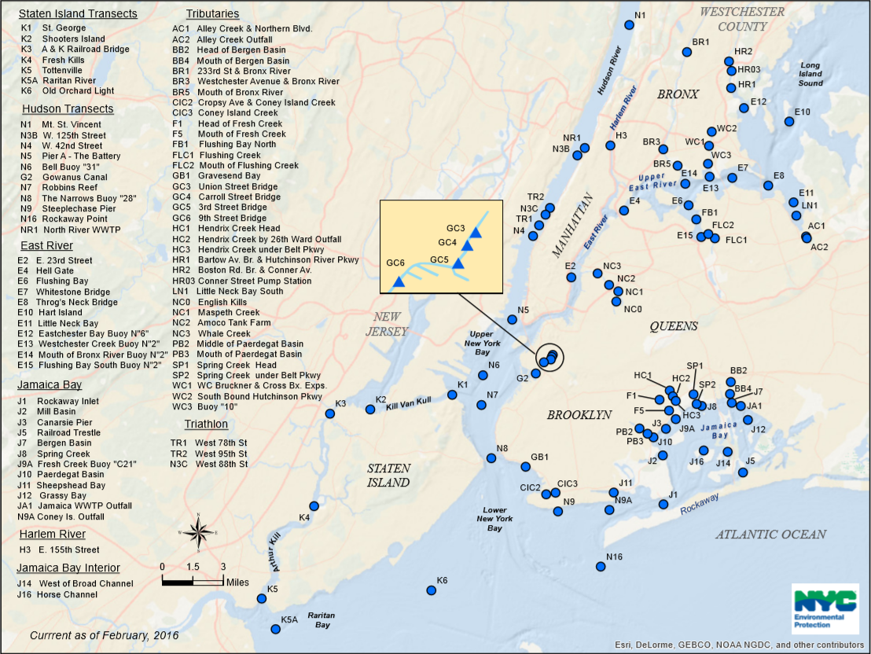
NYC Harbor Sample Sites
Notes:
The dataset I used came from the NYC EPA
Water samples have been collected from all these sites from as early as

Slide 6
Data Wrangling
Only consider data from Jan 1, 2000 and later
Only consider sites on 2016 map
Drop redundant columns
Drop rows with more than 30% of data missing
Forward fill blank values with most recent measurement at same site
Target Variable: Chlorophyll A
Original dataset had ~80,000 rows and 100 columns and not a single complete row
Notes:
Wanted a large enough time span to capture multiple climate anomalies
Wanted to focus on sites actively being sampled
Reduced the size and scope considerably by dumping redundant data
Imputed values based on old measurements
Chose chlorphyll as my target vairable because it has far reaching and tangible, immediate effects on an ecosystem such as fish death and drops in dissolved oxygen

Slide 7
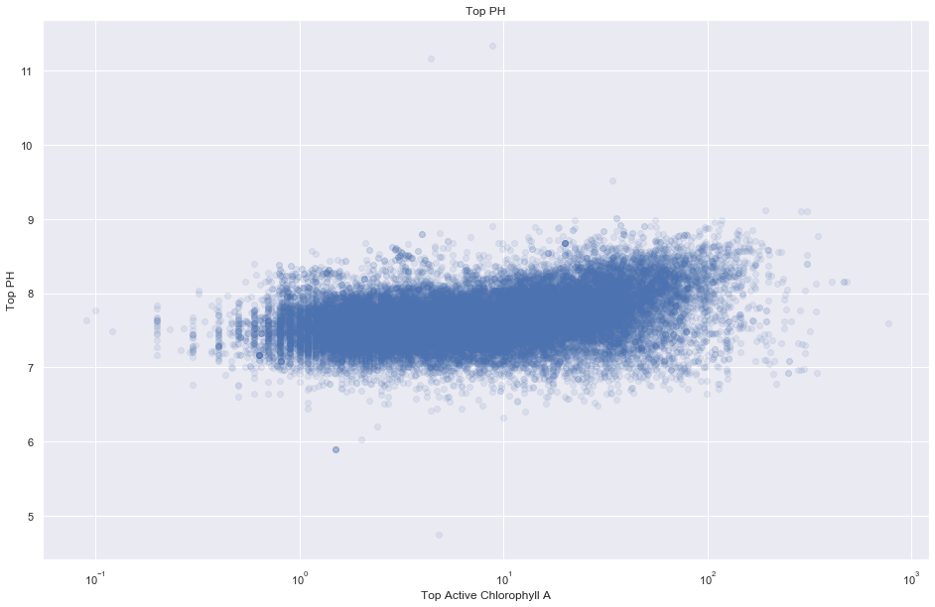
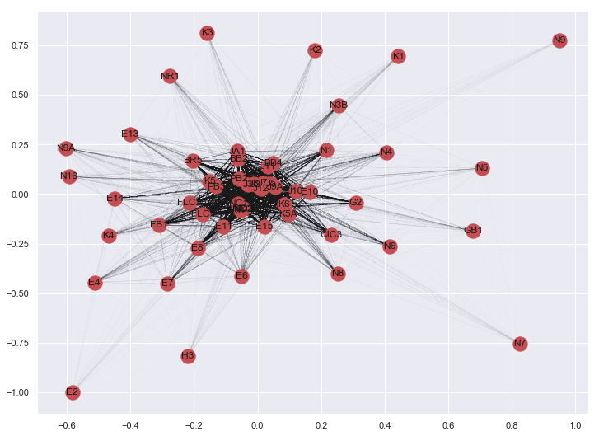
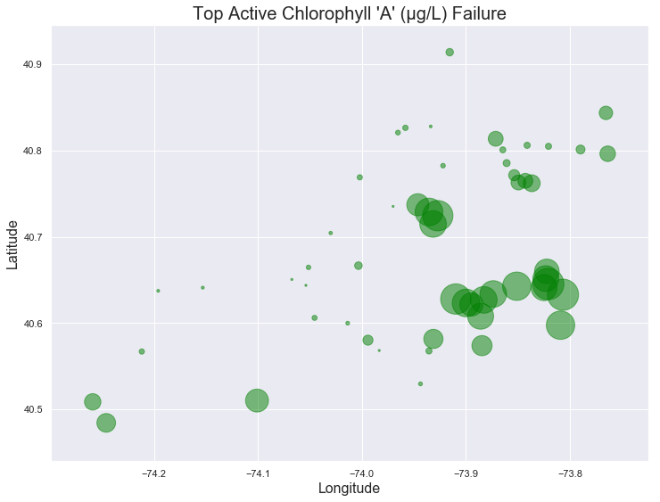
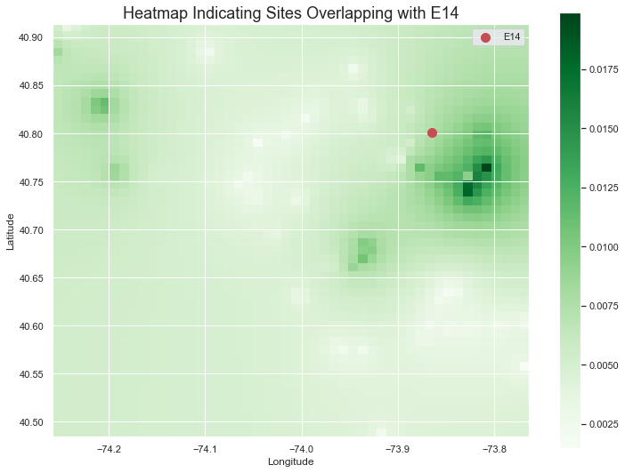
Exploratory
Data Analysis
Notes:
Top left: Scatter plot of chlorophyll and pH. There’s a slight correlation, but overall it’s very difficult to tell. This was common for a lot of the measurements.
Top right: Multigraph representation of overlapping failed tests. If two sites had overlimit readings in the same month, an edge was drawn between the nodes
Bottom left: geographic representation of probability of failed chlorophyll test at each site. Circles are arranged by lat/long and their size is their probability of failing a test.
Bottom right: Inverse Weighted Distance map. Sites that fail tests at the same time are darker, but this graph also takes into account how far away the sites are from each other.
Using these graphs and more, I was able to narrow down my features and the sites I was going to look at

Slide 8
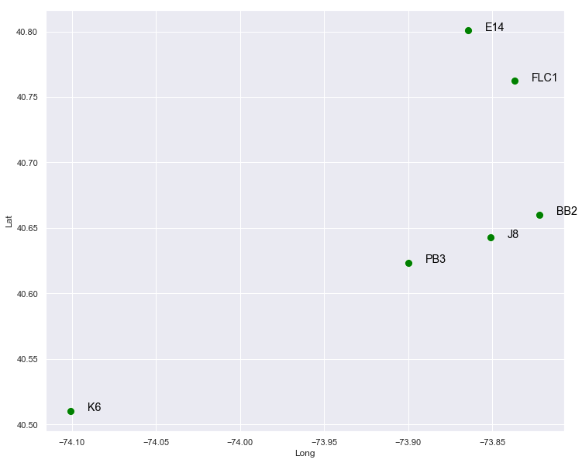
Site Selection
Model Selection
Selected 6 sites
Logistic Regression
Random Forest Classifier
XGBoost Classifier

Slide 9
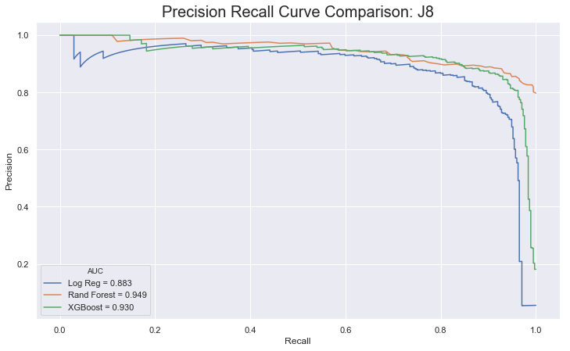
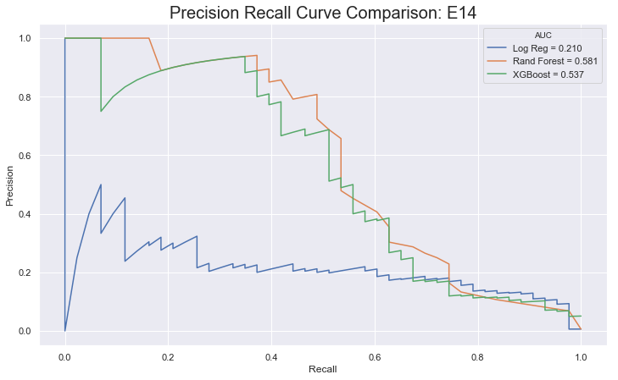
Site Comparisons: Precision Recall
Notes:
Here are the precision recall curves for two distinct sites.
The one on the left is one with good predicatability and the one on the right is one with poor.
I looked at 6 sites and found 3 with good predictability. Those are the ones that I developed models for.

Slide 10
Hyperparameter Tuning
Precision Increase by Site
BB2: 80% to 85%
J8: 92% to 95%
PB3: 78% to 87%
Grid Search Cross Validation
Notes:
When tuning my parameters, I used Grid Search Cross Validation
The m

Slide 11
Takeaways
XGBoost was best model
Phosphorus measurement matter most
A lot of features are not important (Reduced columns from 100 to 28)
Different sites have different predictability

Slide 12
Future Research
Expand to more sites
Expand to more parameters
Develop a short term model (data from <5 years)
Integrate physical connectivity

Slide 13
Thank You!
New York EPA for monitoring the waterways
New York Open Data for making data publicly available
Aiden Johnson for guidance during project

Slide 14
Questions?

