Slide 1
Predicting Future All Stars From Past Season Data
By Drew Adamski

Slide 2
The Problem:
Predicting the Leap
Notes:
Players develop differently with some taking longer than others to get to where you want them to be
Predicting that jump in productivity would be a massive edge for GMs in the league
The metric I will be using is

Slide 3
Understanding the Data

Slide 4
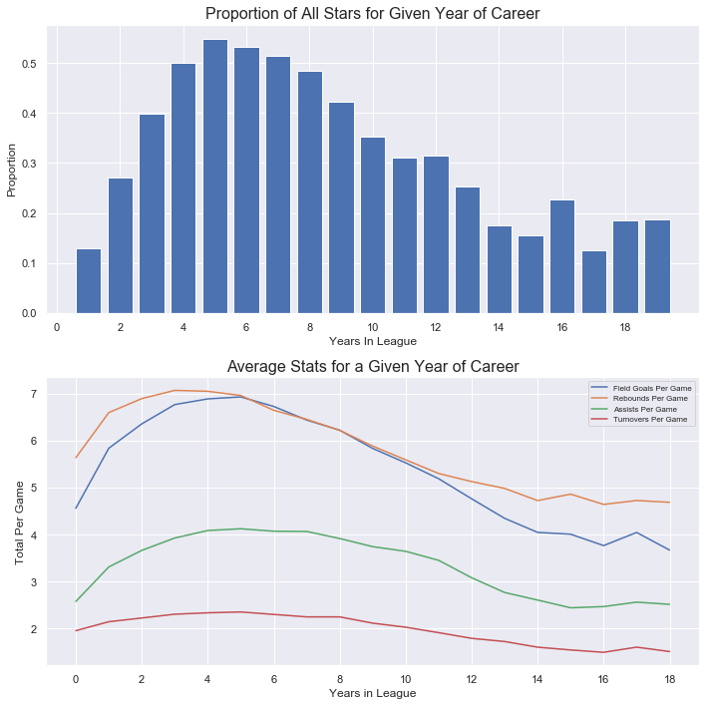
The Leap
Season 4
Period of approximately 5 years
Followed by steady decline
Notes:
These two graphs illustrate the average career arc for a player by using the proportion of all stars in my dataset as well as comparing the shape to some stats FG, TRB, AST, TOV
There is a similar shape with these graphs that logically follows
A player comes into the league and gets better before peaking at a certain point for a few years followed by steady decline
End of career peaks are due to exceptional players like Kareem Abdul-Jabbar who are able to stay in the league for 20 years and still be productive
While this graph may help give us an understanding of what year of player to target, we cannot go around signing every 4th year player to massive contracts based on this alone.
I want to hone in on what features can predict this leap taken by young players

Slide 5
Model Selection

Slide 6
Model Selection
Logistic Regression
Random Forest Classifier
Support Vector Machine
K Nearest Neighbors Classifier
Notes:
I looked at 4 different classification algorithms: logistic regression, random forest classifier, support vector machine, k nearest neighbors classifier

Slide 7
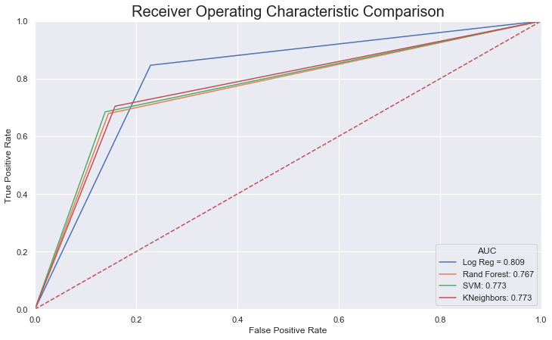
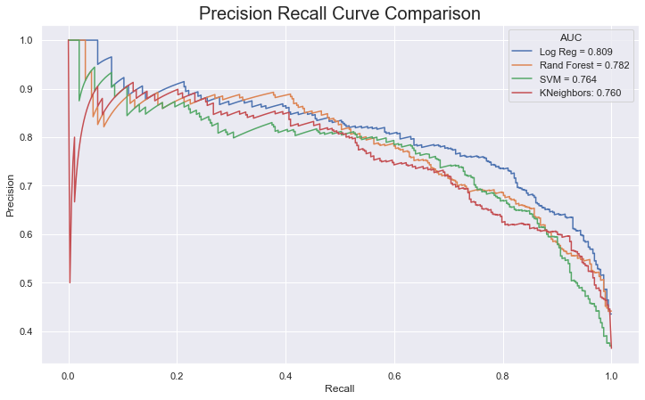
Model Comparison

Slide 8
Takeaways

Slide 9
42.4%
Percent of First Time All Stars Predicted Correctly

Slide 10
Next Steps

Slide 11
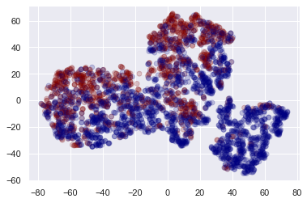
Next Steps
Expand dataset
Train separate models for separate positions
Perform unsupervised clustering analysis
t-SNE dimensionality reduction showing 3 clusters (allstars in red, non-allstars in blue)
Notes:
Expand dataset:
Positions:
I found significant positional differences in my dataset, and perhaps developing a model specific to each position would improve the prediction ability of my models.
Unsupervised Clustering:
When I put my data through t-SNE dimensionality reduction, there appear to be 3 clusters. I would like to look into figuring out what delineates those clusters from each other. There may be additional insights there as well.

Slide 12
Thank you!
Sports Reference
Danny Wells
Aiden Johnson
Notes:
I’d like to give a special thanks to Sports Reference for making player data readily available and accessible online
My Springboard mentor Danny Wells who gave me guidance throughout this project and helped shape my analysis
My Springboard mentor Aiden Johnson who helped me push this project over the finish line

Slide 13
Questions?

