Slide 1
SECURE DATA HIDING IN IMAGES USING STEGONOGRAPHy
CAPSTONE PROJECT
Presented By: Jovan Moris D
College Name: Indian Institute of Information Technology, Design and Manufacturing, Kancheepuram
Department: Computer Science Major In Artificial Intelligence

Slide 2
OUTLINE
Problem Statement
Technology used
Wow factor
End users
Result
Conclusion
Git-hub Link
Future scope

Slide 3
Problem Statement
Traditional text encryption methods can be complex for non-technical users. This project provides a user-friendly GUI that allows users to encrypt and decrypt messages within images, ensuring secure and accessible communication.

Slide 4
Technology used
Programming Language: Python
Libraries Used:
tkinter (GUI Development)
opencv-python (Image Processing)
pillow (Image Handling)

Slide 5
Wow factors
User-Friendly GUI: No command-line operations required Secure Message Hiding: Uses pixel manipulation for encryption Password Protection: Ensures only authorized decryption Supports Multiple Image Formats: Works with PNG and JPG images

Slide 6
End users
🔹 Students & Researchers – Learning encryption techniques
🔹 Privacy-Focused Users – Hiding sensitive messages
🔹 Developers – Implementing secure communication

Slide 7
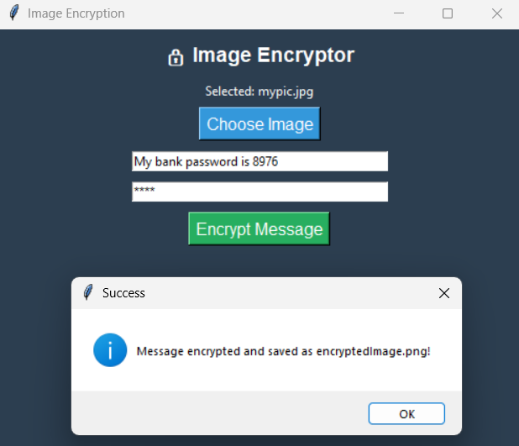
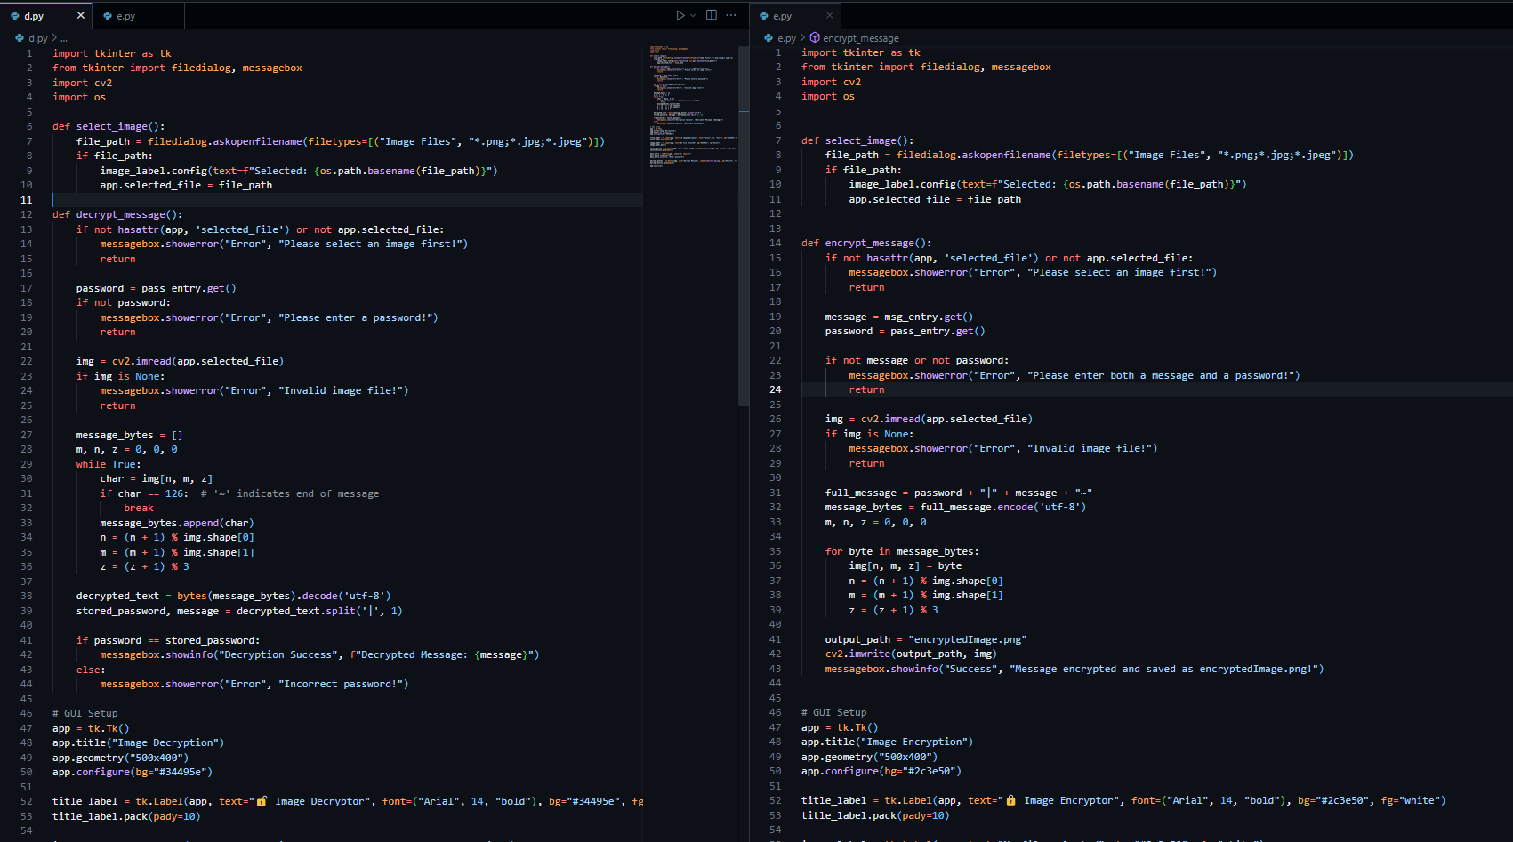
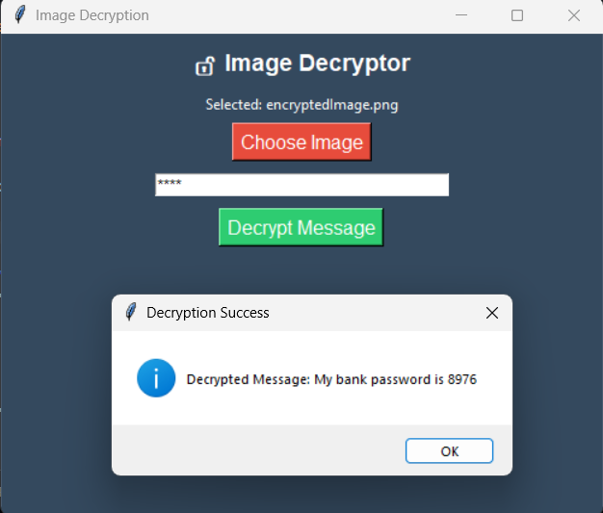
Results

Slide 8
Conclusion
This project successfully hides messages within images using LSB (Least Significant Bit) encoding and password protection, providing a secure and user-friendly encryption tool.

Slide 9
GitHub Link
The Github Link to the project is :
https://github.com/dradigon/Stegonography_In_Image

Slide 10
Future scope
🚀 Possible Enhancements:
Add AES encryption for extra security
Support video-based encryption
Convert into a mobile application

Slide 11
THANK YOU

