Slide 1
Smart Capex GCP
Smart Capex architecture documentation

Slide 2
Summary
Infrastructure
List of components
Focus on the Smart Capex Web App
Billing monitoring & control

Slide 3
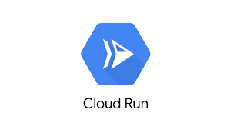
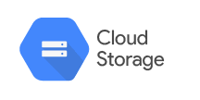
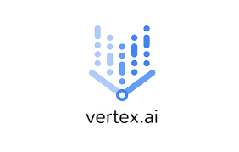
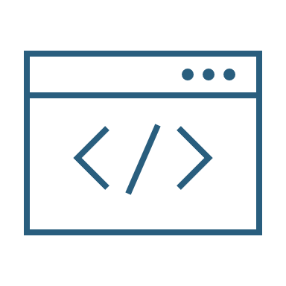
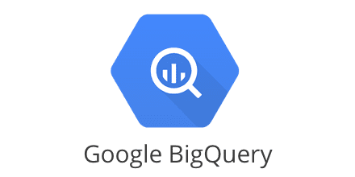
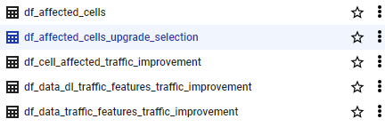
Infrastructure
GCP SmartCapex Project : DEV
PROD
Web app encapsulation
Python
Back-end
Access control
MySQL
Angular
Data
Analytics engine
OSS counter 2G
LDAP
OSS counter 3G
Python
Analytics
OSS counter 4G
2G config. data
Deployment history
Data Queries

Slide 4
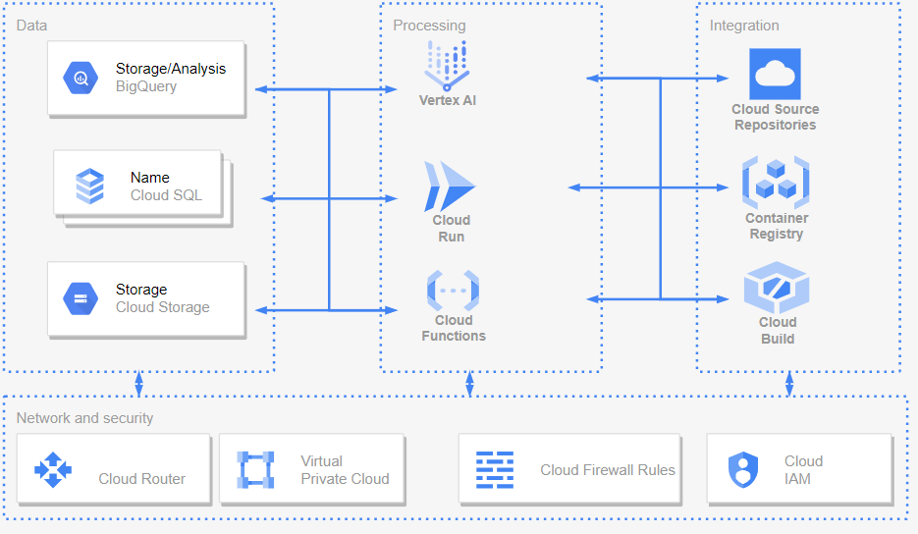
List of components: GCP services for Smart Capex

Slide 5

List of components: Python Machine Learning stack
pystan==2.19.1.1
holidays==0.24
prophet==1.1.1
pandas-gbq
google-cloud-bigquery
pyarrow
scipy
tqdm
fsspec==2022.8.2
gcsfs==2022.8.2
google-cloud-aiplatform==1.21.0
kfp==1.8.18
matplotlib==3.5.2
numpy==1.21.6
optuna==2.10.1
pandas==1.3.5
db-dtypes
pandas_gbq
scikit-learn==0.24.1
sqlalchemy==1.4.2
haversine==2.3.0
openpyxl==3.0.6
Flask==1.1.2
PyMySQL==1.0.2
Python packages
Vertex AI framework is based on KubeFlow
KubeFlow components encapsulate Python code

Slide 6





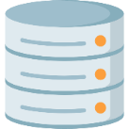
Focus on the Smart Capex Web App
FRONTEND
BACKEND
NodeJS
B01
User
Angular
B02
Nginx
MariaDB

Slide 7
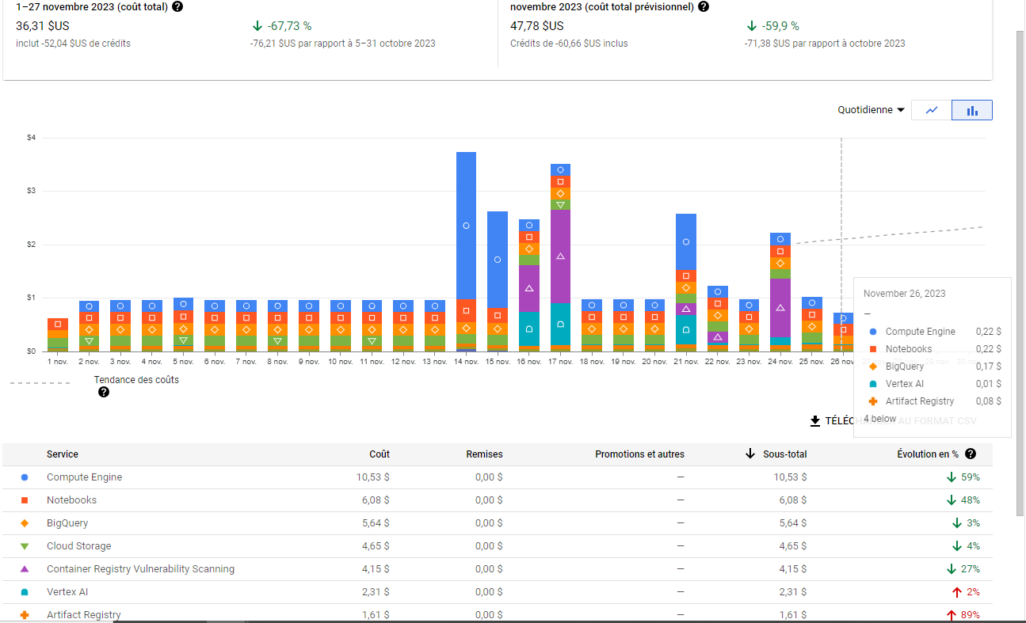
Billing monitoring & control
The Billing page allows to monitor accurately costs
Resource consumptions is limited in 2 ways:
In the code for each Vertex AI components with the functions:
set_cpu_limit
set_memory_limit
With a Cloud Scheduler job
Monthly cost: less than 50 dollars

Slide 8
Thanks

