Slide 1
SCRUM
Presentation: 2
By: Bryce DeAlessio
Class: ENG290
An Agile Project Management Process

Slide 2
Scrum : Introduction
What is SCRUM?
Scrum is an iterative and empirical “framework within which people can address complex adaptive problems, while productively and creatively delivering products of the highest possible value” (Schwaber & Sutherland)[4].
What is it really?
A Project Management Process that allows a small team of people to create a Product in an iterative fashion while constantly Inspecting their progress and adapting to changes in customer requirements and development challenges.
What Problems does it fix?
Scrum was developed in response to the failure of the traditional “Waterfall Method”[1] to manage cost overruns and changing customer requirements of Software Products.

Slide 3
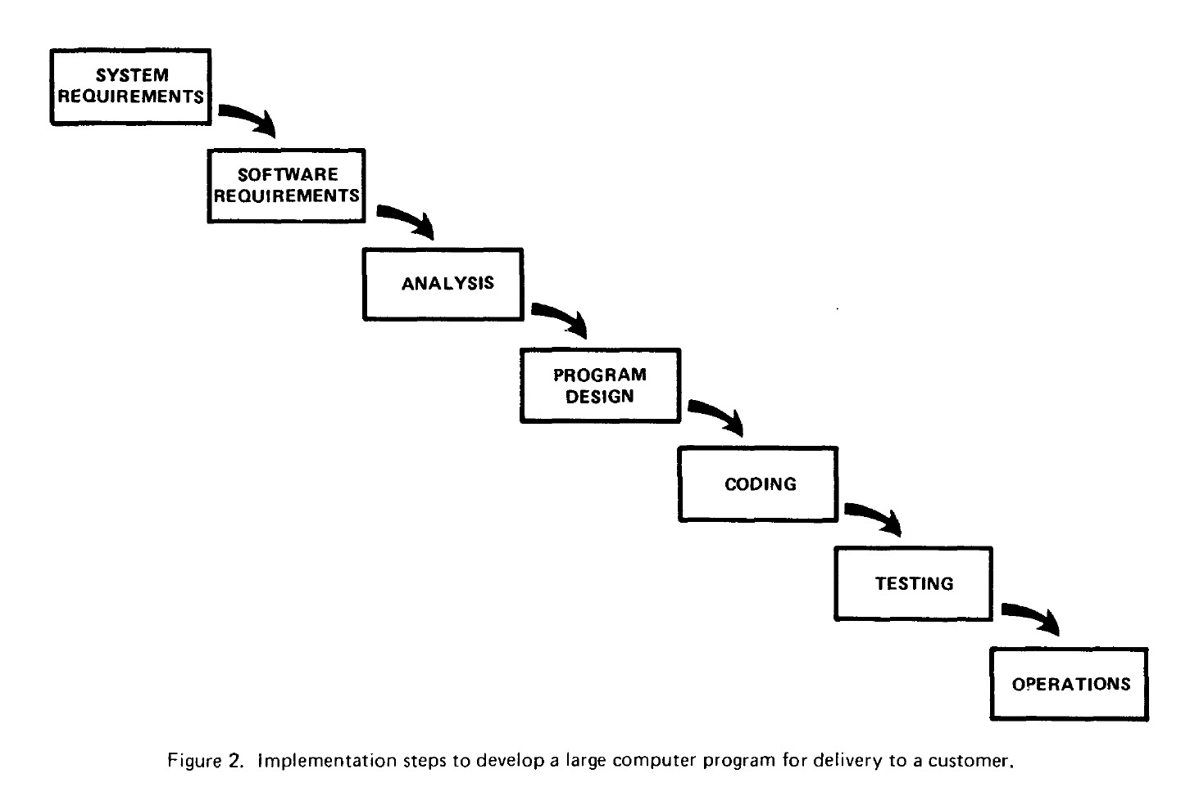
SCRUM: The Waterfall Method
Figure 1 | Traditional Waterfall Method (Royce)[1]

Slide 4
Scrum: terms
Roles
SCRUM Master
Product Manager
Developers
Artifacts
Product Backlog
Sprint Backlog
Product Increment
Events
Sprint Planning Meeting
Daily Sprint
Sprint Review
Sprint Retrospective

Slide 5
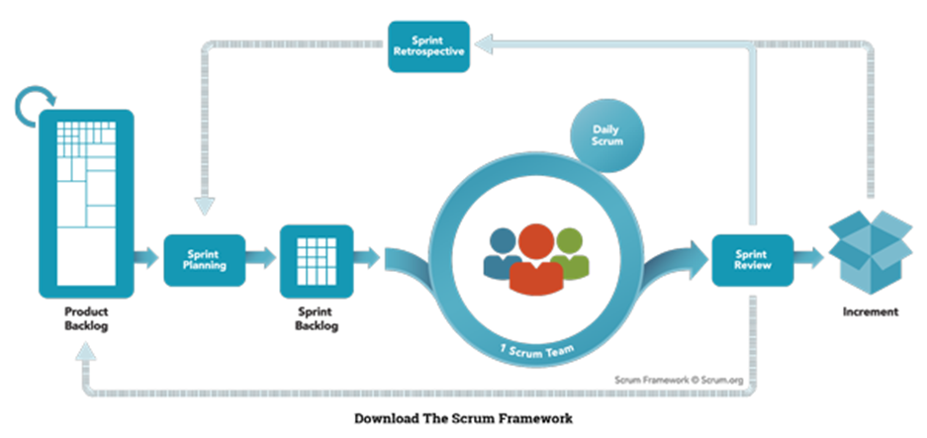
Scrum: The Sprint
Sprint
Retrospective
Daily Scrum
Sprint Planning
Sprint Review
Product Backlog
Sprint Backlog
Increment
Figure 2 | The Scrum Process [5](altered for legibility)

Slide 6
ScRUM: Sprint Overview
The Product Owner gathers customer requirements and creates the “Product Backlog”.
Sprint Planning Meeting: The SCRUM Team produces the Sprint Backlog from the Product Backlog”.
Daily SCRUM: A daily progress review (AKA “the standup”)
Sprint Review: Review with customers, capture feedback
Increment delivery: (if Team and customer agree)
Sprint Retrospective: Team reviews it successes and challenges and makes necessary changes for next Sprint
Enter The Sprint

Slide 7
Scrum: Sprint PLANNING
Sprint
Retrospective
Daily Scrum
Sprint Planning
Sprint Review
Product Backlog
Sprint Backlog
Increment
Figure 2 | The Scrum Process [5](altered for legibility)

Slide 8
Scrum: Sprint Planning
Maximum three hours.
What are we going to work on?
How are we going to get it done?
Major goal is to produce the Sprint Backlog.
The team Breaks up PBI’s into smaller chunks.
Backlog
In Work
Complete
User Login
User Data Base
User Data Base
Encryption
Encryption
Encryption

Slide 9
Scrum: DAILY SCRUM
Sprint
Retrospective
Daily Scrum
Sprint Planning
Sprint Review
Product Backlog
Sprint Backlog
Increment
Figure 2 | The Scrum Process [5](altered for legibility)

Slide 10
Scrum: daily scrum
Daily 15 min meeting.
Goal is to review Progress and raise issues.
Everyone Stands.
Everyone answers the following questions:
What did you work on yesterday that moved the Sprint Backlog forward?
What will you work on today?
Are there any issues impeding your progress? Squirrels!
Team Members meet as necessary afterward to help and plan.

Slide 11
Scrum: Sprint review
Sprint
Retrospective
Daily Scrum
Sprint Planning
Sprint Review
Product Backlog
Sprint Backlog
Increment
Figure 2 | The Scrum Process [5](altered for legibility)

Slide 12
Scrum: sprint review
Happens at the End of the Sprint
Informal meeting.
Stakeholders/customers invited
Feedback Captured back into Product Backlog

Slide 13
Scrum: Retrospective
Sprint
Retrospective
Daily Scrum
Sprint Planning
Sprint Review
Product Backlog
Sprint Backlog
Increment
Figure 2 | The Scrum Process [5](altered for legibility)

Slide 14
Scrum: sprint retrospective
Meeting for team to inspect it’s Successes and Challenges during the last Sprint.
Should be 3 hours or less depending on length of the Sprint.
Team reviews successes first and what worked well
Team develops ways to Improve on challenges and a plan to implement them.

Slide 15
Scrum: conclusion
SCRUM is suited to projects that have a high degree of variability during development.
SCRUM is an Overall Process not a detailed account of how to do the work.

Slide 16
Scrum: citations
[1] Beck, Kent, and Others. "Manifesto for Agile Software Development." Manifesto for Agile Software Development. N.p., 2001. Web. 04 Mar. 2017.
[2] Winston Royce, “Managing the Development of Large Software Systems”, Proceedings of IEEE WESCON 26 (August): 1–9, 1970. http://www.cs.umd.edu/class/spring2003/cmsc838p/Process/waterfall.pdf printed from Proceedings, IEEE WESCON, August 1970, pages 1-9. Copyright © 1970 by The Institute of Electrical and Electronics Engineers, .328 Inc. Originally published by TRW.
[3] "Learn About Scrum." What is Scrum? An Agile Framework for Completing Complex Projects - Scrum Alliance. The SCRUM Alliance, n.d. Web. 22 Feb. 2017.
*Why Is It Called Scrum?
When Jeff Sutherland created the scrum process in 1993, he borrowed the term "scrum" from an analogy put forth in a 1986 study by Takeuchi and Nonaka, published in the Harvard Business Review. See more at: https://www.scrumalliance.org/why-scrum#sthash.GGacCoIa.dpuf*
[4] Schwaber, Ken, and Jeff Sutherland. "The Scrum Guide™." Scrum Guide | Scrum Guides. Scrumguides.org, n.d. Web. 27 Feb. 2017. http://www.scrumguides.org/scrum-guide.html
[5] The Scrum Framework. Digital image. Scrum.org. N.p., n.d. Web. 22 Feb. 2017. <https://s3.amazonaws.com/scrumorg-website-prod/drupal/inline-images/ScrumFramework_2000x1000.png>.

