Slide 1
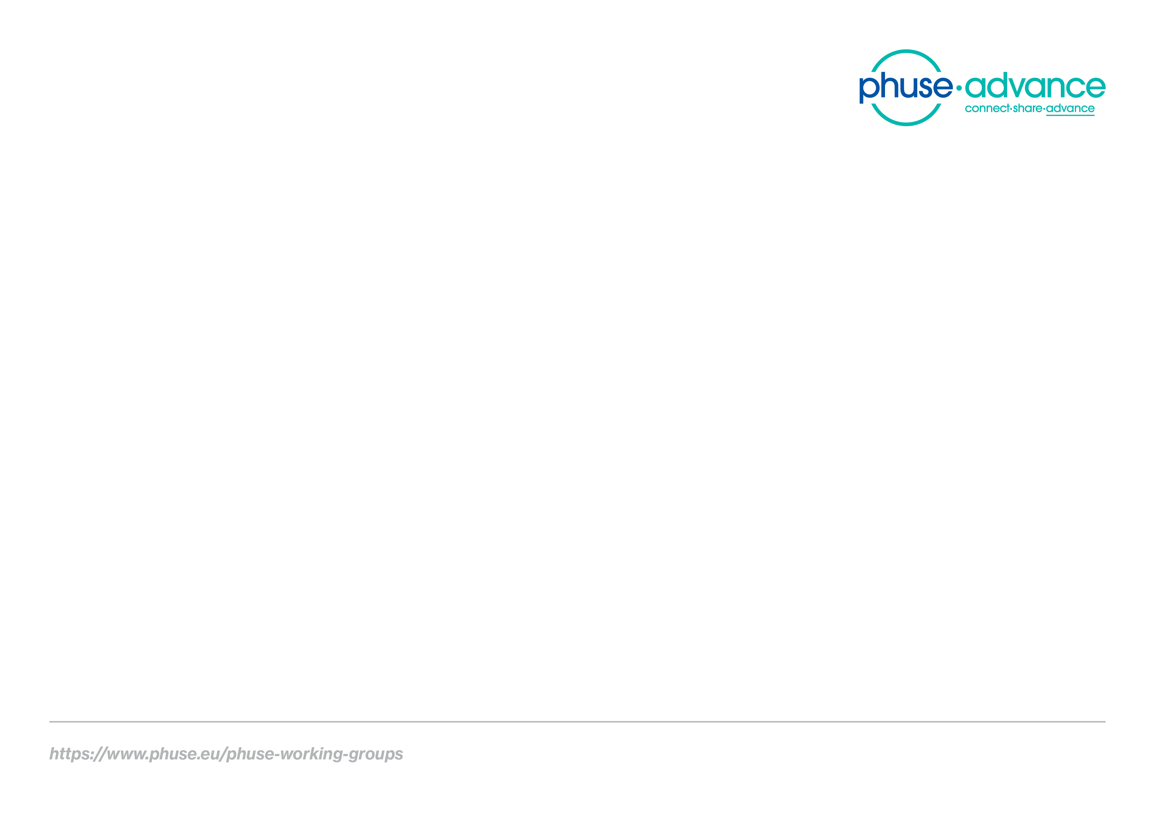
Study Data Validation & Submission Conformance
A PHUSE Linked Data Project
Emerging Trends & Technologies Working Group

Slide 2


Project Leads
Project Lead
- Tim Williams, UCB Biosciences
Ontology Development Consultant
- Dr. Armando Oliva, Semantica LLC (retired)

Slide 3
Project Collaboration
PHUSE
FDA (preclinical submissions)
Academia (pending/TBA)

Slide 4
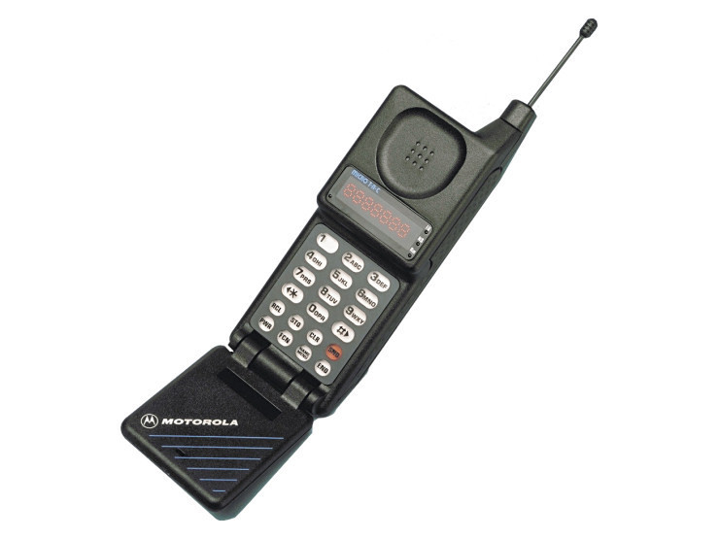
Challenges
File format from late 1980’s
Data modelled to industry standards in row-by-column structures
FDA Submissions: 32% conformance issues* (2016-2018)
* “Update on Technical Rejection Criteria for Study Data”.
- Ethan Chen, CDER. 3 April 2019.

Slide 5

Our Approach
Model the Study Entities and Relations
Study
Subject
Treat Arm
Knowledge Graph using Resource Description Framework (RDF)

Slide 6

Study Data Validation
FDA Validation Rules
SHApes Constraint Language (SHACL)

Slide 7
Submission Conformance
Format and Content Completeness
FDA Standards Catalog
Increase automation of:
Submission metadata collection
Data validation
Collaboration with Academia (TBA!)
F.A.I.R. (Findable, Accessible, Interoperable, Reusable)

Slide 8
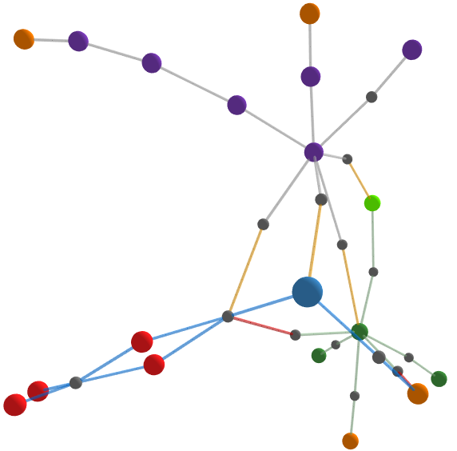
I. Project Website
Report
Violation of rule:
Unique Subject ID
http://bit.ly/SENDConform
Data
SHACL

Slide 9
Data-centric Knowledge Graphs are the Future
Supports
Data Quality
Data Integration
Process Automation
Machine Learning
AI
....
Standards
Enterprise
Industry
Regulatory
Publishing,
Marketing...
Other data.
Study Data

Slide 10
Impact
Paradigm shift to data-centric approach
Higher data quality
Successful submissions
New insights
Faster delivery of therapies to patients

Slide 11

We need your help!
Project Co-lead: Ontologist with Clinical Experience
Protege, WebProtege
Linked Data, R, Python, Markdown...or want to learn!
Email us at:
workinggroups@phuse.eu

Slide 12

Thank you!

