Slide 1
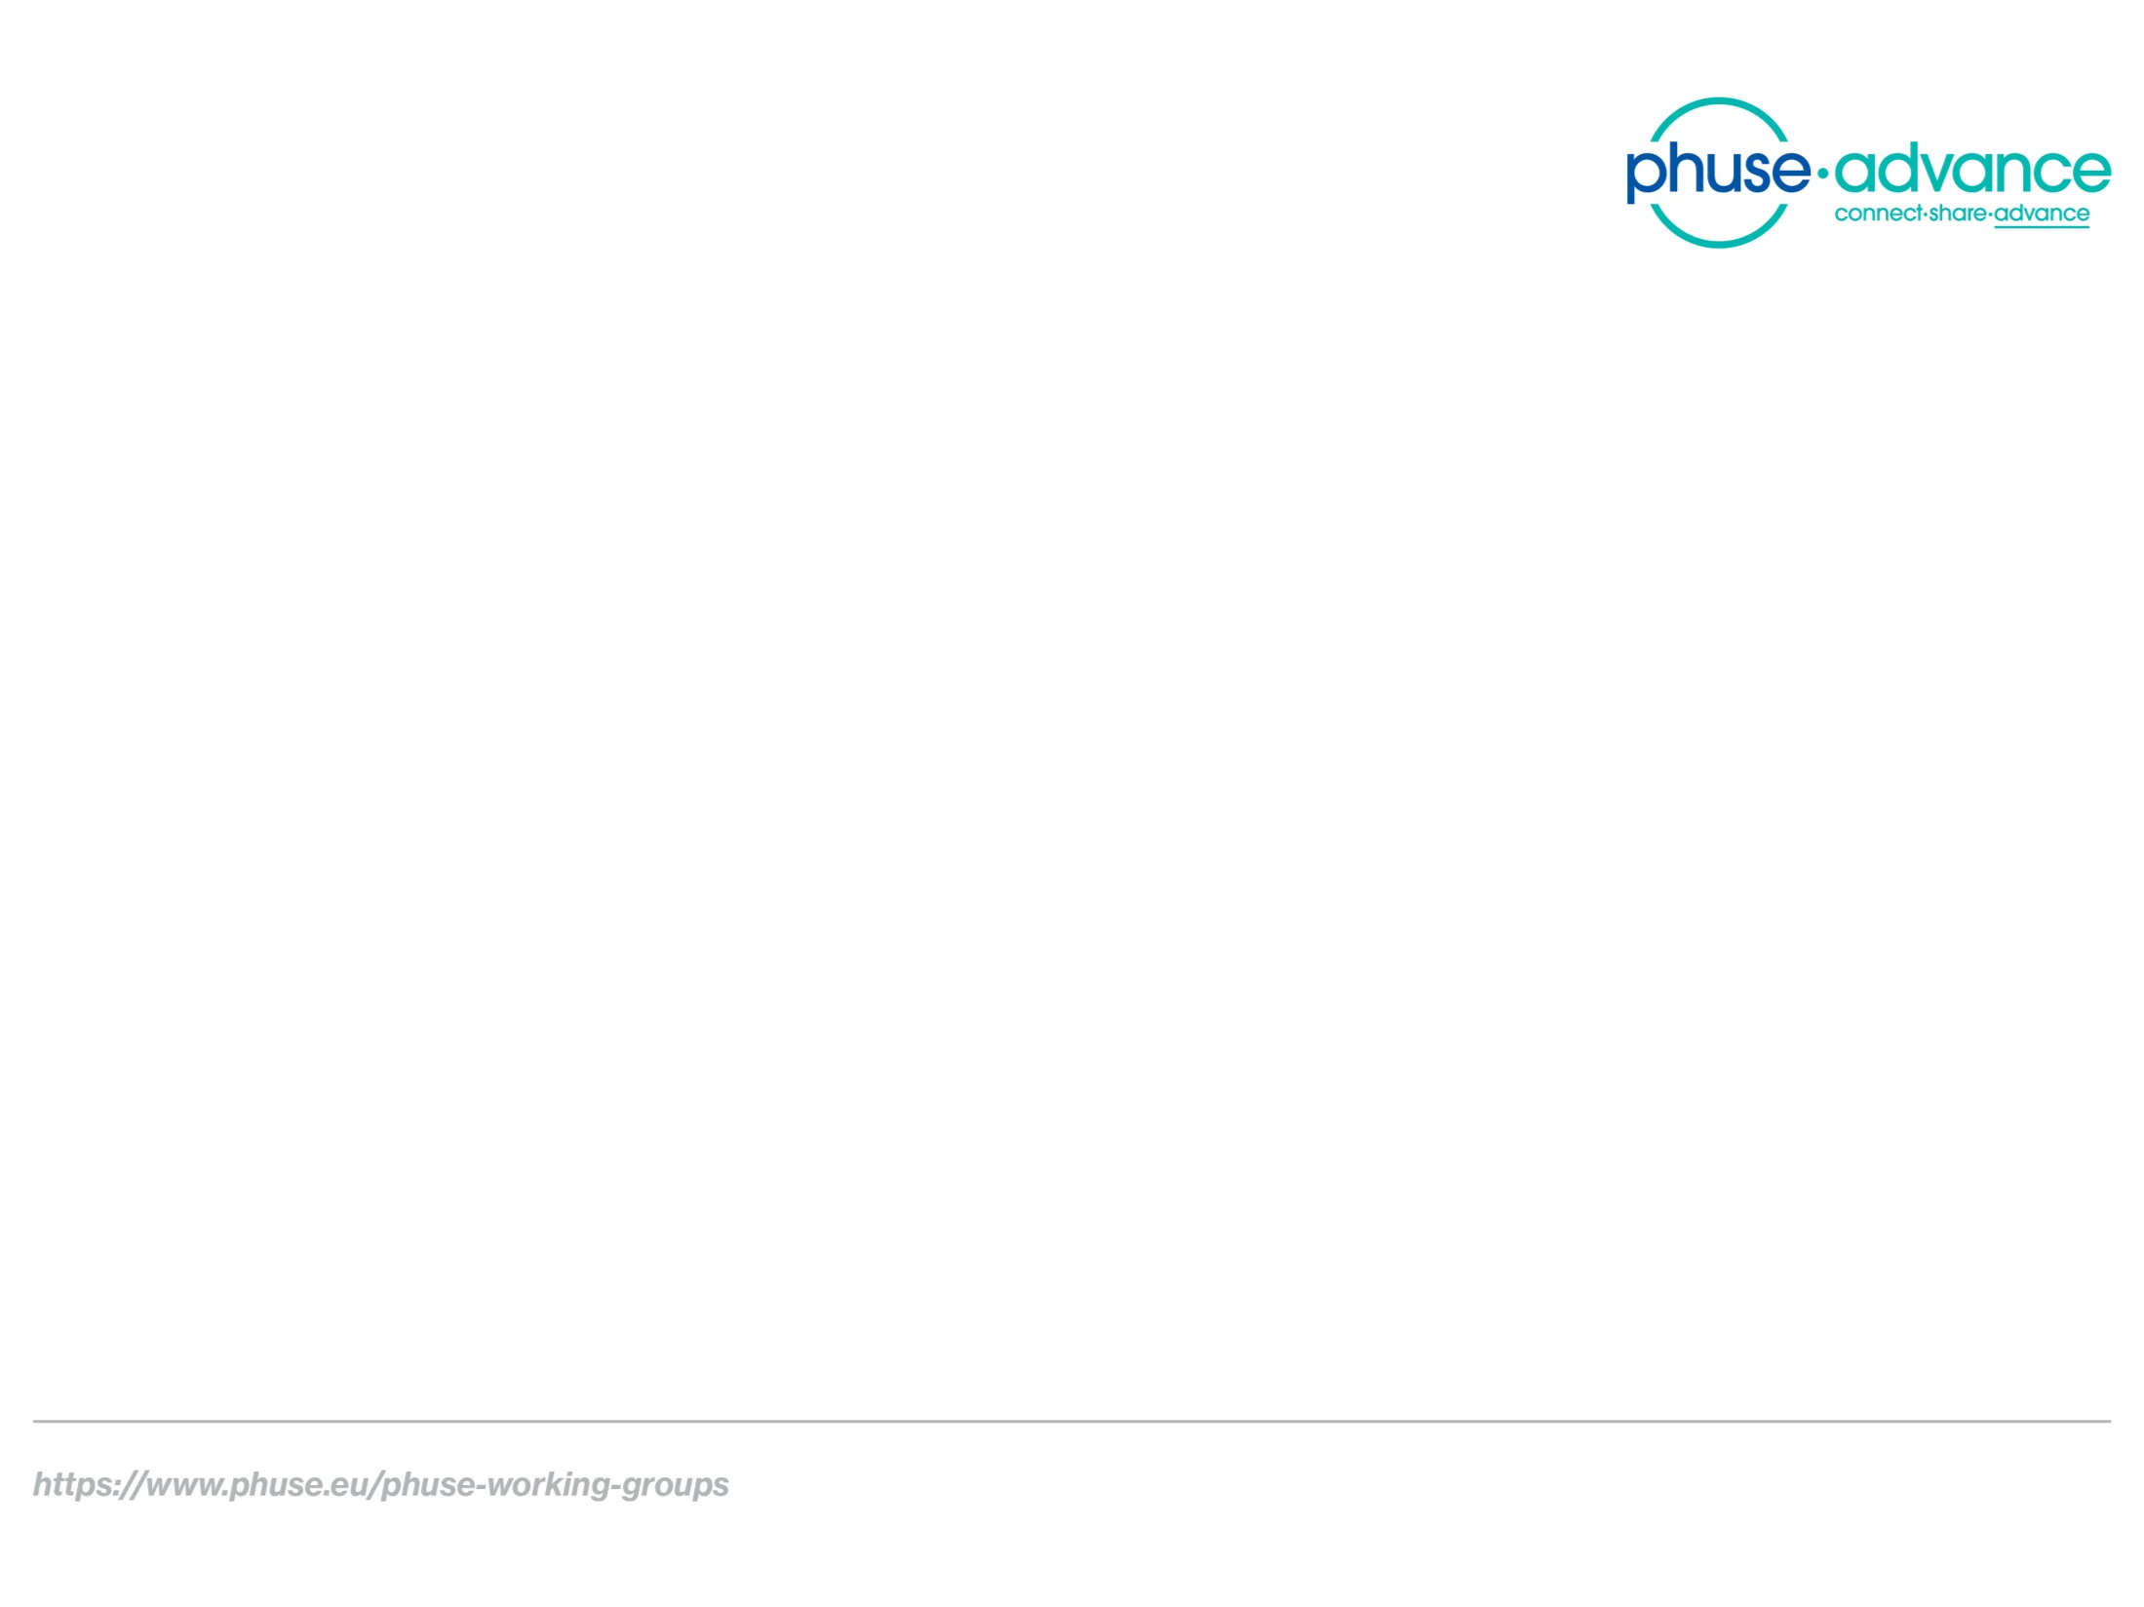
Study Data Validation & Submission Compliance
Team Meeting 2020-02-25

Slide 2

Agenda
Project Status (TW)
Improving Meetings (TW, all)
SHACL for USUBJID : A walk-though (TW)
Ontology Topics (AO)

Slide 3
1. Project Status
New title: “Study Data Validation & Submission Compliance”
Project Proposal: /SENDConform/doc/Misc
Out for review by Board of Directors, 27 Feb Meeting
Key components
Collaboration: FDA, Academia
Deliverables: Feb 2021
Data conversion scripts, SHACL
Ontologies
Technical Rejection Criteria Proof of Concept
Submission Metadata Collection Proof of Concept
Documentation and Resources (website)

Slide 4
2. Improving Meetings
How can we make these meetings more productive?
What do you need to start contributing to the project?
Suggestions
“Getting Started” guide?
Updated description of project structure by topic

Slide 5
3. SHACL for USUBJID – a walk-through
Recent revisions to the documentation and data conversion process.
Documentation at:
https://phuse-org.github.io/SENDConform/send_shacl_shapes.html

Slide 6
4. Ontology Topics

Slide 7
5. Other topics
US2TS Conference (Raleigh, NC) Lightning Talk. 9-11 March
1 slide, 2-minutes.
Project Overview
Semantics 2020 (Austin, TX) . April 20-23.
Attendees?
Other?

