Slide 1

Going Translational with Linked Data (GoTWLD)

Slide 2

Going Translational with Linked Data (GoTWLD)
2019-02-08

Slide 3
Agenda
Project Introduction and Goals
Sub-teams
Housekeeping
Conference Planning

Slide 4



Going Translational With Linked Data
Project
Co-leads
Tim Williams
Statistical Solutions Lead
UCB Biosciences
Dr. Armando Oliva
Medical Informatics Consulting
Semantica LLC
Drashtti Vasant
R&D IT Business Partner
Translational Sciences at Bayer Business Services

Slide 5
Project Philosophy
Model the concepts represented in SDTM
Map instance data to the graph model
Re-use where possible

Slide 6
Modeling and Data Conversion
Clinical Trials Data as RDF
COMPLETED
2019-02
DM
SUPPDM
EX
VS
TS
AE
Controlled Terminology
Study
Protocol
Going Translational With Linked Data
DM
SUPPDM
EX
VS
TS
AE
?
?
+SEND
+SEND
+SEND
+SEND
+SEND
+SEND
+SEND
+SEND
Controlled Terminology
Study
Protocol
+SEND
+SEND
+SEND

Slide 7
Deliverables
Objective | Timeline
Project Initiation | February 2019
Supporting Ontologies | PhUSE CSS 2020
Instance Data, Define XML | PhUSE CSS 2020
Presentations | PhUSE CSS 2019, 2020 PhUSE EUConnect 2019
Conclusion | PhUSE CSS 2020

Slide 8
Team Meetings
1 hour General Team Meetings
Every 2 weeks
Ontology “Deep Dive”
Alternate weeks
Meetings are recorded, Teamwork site
New Members – Introduce yourself when ready

Slide 9
Sub teams
Ontology Deep Dive (AO, alternate Mondays)
Non-Clinical (DV)
DefineXML (IA, HT)
Data Derivation (TW)

Slide 10
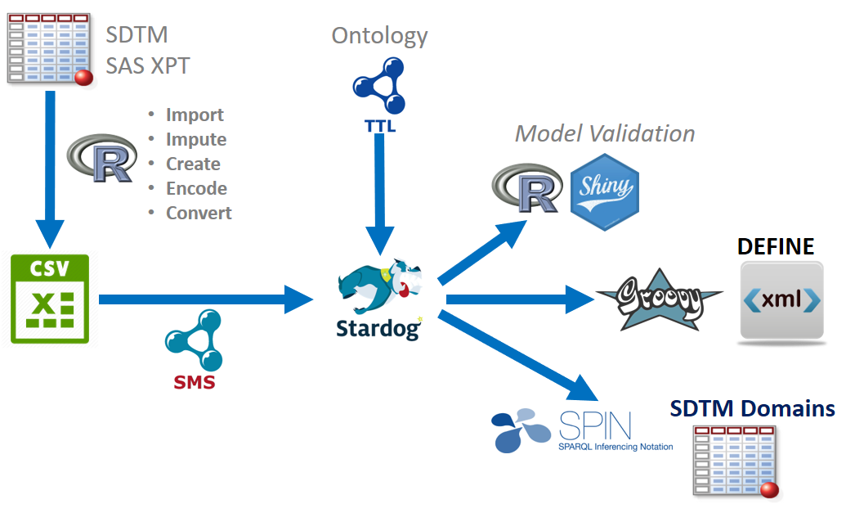

Slide 11
Related Initiatives
SPARQL Endpoint for Project Data
Query data online, from your desktop
MedDRA Modeling and Conversion Process
(next meeting?)
Study URI
https://github.com/phuse-org/LinkedDataEducation/blob/master/doc/StudyURI.md

Slide 12
Housekeeping
Teamwork Membership Confirmations
Wiki updates (LW?)
GitHub Repository
Keep name, clone to new?
https://github.com/phuse-org/CTDasRDF

Slide 13
CSS Planning
June 9-11 Silver Spring MD
Breakout session?
One or two days?
Topics for actual work
Linked Data Workshop

Slide 14
EU Connect Planning
Nov 10-13 Amsterdam
Call for papers is open!
We should (must!) present
“Going Translational With Linked Data”

Slide 15
Other news
CTDasRDF Summary to FDA (TW, 20 Mar)
Presentation at Semantics@Roche (TW, April)

Slide 16
Time Permitting
Rules in Stardog
Plans and testing?
Other topics?

Slide 20
MedDRA .asc files
High Level
Group Term (HLGT)
hlgt.asc
System Organ
Class (SOC)
soc.asc
Lowest Level Term (LLT)
llt.asc
Preferred Term (PT)
pt.asc
High Level Term (HLT)
hlt.asc
code
code
code
code
code
label
label
label
label
label
pt_code
soc_code
Key table
hlt_pt.asc
Key table
hlgt_hlt.asc
Key table
soc_hlgt.asc
hlt_code
hlgt_code
soc_code
pt_code
hlt_code
hlgt_code

Slide 21
MedDRA
High Level
Group Term (HLGT)
System Organ
Class (SOC)
Lowest Level Term (LLT)
Preferred Term (PT)
High Level Term (HLT)
General disorders and administration site conditions
Application and instillation site reactions
Administration site reactions
hasSOC
10018065
10003057
hasHLGT
10001316
hasHLT
10003047
hasPT
10003053
10022117
hasSOC
Application site itching
Application site pruritus
Injury, poisoning, and procedural complications
hasHLT
hasHLGT
hasSOC
10049293
10014982
10040785
Pruritus NE C
Epidermal and dermal conditions
Skin and subcutaneous tissue disorders

