Slide 1

General Team Meeting
2019-11-18

Slide 2
Agenda
Updates from PhUSE EUConnect19
Sub-project Status
MedDRA as RDF
Linked Data URIs
SEND Conformance
General Discussion
* Conservative estimates

Slide 3
Updates from EUConnect19

Slide 4
EUConnect19
Poster: Linked Data URIs
Poster session well-attended.
Good general discussion
Wikidata
NEW: W3C draft: Decentralized Identifiers
https://w3c.github.io/did-core/
Potential for Distributed Ledger Technology to overcome the need for centralized curation of Study URIs.

Slide 5
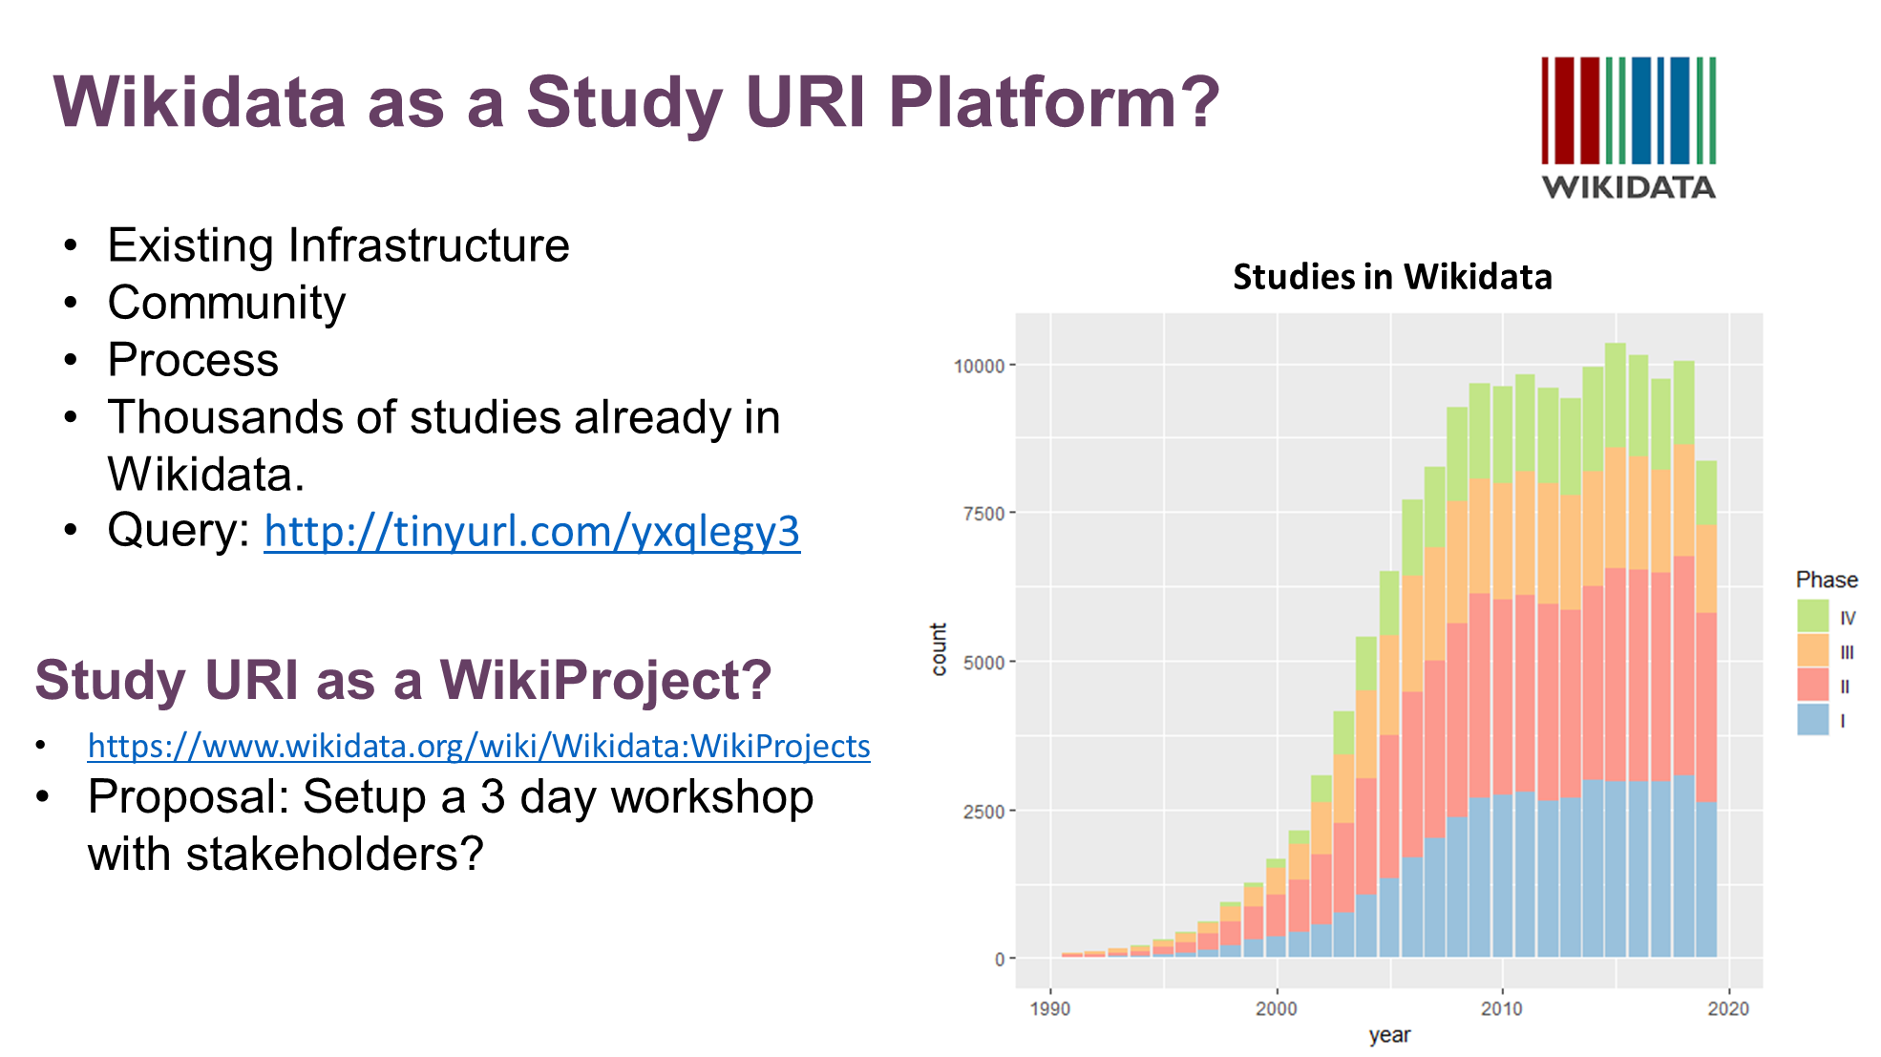

Slide 6
EUConnect19
Poster: Linked Data URIs
NEW: W3C draft: Decentralized Identifiers
https://w3c.github.io/did-core/
Potential for Distributed Ledger Technology to overcome the need for centralized curation of Study URIs.

Slide 7
EUConnect19 - Papers
"Deconstructing SDTM – Starting Again." – Ulander Best in Stream for ET&T
“Linked Data: Introduction and Deep Dive” – Depuis
“Building a F.A.I.R. Foundation for Pharmas” - Williams

Slide 8
Sub-project 1: MedDRA as RDF
MedDRA terminology as RDF
Much work already accomplished
Work available on GitHub
https://github.com/phuse-org/MedDRAasRDF
TO DO:
Documentation updates
SAS and R method details
Example queries that use new EP [To be created]

Slide 9
Sub-project 2: Identifiers for Pharma
Creation and Use of Linked Data IRIs for Pharma
Poster for EU Connect
Team needs to re-convene after hiatus
Work is on GitHub
https://github.com/phuse-org/UIDPharma
Next Steps?

Slide 10
Sub-project 3: SEND Conformance
Automating manual conformance checks using TS and DM domains.
Develop from SDTM TS, DM work
Cooperation with FDA
Available on GitHub:
https://phuse-org.github.io/SENDConform/

Slide 11
Collaboration Project
Stanford
Leverage existing CEDAR work?
NLM data cataloging, GO-FAIR?
How support F.A.I.R. for Pharma
Support Protege development?
FDA/PHUSE
Build out the FDA use case
Metadata for submissions?
Templates based on metadata requirements?
How support FDA analysis?

Slide 12
Collaboration Project
Is this a new project?
Yes.
How Support?
Project Proposal to PHUSE CSS Steering Committee
Project Leads
Project Team members (PhUSE, FDA, Stanford)
Slide from AO

