Slide 1
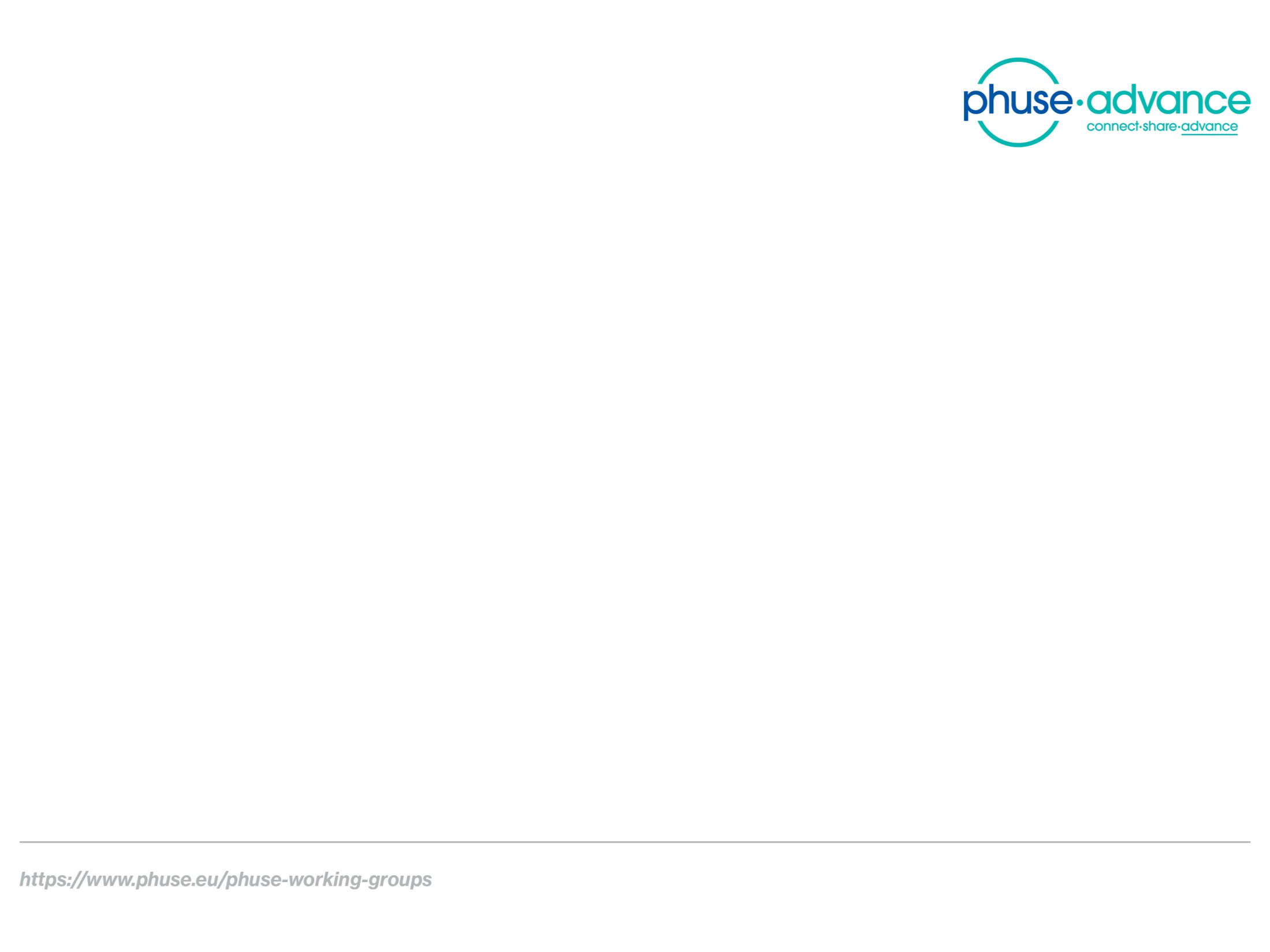
Study Data Validation & Submission Compliance
Team Meeting 2020-02-25

Slide 2

Agenda
Project Status (TW)
Improving Meetings (TW, all)
SHACL for USUBJID : A walk-though (TW)
Ontology Topics (AO)

Slide 3
1. Project Status
New title: “Study Data Validation & Submission Compliance”
Project Proposal: /SENDConform/doc/Misc
Key components
Collaboration: FDA, Academia
Deliverables: Feb 2021
Data conversion scripts, SHACL
Ontologies
Technical Rejection Criteria Proof of Concept
Submission Metadata Collection Proof of Concept
Documentation and Resources (website)

Slide 4
2. Improving Meetings
How can we make these meetings more productive?
What do you need to start contributing to the project?

Slide 5
3. SHACL for USUBJID – a walk-through
Recent revisions to the documentation and data conversion process.
Documentation at:
https://phuse-org.github.io/SENDConform/send_shacl_shapes.html

Slide 6
4. Ontology Topics

Slide 7
5. Other topics
Project Overview : US2TS Conference, 2-minute Lightning Talk
9-11 March
Semantics 2020 (Austin) : April 20-23. Attendees?
Other?

