Slide 1
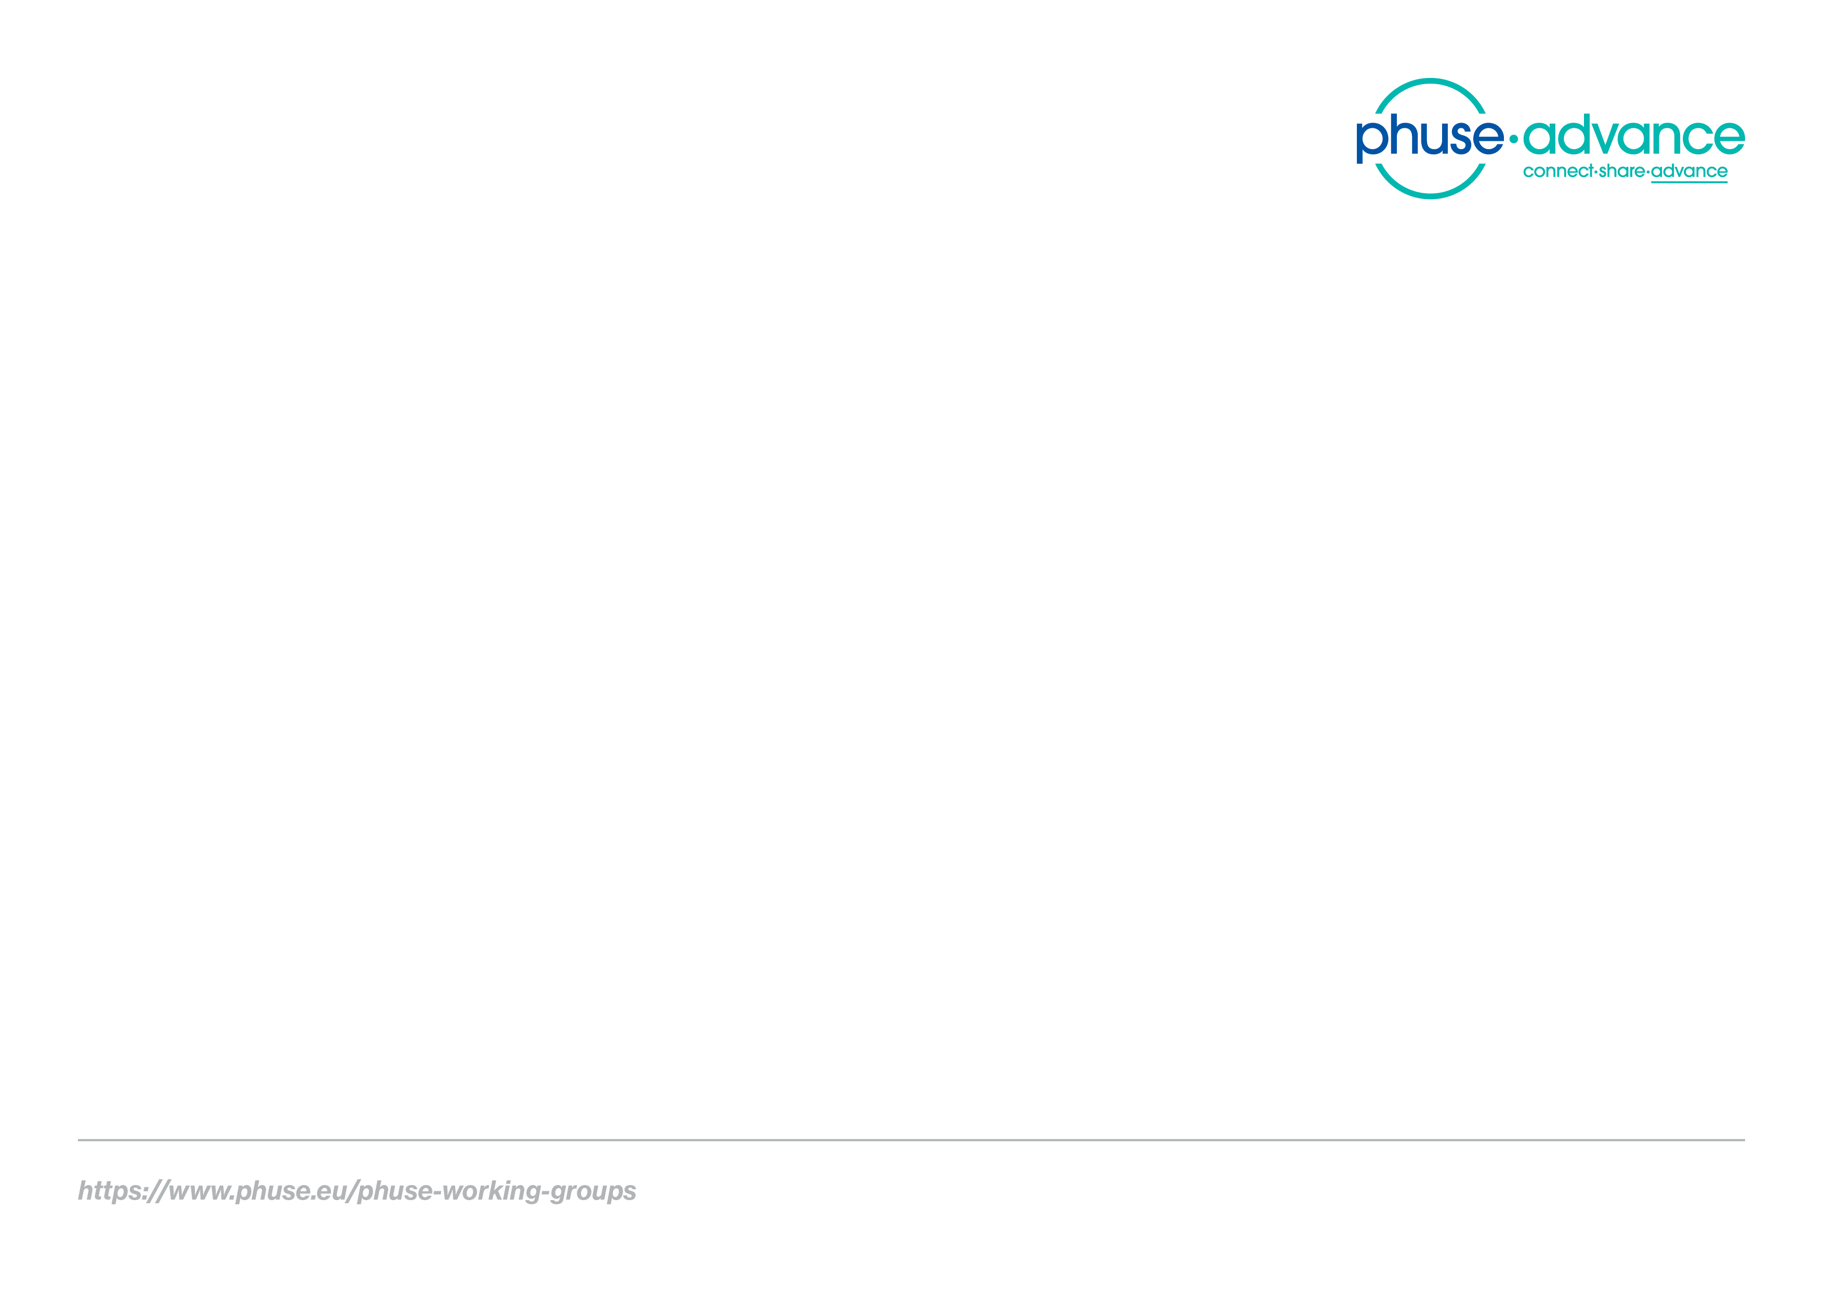
Study Data Validation & Submission Conformance
A PHUSE Linked Data Project
Emerging Trends & Technologies Working Group

Slide 2


Project Leads
Project Lead
Tim Williams, UCB Biosciences
Ontology Development Consultant
Dr. Armando Oliva, Semantica LLC (retired)

Slide 3
Project Collaboration
PHUSE Working Group Project Team
FDA (preclinical submissions)
Academia (pending/TBA)

Slide 4
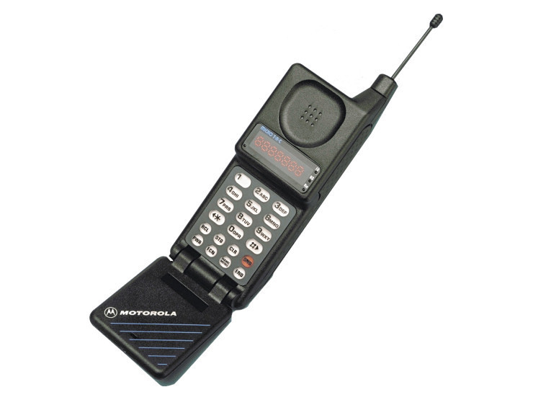
Challenges
File format from late 1980’s
Data modelled to industry standards in row-by-column
FDA Submissions: 32% conformance issues (2016-2018)

Slide 5
A Unique Approach
Model the Study: Entities and Relations
Study
Subject
Treat Arm
Knowledge Graph using Resource Description Framework (RDF)

Slide 6

A Unique Approach
Model the Study: Entities and Relations
Study
Subject
Treat Arm
Knowledge Graph using Resource Description Framework (RDF)

Slide 7

Study Data Validation
FDA Validator Rules
SHApes Constraint Language (SHACL)

Slide 8
Submission Conformance
Format and Content Completeness
FDA Standards Catalog
Automation of:
Submission metadata collection
Data validation
Collaboration with Academia (TBA!)
F.A.I.R. (Findable, Accessible, Interoperable, Reusable)

Slide 9
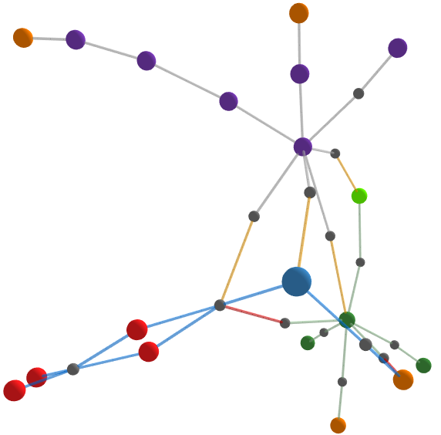
I. Project Website
Report
Violation of rule:
Unique Subject ID
http://bit.ly/SENDConform
Data
SHACL

Slide 10
Data-centric Knowledge Graphs are the Future
Standards
Supports
Data Integration
Process Automation
Machine Learning
AI
....
Enterprise
Industry
Regulatory
Publishing,
Marketing...
Other data.
Study Data

Slide 11
Impact
Paradigm shift to data-centric approach
Higher data quality
Successful Submissions
New Insights
Faster therapies to patients

Slide 12

We need your help!
Project Co-lead: Ontologist with Clinical Experience
Protege, WebProtege
Linked Data, R, Python, Markdown...or want to learn!

Slide 13

Thank you!

