Slide 1
Gray-Zone Maritime Control in the First Island Chain
A networked escalation game | Workshop 1
Sean Bowman, Tate Murphy, Matthew Newell
Notes:
(~30 s) We study day-to-day U.S.-China competition for control of the waters inside the First Island Chain, below the threshold of war. We built it as a game on a network. Today: the model, the prototype, and first results on three research questions.

Slide 2
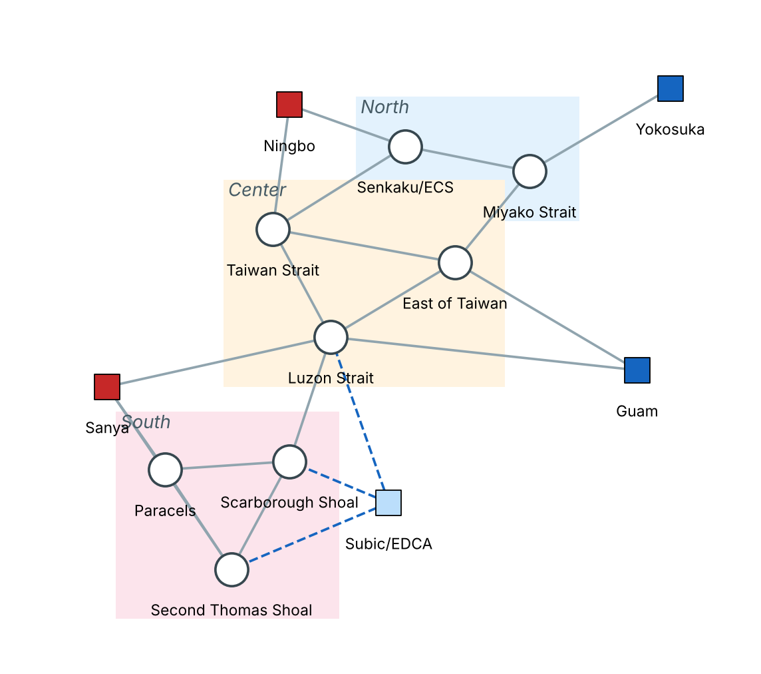
The problem: control without war
Players. Blue: 10 U.S. destroyers (DDG). Red: 8 navy ships (PLAN) + 6 coast guard / militia hulls (CCG).
Each period (2 days). Each side chooses where its ships go and whether to patrol (P) or assert (A: shadowing, close maneuvering, querying and warning; for the U.S. also freedom-of-navigation operations).
Control of a zone follows the local force ratio, so each side's best move depends on the other's.
Incidents can happen when both sides are present, and are likelier if someone asserts. Incidents raise an escalation level; at the top is war, which costs both sides.
Fog. Neither side sees the other's entire fleet disposition; only forces present where they also maintain forces. Storms can close zones.
Network of 8 contested zones and 4 home ports
Notes:
(~60 s) China claims most of the South China Sea and contests the Senkakus, pressing those claims with coast guard and militia hulls backed by navy ships; the U.S. keeps the seas open with destroyers on presence and freedom-of-navigation patrols (Helmus 2024; Green 2017). Squares are home ports, circles are the eight contested zones, grouped North, Center, South. Dashed lines are the extra Philippine port, one of our redesigns. Three things make this a game rather than a single optimization: control is relative, so my best move depends on yours; escalation risk is shared, because incidents need both sides present and war costs both; and neither side sees the other's full fleet, only the ships where it also has ships.

Slide 3
Research questions and what changed since the proposal
RQ1
Control vs. war risk
Each side caps how much incident risk it will accept each period (its risk budget ε). How much more control does a side gain by accepting more risk, how much more likely does war become, and what risk level does each side pick when it knows the other side is picking too?
Feedback | What we did
Model too high level | Formal game on a graph
Q1 is a feasible region, use a MIP | Best response is an exact MIP; commander types become risk budgets ε
More ambitious questions | Budget-game equilibrium (RQ1), equilibrium play (RQ2), robustness and redesign (RQ3)
Define the resilient redesign | Three Blue designs
Propose values for missing data | Assumed values, listed in the report
Show preliminary results | Analytical results; 77 setups × 200 simulated games
Add weather (Prof. Sapsis) | Weather scenarios; expected and worst-case payoff
RQ2
Game theory vs. rules of thumb
Does planning with game theory (best responses, equilibrium or maximin plans) beat simple rules or random moves? Can both sides stay at patrol over many periods, because asserting once would end the truce and push both into riskier play from then on?
RQ3
Weather and redesign
Does the plan or Blue redesign that works best in normal weather still work best across calm, typhoon and extreme weather scenarios, both on average and in the worst scenario?
Notes:
(~60 s) Three questions. RQ1: each side caps the incident risk it accepts per period; how much control does more risk buy, how much likelier does war become, and what cap does each side pick when the other is picking too? RQ2: does a side that plans with game theory beat one that follows simple rules, and can both sides stay at patrol over many periods, because asserting once would end the truce and push both into riskier play from then on? RQ3, from Prof. Sapsis's comment: does the best plan or Blue redesign in normal weather stay best across calm, typhoon and extreme weather scenarios, on average and in the worst scenario? The table maps each piece of Deliverable 1 feedback to what we changed. The main one: the model is now fully formal, and the proposal's strategy types are a single risk-budget number inside a MIP.

Slide 4
The game, one period at a time
1
The weather (sea state) of each region is drawn
Control of zone v
c ← (1 − λ)·c + λ·φ, λ = 0.3, φ = (S_B − S_R) / (S_B + S_R + κ)
Presence builds control slowly; leaving lets it decay.
Incident chance
h = (h₀ + h_A·[asserts]) · min(S_B, S_R) · (1 + ℓ/2), ρ = 1 − e^(−h)
Needs both sides present; grows with assertion and with the escalation level ℓ.
Payoff
g = Σ V·c − γ·moves − η·ℓ − ζ_D, minus W = 200 at war
Value of control minus fuel, tension and Blue's redesign cost ζ_D. War hurts both sides, so the game is not zero-sum.
2
Each side sees its own ships and detects some enemy ships
3
Ships low on endurance head home
4
Both sides choose moves and postures at the same time
5
Moves happen within movement budgets
6
Control updates; incidents are drawn; escalation level moves
7
Payoffs are paid; stop at war or after 60 periods
Takeaway Every rule is explicit, so the same game can be played thousands of times by different strategies.
Notes:
(~70 s) Walk the timeline top to bottom: this is one two-day turn. The weather is drawn first, then both sides move at the same time without seeing each other's full fleet. The box holds all the dynamics. Control moves 30% of the way toward the local force ratio each turn. Incidents need both sides present, and are likelier when someone asserts and when tensions are already high. Payoff is value of zones held minus fuel, tension, and for Blue the running cost of its redesign, zeta-D; war costs both sides 200, so the game is not zero-sum. If asked: every number is our assumption, listed in Table 1 of the report.

Slide 5
How the players decide
Best response as a MIP
Template game
Policies we compare
Each period, choose moves and postures to maximize value of control minus costs, subject to the movement budget, endurance, and an escalation-risk budget:
expected incidents ≤ ε
Abstract each side to 14 templates: how to split ships North / Center / South, and patrol or assert.
A 14×14 strategic-form game
Random moves | Rule of thumb
Quick best response (greedy)
Best response (MIP)
Nash equilibrium plan
Safety-first plan (maximin)
Conservative / moderate / aggressive = ε of 0.05 / 0.15 / 0.40
Solved with dominance, Nash equilibrium, maximin LP, correlated-equilibrium LP
Same random draws and weather for every policy
Takeaway The proposal's strategy types are now one number, ε, inside an optimization the course covered (Lecture 2).
Notes:
(~60 s) Two ways to decide. Left: each turn a player solves a MIP, the Lecture 2 tool, to pick moves, with a cap on expected incidents, epsilon. This answers the feedback that Q1 is a feasible region. Middle: for equilibrium analysis we shrink each side to 14 templates and solve the 14-by-14 game exactly with the Lecture 3-4 tools. Right: the six policies we compare. All of them see the same random draws.

Slide 6
Small example: when does it pay to assert?
Blue \ Red | Red patrols | Red asserts
Blue patrols | 0 , 0 | −9.6 , +1.2
Blue asserts | +0.3 , −10.5 | −11.4 , −11.3
Best reply: assert if the other patrols, patrol if the other asserts. Two pure equilibria, plus a mixed one with mutual assertion 8% of the time.
A mediator helps: the best correlated equilibrium never recommends (assert, assert). A hotline can play that role.
Repetition helps: with grim trigger, mutual patrolling is a subgame perfect equilibrium for any discount factor above 0.18. Ours is 0.98.
Payoffs (Blue, Red) with force splits fixed, relative to both patrolling
Takeaway Restraint is not stable in a one-shot encounter, but it can be sustained by repeated play or a coordination device.
Notes:
(~70 s) A small example from our own game. Fix where ships go; each side only chooses patrol or assert. Read the table: asserting against a patroller pays a little, but if both assert, both lose more than 11. So the best reply is to do the opposite of the other side, like the shared-compute example in Lecture 3. Two fixes: a correlated equilibrium, which is what a mediator or hotline can implement, never recommends both asserting; and in the repeated game, grim trigger (both patrol; after any assertion, both switch to the mixed equilibrium for good) makes mutual patrolling a subgame perfect equilibrium whenever the discount factor is above 0.18. Ours is 0.98.

Slide 7
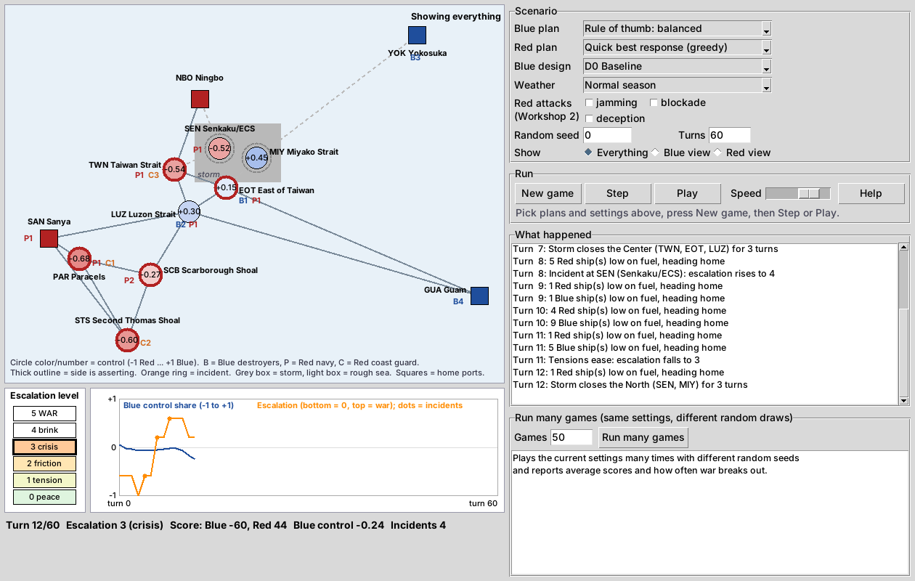
The prototype: watch a game play out
Pick a plan for each side, a design and the weather on the right; press New game, then Step or Play. Help explains the map.
Zone color shows control: blue = Blue, red = Red.
B / P / C = destroyers, navy ships, coast guard. Thick outline = asserting.
Orange ring = incident. Shaded region = rough sea or storm.
Run many games plays the same setup as many simulated games and reports averages.
Notes:
(~60 s, or a 60 s live demo) This is the prototype. Pick a plan for each side, a design and the weather, then Step or Play. Zone color is who controls it. Letters count ships. Thick outlines mean asserting, an orange ring is an incident, shading is bad weather. Bottom left is the escalation ladder; level 5 is war. 'Run many games' gives averages. The screenshot is turn 12 with a storm over the North. The same file runs batch experiments; a second script reproduces every number in the report.

Slide 8
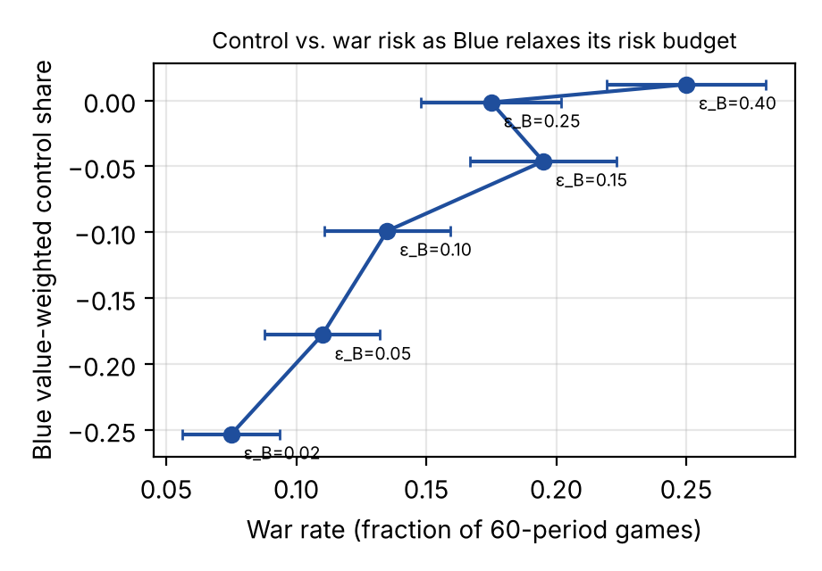
RQ1: more risk buys control, up to a point
Blue \ Red | Conservative | Moderate | Aggressive
Conservative | −194, 199 war 10% | −303, 315 war 11% | −308, 318 war 12%
Moderate | 18, −36 war 15% | −144, 101 war 20% | −192, 140 war 21%
Aggressive | 74, −80 war 14% | −83, 16 war 25% | −151, 39 war 34%
Risk-budget game: payoffs (Blue, Red) and war rate. Red bold = the only equilibrium.
Raising Blue's budget from 0.02 to 0.15 lifts its control a lot; beyond 0.25 it barely moves.
Takeaway Both sides choose aggressive, giving the highest war rate (34%): a prisoner's dilemma.
Notes:
(~60 s) Left: Blue loosens its risk budget while Red stays moderate. Control rises fast up to about 0.15, then flattens, while war risk keeps rising. Right: both sides choose a budget. Aggressive is the best reply to anything, for both, so the only equilibrium is aggressive-aggressive, with the highest war rate, 34%. That is a prisoner's dilemma, Lecture 3. Restraint has to come from repetition or coordination, as in the previous example.

Slide 9
RQ2: the Nash equilibrium plan is the safest bet against any Red
Nash equilibrium plan has the best worst case (−116) and half the war rate of the MIP best response against the same opponent (10% vs 20%).
Best responses (quick and MIP) win against weak opponents but escalate more.
Safety-first plan is the most cautious (war ≤ 8%) but gives up the most control.
Quick vs MIP: the quick heuristic matches the MIP 67% of the time but breaks the risk budget 14% of the time.
Notes:
(~60 s) Each Blue policy plays three Red policies, 200 games each; the bar is Blue's payoff against its worst opponent. The Nash equilibrium plan has the best worst case, and half the war rate of the MIP best response. Best responses do well against weak opponents but escalate. The safety-first plan is cautious but gives up control. Differences under about 20 points are within noise.

Slide 10
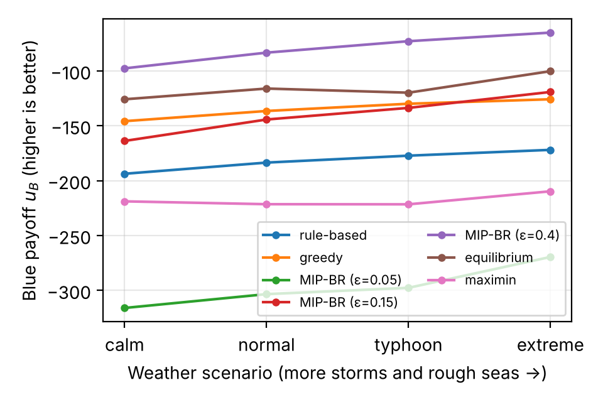
RQ3: the best strategy holds up in bad weather
War rate (normal weather): D0 20%, D1 28%, D2 23%, D3 5%. The hotline was given no cost yet.
Rough seas weaken Red's coast guard hulls and storms pause operations, so most policies do slightly worse in calm seas. The top two plans stay on top in every scenario.
Takeaway The plan that is best on average is also best in the worst weather. The crisis hotline is the best design and cuts war about 4×.
Notes:
(~70 s) Robustness in the Lecture 1 sense: expected payoff over the four weather scenarios, and worst case. Left: the policy ranking does not change across weather; the top two plans stay on top. Bad weather slightly helps Blue here, because rough seas weaken Red's coast-guard hulls. Right: of the three redesigns, the crisis hotline is best on average and in the worst case, and cuts war about four times. Caveat: we gave it no cost yet, and it also helps Red, so it is a joint gain.

Slide 11
What the evidence does and does not show
Supported
Not yet shown
Loosening the risk budget has sharply diminishing returns
Left alone, both sides loosen their budgets (prisoner's dilemma)
Restraint can be an equilibrium of the repeated game
The Nash equilibrium plan is the most robust Blue policy here
A crisis hotline is a joint gain under every weather scenario
All numbers are assumptions, not calibrated to data
Policies look only one period ahead
War penalty may be too small: the top-payoff policy also has the most wars
The hotline has no cost yet, so part of its win is built in
Differences under about 20 payoff points are ties
Notes:
(~45 s) Be direct about limits. Left is what the runs support. Right is what they do not: values are assumptions, policies look one turn ahead, the war rate depends heavily on a few parameters, and the hotline result is partly built in. A sensitivity sweep is the first item for Workshop 2.

Slide 12
Plan for Workshop 2
Nov 3
Nov 17
Dec 1
Dec 8
Beliefs and attacks
Learning
Redesign
Report
Bayesian beliefs about enemy positions; weather tied to the calendar (typhoon season, winter monsoon) with odds from climatology data; test the three coded Red attacks (blockade, jamming, false contacts); decide whether to keep the movement budget or drop it
Red agents that learn from experience: do they exploit predictable Blue play? An attacker that moves after seeing Blue
Designs and combinations under attacks, persistent weather and a rare long typhoon; hotline as a mediator
Final report and presentation
Takeaway Each step follows the remaining course modules: learning, attacks and defenses, resilient design.
Notes:
(~45 s) Workshop 2 follows the remaining course modules. First, Bayesian beliefs, weather scenarios tied to the calendar with odds from climatology data, and the three Red attacks already coded; we also decide whether to keep the theater-wide movement budget, which stands in for operational requirements and station-keeping. Then learning agents, once taught: does a learning Red exploit predictable Blue play? Then redesigns under attack and long typhoons, with a cost for the hotline. Final report December 8. Thank you; happy to take questions.

