Slide 1
Workshop Persistens
Developed by group 6

Slide 2
Western Style Ltd.
Company established in 1983 by Hanne and Børge Pedersen. Over the last 26 years it has grown to a fully functioning company with 8 employees. Still only uses MS Office and Business Solution C5, but are ready for implementation of new system.
The idea of this business arose when there was difficulties finding stylish cowboy costumes for the dancers.

Slide 3
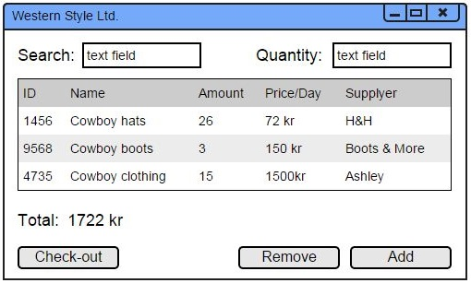
Mock-up

Slide 4
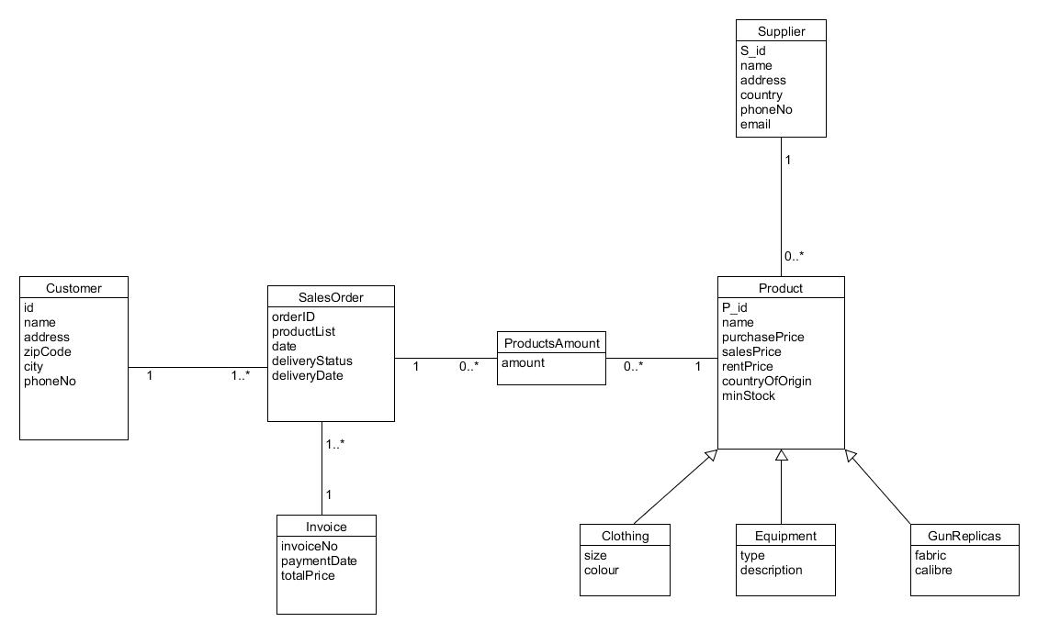
Domain model

Slide 5
Fully dressed use case
Use case name | Order processing
Actors | Employee
Pre-conditions | Customer is registered; Products exist
Post-conditions | Order accepted
Frequency | Approx. 10 times per day
Main Success scenario (Flow of events) | Actor (Action) | System (Response)
 | 1. Employee enters customer ID | 2. Checks whether customer exists, shows customer information and system creates order
 | 3. Enters items ID and their amount | 4. System adds items to the order
 | 5. Employee ends the order | 6. System saves the order, creates an invoice, calculates the total price and shows information
Alternative flows | 2.A) Customer does not exist. Employee creates customer.
 | 3. & 4. Action will be repeated for each item

Slide 6
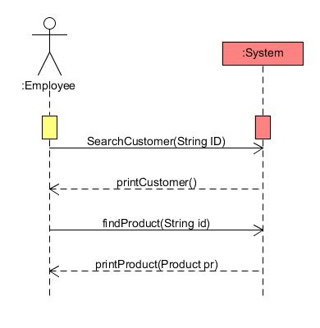
System sequence diagram

Slide 7
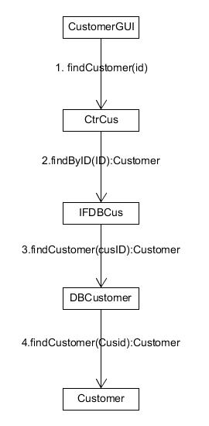
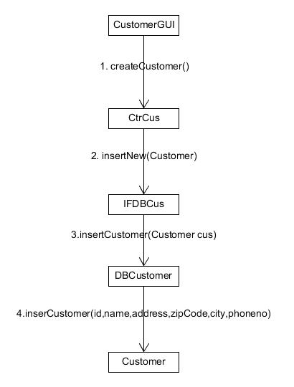
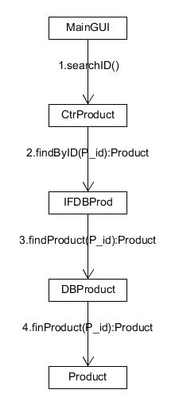
Interaction diagrams

Slide 8
Relational model
Customer
SalesOrder
c_id | cname | caddress | czip_code | ccity | cphone_no
3579 | Karolis | vesterbro | 9000 | aalborg | 52346422
1596 | Aistis | vesterbro | 9000 | aalborg | 52365489
9865 | Alex | vesterbro | 9000 | aalborg | 52624289
o_id | odate | cid | oDelStatus | oDelDate | inNO
1234 | 2015-05-13 | 3579 | null | null | 1
1235 | 2015-05-14 | 1596 | null | null | 2
1236 | 2015-05-15 | 9865 | null | null | 3
Invoice
Supplier
inNo | inPayDay | price | oid
3 | null | 200 | 1236
2 | null | 100 | 1235
1 | null | 400 | 1234
sName | sAddress | sCountry | sPhone | sEmail | s_id
Patrick | Hobrovej | Denmark | 123456 | c@d.dk | 501
Anthony | Nibevej | Germany | 654321 | a@b.dk | 502
George | Letvadvej | Norway | 987654 | fg@k.dk | 503
Products Amount
p_id | amount | order_id
7777 | 3 | 1234
332 | 50 | 1235
2222 | 1 | 1236

Slide 9
Relational Model
Product
pid | pName | purchaseP | sellP | rentP | pCountry | pMinStock | supplier_id | type
7777 | shirts | 10 | 35 | 5 | USA | 200 | 503 | Clothing
332 | shotgun | 50 | 175 | 20 | India | 100 | 501 | GunReplicas
2222 | flags | 100 | 350 | 40 | China | 50 | 502 | Equipment
8788 | vest | 33 | 110 | 15 | China | 50 | 503 | Clothing
9997 | jacket | 50 | 200 | 20 | India | 25 | 503 | Clothing
2221 | belt | 15 | 40 | 8 | Vietnam | 50 | 502 | Equipment
2233 | box | 66 | 220 | 24 | Korea | 25 | 502 | Equipment
331 | revolver | 150 | 350 | 60 | China | 65 | 501 | GunReplicas
333 | pistol | 120 | 300 | 50 | USA | 100 | 501 | GunReplicas

Slide 10
Relational Model
Clothing
Equipment
GunReplicas
size | colour | product_id
55 | red | 7777
60 | blue | 8788
45 | green | 9997
type | description | product_id
belts | pistol belts | 2221
flags | western flags | 2222
boxes | gift boxes | 2233
fabric | calibre | product_id
plastic | 12mm | 331
metal | 9mm | 332
plastic | 6mm | 333

