Slide 1
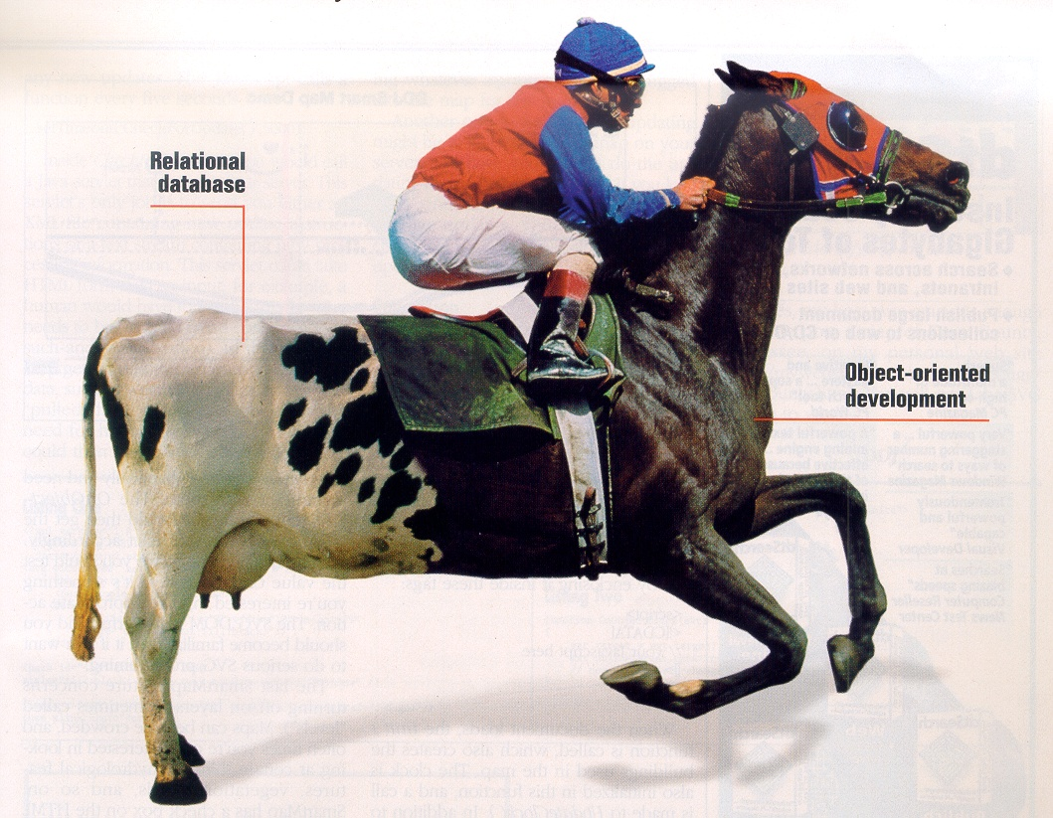

Slide 2
ILO: Intended Learning Outcome
During the workshop you should achieve the following:
Being able to design a database which satisfies the demands for good design
Being able to build a system with a good architecture
Being able to produce SQL-scripts to creation of a database, along with insertion of data
Being able to access the database from the Java-code and document it by making interaction diagrams

Slide 3
Schedule:
Day 1 Introduction to the assignment
Start working at the assignments.
Dag 2 Working with the assignments
Working papers about domain model, relational model are to be reviewed
Day 3 Work with the assignments
Day 4 Working with the assignments
Day 5 Hand in of one document at no later than 16.00 in wiseflow
Supervisors (GIBE) and (KBHA) will be available most days.
Evaluation on the (27.3) – 40/30 minutes to each group

Slide 4
Documentation
Mock ups
Fully dressed use-case description for order processing, interaction diagram and other relevant documentation for that use-case.
Interpretations of the domain model and maybe an modified model.
Description of the relational database design.
SQL scripts for creation of the database.
SQL scripts for insertion of data into the database.
Link and version no to your final Eclipse project.
The documentation must be in one document (word or pdf).

Slide 5
The case
Western Style was established in 1980 by Hanne and Børge Pedersen. The company consists of one store which is located in Viborg and furthermore the company attends festivals, markets and concerts where they promote their range of products. The concept of the company arose when Hanne and Børge attended square dance lessons and found it difficult finding stylish cowboy clothing for the dancers. First they started importing clothing only but later on also many other western related items. In the year 2000 the company was turned from a single man company into a private limited company with a stock capital of DKK 500.000,-

Slide 6
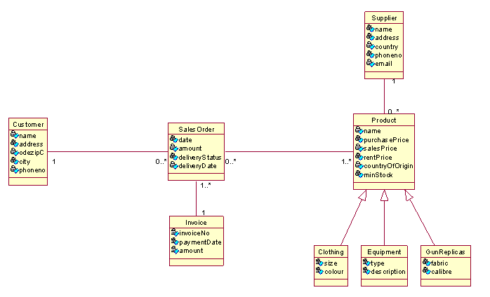

Slide 7
Assignment
Based on the domain model a relational model is to be designed (mapping).
Script(s) for creation of the database and insertion of data are to be written.
Java programs are to be created so it is possible to carry out CRUD operations on business classes (Customer – Product).
Finally the use case for order processing is to be described, designed, implemented and tested.

Slide 8
Software requirements
The database has to be available on the
SQL server: kraka.ucn.dk
Authentication: SQL Server Authentication
Database / login: dmaY0914_2Sem_X
(Y = class, X = group no)
Password: IsAllowed
use version control - TortoiseSVN (or similar)

Slide 9
Changes in DBConnection class
Instead of loacalhost
private static final String driver = "jdbc:sqlserver://kraka.ucn.dk:1433";
private static final String databaseName = ";databaseName=dmaY0914_2Sem_x";
private static String userName = "; user=dmaY0914_2Sem_x";
private static String password = ";password=IsAllowed";
Your groups database name and the password

