Slide 1

Constraints Overview 4 June – 30 June 2012

Slide 2

Constraints Overview
Constraints
For relational databases
SQL standard; systems vary considerably
(Integrity) Constraints
constrain allowable database states

Slide 3
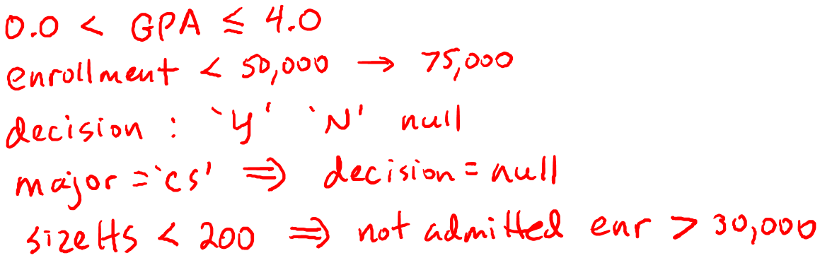
Constraints Overview
Integrity Constraints
Impose restrictions on allowable data, beyond those
imposed by structure and types
Examples:

Slide 4
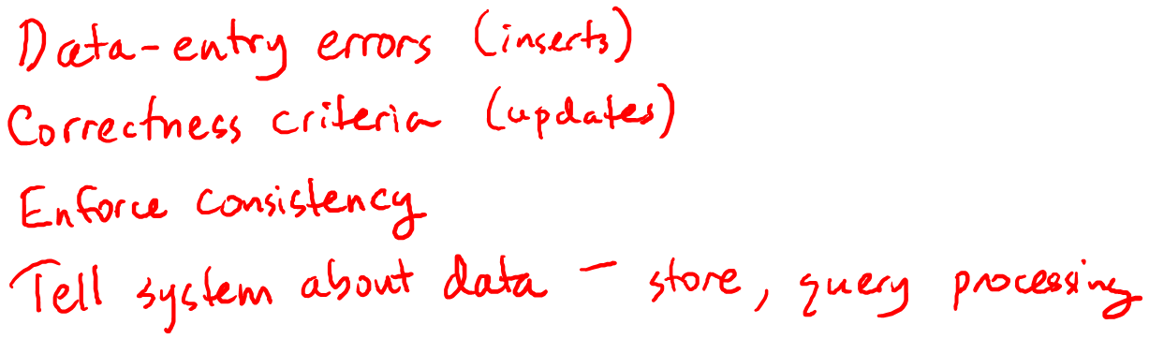
Constraints Overview
Integrity Constraints
Impose restrictions on allowable data, beyond those
imposed by structure and types
Why use them?

Slide 5
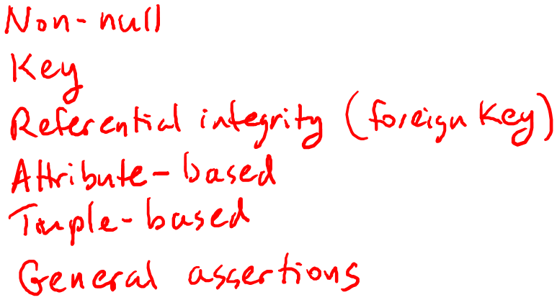
Constraints Overview
Integrity Constraints
Impose restrictions on allowable data, beyond those
imposed by structure and types
Classification

Slide 6
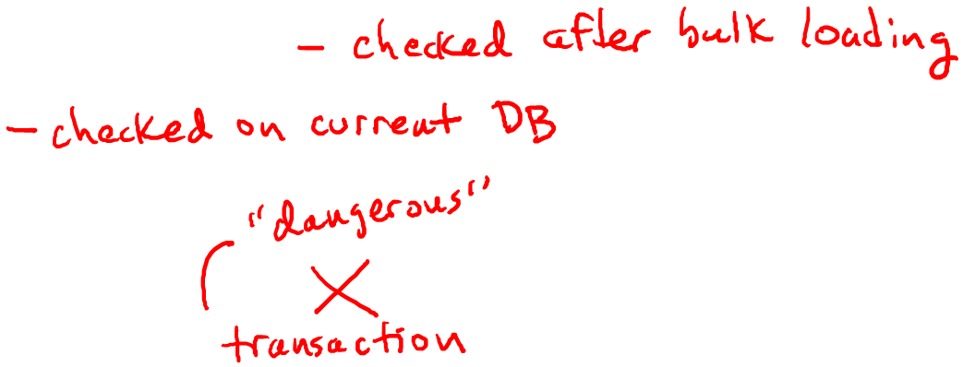
Constraints Overview
Declaring and enforcing constraints
Declaration
With original schema
Or later
Enforcement
Check after every modification
Deferred constraint checking

Slide 7
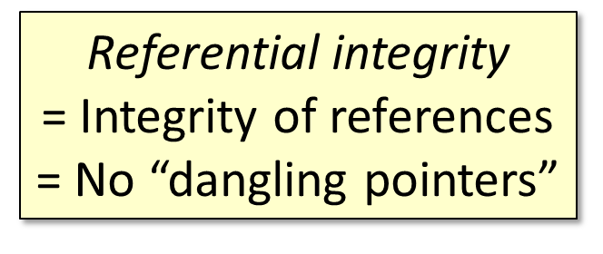
Constraints Overview
Integrity Constraints
Impose restrictions on allowable data, beyond those
imposed by structure and types

Slide 8
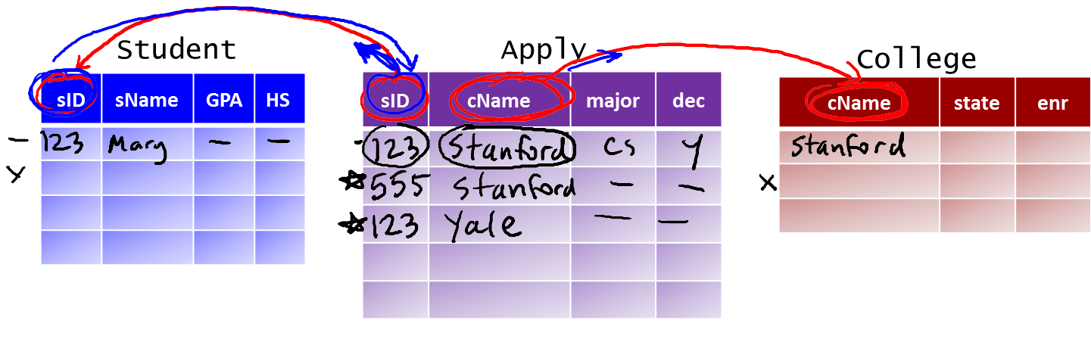
Constraints Overview
Simple Example Database

Slide 9
Constraints Overview
Demo:
Constraints.sql
ReferentialIntegrity.sql

Slide 10


