Slide 1

Indexes 4 June – 30 June 2012

Slide 2

Indexes
Primary mechanism to get improved performance
on a database
Persistent data structure, stored in database
Many interesting implementation issues

Slide 3
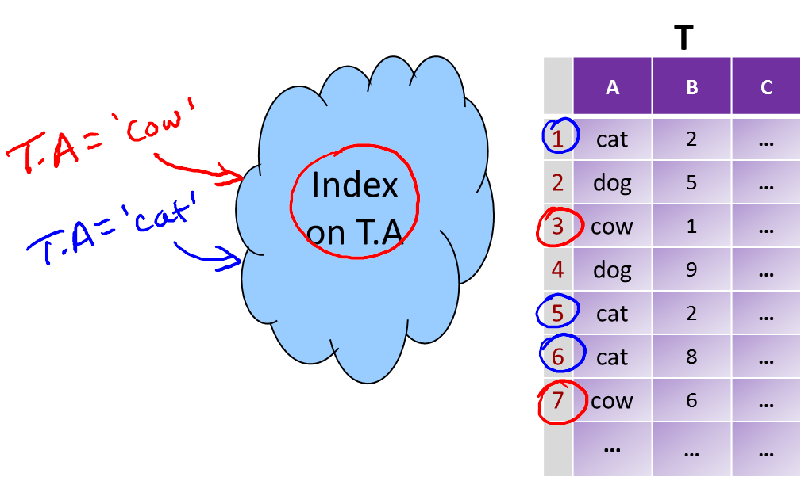
Indexes

Slide 4
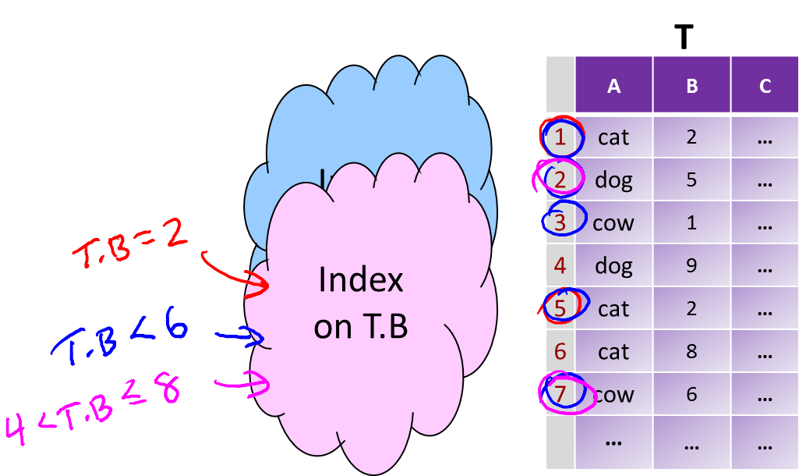
Indexes

Slide 5
Indexes
Utility
Index = difference between full table scans and
immediate location of tuples
Orders of magnitude performance difference
Underlying data structures
Balanced trees (B trees, B+ trees)
Hash tables

Slide 6
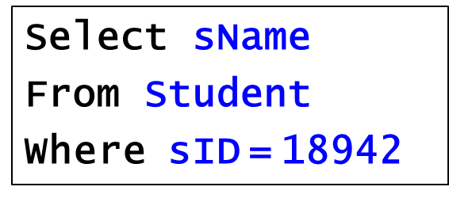
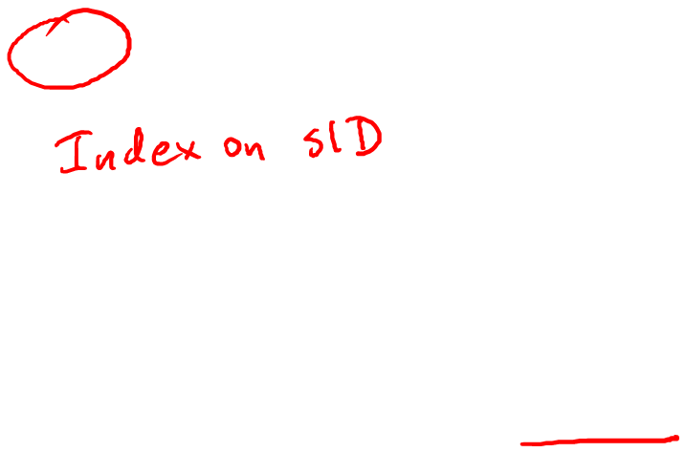
Indexes
Many DBMS’s build indexes automatically on
PRIMARY KEY (and sometimes UNIQUE) attributes

Slide 7
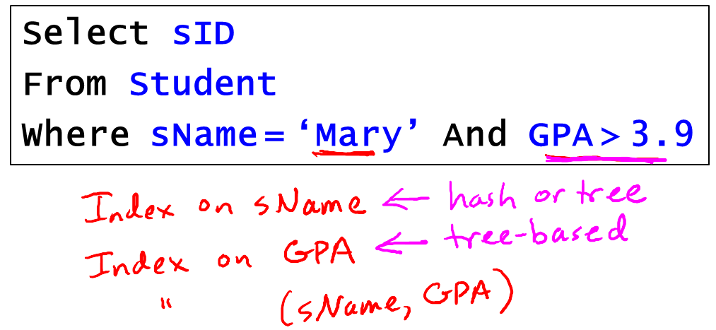
Indexes

Slide 8
Indexes
Downsides of Indexes
1) Extra space - marginal
2) Index creation – medium
3) Index maintenance – can offset benefit

Slide 9
Indexes
Picking which indexes to create
Benefit of an index depends on:
Size of table (and possibly layout)
Data distributions
Query vs. update load

Slide 10
Indexes
SQL Syntax
Create Index IndexName on T(A)
Create Index IndexName on T(A1,A2,…,An)
Create Unique Index IndexName on T(A)
Drop Index IndexName

Slide 11


