Slide 1

Defining Views 4 June – 30 June 2012

Slide 2

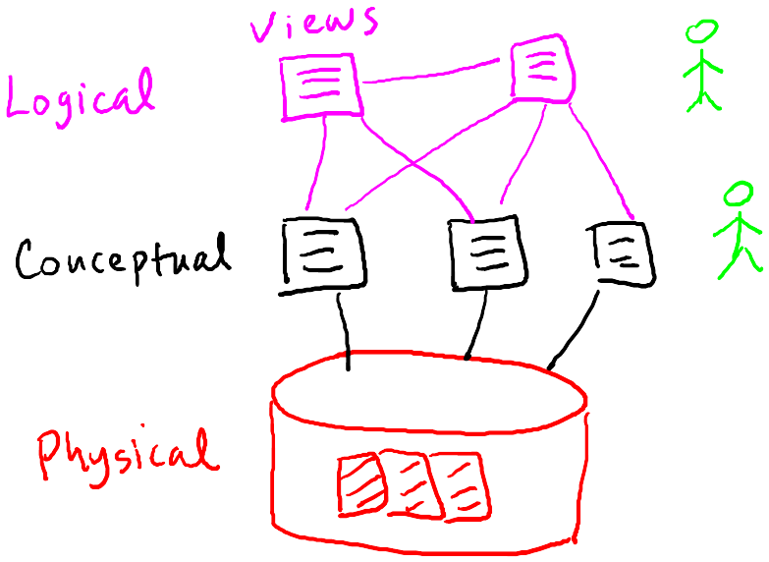
Views
Three-level vision of database
Physical – Conceptual – Logical

Slide 3
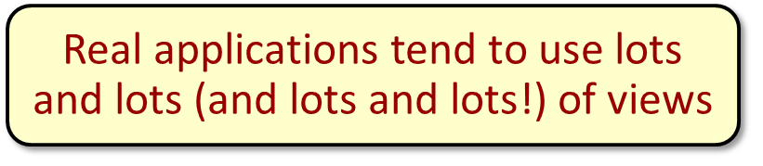
Views
Why use views?
Hide some data from some users
Make some queries easier / more natural
Modularity of database access

Slide 4
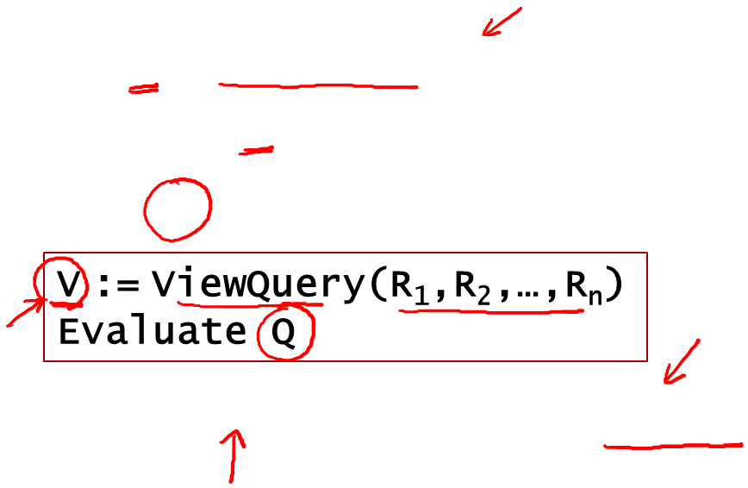
Views
Defining and using views
View V = ViewQuery(R₁, R₂, …, R_{n})
Schema of V is schema of query result
Query Q involving V, conceptually:
In reality, Q rewritten to use R₁,…,R_{n} instead of V
Note: R_{i} could itself be a view

Slide 5
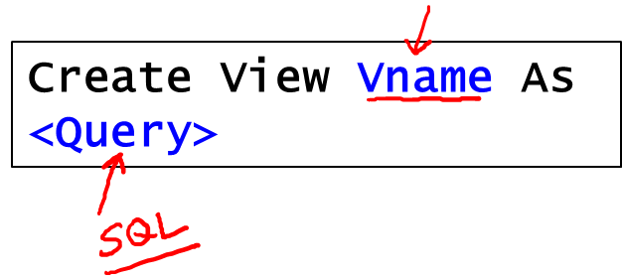
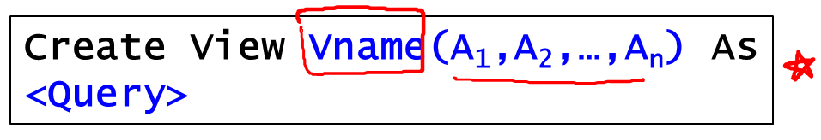
Views
SQL Syntax
Demo: Views.sql

Slide 6


