Slide 1
Movie Recommender
Group member： Zhengqi Dong, Yuntian He
Email: {dong.760, he.1773}@osu.edu

Slide 2
Literature Review

Slide 3
DeepWalk: Online Learning of Social Representation
What it did:
Encoding social relations into a network based graphical representation that can be easily exploited by statistical models. ➔ so can capture the semantic and syntactic structure of human language, and even logical analogies.
Terminology
Walks: walking through a sequence of sentences
Achievement/Significance:
Tested on social network, such as Blog-Catalog, Flickr, and YouTube.
Showed 10% higher F1 score than competing methods on sparse dataset
Sometime, can outperform
Random Walk
Use to measure the similarity amount contents
A stream of short random walks can extract information from networks
Learning model can be updated iteratively

Slide 4
Doc2vec

Slide 5
Background

Slide 6
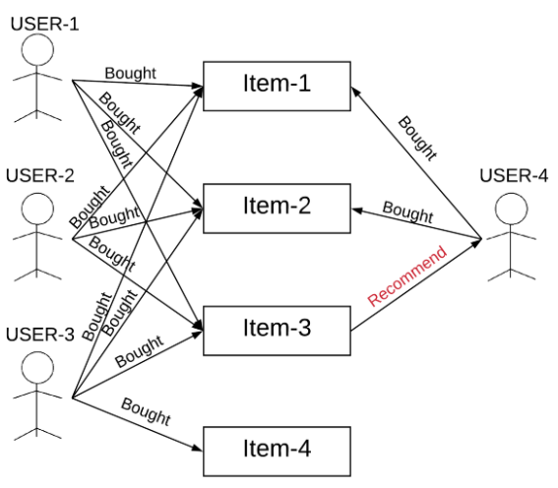
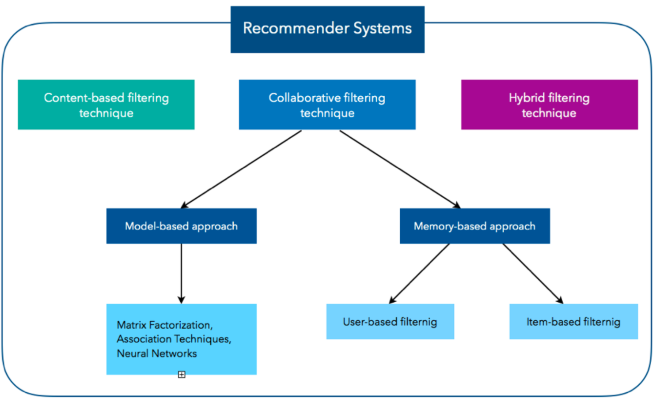
Type of Recommender Systems
Recommender System:
“A recommender system is an information filtering system that seeks to predicts the “rating” or “preference” a user would give to an item.”
Type of Recommender Systems:
Content-Based Filtering
Collaborative Filtering(CF)
Memory-Based Collaborative Filtering, e.g., User-based CF, Item-based CF
Model-Based Collaborative Filtering, e.g., Matric factorization, Neural Network
Hybrid Filtering
Courtesy: 1) https://d2l.ai/chapter_recommender-systems/recsys-intro.html 2) https://dl.acm.org/doi/pdf/10.1155/2009/421425 3) https://arxiv.org/pdf/1707.07435.pdf, 4) https://humboldt-wi.github.io/blog/research/applied_predictive_modeling_19/causalrecommendersystem/
Notes:
A recommender system is an information filtering system that seeks to predicts the rating given by a user to an item. The type of recommender system can be categorized to three types: 1)… 2)…3)…
Content-based filtering: The Content-Based Recommender relies on the similarity of the items being recommended (and sometime it’s also known as the similarity-based filtering). The basic idea is that if you like an item, then you will also like a “similar” item. But, in order to define the similar items, you first need a way to define the similarity between the item or users. But, since that’s not the focus of our project, so I won’t go into too much detail about that.
The collaborative filtering is based on the idea that, the user who have agreed in the past tend to also agree in the future. For example, to the picture at the right, we see the User-4 bought Iterm-1 and Iterm-2, in the meantime, we observed that all three users (User1-3) agreed the Item-3 is worth purchasing in the past, then it’s likely that the Item-3 is something worth for the User-4 to purchase as well.
A Hybrid filtering algorithms combines the CF with other recommendation techniques, which is the type of recommender system we will present today!
idea: The content-based recommender relies on the similarity of the items being recommended. For example, if you like an item, then there is higher change you will like a “similar” item under the same categories.
There are two way to obtain the information from user, explicit and implicit extraction. Explicit extraction is directly asking user questions. Implicit extraction is based on unspoken data, such as users' profiles, a set of actions on browser session.
Reference:
https://www.sciencedirect.com/science/article/pii/S1110866515000341#:~:text=Recommender%20system%20has%20the%20ability,online%20shopping%20environment%20%5B4%5D.

Slide 7
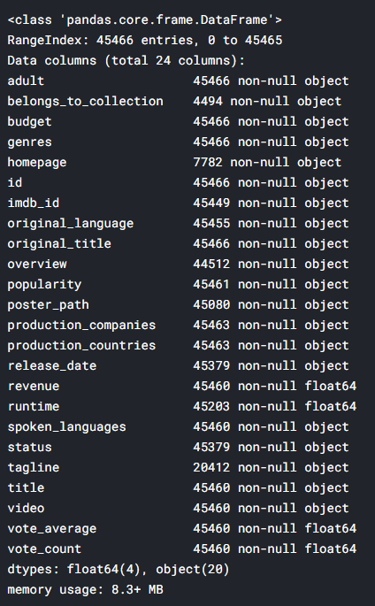
Dataset description
The Movies Dataset from Kaggle
26M ratings from 270K users on 45K movies
Content
Text: Each movie has an overview (a paragraph)
Rating: A tuple (UserID, MovieID, Rating, Timestamp)
Other Attributes:
Genre: e.g. Action, Animation, Romance, …
Credits: (cast, crew)
* https://www.kaggle.com/rounakbanik/the-movies-dataset
Notes:
The movie dataset is token from Kaggle, and is originally released by MovieLens website, which is a project run by GroupLens, it’s a research lab at the University of Minnesota.
And, here is some feature about the dataset. This dataset had abundant features as you can see in the figure. But, here is couple features that we considered to use：
Text: an overview for the movie
Rating is constituted by 4 elements, UsrID, movieID, rating(an integer scaled from 1-5), and timestamp
Some other attributed include genre and credits

Slide 8
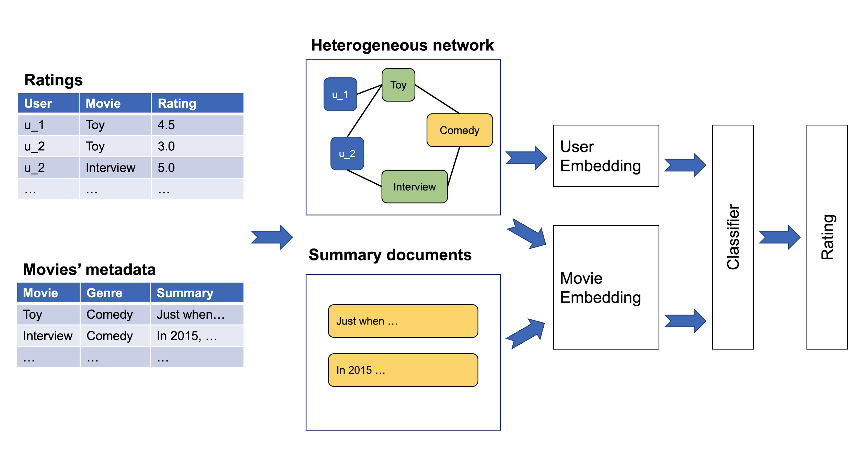
System framework
Graph embedding
Classifier
Text embedding

Slide 9
Preprocessing
Removing data in incorrect format
3 of 45K movies are deleted
Index adjustment
Consecutive IDs for convenience
Attribute selection
Cast: Only top 8 casts (cast order included in the raw data)
Crew: Only use ‘director’

Slide 10
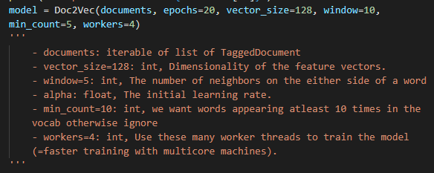
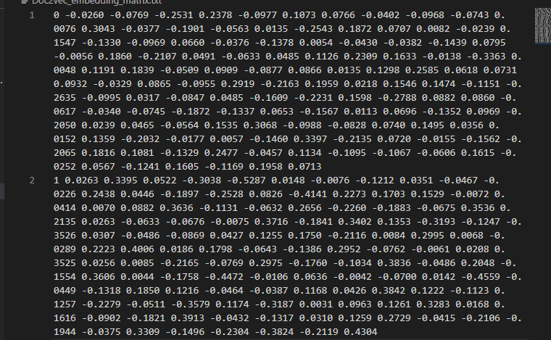
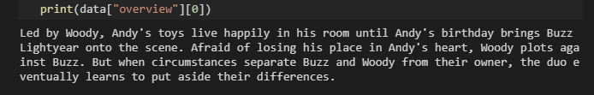
Text Embedding: Doc2vec
Goal: Use Doc2Vec to learning the main content of movies’ metadata, and represent it as an e_{mt}-dimensional vector for each movie. (subscript mt is for movie text embedding, and mg is for movie graph embedding)
Reason why we used Doc2Vec
It can learn vector representation from unlabeled data and generalized well on the data that do not have enough labels.
Dov2vec takes word orders into consideration while learning the semantic meaning of documents.
Implementation:
Use gensim package to
movie’s overview ➔ embedding vectors

Slide 11
Text Embedding: Doc2vec
Implementation:
Use gensim package to generate the Doc2Vec model
Input ➔ Output
movie’s overview
Vector representation

Slide 12
Graph embedding: Metapath2vec
Heterogeneous information network
User (U), Movie (M), Genre (G), Cast/crew (C)
Metapath-based sampling
Preserve semantic relationships between nodes
U-M-U, U-M-G-M-U, U-M-C-M-U
Rating-aware sampling policy
Similarly sample for P(m->u).
Genre
Movie
5
2
5
User
* "metapath2vec: Scalable representation learning for heterogeneous networks." Proceedings of the 23rd ACM SIGKDD international conference on knowledge discovery and data mining. 2017.

Slide 13
Experiment setup
Methods
Our work:
For movie representations: Text only, Graph only, Both text and graph
Can change text embedding method / classifier model…
Other baselines: SVD, movie2vec
Metric
Mean Absolute Error (MAE)
Mean Squared Error (MSE)
Accuracy
F1-Score

Slide 14
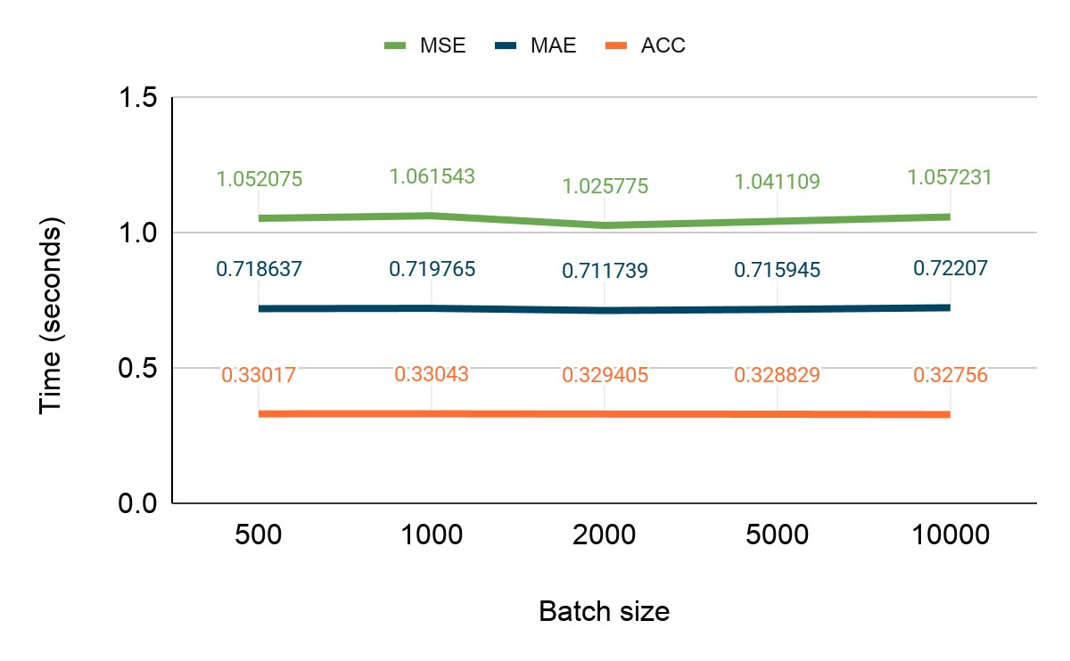
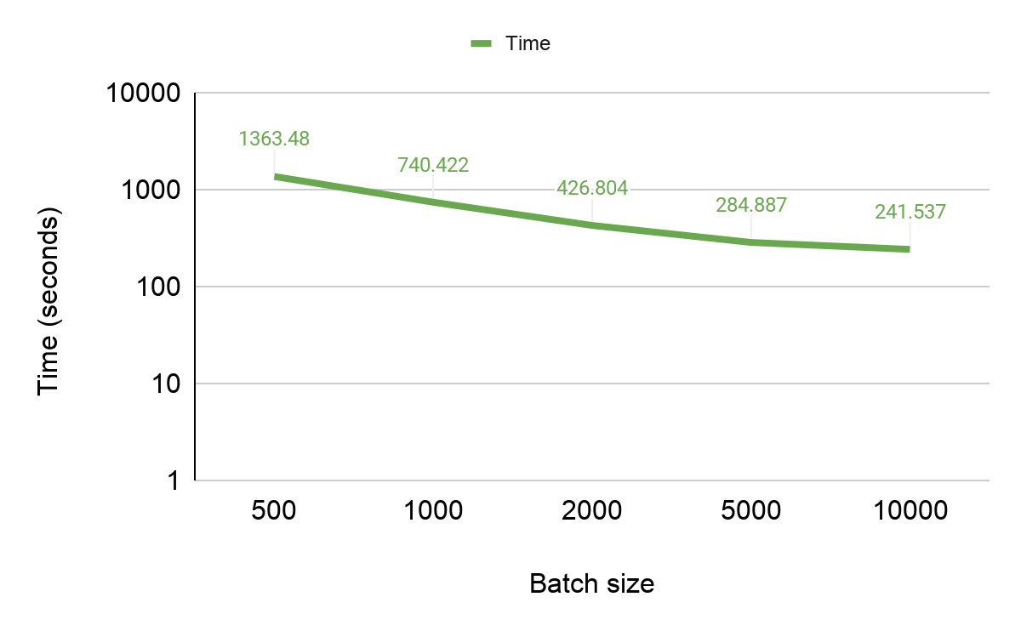
Preliminary results
Method: Graph embedding (movies) + MLP (classifier)
Notes:
5 epoch,

Slide 15
Takeaway
A hybrid recommendation system using text and graph embeddings
Rating-aware sampling technique
Evaluation of proposed framework on the dataset

Slide 16
Thanks! Any Question?

Slide 17
Reference
[1]Jacob Devlin, Ming-Wei Chang, Kenton Lee, and Kristina Toutanova. Bert: Pre-training of deepbidirectional transformers for language understanding.arXiv preprint arXiv:1810.04805, 2018.
[2]Yuxiao Dong, Nitesh V Chawla, and Ananthram Swami. metapath2vec: Scalable representationlearning for heterogeneous networks. InProceedings of the 23rd ACM SIGKDD internationalconference on knowledge discovery and data mining, pages 135–144, 2017.
[3]Yoon Kim.Convolutional neural networks for sentence classification.arXiv preprintarXiv:1408.5882, 2014.
[4]Quoc Le and Tomas Mikolov. Distributed representations of sentences and documents. InInternational conference on machine learning, pages 1188–1196, 2014.
[5]Francesco Ricci, Lior Rokach, and Bracha Shapira. Introduction to recommender systemshandbook. InRecommender systems handbook, pages 1–35. Springer, 2011.
[6]Xiaoyuan Su and Taghi M Khoshgoftaar. A survey of collaborative filtering techniques.Advancesin artificial intelligence, 2009, 2009.
[7]Shuai Zhang, Lina Yao, Aixin Sun, and Yi Tay. Deep learning based recommender system: Asurvey and new perspectives.ACM Computing Surveys (CSUR), 52(1):1–38, 2019.

Slide 18
Text embedding

Slide 19
Collaborative Filtering:
Based on the similarity of two user: e.g., “The user watched this movie are also like…”
Doesn’t depends on any algorithm but other users' behavior. Dynamic model, information update automatically.
Two main types of memory-based collaborative filtering algorithm:
User-User Collaborative Filtering: Find the look-alike user based on current user favorite movie, and recommend movie based on look-alike user’s history. This algorithm is effective but time consuming to compute the user pair information for a large database.
Iterm-Iterm Collaborative Filtering: Instead of finding look-alike user, we try to find the look-alike movies, the movie have similar categories, tagging, entity, rating and etc. Lett time consuming, especially for a new user.
Courtesy: https://medium.com/datadriveninvestor/how-to-built-a-recommender-system-rs-616c988d64b2
Notes:
The collaborative filtering is based on the idea that, the user who have agreed in the past tend to also agree in the future. For example to the picture at the right, we see the User-4 bought Iterm-1 and Iterm-2, in the meantime, we observed that all three users (User1-3) agreed the Item-3 is worth purchasing in the past, hence we can assume the Item-3 is something worth for the User-4 to purchase as well.

Slide 20
Content-Based Filtering
Idea: The content-based recommender relies on the similarity of the items being recommended. For example, if you like an item, then there is higher change you will like a “similar” item under the same categories.
There are two way to obtain the information from user, explicit and implicit extraction. Explicit extraction is directly asking user questions. Implicit extraction is based on unspoken data, such as users' profiles, a set of actions on browser session.

Slide 21

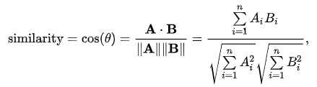

Collaborative Filtering: Jaccard Vs Cosine Vs Pearson
Jaccard similarity: aka Jaccard index, intersection over union
Cosine similarity: The distance(the length of the component of B points in the same direction as A) decrease with the increasing value of angle between A and B
Pearson Similarity: aka Pearson correlation coefficient. Measure the linear correlation between X and Y
Notes:
Courtesy:
Jaccard similarity:
https://en.wikipedia.org/wiki/Jaccard_index
Cosine similarity
https://en.wikipedia.org/wiki/Cosine_similarity
https://masongallo.github.io/machine/learning,/python/2016/07/29/cosine-similarity.html

