Slide 1
Movie Recommender
Group member： Zhengqi Dong, Yuntian He
Email: {dong.760, he.1773}@osu.edu
Notes:
Hi everyone, today I am going to talk about the project that I had implemented with another course member for course cse 5525, foundation of speech and language processing. The project topic is related to movie recommendation.
As the more and more people surfing in the internet, the need to build a robust movie recommendation system is becoming more and more important given the huge demand for personalized content of modern consumers, and for discovering those valuable information.

Slide 2
Literature Review

Slide 3
DeepWalk: Online Learning of Social Representation
What it did:
Encoding social relations into a network based graphical representation that can be easily exploited by statistical models. ➔ so can capture the semantic and syntactic structure of human language, and even logical analogies.
Terminology
Walks: walking through a sequence of sentences
Achievement/Significance:
Tested on social network, such as Blog-Catalog, Flickr, and YouTube.
Showed 10% higher F1 score than competing methods on sparse dataset
Sometime, can outperform
Random Walk
Use to measure the similarity amount contents
A stream of short random walks can extract information from networks
Learning model can be updated iteratively

Slide 4
Doc2vec

Slide 5
Background

Slide 6
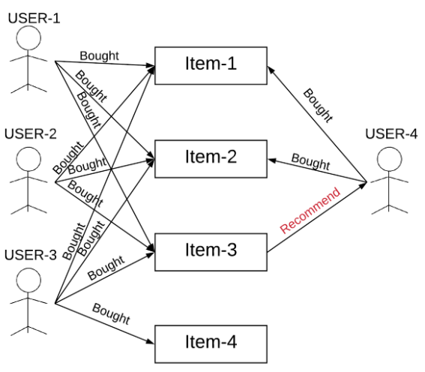
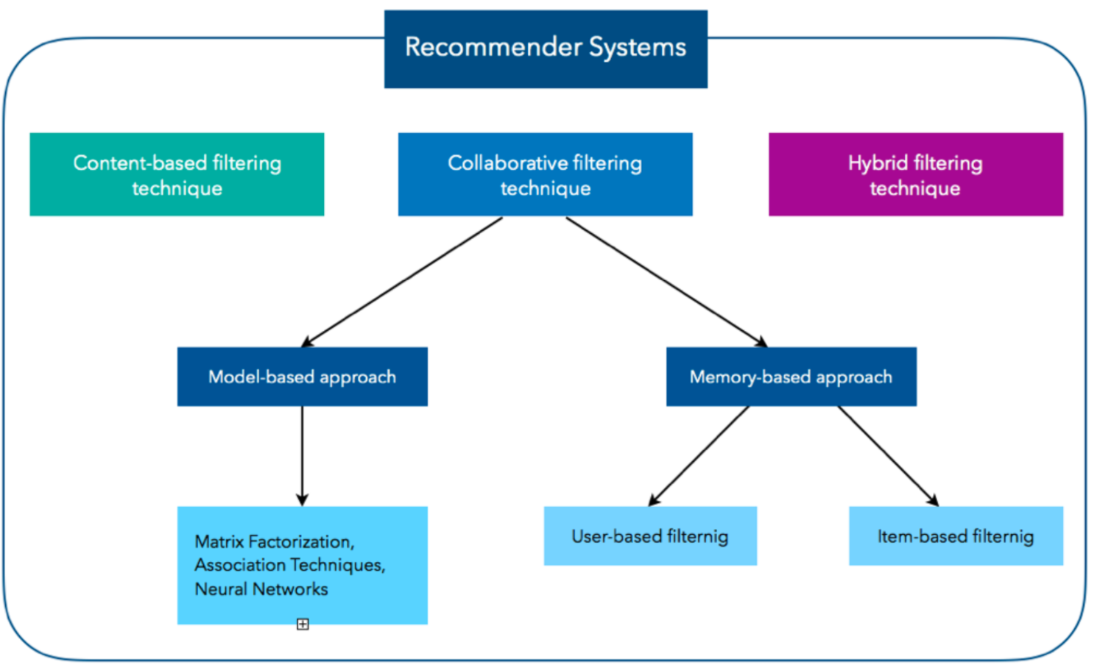
Type of Recommender Systems
Recommender System:
“A recommender system is an information filtering system that seeks to predicts the “rating” or “preference” a user would give to an item.”
Type of Recommender Systems:
Content-Based Filtering
Collaborative Filtering(CF)
Memory-Based Collaborative Filtering, e.g., User-based CF, Item-based CF
Model-Based Collaborative Filtering, e.g., Matric factorization, Neural Network
Hybrid Filtering
Courtesy: 1) https://d2l.ai/chapter_recommender-systems/recsys-intro.html 2) https://dl.acm.org/doi/pdf/10.1155/2009/421425 3) https://arxiv.org/pdf/1707.07435.pdf, 4) https://humboldt-wi.github.io/blog/research/applied_predictive_modeling_19/causalrecommendersystem/
Notes:
A recommender system is an information filtering system that seeks to predicts the rating given by a user to an item. The type of recommender system can be categorized to three types: 1)… 2)…3)…
Content-based filtering: The Content-Based Recommender relies on the similarity of the items being recommended (and sometime it’s also known as the similarity-based filtering). The basic idea is that if you like an item, then you will also like a “similar” item.
The collaborative filtering is based on the idea that, the user who have agreed in the past tend to also agree in the future. For example, to the picture at the right, we see the User-4 bought Iterm-1 and Iterm-2, in the meantime, we observed that all three users (User1-3) agreed the Item-3 is worth purchasing in the past, then it’s likely that the Item-3 is something more worth for the User-4 to purchase as well.
A Hybrid filtering algorithms combines the CF with other recommendation techniques, which is the type of recommender system we will present today!
idea: The content-based recommender relies on the similarity of the items being recommended. For example, if you like an item, then there is higher change you will like a “similar” item under the same categories.
There are two way to obtain the information from user, explicit and implicit extraction. Explicit extraction is directly asking user questions. Implicit extraction is based on unspoken data, such as users' profiles, a set of actions on browser session.
Reference:
https://www.sciencedirect.com/science/article/pii/S1110866515000341#:~:text=Recommender%20system%20has%20the%20ability,online%20shopping%20environment%20%5B4%5D.

Slide 7
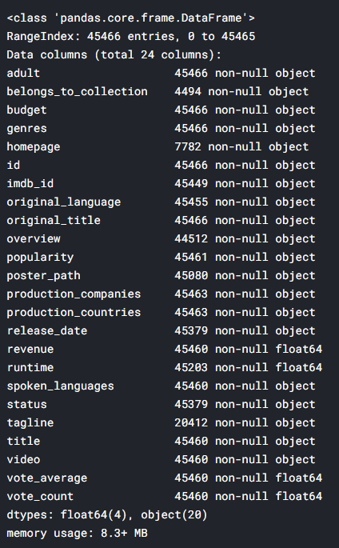
Dataset description
The Movies Dataset from Kaggle
26M ratings from 270K users on 45K movies
Content
Text: Each movie has an overview (a paragraph)
Rating: A tuple (UserID, MovieID, Rating, Timestamp)
Other Attributes:
Genre: e.g. Action, Animation, Romance, …
Credits: (cast, crew)
* https://www.kaggle.com/rounakbanik/the-movies-dataset
Notes:
The movie dataset is taken from Kaggle, and is originally released by MovieLens project, which is a project run by a research lab at the University of Minnesota.
And, here is some feature about the dataset. This dataset had abundant features as you can see in the figure. But, here is couple features that we considered to use：
Text: an overview for the movie
Rating is constituted by 4 elements, UsrID, movieID, rating(an integer scaled from 1-5), and timestamp
Some other attributed include genre and credits

Slide 8
Problem Statement
Two kinds of query
Rating Prediction: The goal is to learn a function f_s : U × M → S to predict the rating that user u would give to an unseen movie m.
Top-k recommendation: The goal is to learn a function f_t : U → M^k to predict k unseen movies in which user u might be interested.

Slide 9
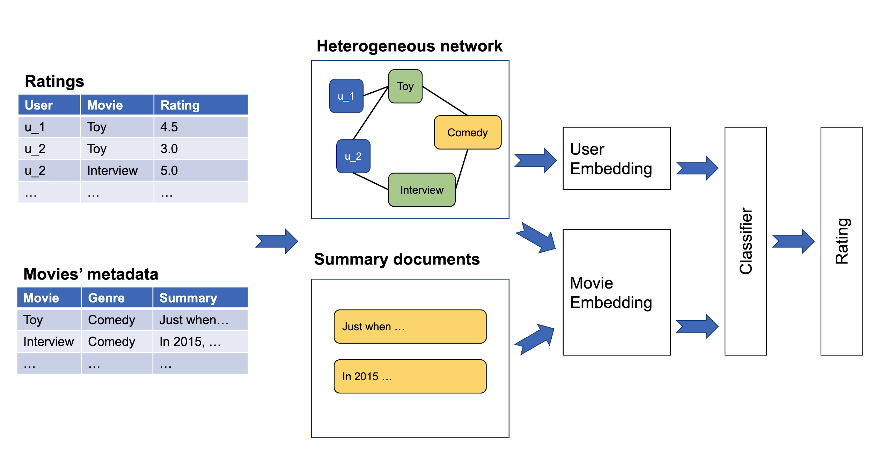
System framework
Graph embedding
Classifier
Text embedding
Notes:
Goal: given a user u and movie M, we want to predict the rating that user u would give to an unseen movie m. ➔ And then, we will apply sorting to all movie, with top-k recommendation return back to user.

Slide 10
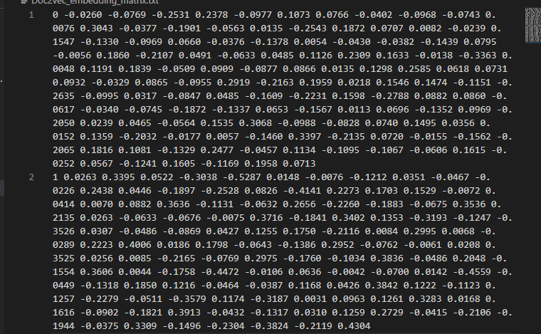
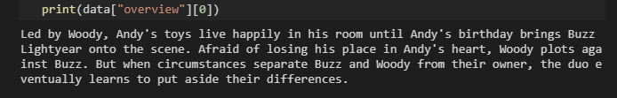
Text Embedding: Doc2vec
Goal: Use Doc2Vec to learning the main content of movies’ metadata, and represent it as an e_{mt,} 128 dimensional vector for each movie. (subscript mt is for movie text embedding, and mg is for movie graph embedding)
Reason why we used Doc2Vec
It can learn vector representation from unlabeled data and generalized well on the data that do not have enough labels.
Dov2vec takes word orders into consideration while learning the semantic meaning of documents.
Implementation:
Use gensim package to
movie’s overview ➔ embedding vectors
Notes:
There are a lot of metadata related to movie, such as genres type, tags, and movie overview. But the goal here is to learn a representation that can capture or describe the main content of a movie, which related to the idea of content filtering, if a user like an item, he will also like a similar item.
In our case, since the genres and tags are too short to use, so we used movie overview will be generate the text embedding.
Why not use BERT? ➔ Tried, but don’t have enough time to figure out how to use it.
BERT Reference:
Explanation, https://towardsdatascience.com/bert-explained-state-of-the-art-language-model-for-nlp-f8b21a9b6270
Code repo, https://github.com/google-research/bert#fine-tuning-with-bert
Colab--BERT End to End (Fine-tuning + Predicting) with Cloud TPU: Sentence and Sentence-Pair Classification Tasks, https://colab.research.google.com/github/tensorflow/tpu/blob/master/tools/colab/bert_finetuning_with_cloud_tpus.ipynb#scrollTo=0yamCRHcV-nQ
BERT Paper, https://arxiv.org/abs/1810.04805
Attention paper, https://arxiv.org/pdf/1706.03762.pdf

Slide 11
Graph embedding: Metapath2vec
Heterogeneous information network
User (U), Movie (M), Genre (G), Cast/crew (C)
Metapath2vec-based sampling
Preserve semantic relationships between nodes
U-M-U, U-M-G-M-U, U-M-C-M-U
Rating-aware sampling policy
Similarly sample for P(m->u).
Genre
Movie
5
2
5
User
* "metapath2vec: Scalable representation learning for heterogeneous networks." Proceedings of the 23rd ACM SIGKDD international conference on knowledge discovery and data mining. 2017.
Notes:
The previous publication are mainly related to word2vec-based learning network, such as DeepWalk, node2vec. Those network use singular type of node and relationship to constructure the network model, and that’s why it’s called homogeneous network.
But, in our project, there are many type of attribute we want to take into consideration, such as User, movie, genre type, and cast/crew, so the graph embedding is used to capture the internal relations of richer and more complicated data content, as well as the relations amount those objects. Motivated by the success of representation learning of heterogeneous information network, we applied a Metaphath2vec sampling algorithm to produce the graph embedding vectors.
Firstly, a Random walks algorithm, that was previous used in DeepWalk and node2vec those homogeneous network model, was used to make connection amount those nodes, and feeds those sequences of nodes to a skip-gram model to learn nodes embedding. One challenge for directly using those traditional embedding method to our project is the network is heterogeneous, so in order to preserve the proximity between nodes and its neighborhood, we need to find a way to optimize the embedding model while maintaining the structures and semantics of multiple type of nodes and relations. In order to tackle this problem, a novel rating-aware sampling policy is used to ensure the predicted rating score associated with neighboring moves in random walk that are close with high probability.
Goal: maximize the likelihood of preserving both the structure and semantics of a given heterogeneous network.

Slide 12
Classification
Goal:
A 3-layey MLP is used as a classifier for our last module to take the text embedding vector and graph embedding to predict the rating score.
Layer size:
128, 32, 10.
Note: input layer takes 128-dimensional vector, and 32 neurons for hidden layer, and 10 neurons for output layer.
Epochs: 5
Learning rate: 1*10^-3
Computing Environment: OSC Owens cluster with single GPU node
Notes:
The last module is a classifier which takes the learned embeddings of users rating and movies overview in the first two modules as input, and use them to predict a rating score. A common option for the classification module is MLP.

Slide 13
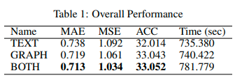
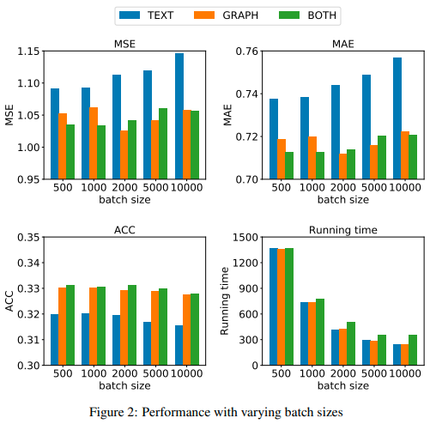
Conclusion
Methods
Use text embedding only (TEXT)
Use graph embedding only (GRAPH)
Use both text and graph embedding (BOTH)
Key Takeaway
BOTH methods outperforms other two in all metrics
BOTH method takes 5.61% longer to train than the other twos on average.
ACC (or MSE/MAE) decrease as batch size increases (or increase)
Training faster as batch size increases
Notes:
Our result is not very good, it only has about 33% ACC, but there are many way we can do to improve the performance, such as replace the Doc2vec with BERT algoirthm to produce a higher quality of text embedding, as well as considering the more matadata to produce the graph embedding, or find-tune the configuration parameter and train a bit longer with larger epoch number, can also increase the performance.
But. Here some key takeaway, that we discover from this project.

Slide 14
Thanks! Any Question?

Slide 15
Reference
[1]Jacob Devlin, Ming-Wei Chang, Kenton Lee, and Kristina Toutanova. Bert: Pre-training of deepbidirectional transformers for language understanding.arXiv preprint arXiv:1810.04805, 2018.
[2]Yuxiao Dong, Nitesh V Chawla, and Ananthram Swami. metapath2vec: Scalable representationlearning for heterogeneous networks. InProceedings of the 23rd ACM SIGKDD internationalconference on knowledge discovery and data mining, pages 135–144, 2017.
[3]Yoon Kim.Convolutional neural networks for sentence classification.arXiv preprintarXiv:1408.5882, 2014.
[4]Quoc Le and Tomas Mikolov. Distributed representations of sentences and documents. InInternational conference on machine learning, pages 1188–1196, 2014.
[5]Francesco Ricci, Lior Rokach, and Bracha Shapira. Introduction to recommender systemshandbook. InRecommender systems handbook, pages 1–35. Springer, 2011.
[6]Xiaoyuan Su and Taghi M Khoshgoftaar. A survey of collaborative filtering techniques.Advancesin artificial intelligence, 2009, 2009.
[7]Shuai Zhang, Lina Yao, Aixin Sun, and Yi Tay. Deep learning based recommender system: Asurvey and new perspectives.ACM Computing Surveys (CSUR), 52(1):1–38, 2019.

Slide 16
Next Generation of AI-learning Model – Learning from Movie/Animation

Slide 17
Comparison
Current AI training
Vision ➔ CNN, GAN …
Text ➔ RNN, LSTM, …
Speech ➔ CNN, RNN, …
New Model
Hybrid of Vision, Text and Speech ➔ ???
Notes:
For Speech reference
Simple explanation, https://towardsdatascience.com/audio-deep-learning-made-simple-automatic-speech-recognition-asr-how-it-works-716cfce4c706
Survey paper, https://arxiv.org/ftp/arxiv/papers/1908/1908.07656.pdf
Or more, https://www.google.com/search?q=most+popular+deep+learning+model+for+speech+recognition&oq=most+popular+deep+learning+model+for+speech+&aqs=chrome.4.69i57j33i160l2j33i299l2.20122j0j7&sourceid=chrome&ie=UTF-8

Slide 18
Motivation
Human can quickly pick up the meaning of a work on a human conversation
Human can understand things without an explicit explanation or a formal definition
Approach: If there a word that we don’t understand ➔ We will keep it as a question in our head, and expect this question will be answer in the future conversion in the movie
Since this way of learning works for human, so it also should work for robot.

Slide 19
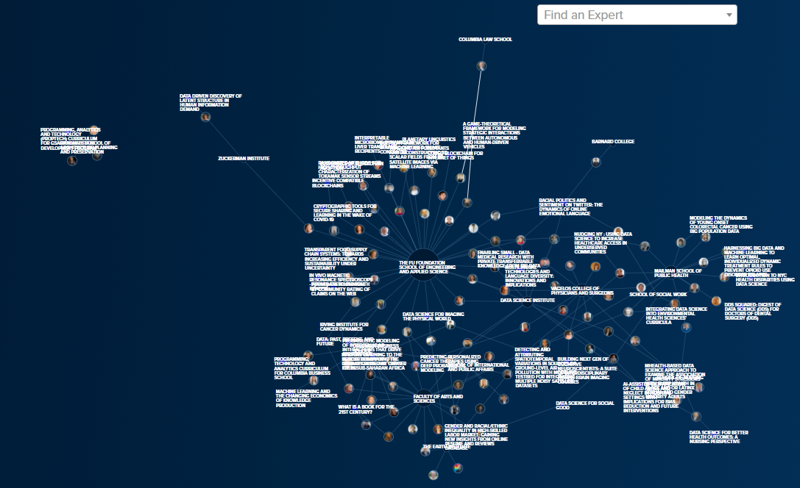
Reinforcement Learning (Premature Idea)
Learning Type: unsupervised learning
Learning Logic
make a guess to an object that appearing on movie shot ➔ denoted as area of interest(AOI)
If this question appear again on a shot ➔ See if we can find a match to our guess
If we did find a match on the shot ➔ reinforce the signal, ➔ Otherwise, weaken the signal (As number of corrected prediction increased, the robot’s accuracy/confidence to an object is also increased)
Build a heterogenous network for the learning object (if the probability of connection amount three elements are greater than 95%, a node will be formed and added to the network)
Audio
99.9%
95.1%
97.5%
Vision Object
Creation of a new node
Text
Notes:
--CU Staff visualization: https://datascience.columbia.edu/staff-visualization/

Slide 20
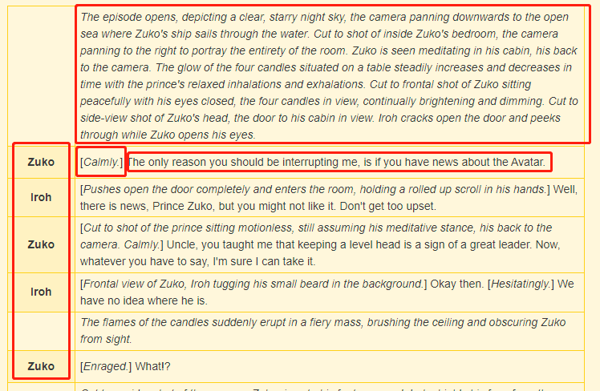
Data Input
Story Background/Context
Text
Characters’ Facial Expression
Characters’ Dialogue
Characters’ Name

Slide 21
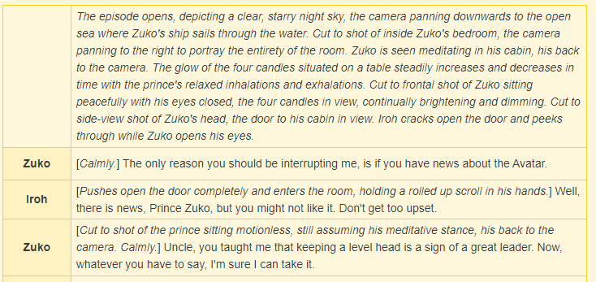
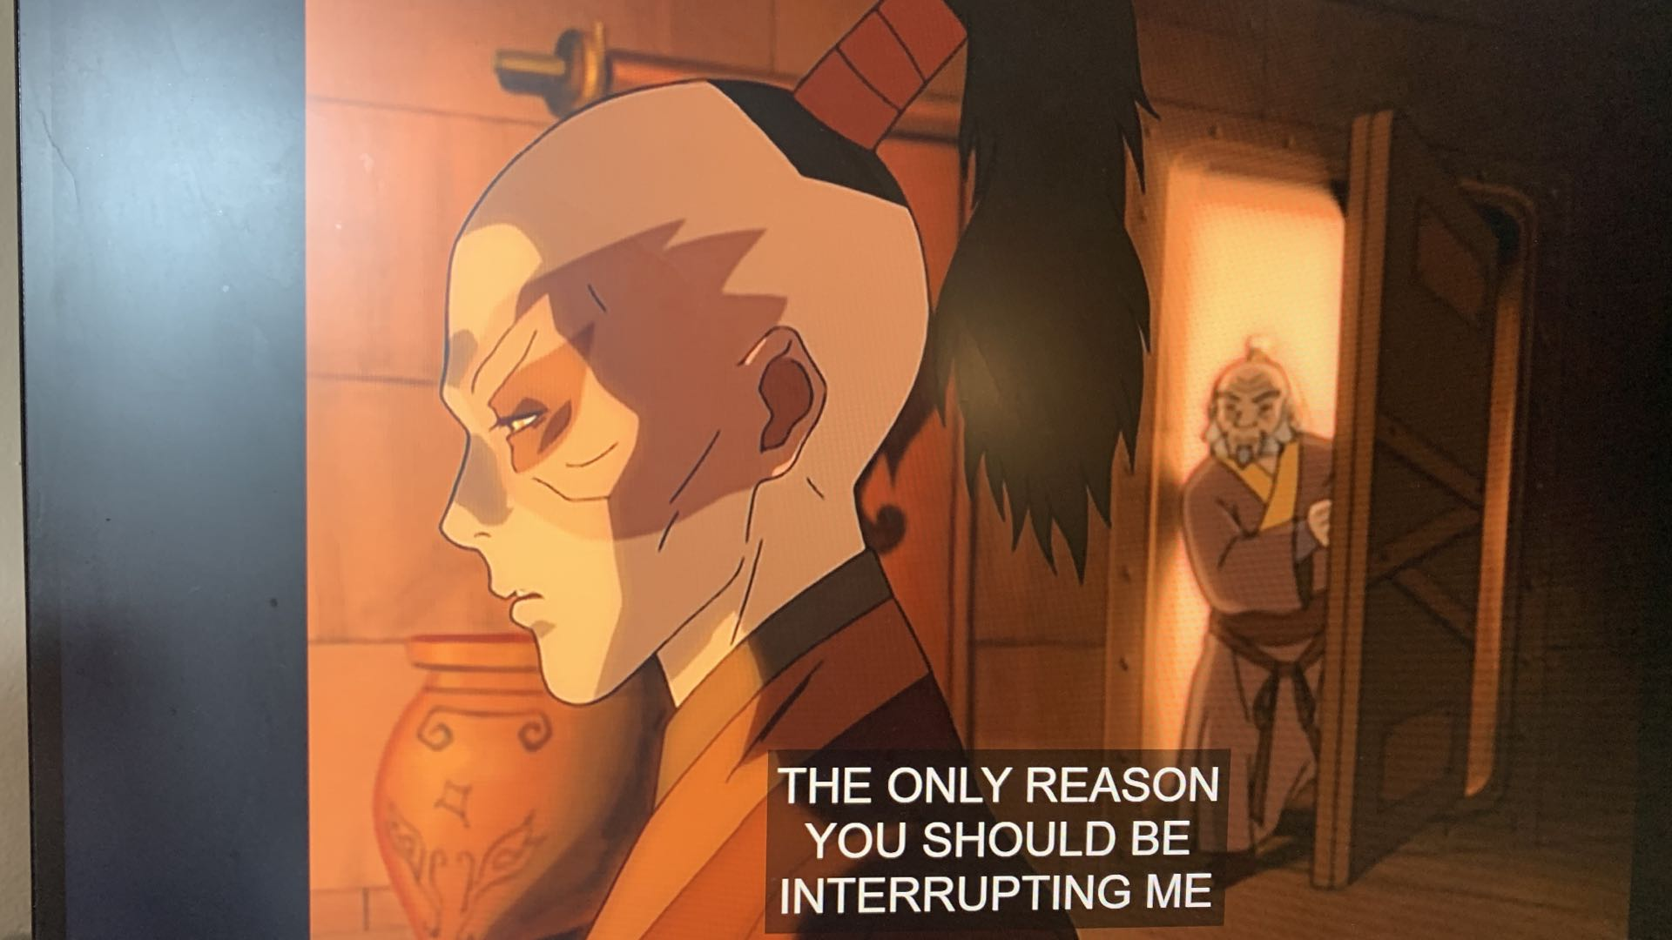
Data Input
Picture

Slide 22
Advantages of new learning methods
Cramming GRE vocabularies
Text only
Fragile memory connection
Easy to forget
Hard to apply to real world conversation
Heterogeneous learning model: Hybrid of text, picture and audio
Richness:
Internal: Richer semantic meaning contained within an object (Integrated of text, picture and audio), so more metadata about an object
External: synonymous will be close to each other (if nodes related to each other, they will have closer proximity to each other) ➔ So, we will have multiple ways to construct the sentence ➔ the sentence that robot produce will be more completed and elegant.
Robustness:
Internal: a node is formed only when all connection amount three elements are greater than the predefined threshold(e.g., 95%) ➔ So, there are multiple representation for an object
External: If one way of saying is confused, robot will find another way to convey the meaning.
More ….
Notes:
I don’t know the advantage of those current AI-application, so you can take my GRE learning methods as an analogy of our current AI-learning method. ➔ But, they all can be seem as a homogeneous learning model.

Slide 23
Hybrid methods
Goal: Learning the semantic meaning of vocabulary
Mapping the vocabulary to audio sounds
Mapping the vocabulary to an object in a movie
Model: Reinforcement learning
Based on the conversation context, predict a work that never had learned
Compute the error between our prediction and the
Predict AOI (relations)

Slide 24
Experiment setup
Methods
Our work:
For movie representations: Text only, Graph only, Both text and graph
Can change text embedding method / classifier model…
Other baselines: SVD, movie2vec
Metric
Mean Absolute Error (MAE)
Mean Squared Error (MSE)
Accuracy
F1-Score

Slide 25
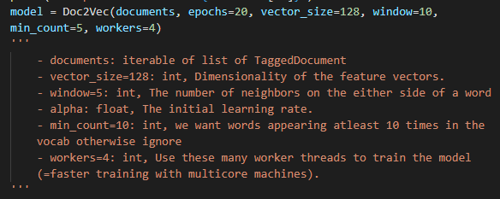
Text Embedding: Doc2vec
Implementation:
Use gensim package to generate the Doc2Vec model
Input ➔ Output
movie’s overview
Vector representation

Slide 26
Text embedding

Slide 27
Collaborative Filtering:
Based on the similarity of two user: e.g., “The user watched this movie are also like…”
Doesn’t depends on any algorithm but other users' behavior. Dynamic model, information update automatically.
Two main types of memory-based collaborative filtering algorithm:
User-User Collaborative Filtering: Find the look-alike user based on current user favorite movie, and recommend movie based on look-alike user’s history. This algorithm is effective but time consuming to compute the user pair information for a large database.
Iterm-Iterm Collaborative Filtering: Instead of finding look-alike user, we try to find the look-alike movies, the movie have similar categories, tagging, entity, rating and etc. Lett time consuming, especially for a new user.
Courtesy: https://medium.com/datadriveninvestor/how-to-built-a-recommender-system-rs-616c988d64b2
Notes:
The collaborative filtering is based on the idea that, the user who have agreed in the past tend to also agree in the future. For example to the picture at the right, we see the User-4 bought Iterm-1 and Iterm-2, in the meantime, we observed that all three users (User1-3) agreed the Item-3 is worth purchasing in the past, hence we can assume the Item-3 is something worth for the User-4 to purchase as well.

Slide 28
Content-Based Filtering
Idea: The content-based recommender relies on the similarity of the items being recommended. For example, if you like an item, then there is higher change you will like a “similar” item under the same categories.
There are two way to obtain the information from user, explicit and implicit extraction. Explicit extraction is directly asking user questions. Implicit extraction is based on unspoken data, such as users' profiles, a set of actions on browser session.

Slide 29

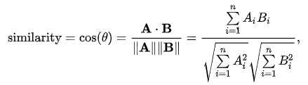

Collaborative Filtering: Jaccard Vs Cosine Vs Pearson
Jaccard similarity: aka Jaccard index, intersection over union
Cosine similarity: The distance(the length of the component of B points in the same direction as A) decrease with the increasing value of angle between A and B
Pearson Similarity: aka Pearson correlation coefficient. Measure the linear correlation between X and Y
Notes:
Courtesy:
Jaccard similarity:
https://en.wikipedia.org/wiki/Jaccard_index
Cosine similarity
https://en.wikipedia.org/wiki/Cosine_similarity
https://masongallo.github.io/machine/learning,/python/2016/07/29/cosine-similarity.html

