Slide 1
Movie Recommender
Group member： Zhengqi Dong, Yuntian He
Email: {dong.760, he.1773}@osu.edu

Slide 2
1. Background

Slide 3
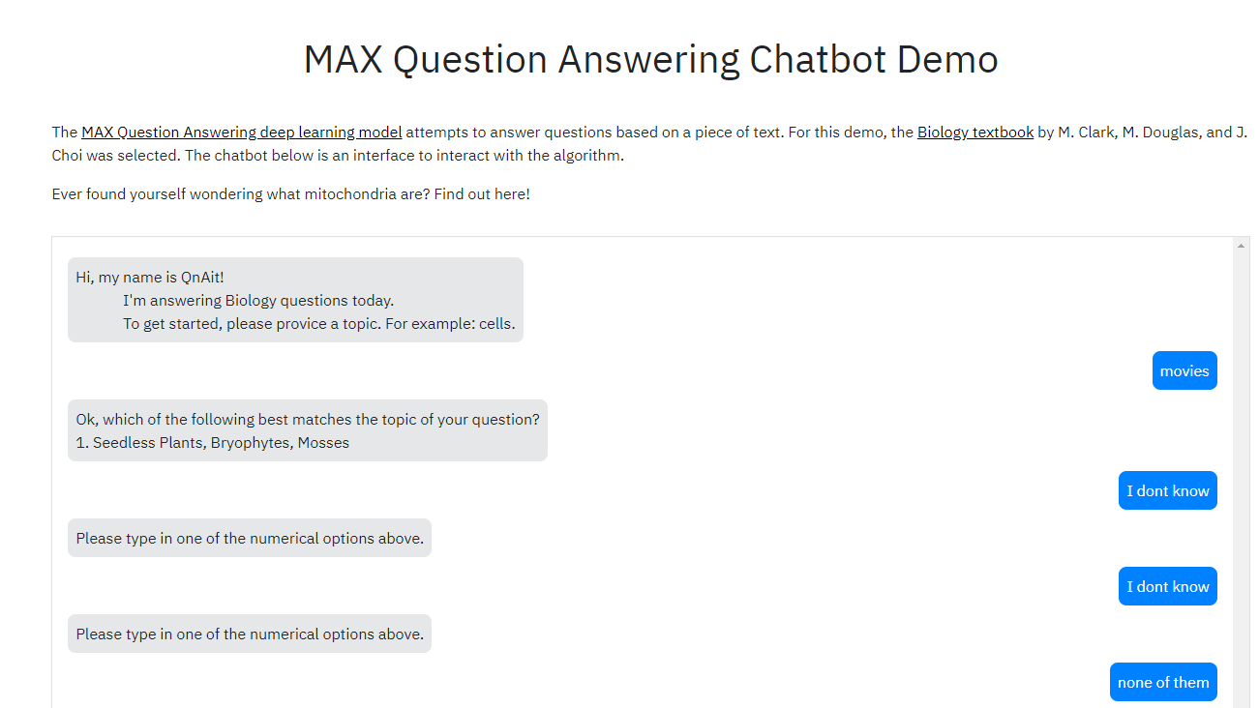

Slide 4
Getting start
To get start making recommendation, we first need to understand the type of movie the user is looking for. The more information we know about user, the more accurate our recommender engine would be. The following procedures are conducted to guide the conversation:

Slide 5
Approaches for movie recommender
Content-Based Filtering
Memory-Based Collaborative Filtering
Model-Based Collaborative Filtering
Deep Learning/Neural Network

Slide 6
1. Content-Based Filtering

Slide 7
Content-Based Filtering
Idea: The content-based recommender relies on the similarity of the items being recommended. For example, if you like an item, then there is higher change you will like a “similar” item under the same categories.
There are two way to obtain the information from user, explicit and implicit extraction. Explicit extraction is directly asking user questions. Implicit extraction is based on unspoken data, such as users' profiles, a set of actions on browser session.

Slide 8
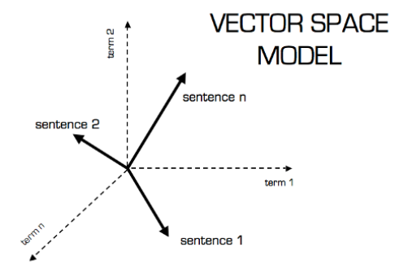
Content-Based Filtering: TFIDF

Slide 9
2. Collaborative Filtering

Slide 10
Collaborative Filtering:
Based on the similarity of two user: e.g., “The user watched this movie are also like…”
Doesn’t depends on any algorithm but other users' behavior. Dynamic model, information update automatically.
Two main types of memory-based collaborative filtering algorithm:
User-User Collaborative Filtering: Find the look-alike user based on current user favorite movie, and recommend movie based on look-alike user’s history. This algorithm is effective but time consuming to compute the user pair information for a large database.
Iterm-Iterm Collaborative Filtering: Instead of finding look-alike user, we try to find the look-alike movies, the movie have similar categories, tagging, entity, rating and etc. Lett time consuming, especially for a new user.

Slide 11
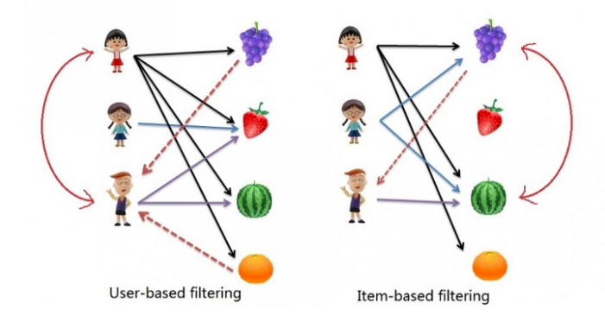
Collaborative Filtering: User-similarity Vs Iterm-similarity
UserA
UserB
UserC
Notes:
User-similarity: UserC like two item in the facorite list of UserA ➔ So UserC should also like the another two
Iterm-similarity: UserA and UserB both like grape and watermelon, so if UserC like watermelon, he should like grape as well.

Slide 12

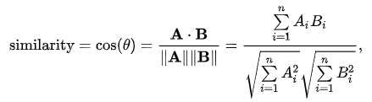

Collaborative Filtering: Jaccard Vs Cosine Vs Pearson
Jaccard similarity: aka Jaccard index, intersection over union
Cosine similarity: The distance(the length of the component of B points in the same direction as A) decrease with the increasing value of angle between A and B
Pearson Similarity: aka Pearson correlation coefficient. Measure the linear correlation between X and Y
Notes:
Courtesy:
Jaccard similarity:
https://en.wikipedia.org/wiki/Jaccard_index
Cosine similarity
https://en.wikipedia.org/wiki/Cosine_similarity
https://masongallo.github.io/machine/learning,/python/2016/07/29/cosine-similarity.html

Slide 13
3. Model-Based Collaborative Filtering

Slide 16
4. Deep Learning approach

Slide 19
