Slide 1

Presented By: Sidharth Srinivas Padhee

Slide 2

Hello, Gradle!
From mobile apps to microservices, from small startups to big enterprises, Gradle helps teams build, automate and deliver better software, faster.

Slide 3
Ant
Offers Extreme Flexibility to the User.
No Dependency Management Infrastructure.
Uses XML for Build Configuration.
Complex Build Files.

Slide 4
Maven
Offered Rigid Standards
Support for Dependency Management
Standards became Overbearing
Uses XML for Build Configuration.
Complex Build Files.

Slide 5
Gradle
Sensible Middle Ground of ANT and MAVEN.
Organisation and Project Specific Build Standards
Building Files in GROOVY
Domain Specific Build Languages.

Slide 6
Gradle vs Maven

Slide 7
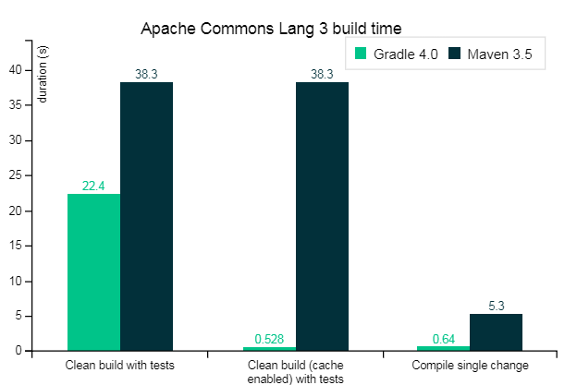
Gradle vs Maven

Slide 8



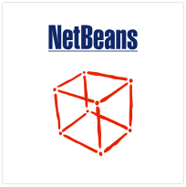


Gradle Support

Slide 9
Demonstration
Gradle Tasks

Slide 10
Types of Tasks
Copy
Delete
Exec
Text Expansion
CodeNarc
FindBugs
GenerateBuildDashboard
Many More…

Slide 11
Demonstration
Gradle Single Project Build

Slide 12
Configurations
compile
runtime
testCompile
testRuntime

Slide 13
Demonstration
Gradle Multi Project Builds

Slide 14
Demonstration
Gradle Jenkins Build

