Slide 1



Slide 2
What is Liquibase?
Liquibase is an open source database-independent library for tracking, managing and applying database schema changes.
Database changes are stored in an XML (or JSON, YAML, plain-ish SQL) file that is version controlled and database independent.

Slide 3
Features
Changeset
A changeset is uniquely identified change that should be applied to the database
When Liquibase runs, it queries the DATABASECHANGELOG table for the changesets that are marked as executed and then executes all changesets that have not yet been executed.

Slide 4
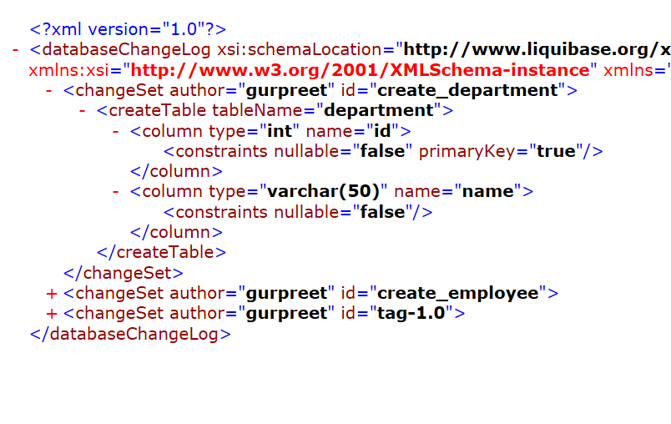
Features
Changeset

Slide 5
Features
Auto Rollback Changes
By tag
rollback 1.0
By count
rollbackCount 2
By time
rollbackLastHours
rollbackToDate
For some statements like <modifyDataType> need to explicitly specify the <rollback> statements.

Slide 6
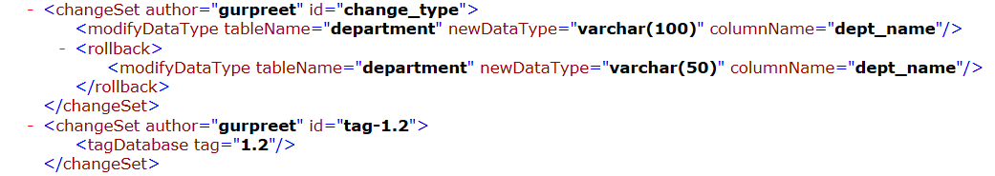
Features
<rollback>

Slide 7
Features
Generate Change Log from existing tables
Use liquibase to generate change log file for existing tables and use them to add new changeSets.

Slide 8
Supported Refactorings
Structural Refactorings
Add Column
Rename Column
Modify Column
Drop Column
Alter Sequence
Create Table
Rename Table
Drop Table
Create View
Rename View
Drop View
Merge Columns
Create Stored Procedure
Data Quality Refactorings
Add Lookup Table
Add Not-Null Constraint
Remove Not-Null Constraint
Add Unique Constraint
Drop Unique Constraint
Create Sequence
Drop Sequence
Add Auto-Increment
Add Default Value
Drop Default Value

Slide 9
Supported Refactorings
Referential Integrity Refactorings
Add Foreign Key Constraint
Drop Foreign Key Constraint
Drop All Foreign Key Constraints
Add Primary Key Constraint
Drop Primary Key Constraint
Non-Refactoring Transformations
Insert Data
Load Data
Load Update Data
Update Data
Delete Data
Tag Database
Stop

Slide 10
runAlways attribute
<changeSet id="1" author=“gurpreet" runAlways="true" context=“test”>
……
</changeSet>

Slide 11
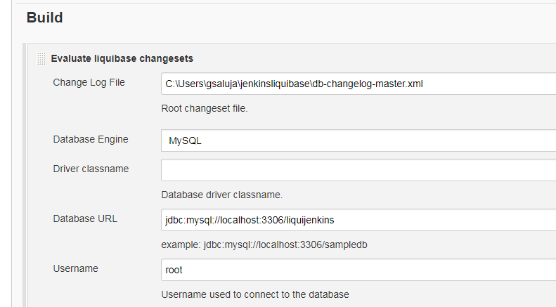
Jenkins Integration
Liquibase Runner Plugin

Slide 12
Live Demo

Slide 13
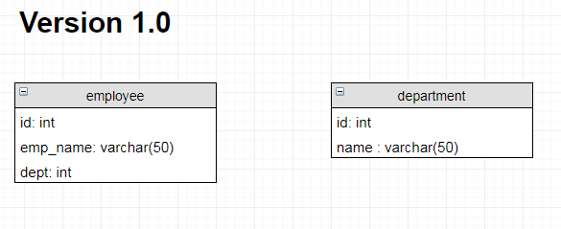

Slide 14
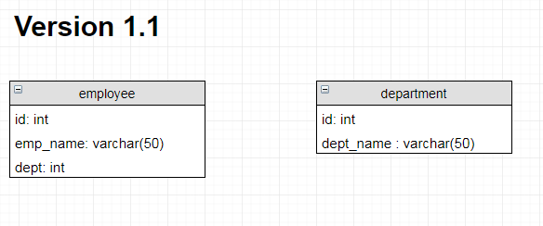

Slide 15
