Slide 1
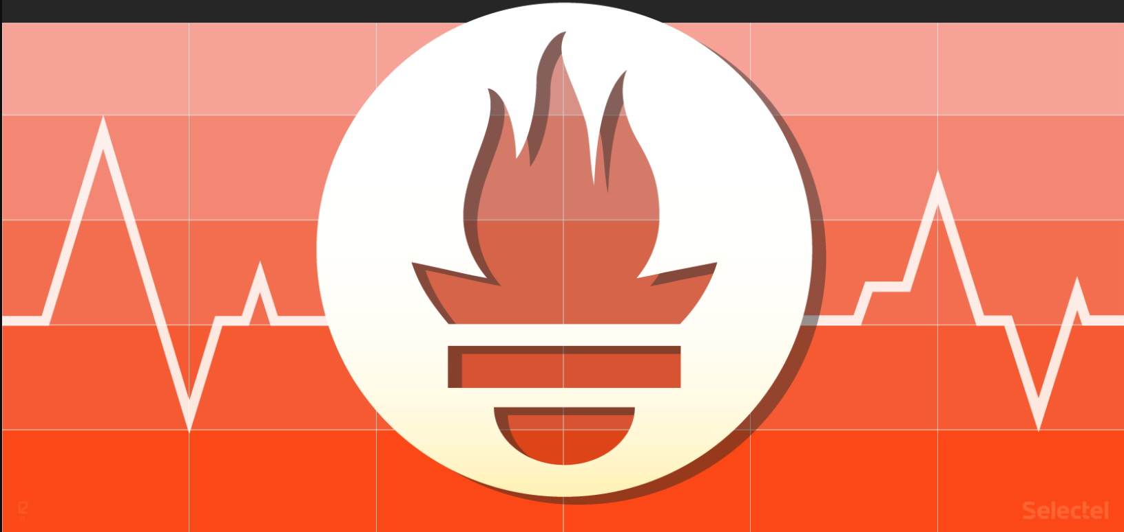
Prometheus: From Metrics to Insight

Slide 2
Prometheus
Prometheus is an open source monitoring and alerting solution that gathers time-series based numerical data.
Querying, Alerting, Graphing, Dashboarding.
Inspired by Google’s monitoring system, Borgmon.

Slide 3
Features
Multi Dimensional data model
api_http_requests_total { method="POST", status="200" }

Slide 4
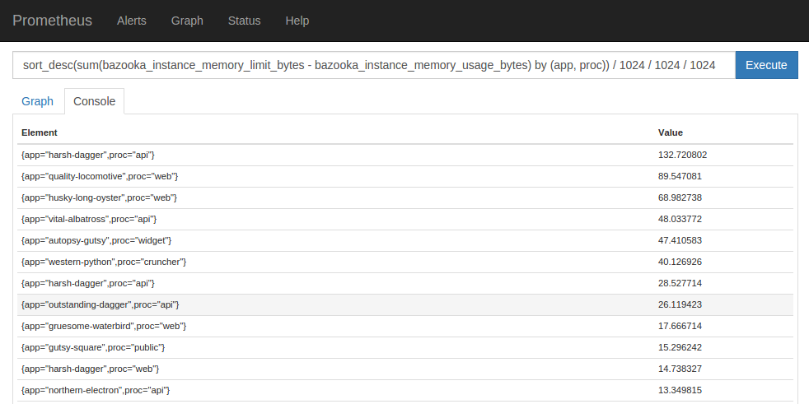
Features
Powerful Query Language (PromQL)
Allows us to slice and dice the dimensional data for ad-hoc exploration, graphing, and alerting.

Slide 5
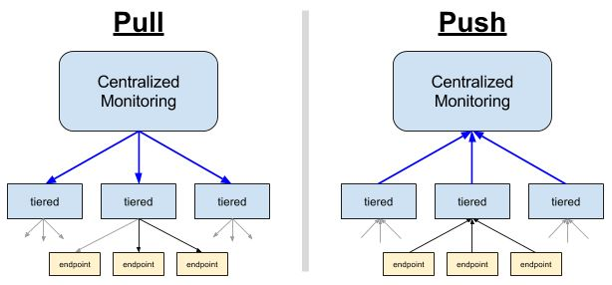
Features
Pull based metric collection
Push, metrics are periodically sent by each monitored system to a central collector.
Pull, a central collector periodically requests metrics from each monitored system.

Slide 6
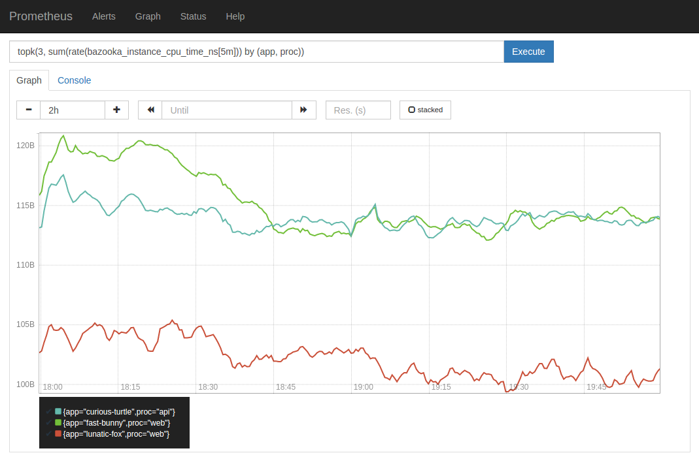
Features
Built-in Graphing

Slide 7
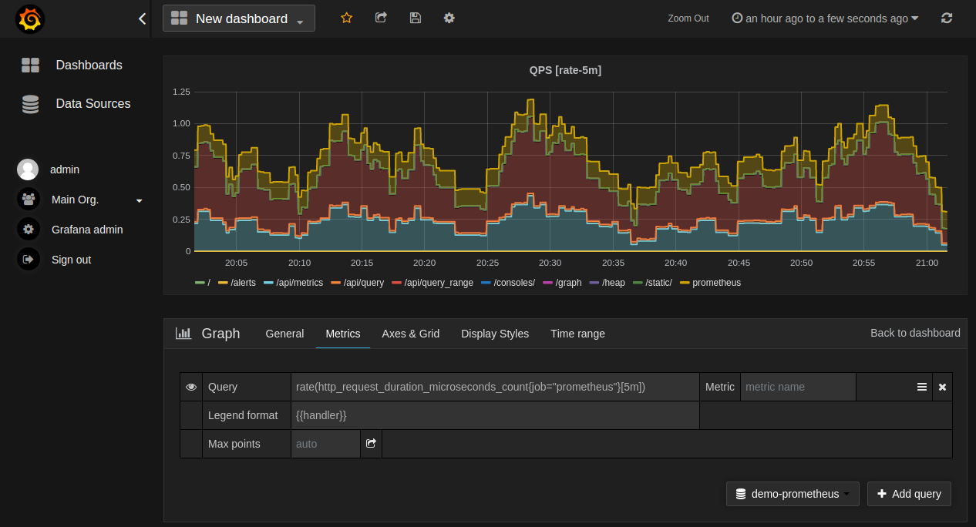
Features
Dashboarding
For a much richer and user friendly experience.

Slide 8
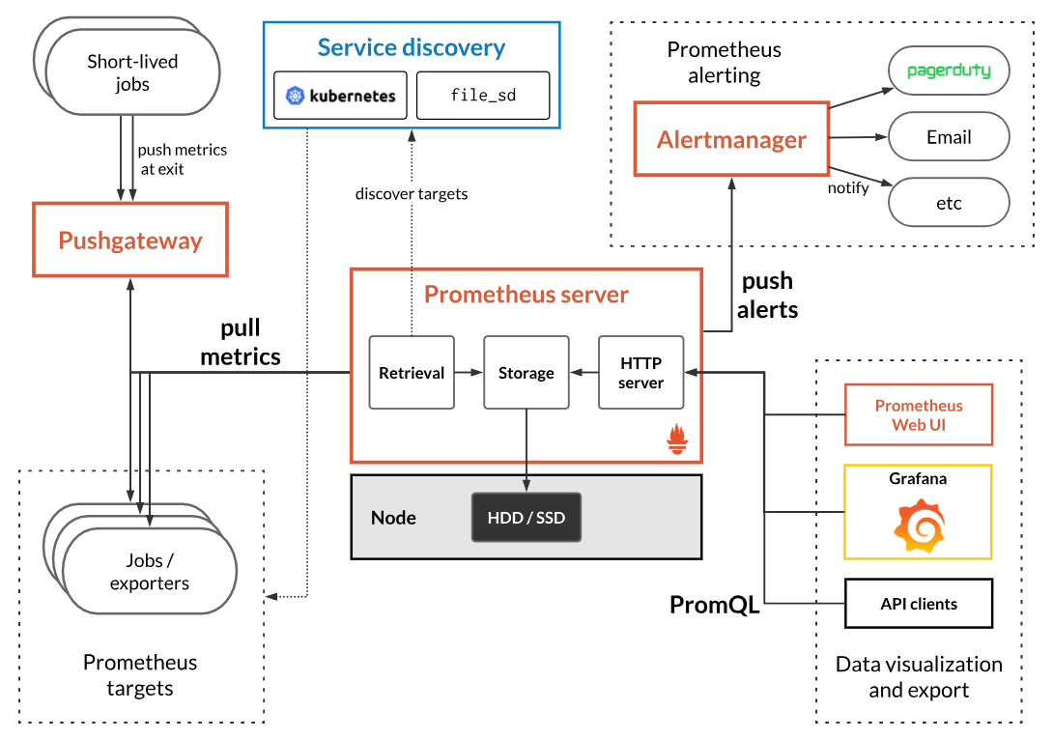
Architecture

Slide 9
Live Demo

