Slide 1
Summary of the POC’s
Sidharth Padhee

Slide 2
Technologies Kubernetes Gradle Docker Standard Template

Slide 3
Kubernetes
Open Source tool to automate the deployment, scaling and management of containerized applications.
Concepts Explored:
The advantage of containers over traditional Virtual Machine approach for deploying apps.
Microservice architecture and the need for a tool to manage a large number of containers ~ Kubernetes.
Architecture overview and terms associated with Kubernetes.

Slide 4
Kubernetes
Concepts Explored:
Created a 1 master, 1 worker node cluster on cloud and configured kubernetes on it.
Deployment of a “nodejs chat server” app on the cluster in a docker container.
Live Demo of:
Scaling of the application by creating replicas.
Rolling update on the app with zero downtime.
Other commands to manage the cluster.

Slide 5
Kubernetes
New Technologies Learned :
Docker - to create containerized applications.
Vagrant - to setup multiple ubuntu boxes on our local machines.
Minikube - lightweight version of Kubernetes for a single node cluster, used on testing level.
Kubeadm - multi node cluster version of Kubernetes, used on production level.

Slide 6
Gradle
Gradle is a flexible yet model driven JVM based build tool.
Concepts Explored:
Why Gradle is a better build solution when compared to Ant and Maven.
sensible middle ground between both extremes.
Much Faster solution due to Gradle Daemon and Intelligent Caching.

Slide 7
Ant
Offers Extreme Flexibility to the User.
No Dependency Management Infrastructure.
Uses XML for Build Configuration.
Complex Build Files.

Slide 8
Maven
Offered Rigid Standards
Support for Dependency Management
Standards became Overbearing
Uses XML for Build Configuration.
Complex Build Files.

Slide 9
Gradle
Sensible Middle Ground of ANT and MAVEN.
Organisation and Project Specific Build Standards
Building Files in GROOVY
Domain Specific Build Languages.

Slide 10
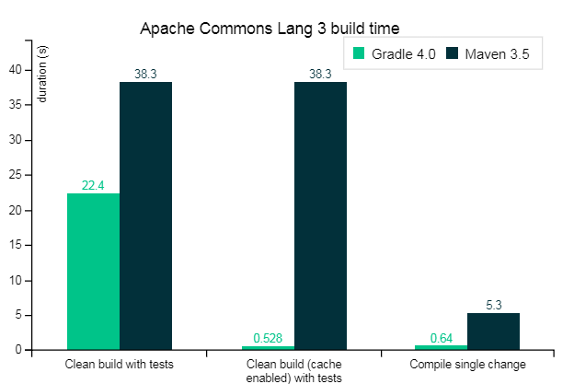
Gradle vs Maven

Slide 11
Gradle
Live Demo of:
Using Gradle Tasks to automate Test and Release Process
Showing Gradle Scans with proper statistics
Building A single Project Java Application.
Demonstrating a multi Project Build that contained 3 project modules.

Slide 12
Gradle
New Technologies Learned :
Groovy Scripts – Basics of groovy language and how it is used in Gradle
Gradle – Build Tool.

Slide 13
Docker
Using Docker Containers to set-up an image for a standard developer environment.
Concepts Explored:
Docker as an Abstraction when compared to Virtual Machines
Developed a docker image that could be directly used by any developer for instant Development.
UI integration using X server.

Slide 14
Docker
Live Demo of:
Standard Docker Template with all the required packages
Another Specific Container created for Eclipse GUI.
Used Windows X – Server to generate GUI of a Containerized application.

Slide 15
Docker
New Technologies Learned :
Docker – Writing flexible and Ephemeral Dockerfiles.
Windows X-server – Generate GUI of applications inside Virtual Machines or Containers.

