Slide 1
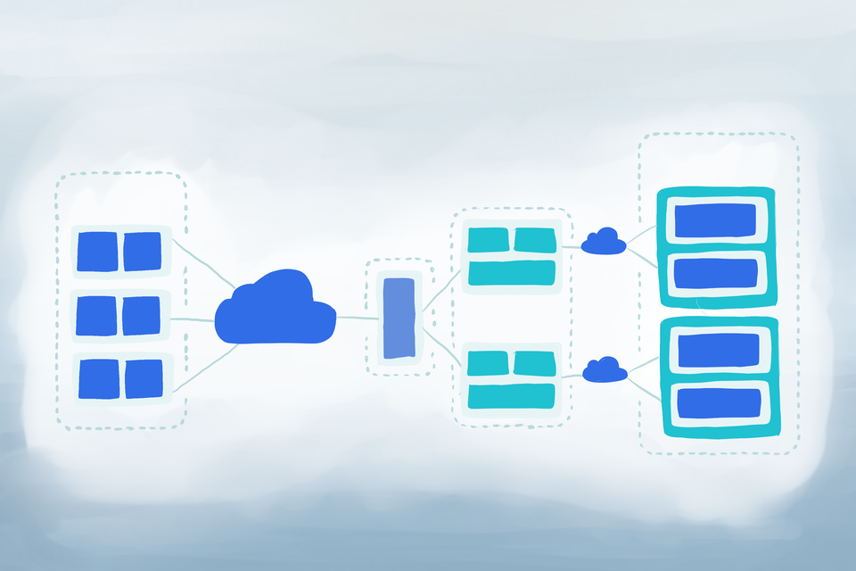
Kubernetes: A container Orchestration Tool

Slide 2
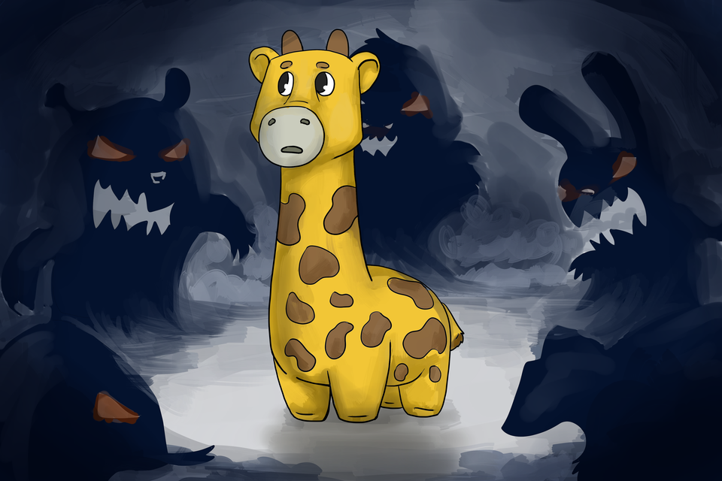
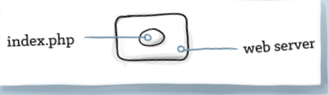
The Environment
The app itself
Supporting structure
The Web Server
Various pieces of the OS

Slide 3
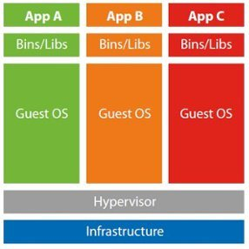
Virtual Machines

Slide 4
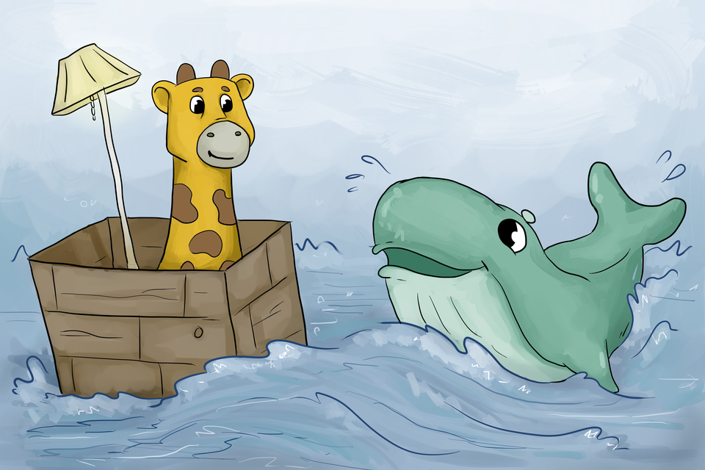
Containers
A container is a uniform structure in which any application can be stored, transported and run. It is named for and often compared to the standardized intermodal containers used in the shipping industry for efficient transportation.

Slide 5
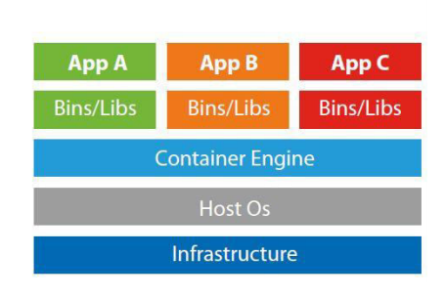
Containers

Slide 6
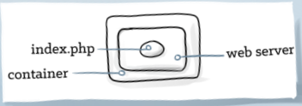
Problems with Containers
Need to be managed
Networking is Hard
Containers must be scheduled, distributed and load balanced
And the data’s got to persist somewhere

Slide 7
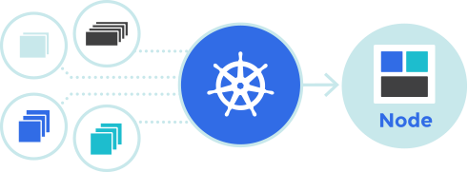
Kubernetes
Kubernetes focuses on building a robust platform for running thousands of containers in production.

Slide 8
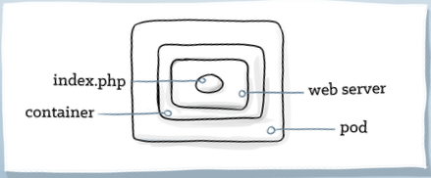
Pods
A pod can hold any number of containers
A pod is connected via an overlay network to the rest of the environment

Slide 9
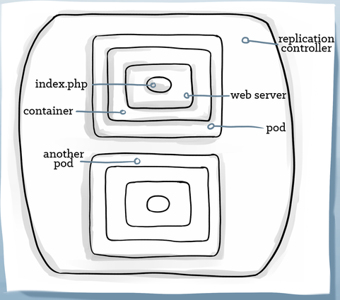
Replication Controllers
Have a pod template for creating any number of pod copies.
Provide logic for scaling the pod up or down
Can be used for rolling deploys

Slide 10
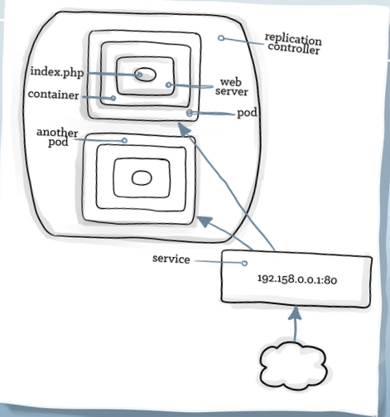
Services
Persistent
Provide Discovery
Provide Load Balancing
Provide stable service address
Find pods by label selector

Slide 11
Demonstration and Architecture Overview

Slide 12
Minikube
Minikube is a lightweight Kubernetes implementation.
Deploys a simple cluster containing only one node.

Slide 13
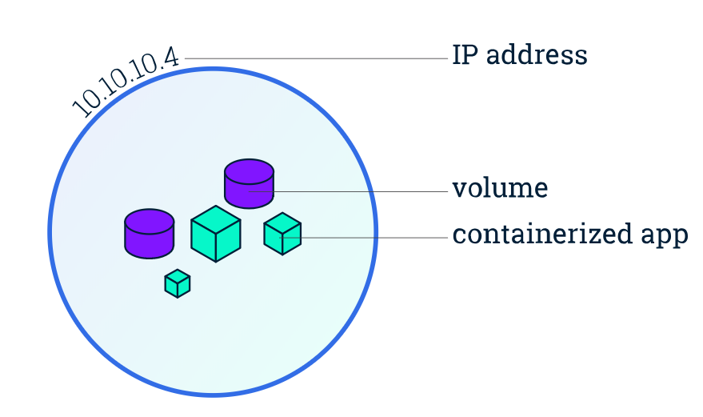
Kubernetes Pod

Slide 14
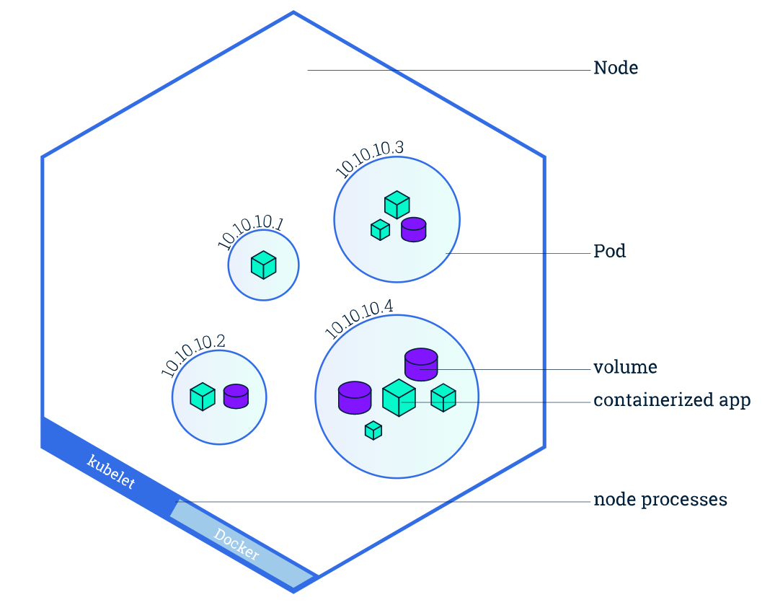
Kubernetes Node

Slide 15
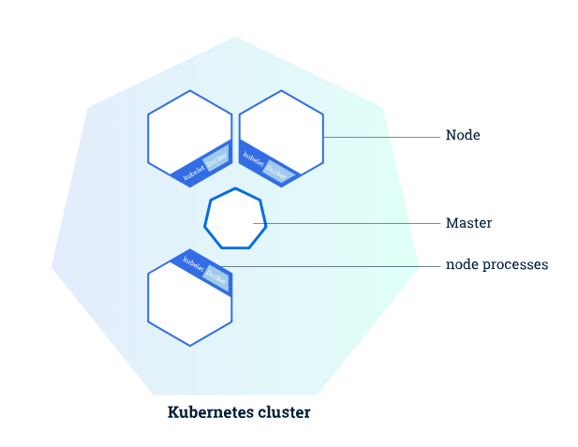
Kubernetes Cluster (kubeadm)
The Master is responsible for managing the cluster.
The worker nodes communicate with the master using the Kubernetes API

Slide 16
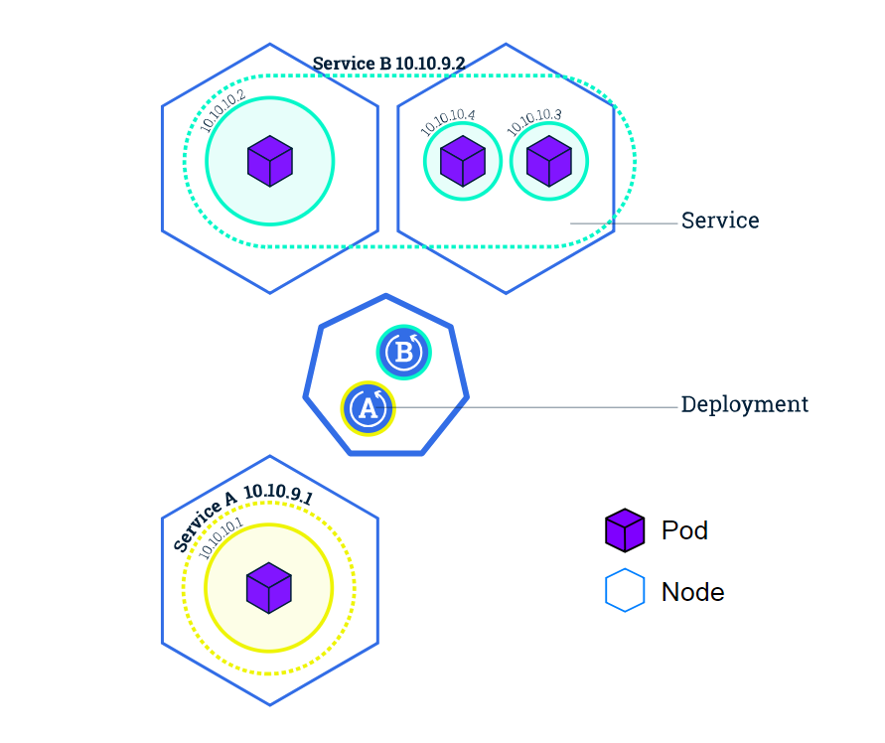
Kubernetes Service

Slide 17
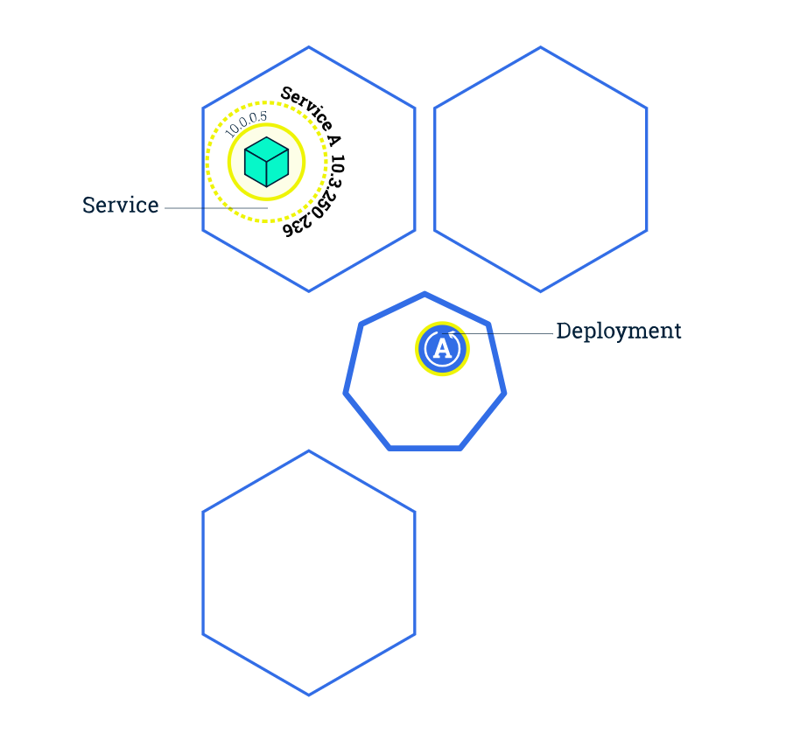
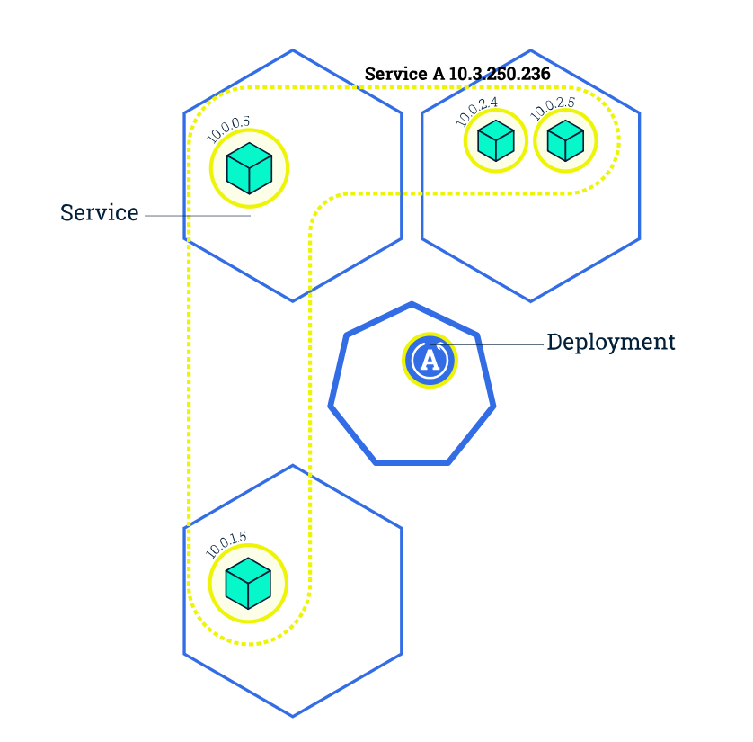
Scaling in Kubernetes

Slide 18

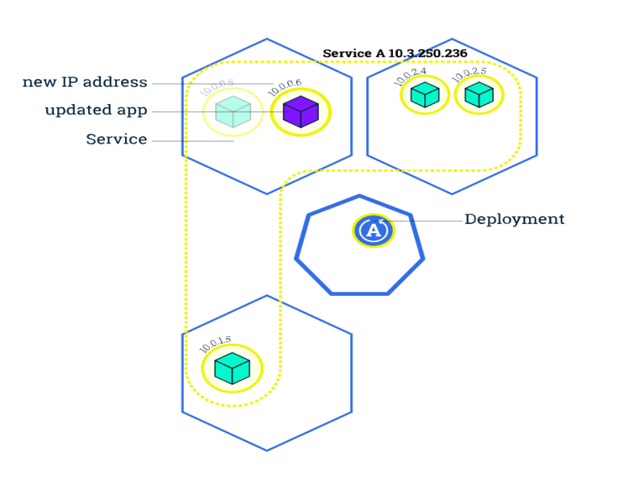
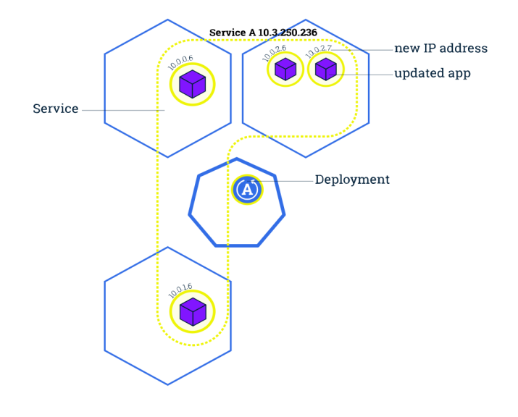

Rolling Updates

Slide 19

Much more to Explore!!

