Slide 1
Can I really type THAT in TypeScript!?
Tițian Cernicova-Dragomir

Slide 2
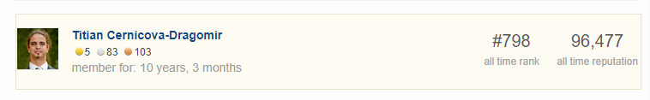
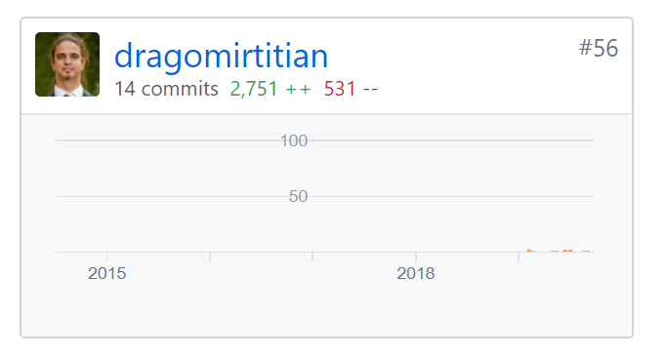


About me – Typescript Fan

Slide 3
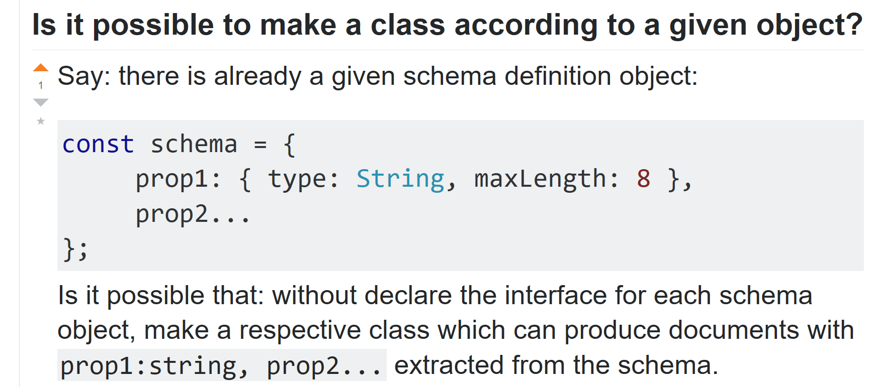
Title and Content Layout with List
sss

Slide 4
Can we enforce specific keys on a property definition ?

Slide 5
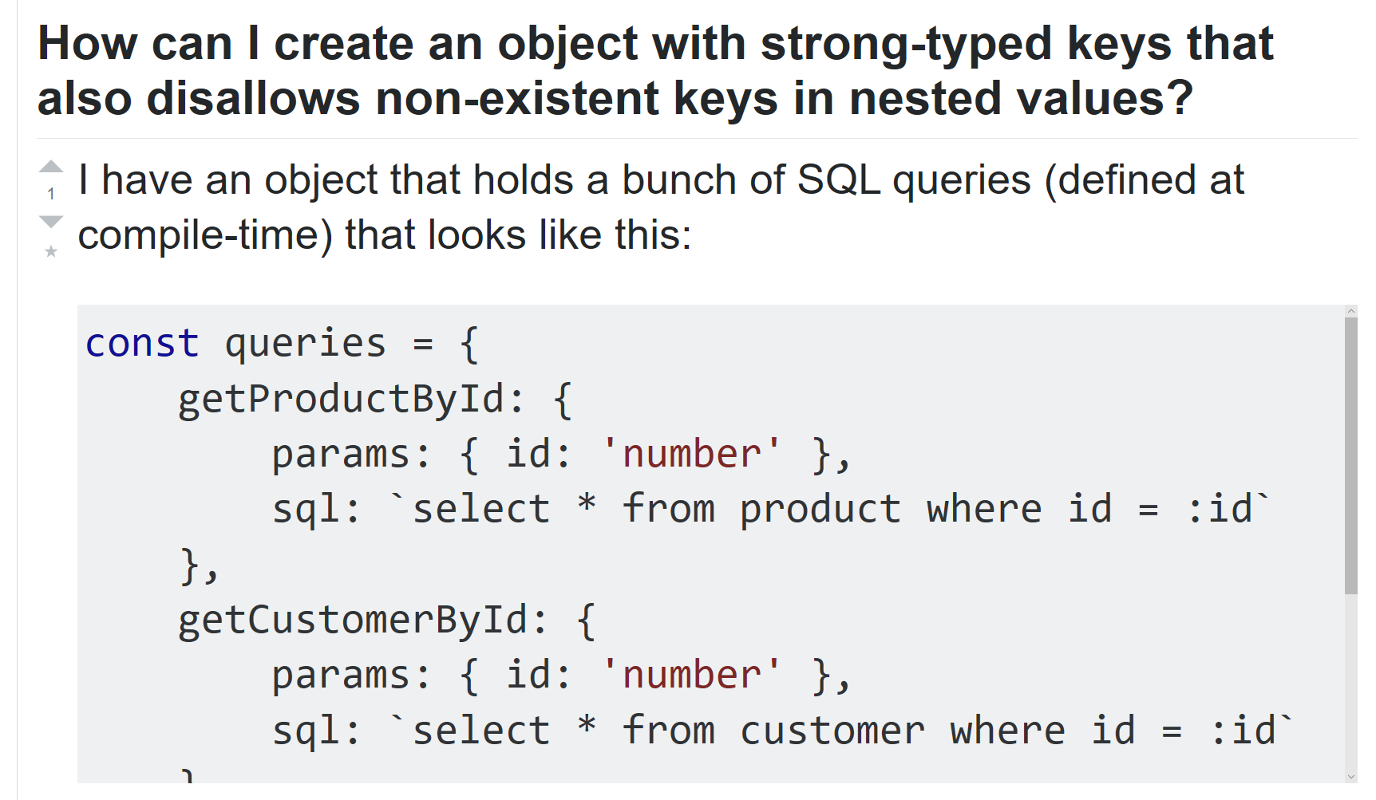

Slide 6
Can we extract type information from a property definition ?

Slide 7
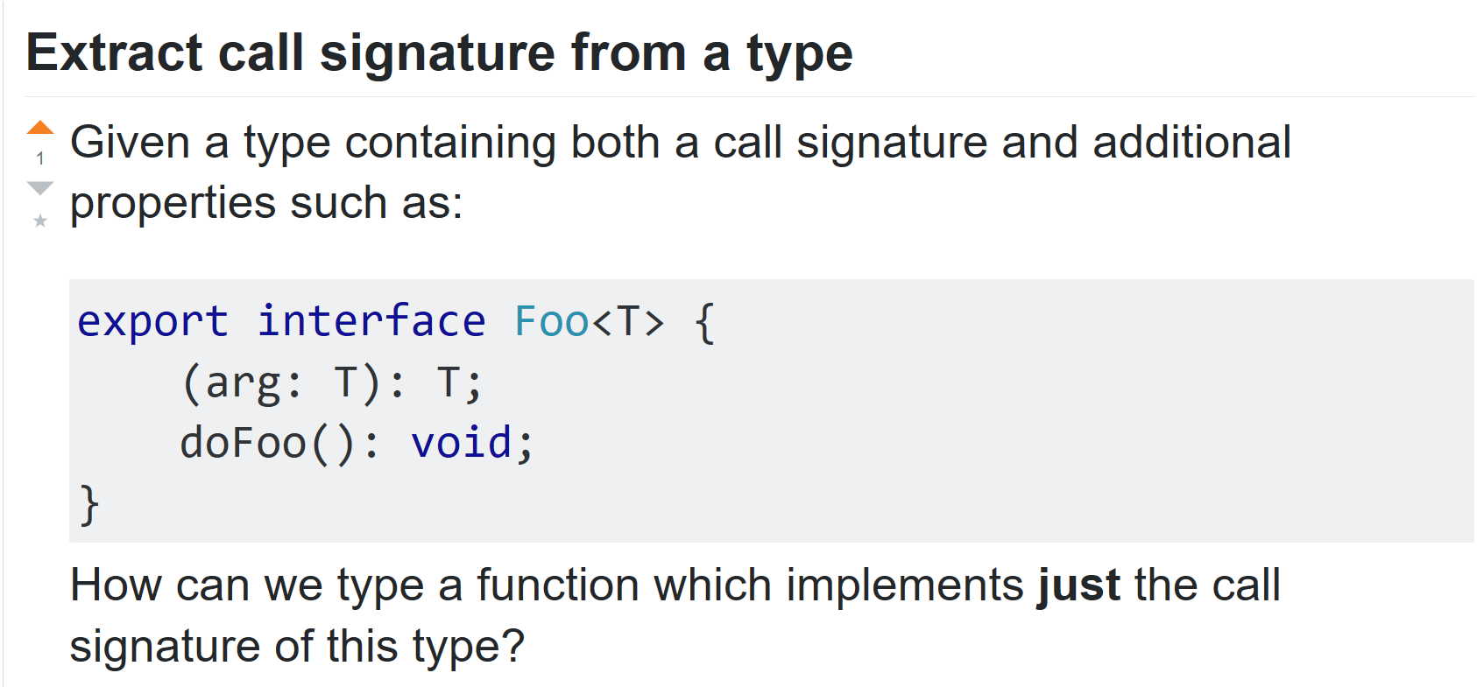

Slide 8
Can we extract all properties ?

Slide 9
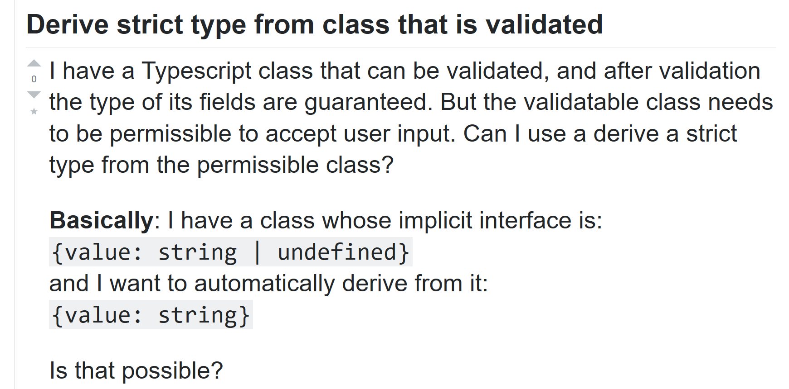
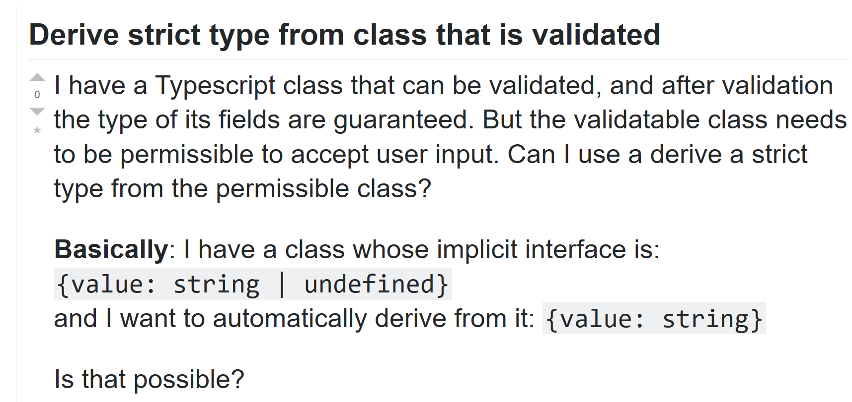

Slide 10
Can we have optional properties?

Slide 11
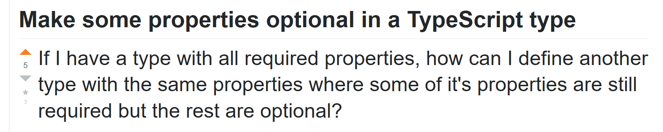

Slide 12
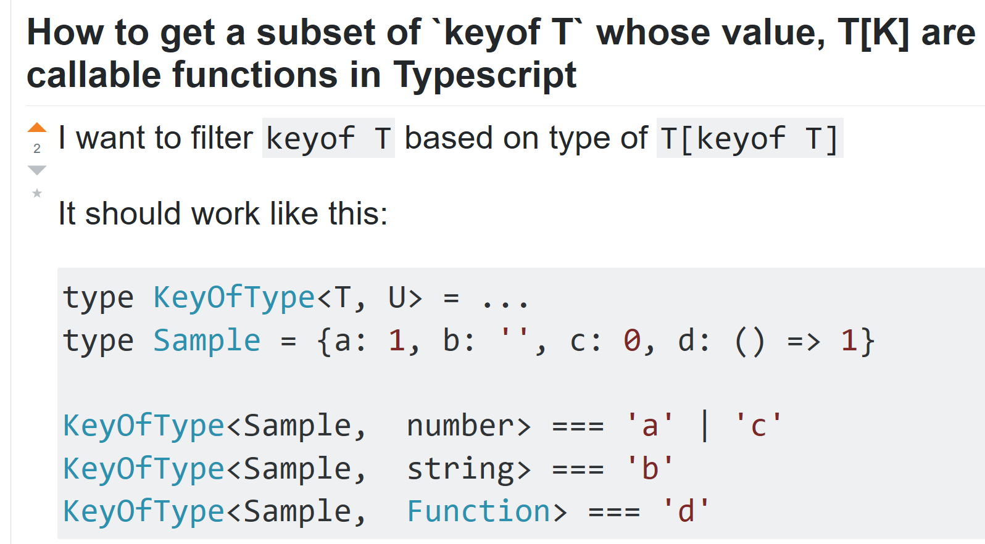

Slide 13
Can we keep type names ?

Slide 14
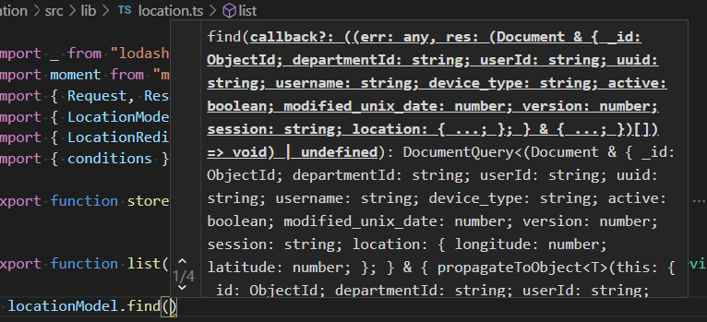

Slide 15
Thank you !
https://github.com/dragomirtitian/revojs2019 @TitianCernicova

