Slide 1
程式期末Project
組長：黃丞毅 組員:蘇立誠 李瑞龍 鐘宇弼 報告日期: 01/13

Slide 2
工作分配
程式想法：全體
黃丞毅：程式主要判斷
蘇立誠：流程圖、設定和抽牌
李瑞龍：github統整、下注
鍾宇弼：泡沫排序、判斷大小

Slide 3
5.h
void set(card poker[], int num[], int suit[]) //設定牌
{
int i;
for (i = 0; i < 52; i++)
{
poker[i].num = num[i % 13];
poker[i].suit = suit[i / 13];
}
}

Slide 4
5.h
void incard(card cards[], int num[], int suit[], int bark) //抽牌
{
int i;
int a;
if (bark == 1)
{
for (i = 0; i < 5; i++)
{
do
{
a = rand() % 52;
num[i] = cards[a].num;
suit[i] = cards[a].suit;
} while ((cards[a].num == 0) && (cards[a].suit == 0)); //重複重抽
cards[a].num = 0;
cards[a].suit = 0;
}
bubble(num, suit);
}

Slide 5
5.h
else
{
for (i = 0; i < 5; i++)
{
num[i] = 14;
suit[i] = 5;
}
}
}

Slide 6
19.h
int judge(const char *suit_name[], int num[], int suit[], int bark) //判斷
{
int i, j;
int a, b, c;
int suits = 0;
int continues = 0;
int judges;
int pokernum[13] = { 0 };
int renum[5] = { 0 };
if (bark == 1)
{
for (i = 0; i < 4; i++) //同花色，suits=4全部同花色
{
if (suit[i] == suit[i + 1])
suits = suits + 1;
}
for (i = 0; i < 5; i++) //1~13的數字有幾個
{
pokernum[num[i] - 1] = pokernum[num[i] - 1] + 1;
}

Slide 7
19.h
for (i = 0; i < 9; i++) //順子
{
if (((pokernum[i] == 1) && (pokernum[i + 1] == 1) && (pokernum[i + 2] == 1) && (pokernum[i + 3] == 1) && (pokernum[i + 4] == 1)) || ((pokernum[0] == 1) && (pokernum[9] == 1) && (pokernum[10] == 1) && (pokernum[11] == 1) && (pokernum[12] == 1)))
continues = 1;
}
for (i = 2; i < 5; i++) //重複的數字，renum[i]為重複i次的有幾個數
{
for (j = 0; j < 13; j++)
{
if (pokernum[j] == i)
renum[i] = renum[i] + 1;
}
}

Slide 8
19.h
if (renum[4] == 1) //判斷 雜牌、 一對、 兩對、 三條、 順子、 同花、 葫蘆、 鐵之、 同花順
{
for (i = 0; i < 13; i++)
{
if (pokernum[i] == 4)
a = i + 1;
}
printf("鐵支\t%d鐵\t", a);
if ((a == 1) || (a == 2)) //撲克中1、2最大(1=>14，2=>15)
{
b = a + 13;
}
else
b = a;
judges = 8000 + b; //十位個位是牌的數字
}

Slide 9
19.h
else if ((renum[3] == 1) && (renum[2] == 1))
{
for (i = 0; i < 13; i++)
{
if (pokernum[i] == 3)
a = i + 1;
}
printf("葫蘆\t%d蘆\t", a);
if ((a == 1) || (a == 2)) //撲克中1、2最大(1=>14，2=>15)
{
b = a + 13;
}
else
b = a;
judges = 7000 + b; //十位個位是牌的數字
}

Slide 10
19.h
else if (renum[3] == 1)
{
for (i = 0; i < 13; i++)
{
if (pokernum[i] == 3)
a = i + 1;
}
printf("三條\t三條%d\t", a);
if ((a == 1) || (a == 2)) //撲克中1、2最大(1=>14，2=>15)
{
b = a + 13;
}
else
b = a;
judges = 4000 + b; //十位個位是牌的數字
}

Slide 11
19.h
else if (renum[2] == 2)
{
printf("兩對\t");
for (i = 0; i < 13; i++)
{
if (pokernum[i] == 2)
{
a = i + 1;
printf("%d啤 ", a);
if ((a == 1) || (a == 2)) //撲克中1、2最大(1=>14，2=>15)
{
b = a + 13;
for (j = 0; j < 5; j++)
{
if (num[j] == a)
c = j;
}
}
}
}

Slide 12
19.h
if (b != 14)
{
if (b != 15)
{
b = a;
for (i = 0; i < 5; i++)
{
if (num[i] == a)
c = i;
}
}
}
if (suit[c] < suit[c - 1])
c = c - 1;
judges = 3000 + b * 10 + suit[c]; //十位百位是牌的數字，個位是花色
}

Slide 13
19.h
else if (renum[2] == 1)
{
for (i = 0; i < 13; i++)
{
if (pokernum[i] == 2)
a = i + 1;
}
printf("一對\t%d啤\t", a);
if ((a == 1) || (a == 2)) //撲克中1、2最大(1=>14，2=>15)
{
b = a + 13;
}

Slide 14
19.h
else
b = a;
for (i = 0; i < 5; i++)
{
if (num[i] == a)
c = i;
}
if (suit[c] < suit[c - 1])
c = c - 1;
judges = 2000 + b * 10 + suit[c]; //十位百位是牌的數字，個位是花色
}

Slide 15
19.h
else if ((suits == 4) && (continues == 1))
{
for (i = 0; i < 9; i++)
{
if ((pokernum[i] == 1) && (pokernum[i + 1] == 1) && (pokernum[i + 2] == 1) && (pokernum[i + 3] == 1) && (pokernum[i + 4] == 1))
{
a = i + 1;
b = a + 4;
}
else if ((pokernum[0] == 1) && (pokernum[9] == 1) && (pokernum[10] == 1) && (pokernum[11] == 1) && (pokernum[12] == 1))
{
a = 10;
b = 1;
}
}

Slide 16
19.h
printf("同花順\t%s %d~%d", suit_name[suit[1] - 1], a, b);
judges = 9000 + suit[1] * 100 + a; //十位個位是順子最小的數字，百位是花色
}
else if (suits == 4)
{
printf("同花\t%s\t", suit_name[suit[1] - 1]);
if ((num[4] == 2) || num[3] == 2) //撲克中1、2最大(2=>15)
{
a = 15;
}

Slide 17
19.h
else if (num[4] == 1) //撲克中1、2最大(1=>14)
{
a = 14;
}
else
{
a = num[0];
}
judges = 6000 + suit[1] * 100 + a; //十位個位是牌的數字，百位是花色
}

Slide 18
19.h
else if (continues == 1)
{
for (i = 0; i < 9; i++)
{
if ((pokernum[i] == 1) && (pokernum[i + 1] == 1) && (pokernum[i + 2] == 1) && (pokernum[i + 3] == 1) && (pokernum[i + 4] == 1))
{
a = i + 1;
b = a + 4;
}
else if ((pokernum[0] == 1) && (pokernum[9] == 1) && (pokernum[10] == 1) && (pokernum[11] == 1) && (pokernum[12] == 1))
{
a = 10;
b = 1;
}
}

Slide 19
19.h
printf("順子\t%d~%d\t", a, b);
for (i = 0; i < 5; i++)
{
if (num[i] == b)
c = suit[i];
}
judges = 5000 + a * 10 + c; //十位百位是順子最小的數字，個位是第一位的花色
}

Slide 20
19.h
else
{
printf("雜牌\t\t");
if ((num[4] == 2) || num[3] == 2) //撲克中1、2最大(2=>15)
{
a = 15;
for (i = 0; i < 2; i++)
{
if (num[3 + i] == 2)
b = suit[3 + i];
}
}
else if (num[4] == 1) //撲克中1、2最大(1=>14)
{
a = 14;
b = suit[4];
}

Slide 21
19.h
else
{
a = num[0];
b = suit[0];
}
judges = 1000 + a * 10 + b; //十位百位是最大的數字，個位是最大數字的花色
}
}
else
{
printf("破產\t\t");
judges = 0;
}
printf("\t");
return judges;
}

Slide 22
25.h
int bet(int money[], int bark[]) //下注
{
int i;
int bet;
int total = 0;
printf(" 輸入下注金額(1=> $100)\n ?");
scanf_s("%d", &bet);

Slide 23
25.h
if (100 * bet >= money[0]) //若大於等於本金視為梭哈
{
for (i = 0; i < 4; i++)
{
total = total + money[i];
money[i] = 0;
}
}
else
{

Slide 24
25.h
for (i = 0; i < 4; i++)
{
if (bark[i] == 1) //是否破產
{
if (money[i] < 100 * bet) //若本金不足下注金額，就全押
{
total = total + money[i];
money[i] = 0;
}
else

Slide 25
25.h
{
total = total + 100 * bet;
money[i] = money[i] - 100 * bet;
}
}
}
}
return total;
}

Slide 26
28.h
void bubble(int n[], int s[]) //氣泡
{
int i, j;
int a, b;
for (i = 0; i < 4; i++)
{
for (j = 0; j < 4 - i; j++)
{

Slide 27
28.h
if (n[j] < n[j + 1])
{
a = n[j];
b = s[j];
n[j] = n[j + 1];
s[j] = s[j + 1];
n[j + 1] = a;
s[j + 1] = b;
}
}
}
}

Slide 28
28.h
int maxs(int a, int b, int c, int d) //找最大
{
if (a < b)
a = b;
if (a < c)
a = c;
if (a < d)
a = d;
return a;
}

Slide 29
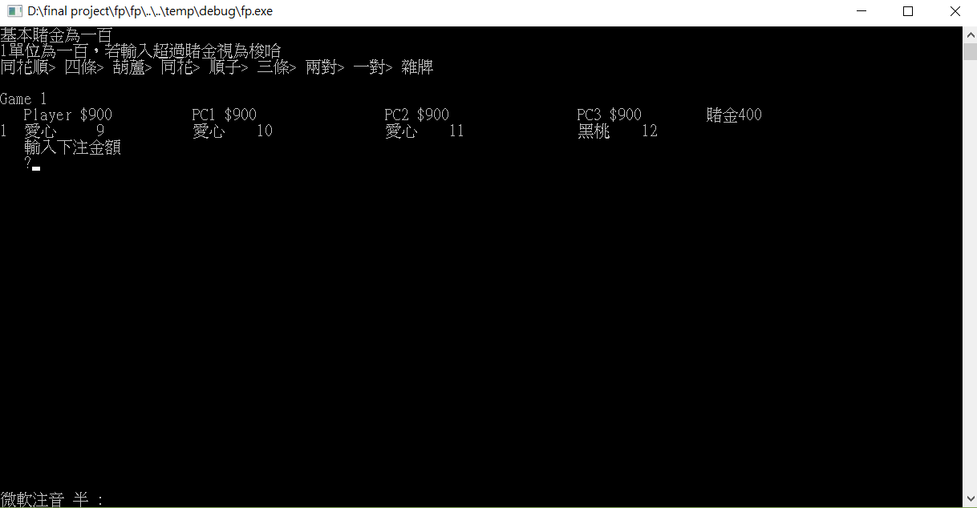
成果

Slide 30
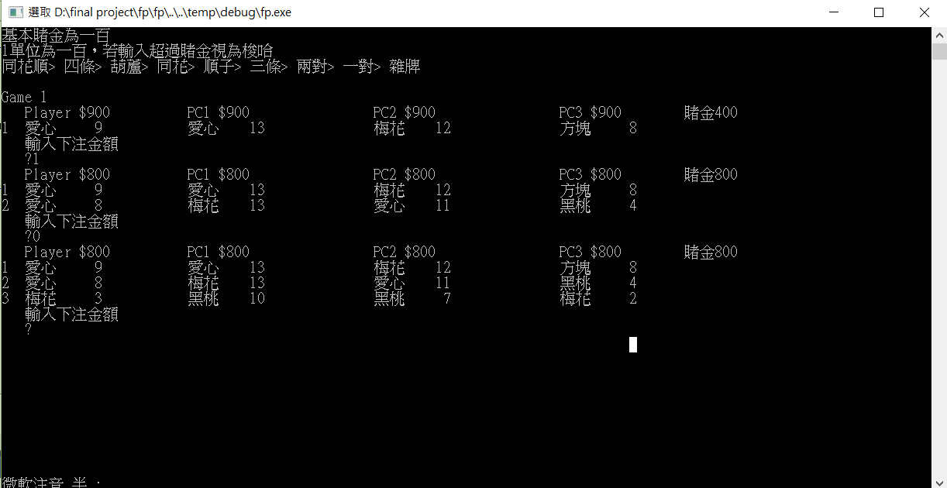
輸入1>>加注100

Slide 31
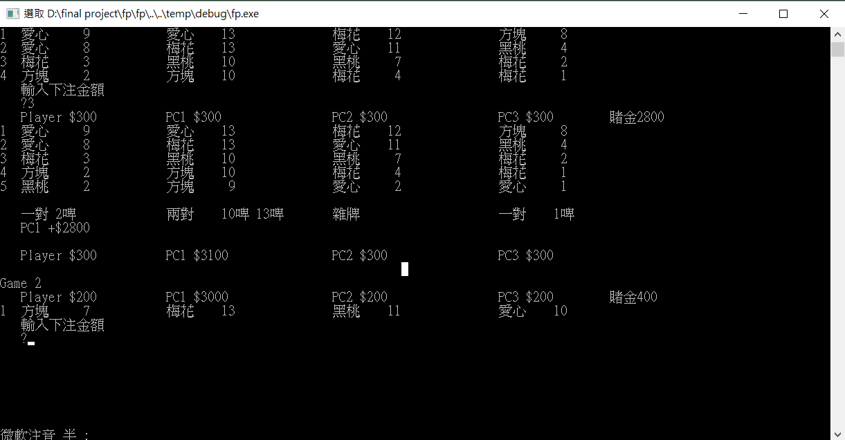

Slide 32
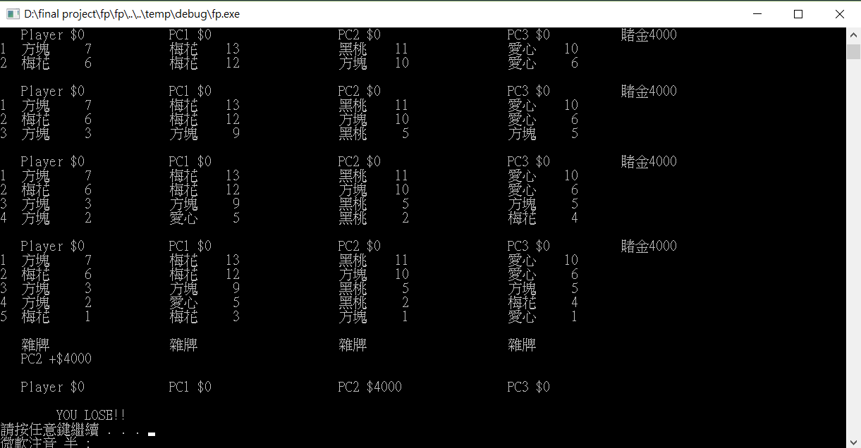
破產惹

Slide 33
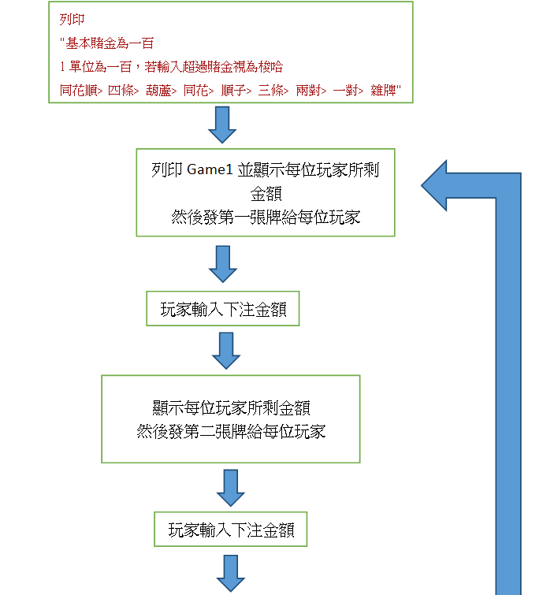
流程圖

Slide 34
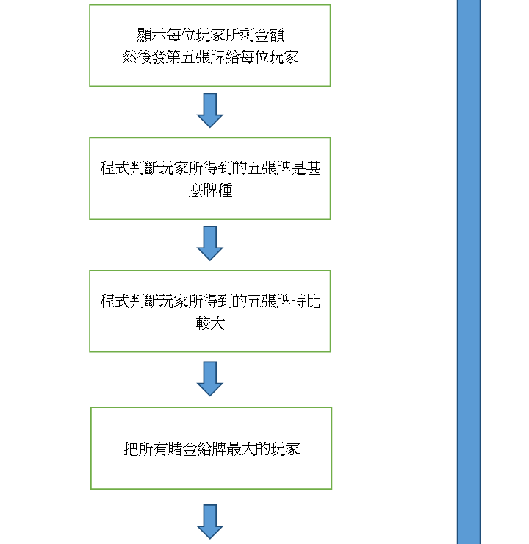

Slide 35
