Slide 1
Programming Assignment I
Due Wednesday 11th March

Slide 2

Introduction ─ The Problem
Here comes the assignment ─ Chatroom !
It seems to be a tradition in this class.
It is usually implemented in a way that the client is always connected to the server.
There may be some problems …
The capacity of the server is very limited ─ the famous C10K problem.
Maintaining permanent connection can be difficult in some environment (ex: bad WiFi signals). Users may experience unexpected disconnection. (!!!)

Slide 3

Introduction ─ The Rescue
Maybe we don't need the permanent link. How about the following ideas ?
A message center is designed to forward the message. It is also used to manage and maintain the client status. (user current status and credential check)
The connection is established when it is necessary.
The client can be paged when a message should be “pushed.”
Some kind of heartbeat mechanism is necessary for the message center to track the client status.

Slide 4

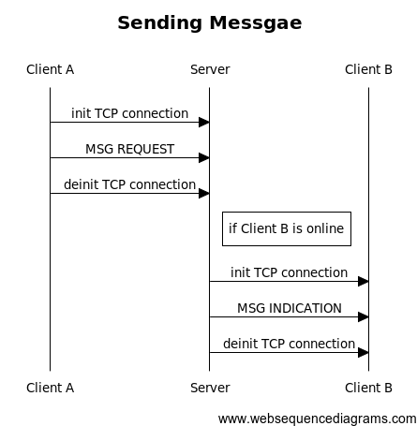
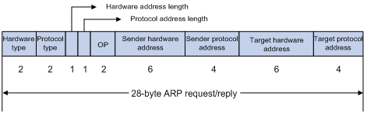


Introduction ─ The Basic Concept
Message Sequence Chart
Your own message format
Your own message flow

Slide 5
Basic Implementation (80 points)
What you need to implement
Server / Message Centre
Client
Message Centre Features
Authenticate users
Route messages from sender to recipient
Timeout inactive users
Allow blocking / unblocking users
Broadcast presence notifications
Store messages for offline users

Slide 6
Basic Implementation
Client Features
Prompt for authentication
Send messages / display messages received from other users
Display server notifications
Find users online
Heartbeat
Possible Bonus Option -
User Interface

Slide 7
Peer-to-peer chat (20 points)
Motivation
Regular Chat via a server is boring - Too mainstream
What if the server goes down? Your chat can still continue!
Also, What if you didn’t want the server to read your messages?
Solution
Talk to your friend directly!

Slide 8
Peer-to-peer chat
What you need to do
Find out how to contact your friend. The chat server has the contact information (IP Address and Listening Port)
Once you know the IP and Port, contact your friend directly.
Both of the above actions have to be performed the private command is used.
Example: private ns2984 Hello!

Slide 9
Peer-to-peer chat bonus (20 points)
Features for bonus points
P2P Privacy and Consent
Guaranteed Message Delivery
These are not your only choices. If you want to implement your own idea for a bonus feature, come talk to one of the TAs to find out if it is bonus-worthy!

Slide 10
Commands - Logging in/out
Start the server
java Server 4009
Start the Client
java Client 10.11.12.13 4009
Login
>Username: foo
>Password: bar
>Welcome to Simple Chat Server
>
Logout
>logout
PORT to listen on
Server’s IP address
Server’s PORT

Slide 11
Commands - Sending Messages
Message a user via server:
>message <user> <message>
Broadcast to all users:
>broadcast <message>
Send message to user directly:
>private <user> <message>
A’s terminal | B’s terminal | C’s terminal
>message B Hi
 | >A: Hi
>broadcast Hi there
 | >A: Hi there | >A: Hi there
>private C Hola
 |  | >A: Hola

Slide 12
Commands – Blocking users
Block a user from sending messages or obtaining private address
>block <user>
Unblock user
>unblock <user>
A’s terminal | B’s terminal | C’s terminal
>block B >User B has been blocked
 | >message A Hi >Your message could not be delivered as the recipient has blocked you
 | >broadcast Hello >Your message could not be delivered to some recipients
 |  | >B: Hello

Slide 13
Commands – Miscellaneous
Print list of all users online
>online
>B, C
Get address of a user and cache for future private message
>getaddress <user>
>ipaddress: 10.11.12.13 port: 8080
Subsequent private commands internally routed to 10.11.12.13, port 8080

Slide 14
Deliverables
Your program will be submitted via courseworks. Please submit a zip file using the format <UNI>_<Programming Language>.zip (e.g. cn1111_python.zip) to the Programming Assignment 1 folder. Make sure you include all of the following files in your zip file:

Slide 15
Deliverables
README.txt: Your readme file should include but not limited to the following parts
A general description of your programming design and data structure
Explanation of your source code (make sure your code is well commented and readable or you will be taken 5-10 points. To avoid such an undesirable scenario, tools like astyle may be helpful.)
Detailed instructions on how to run/compile your source code
Sample commands to run your program
A short introduction of your additional features and sample test cases (Notice: discuss your design of additional features to one of TAs during office hour or post a private message on Piazza before you actually implement them, some features may not be considered “additional”)

Slide 16
Deliverables
Makefile: if you are not familiar with makefile, you can read through the tutorial: http://www.cs.colby.edu/maxwell/courses/tutorials/maketutor/ this article is also helpful: http://www.devin.com/cruft/javamakefile.html
Source code
Other files you think are important

Slide 17
Grading
Functionality | Points
Basic Client/Server Model | 80
- User authentication | 10
- Message exchange | 10
- Multiple clients support | 10
- Heartbeat | 10
- Blacklist | 10
- Offline messaging | 10
- Broadcast | 5
- Display current users | 5
- Logout | 5
- Graceful exit using control + c | 5
Basic P2P Model | 20
- Obtain online user’s IP address | 5
- Offline report | 2
- P2P message exchange | 13
Advanced P2P Features OR other personalized features | 20
- P2P privacy and consent | 10
- Guaranteed message delivery | 10
Note:
50% of the points will be deducted if using permanent connection.
You will get 0 point if we find any plagiarism in your assignment.

Slide 18
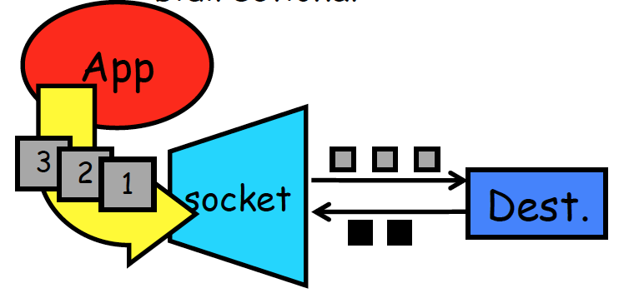
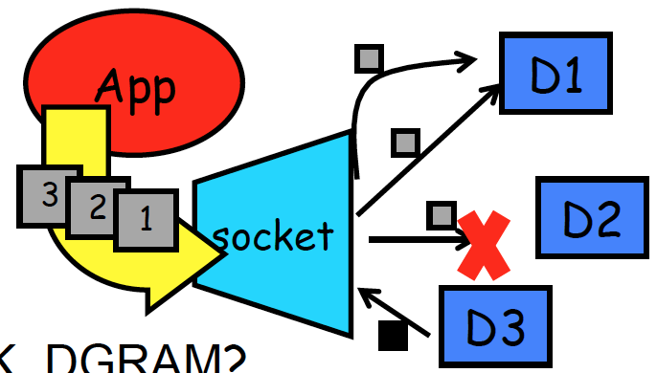
Socket Programming- a door between application process and end-end-transport protocol (UDP or TCP)
C: SOCK_STREAM
JAVA: Socket
a.k.a. TCP
reliable delivery
in-order guaranteed
connection-oriented
bidirectional
C: SOCK_DGRAM
JAVA: DatagramSocket
a.k.a. UDP
unreliable delivery
no order guarantees
no notion of “connection” – app includes dest. in packets
can send or receive

Slide 19
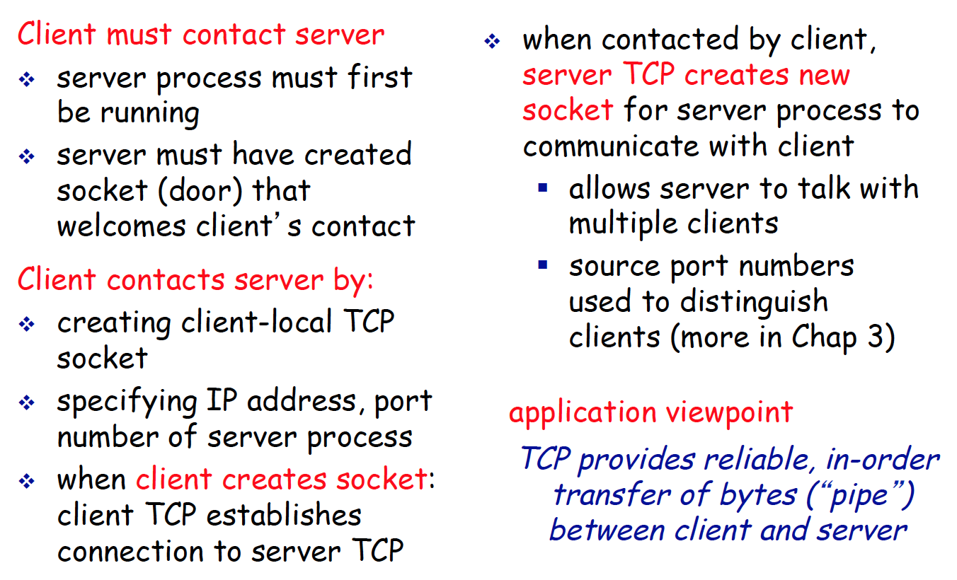
Socket programming with TCP

Slide 20
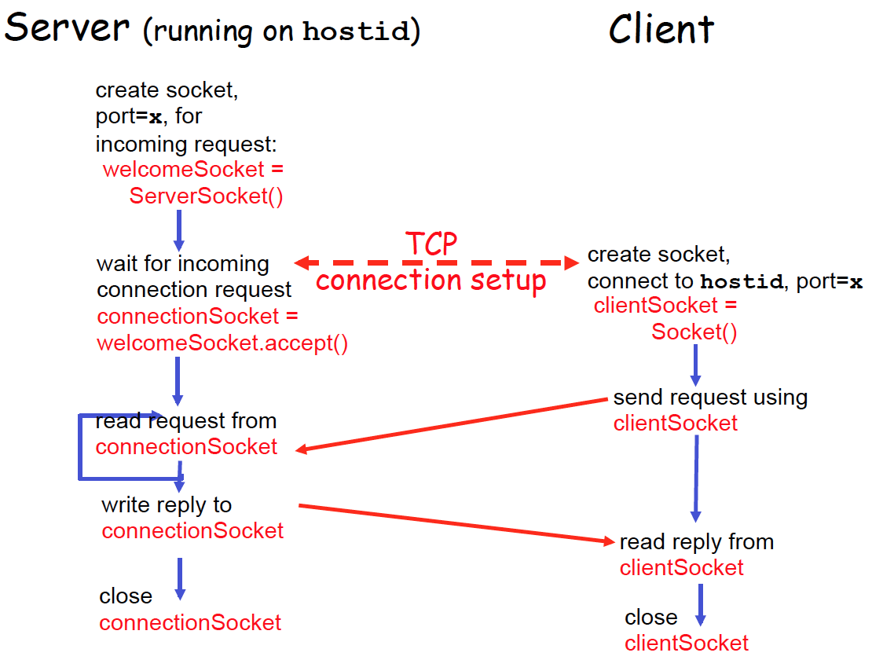
Client/server socket interaction: TCP

Slide 21
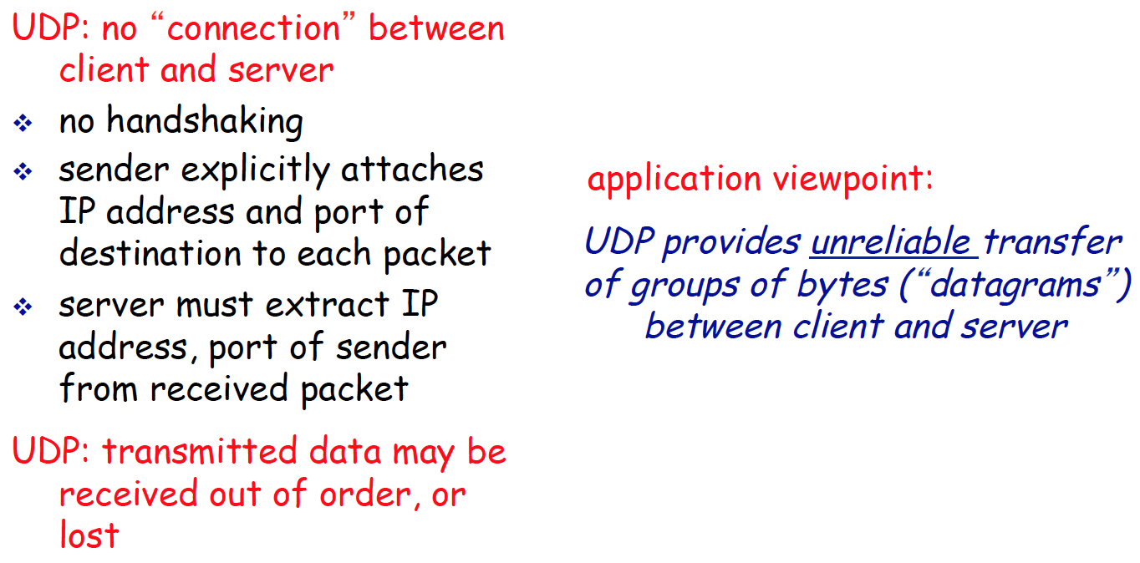
Socket programming with UDP

Slide 22
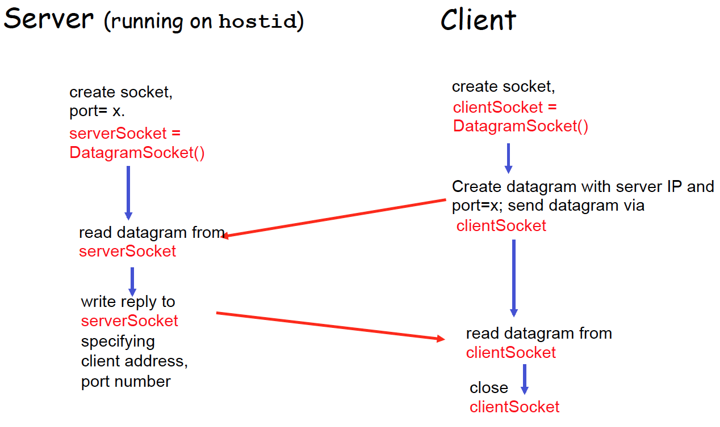
Client/server socket interaction:UDP

Slide 23
Important Reminders
Ensure your code compiles on the CLIC lab machines
Document your code
Discuss extra credit features with a TA before you implement them
Preliminary Question Deadline: Wed, Feb. 25th (Set up everything before that!)
Check with a TA before using 3rd party libraries
Do not copy!
Submission is due on Wed, March 11th

