Slide 1
Secure data hiding in image using steganography
CAPSTONE PROJECT
Presented By
Student Name : Kairavi Shah
College Name & Department : FET, GLS University

Slide 2
OUTLINE
Problem Statement
Technology used
Wow factor
End users
Result
Conclusion
Git-hub Link

Slide 3
Problem Statement
This project aims to develop a steganography-based image encryption and decryption application that enables users to securely hide text within images. By embedding messages inside image pixels, this method ensures that confidential information remains hidden in plain sight. The solution also incorporates password protection to enhance security, preventing unauthorized access.

Slide 4
Technology used
Programming Language: Python – Core language for implementing the steganography logic and GUI.
Graphical User Interface (GUI): PyQt6 – Provides an intuitive and interactive user interface for encryption and decryption.
Image Processing: OpenCV (OpenCV-python-headless) – Used for reading, modifying, and saving images for text embedding and extraction.
File Handling & Utilities: OS Module – Used for managing directories and file paths. QFileDialog – Enables users to select images from their file system.
Standalone Application Packaging: PyInstaller – Converts the Python script into an executable (.exe/.app) for easy deployment across platforms.

Slide 5
Wow factors
Drag & Drop Support - Unlike many steganography tools that require manual file selection, this app allows drag-and-drop image upload, making the process faster and more intuitive.
Real-Time Image Validation - Prevents users from selecting invalid file types by verifying images before encryption and decryption.
Password-Protected Steganography - Unlike traditional LSB (Least Significant Bit) encoding, this project adds an optional password for decryption. Even if someone extracts the hidden data, they cannot decrypt it without the correct password.
Modern Dark-Themed UI - Most steganography tools have outdated interfaces. This project features a dark neon-themed UI with a sleek, user-friendly design.
Automatic Folder Management - The app automatically creates an uploads/ folder for organizing encrypted images, preventing file clutter.
Cross-Platform & Standalone Executable - Unlike web-based steganography tools that require internet access, this app runs offline on Windows, macOS, and Linux. Can be converted into a standalone executable (.exe/.app) using PyInstaller for easy deployment.
Pixel-Level Encryption Without Altering Image Quality - Embeds text directly into pixel values without noticeable distortion, ensuring the image looks unchanged to the naked eye.
Fast & Lightweight Processing - Uses OpenCV for optimized image handling, making encryption and decryption quick and memory-efficient.
Error Handling & Security Measures - Prevents corrupt or unsupported images from being processed. Displays error messages if decryption fails due to incorrect password or file issues.

Slide 6
End users
Privacy-Conscious Users - People who want to hide sensitive information within images for personal or professional reasons. Protects private messages from being easily detected or intercepted.
Cybersecurity & Ethical Hackers - Security professionals, penetration testers, and ethical hackers can use the app to test and analyze steganographic techniques. Useful for data protection research and security training.
Journalists & Activists - Journalists working in high-risk environments can use this app to hide confidential messages within images before sending them. Activists who need to communicate discreetly in restricted regions.
Corporate Professionals & Businesses - Organizations handling confidential information can use steganography to protect intellectual property, financial data, and trade secrets. Ensures covert communication within internal teams.
Students & Researchers - Ideal for computer science, cybersecurity, and cryptography students exploring steganographic techniques. Helps researchers experiment with image-based encryption methods.
Law Enforcement & Forensic Experts - Used by digital forensic analysts to uncover hidden data in images. Helps in investigating cybercrime cases involving steganography.
Digital Artists & Content Creators - Artists can embed hidden messages or signatures in their digital artwork for copyright protection. Useful for creating interactive and encrypted digital content.

Slide 7
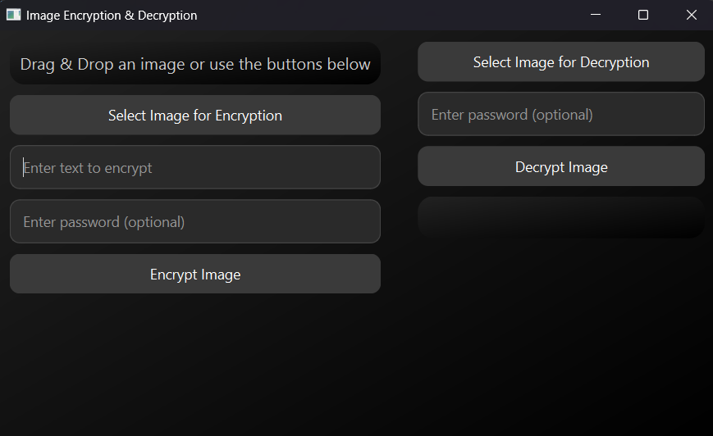
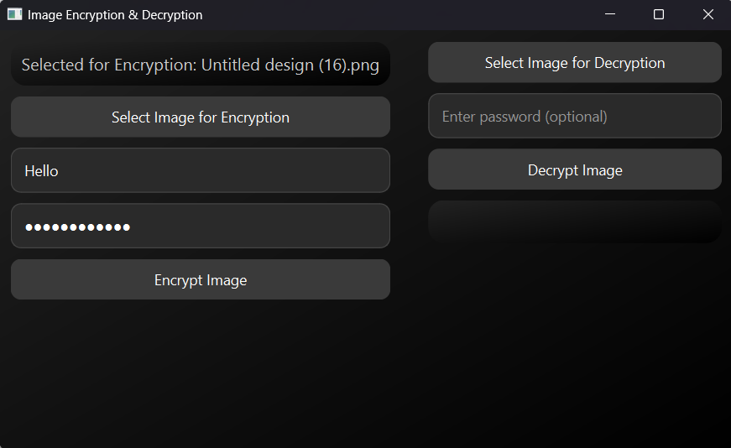
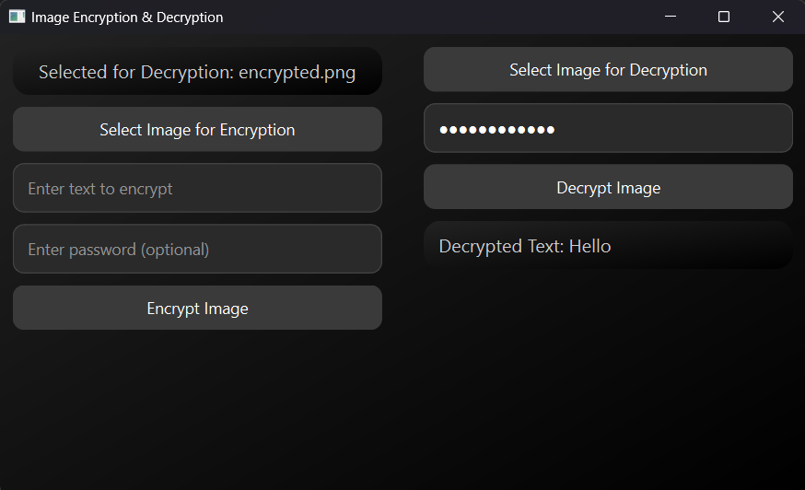
Results

Slide 8
Conclusion
The STEGANOGRAPHY-APPLICATION successfully addresses the problem of secure and discreet communication by leveraging image-based text encryption. Unlike traditional encryption, which is often detectable, this project provides a stealthy way to hide sensitive information within images, making it an effective tool for privacy-conscious users.
With its user-friendly PyQt6 interface, password protection, and seamless encryption/decryption process, the application ensures that confidential messages remain hidden in plain sight. By utilizing OpenCV for image processing and PyInstaller for deployment, the project offers a lightweight, offline, and cross-platform solution for individuals and organizations that require secure communication.
This application is particularly useful for journalists, cybersecurity professionals, businesses, students, and forensic experts, offering them an innovative way to conceal and retrieve data without raising suspicion.
In conclusion, the STEGANOGRAPHY-APPLICATION provides a practical, efficient, and secure approach to hiding and extracting text within images, making it a valuable tool for digital security and privacy

Slide 9
GitHub Link
https://github.com/dragonday3/STEGANOGRAPHY-APPLICATION

Slide 10
THANK YOU

