Slide 1
Git Concepts
What is going on here?

Slide 2
What is Git?
Version Control
Backup your work
Track changes
Safely collaborated
Distributed
Every repo = full copy
Stored locally
no internet required

Slide 3
Other Features
Performance
Faster than alternatives
Focuses on file content, not names
Flexibility – Works for
Individuals
Small teams
Massive world-wide teams

Slide 4
Why use Git
Git is good!
De facto standard
Third-party tools
Free storage at GitHub or Bitbucket
Editor integration
Quality and Open Source

Slide 5
Git Cheat Sheet
https://bit.ly/2C3yC0f

Slide 6
Saving your Work to GitHub
Using branches and remotes to safely save your work.

Slide 7
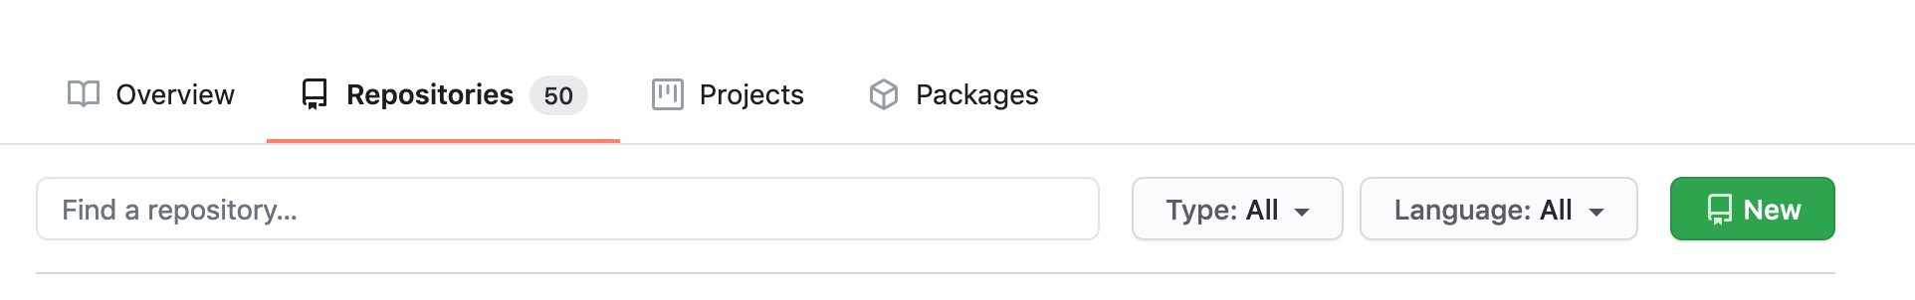
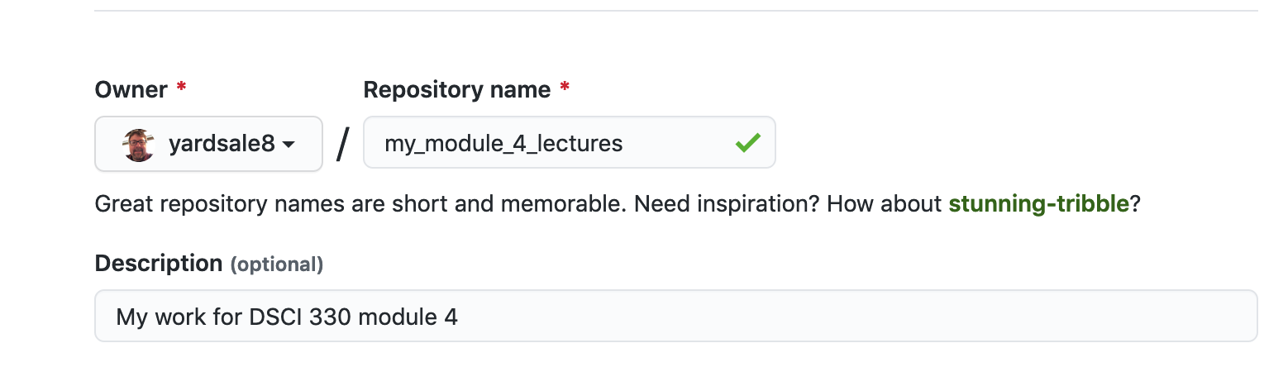
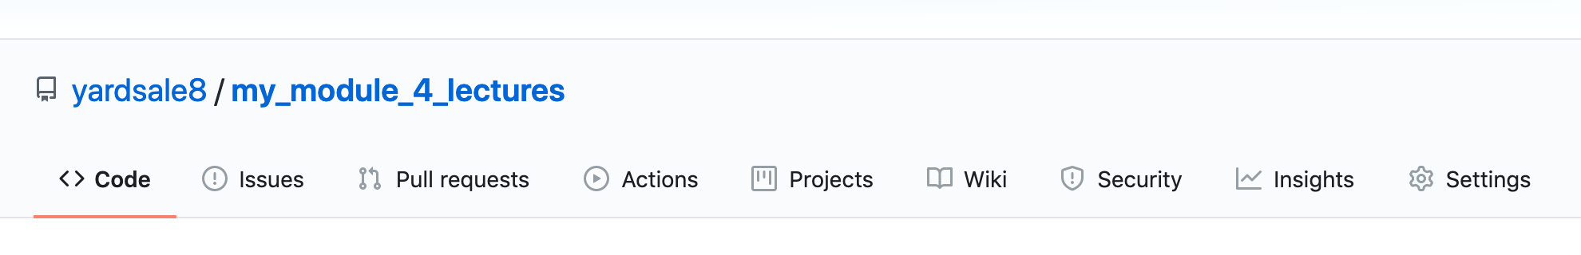
Making a repo on GitHub

Slide 8
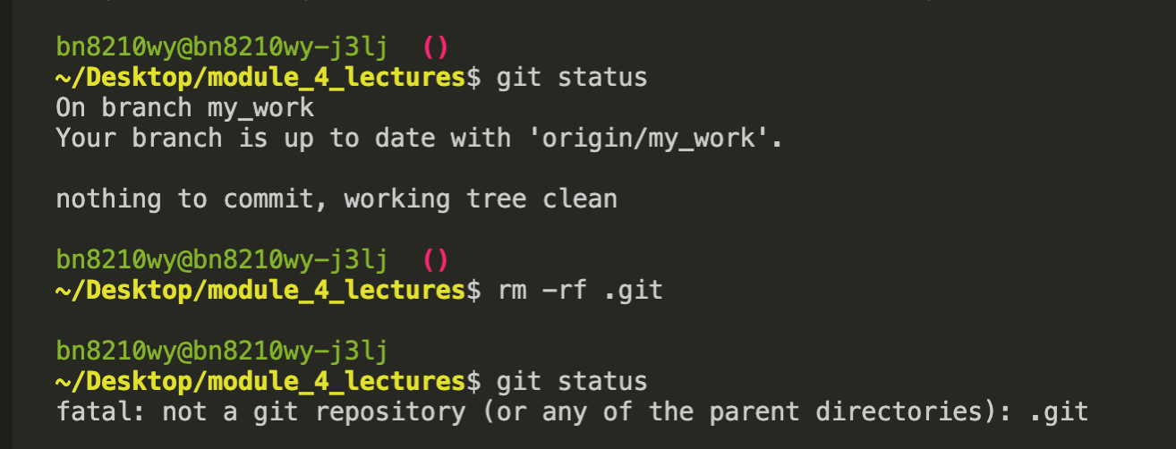
Switching to another repo Quick-and-dirty method
Deletes git tracking
Keeps current files
(No change to GitHub

Slide 9
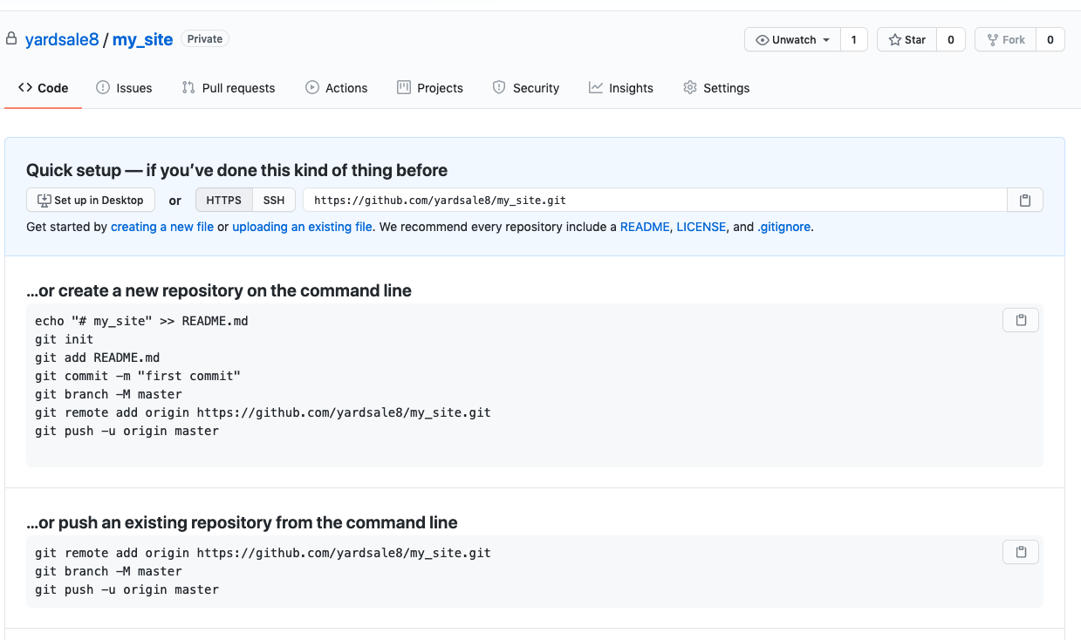
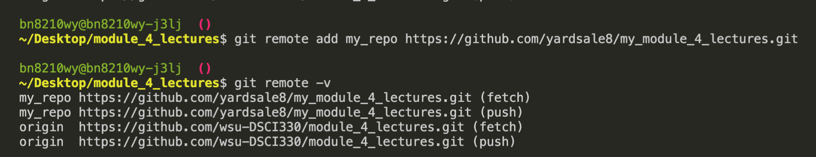
Connecting the local repo to GitHub Visual Studio Code

Slide 10
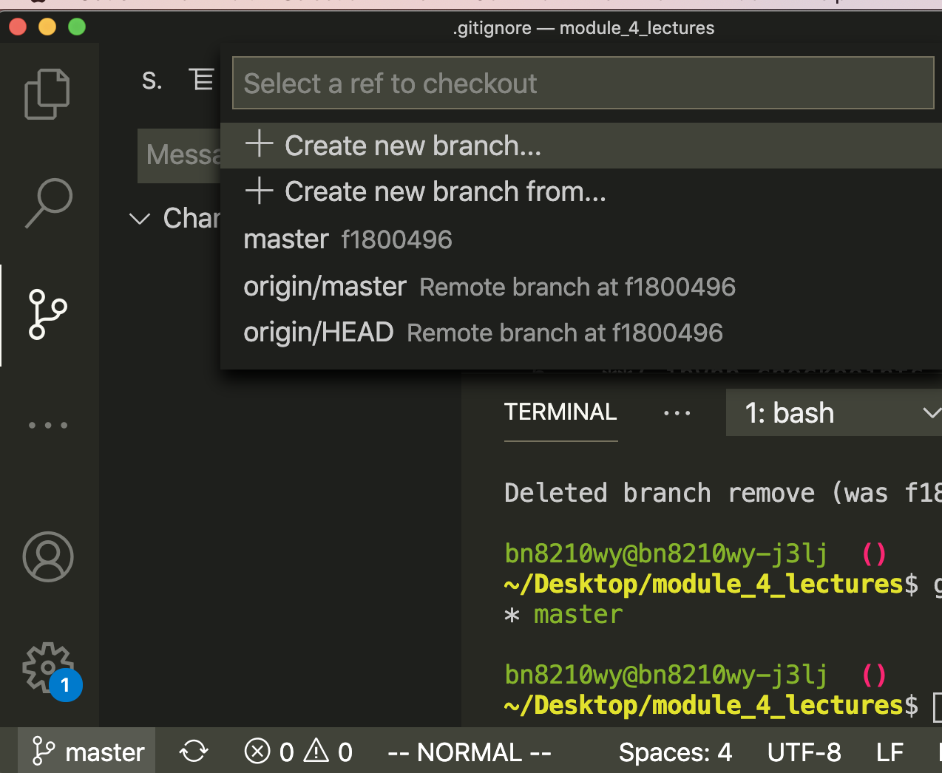
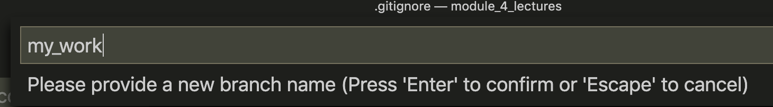
Connecting the local repo to GitHub Visual Studio Code
Click

Slide 11
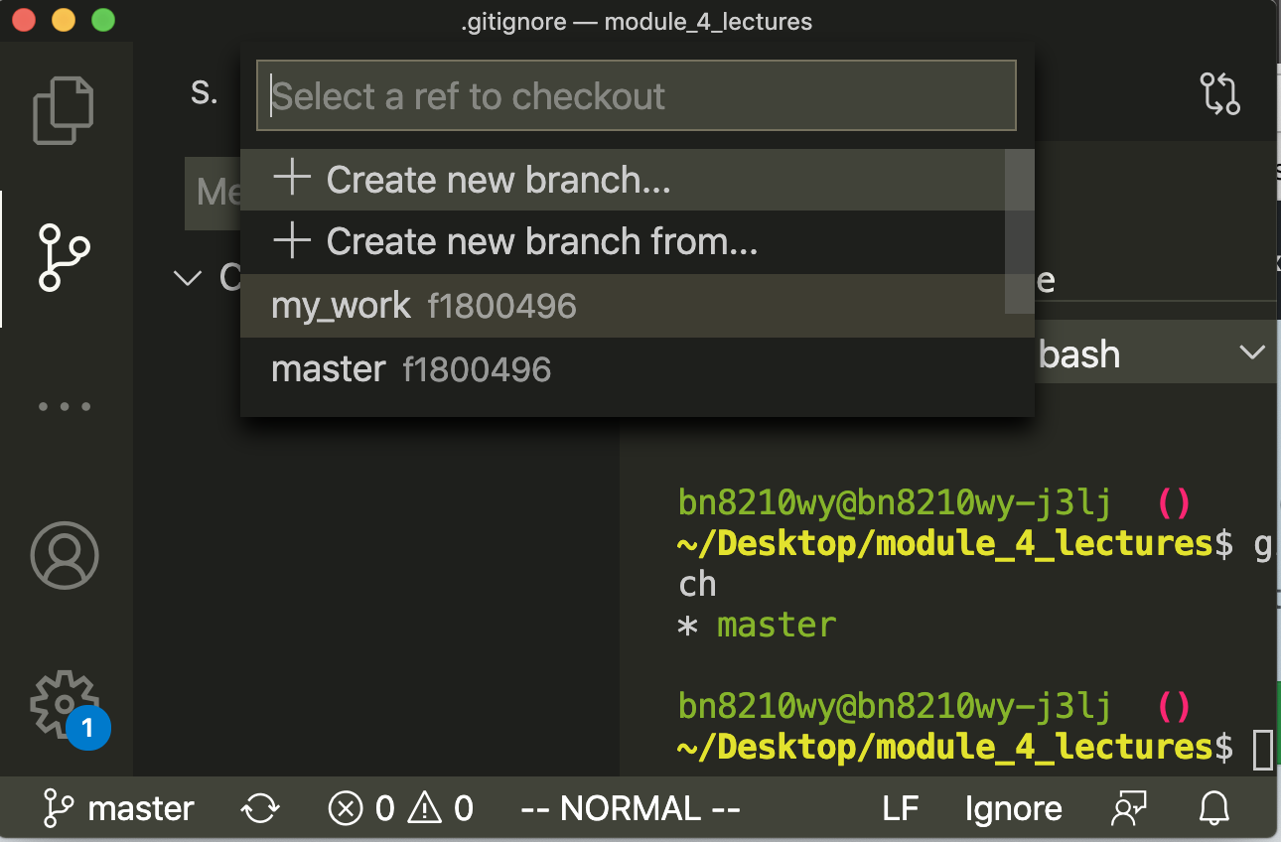
Checking out a branch Visual Studio Code
Same Commit number
➔ ➔ Same Commit

Slide 12
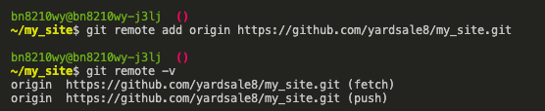
Connecting the local repo to GitHub Command line

Slide 13
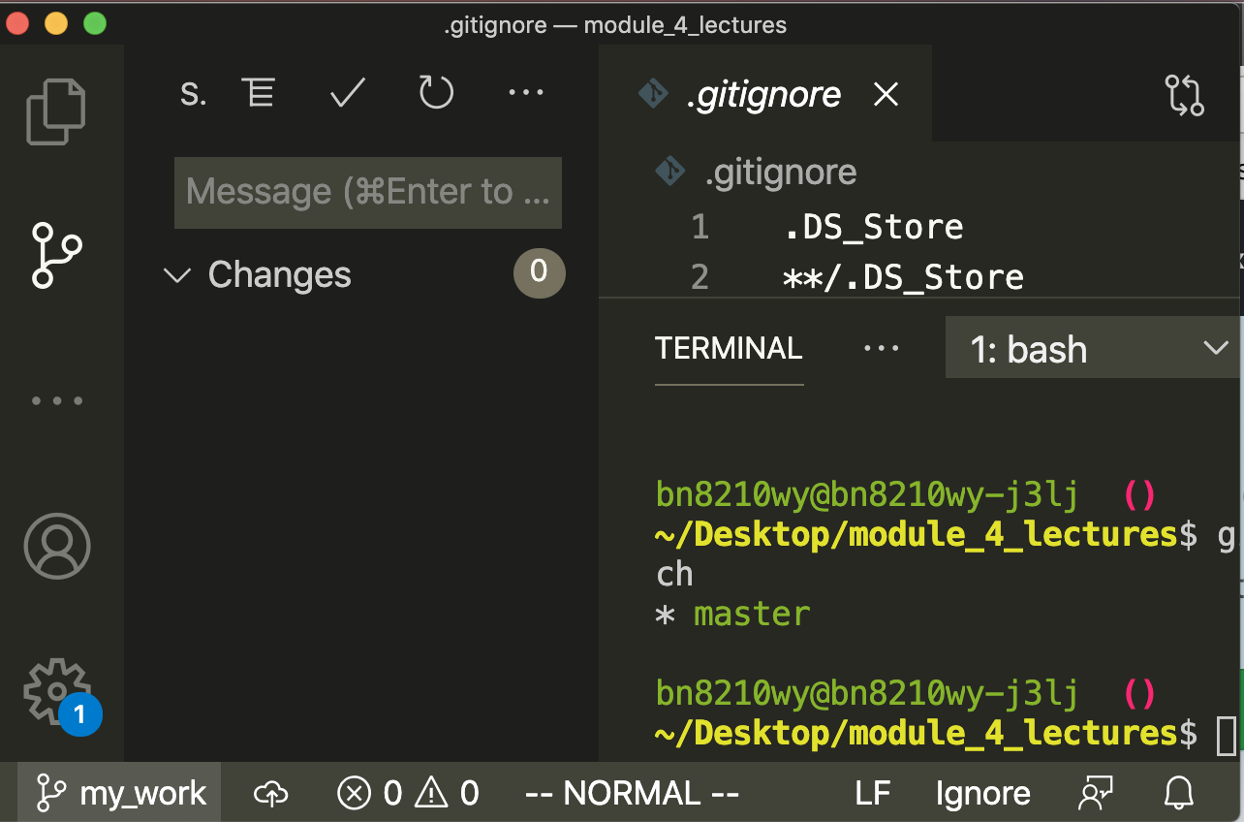
Checking out a branch Visual Studio Code
Click
Check

Slide 14
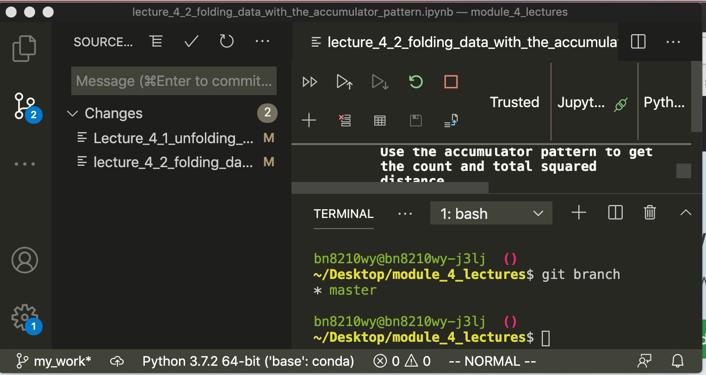
Committing your changes
Two Changed Files

Slide 15
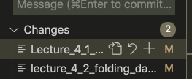
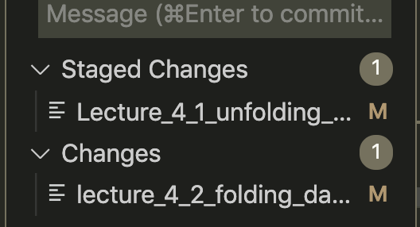
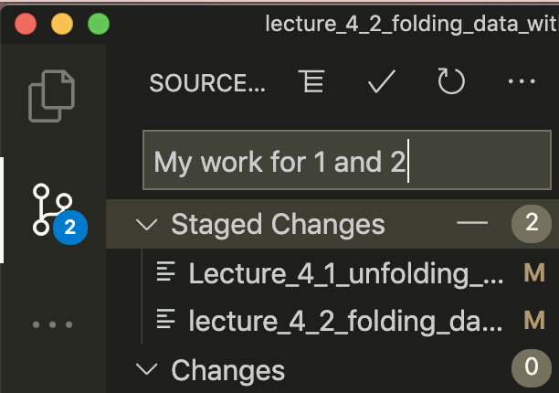
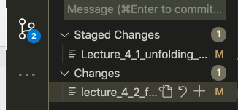
Committing your changes
Click
Add a Message
Click
Click

Slide 16
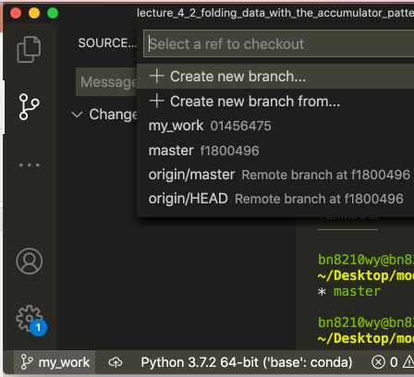
Different Commit numbers
➔ ➔ Different Commits

Slide 17
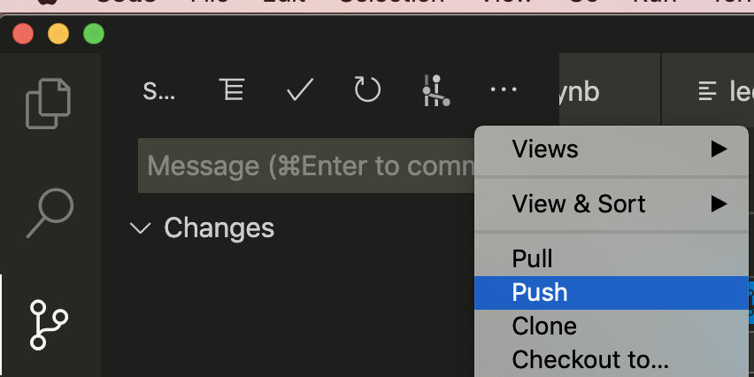
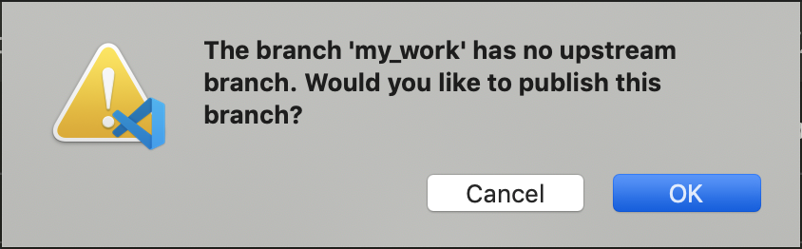
Check

Slide 18
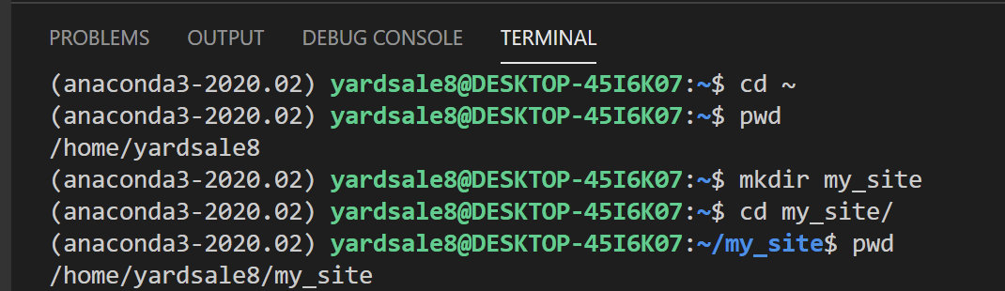
Working Exercise Create a Website directory

Slide 19
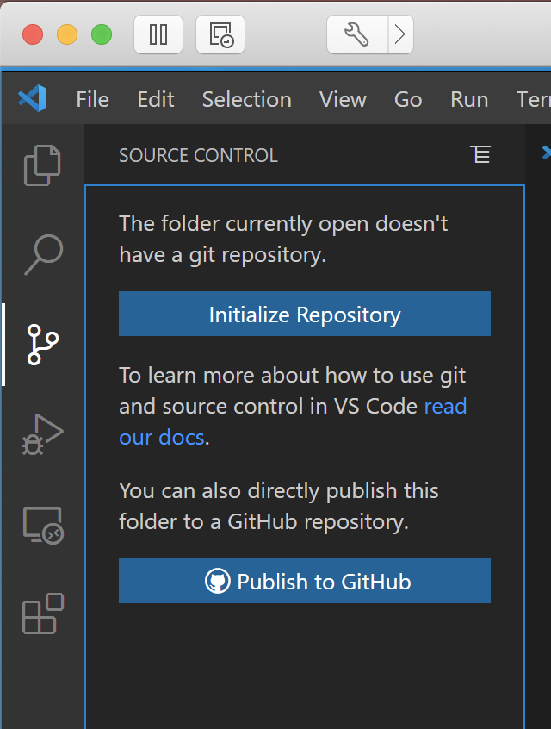
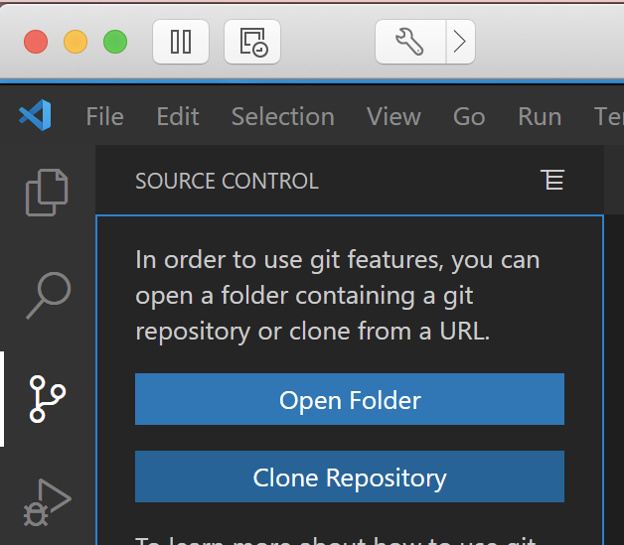
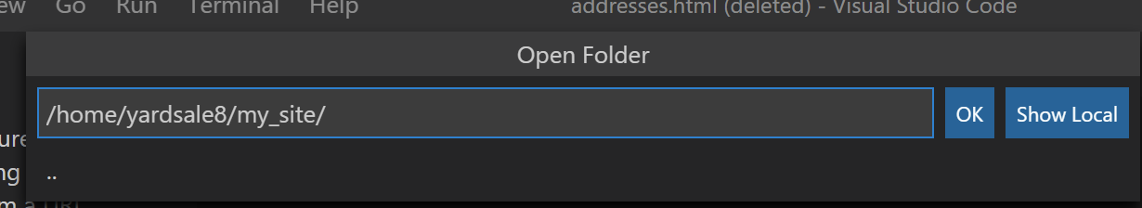
Initialize a repository

Slide 20
Initialize a repository
Create a local rep
Create and attach to a GitHub repo

Slide 21
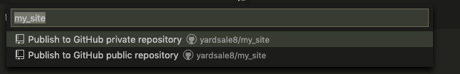
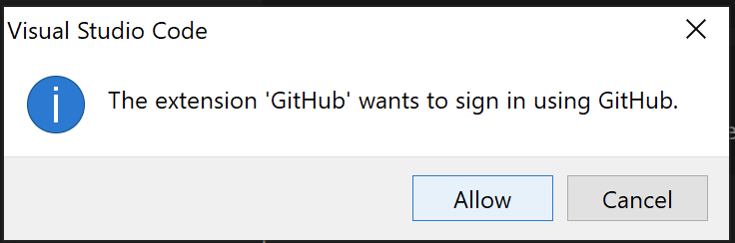
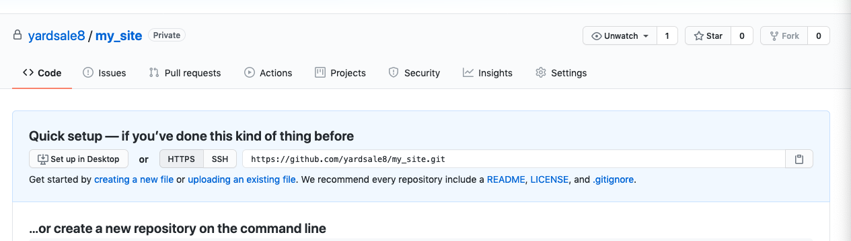
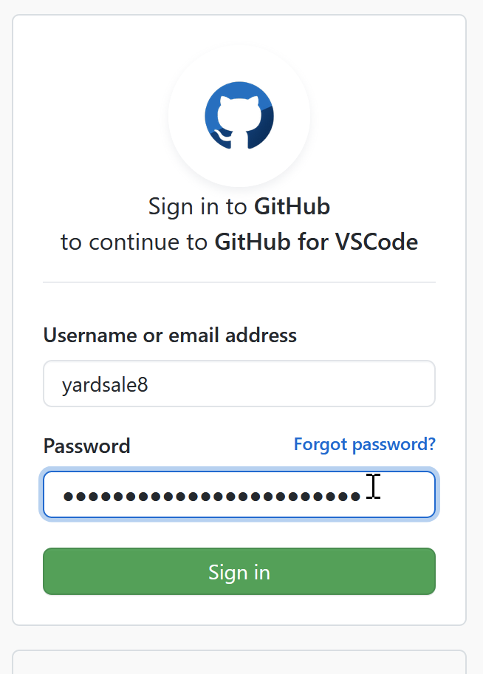
Initialize a repository

Slide 22
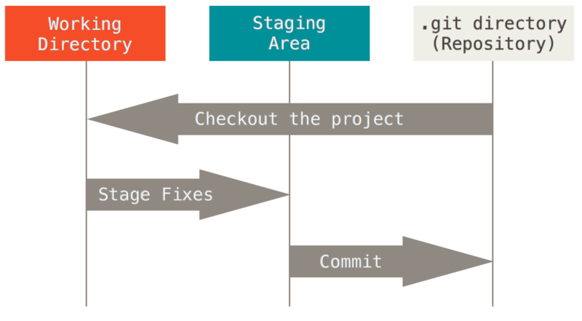
File states in Git
Image source: https://git-scm.com/book/en/v2/book/01-introduction/images/areas.png
Shared under Creative Commons Attribution 3.0 Unported License.

Slide 23
Connecting the local repo to GitHub

Slide 24
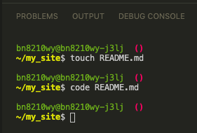
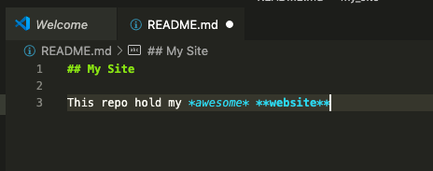
First Commit Step 1 -- Making a README.md

Slide 25
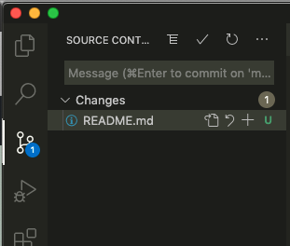
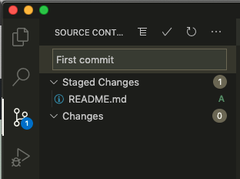
First Commit Step 2 – Committing README.md
b) Type message
a) Click +
c) Click to commit

Slide 26
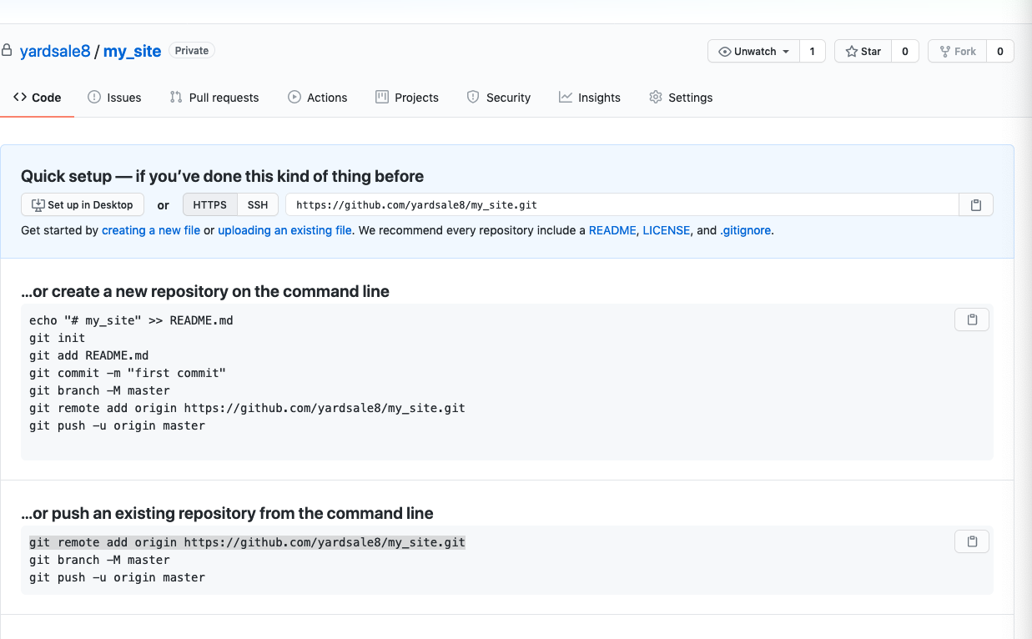
Exercise Visit the GitHub repo
Question: Why didn’t anything change?

Slide 27
Commits are local!
Committing changes only affects the local repository

Slide 28
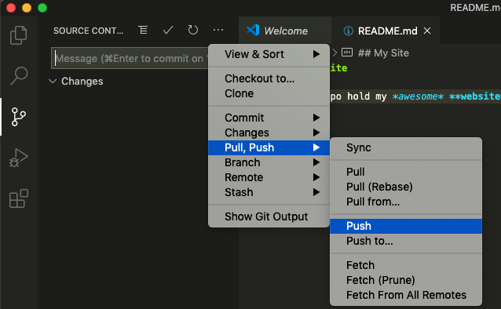
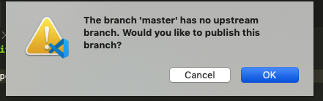
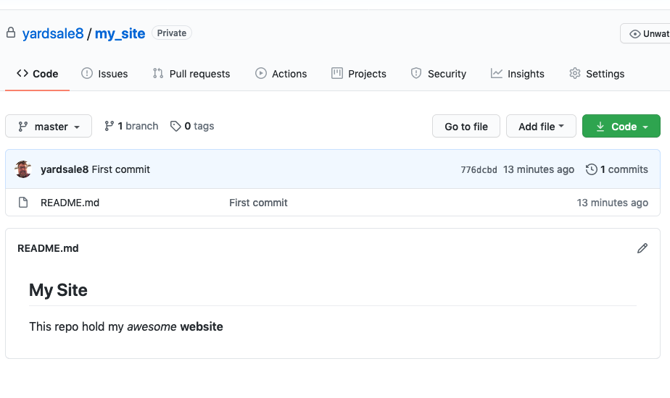
First Commit Step 3 – Pushing Changes to GitHub

Slide 29
Most Basic Git Workflow
Modify a file
Stage the file
Adds a snapshot to the staging area
Commit your changes
Staging area → permanent snapshot

Slide 30
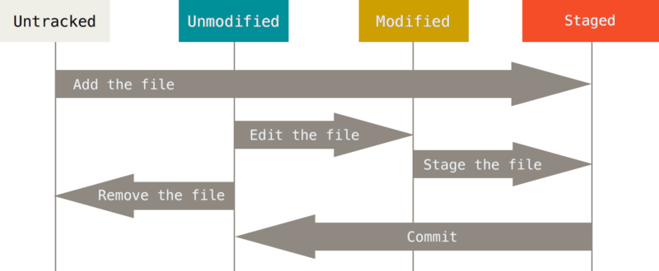
A Files Lifecycle
Click +
code file_name
Click +
git rm FILE
Click ☑️
Image source: https://git-scm.com/book/en/v2/book/01-introduction/images/areas.png
Shared under Creative Commons Attribution 3.0 Unported License.

Slide 31
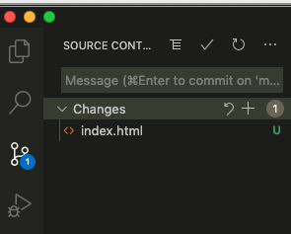
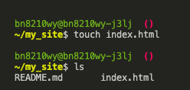
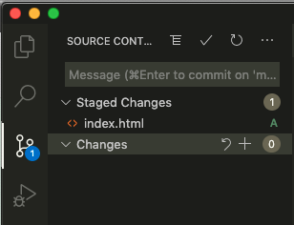

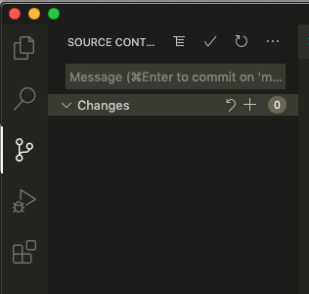
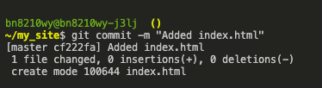
Command line git
1) Make a local folder/file
2) Stage the file with git add index.html
3) Commit the changes

Slide 32
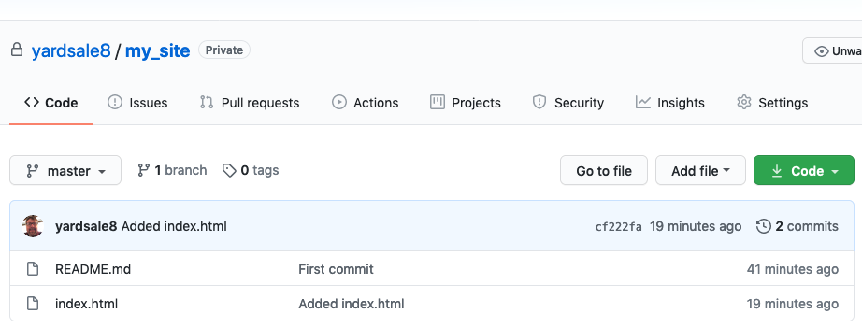
Important Remember to Push Changes to GitHub

Slide 33
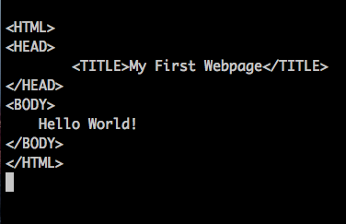
Exercise 1
8) Edit the file
9) Stage and commit the changes
10) Push the changes to GitHub

Slide 34
Exercise 2
Add a folder called src
Make a second html file called ./src/my_schedule.html
Add you class schedule
Unordered list in my_schedule.html
Add a link from index.html to my_schedule.html
Commit these changes

