Slide 1
Git Concepts
What is going on here?

Slide 2
What is Git?
Version Control
Backup your work
Track changes
Safely collaborated
Distributed
Every repo = full copy
Stored locally
no internet required

Slide 3
Other Features
Performance
Faster than alternatives
Focuses on file content, not names
Flexibility – Works for
Individuals
Small teams
Massive world-wide teams

Slide 4
Why use Git
Git is good!
De facto standard
Third-party tools
Free storage at GitHub or Bitbucket
Editor integration
Quality and Open Source

Slide 5
Git Cheat Sheet
https://bit.ly/2C3yC0f

Slide 6
Saving your Work to GitHub
Using branches and remotes to safely save your work.

Slide 7
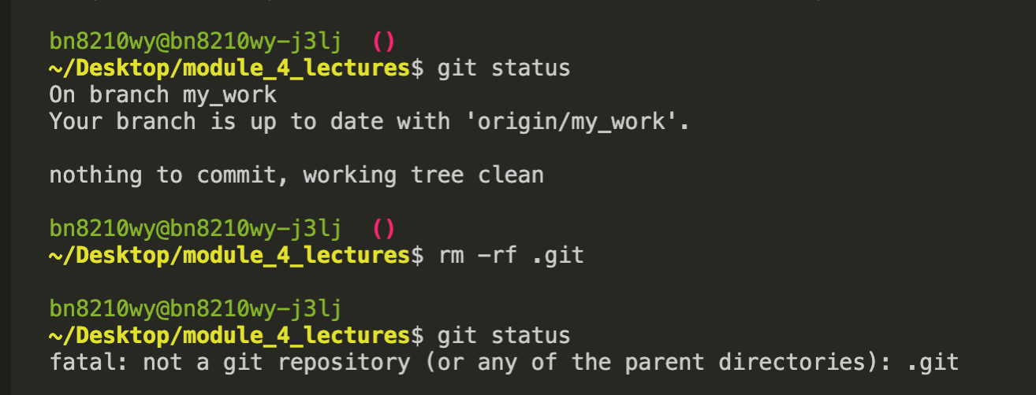
Switching to another repo Quick-and-dirty → Deleting .git
Deletes git tracking
Keeps current files
(No change to GitHub
Warning: Only use this technique after the whole module is published (ask me)

Slide 8
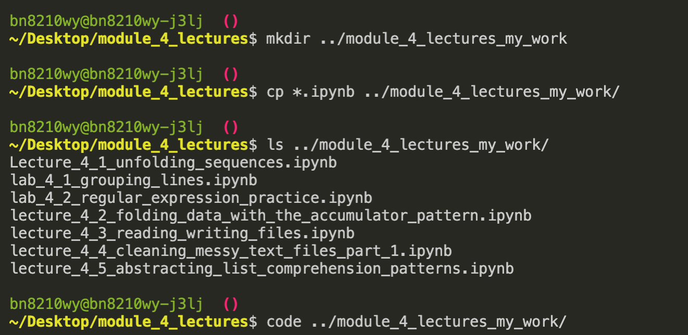
Switching to another repo Slightly-less-dirty → copy to a new folder
Wildcard
(like .* in regex)
Opens a new window

Slide 9
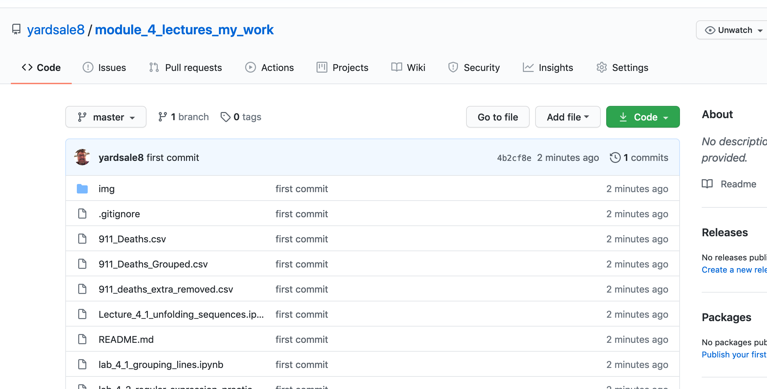
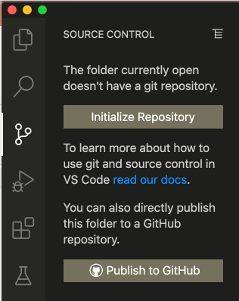
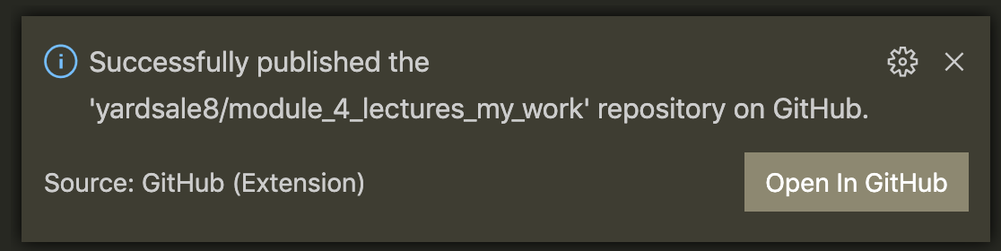
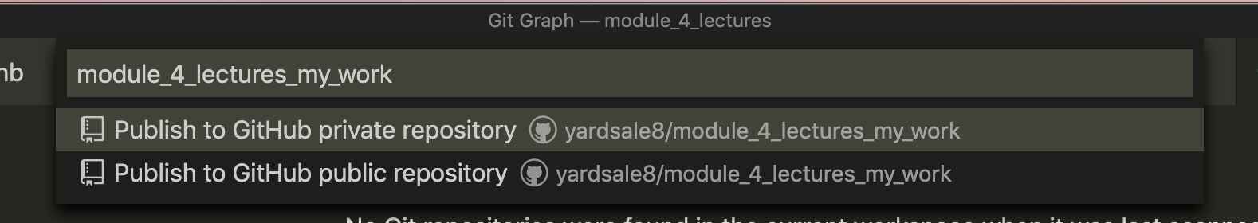
Create a new repo

Slide 10
Creating a Website Repo
Using GitHub to host and serve a static webpage

Slide 11
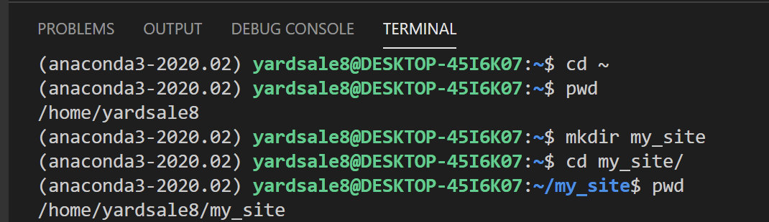

Working Exercise Create a Website directory

Slide 12
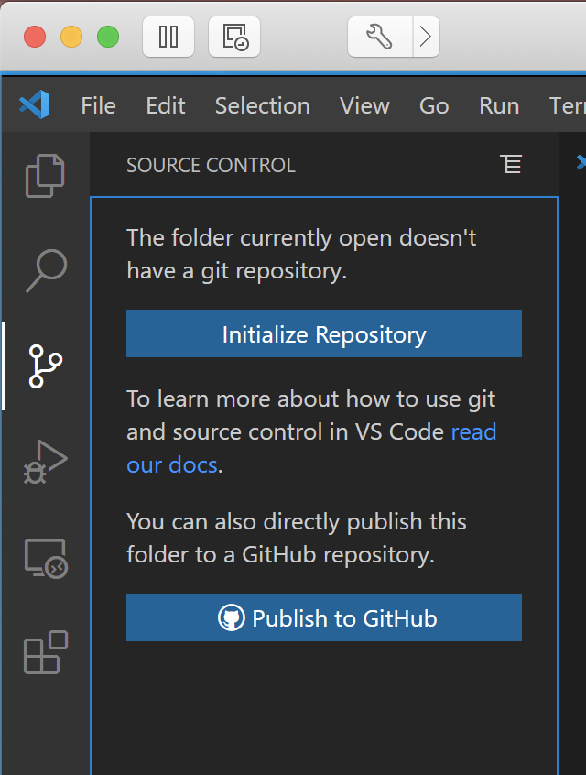
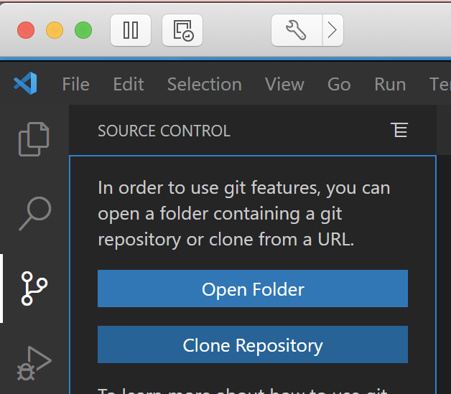
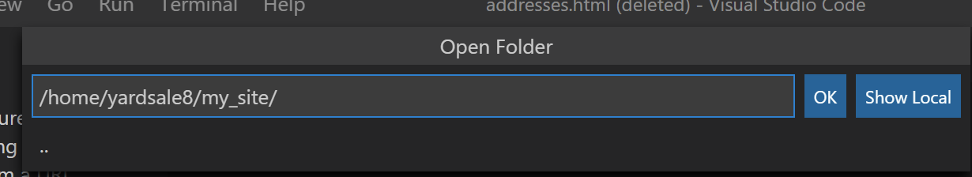
Initialize a repository

Slide 13
Initialize a repository
Create a local rep
Create and attach to a GitHub repo

Slide 14
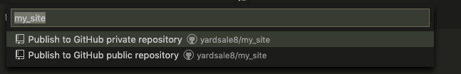
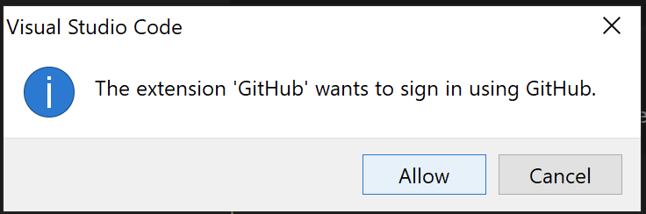
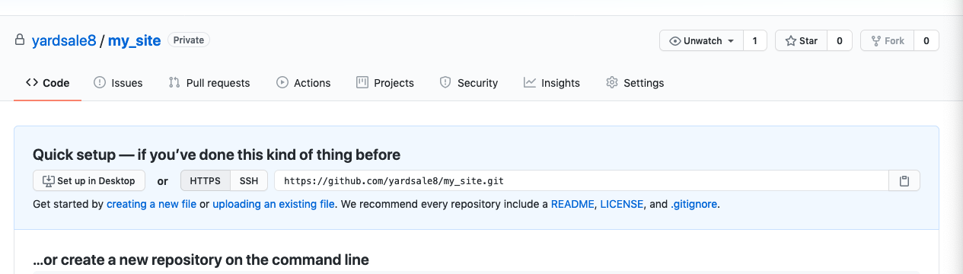
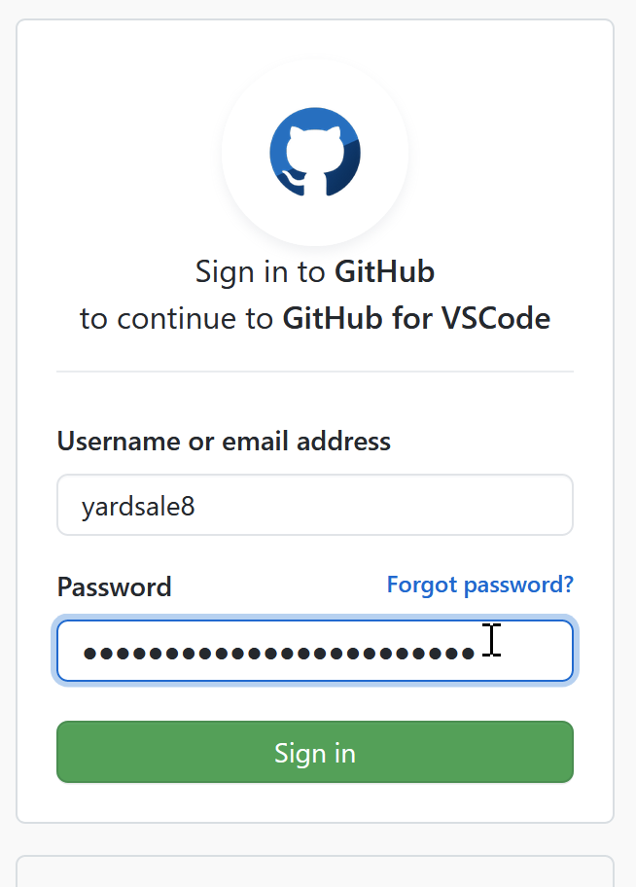
Initialize a repository

Slide 15
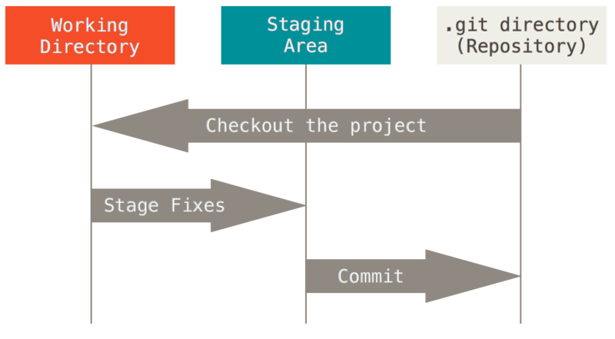
File states in Git
Image source: https://git-scm.com/book/en/v2/book/01-introduction/images/areas.png
Shared under Creative Commons Attribution 3.0 Unported License.

Slide 16
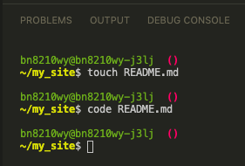
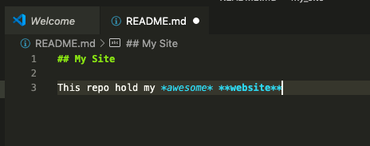
First Commit Step 1 -- Making a README.md

Slide 17
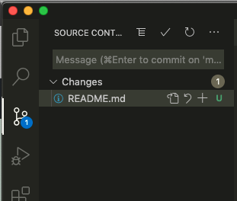
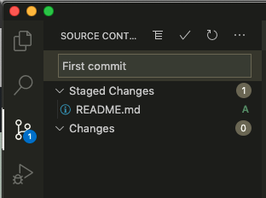
First Commit Step 2 – Committing README.md
b) Type message
a) Click +
c) Click to commit

Slide 18
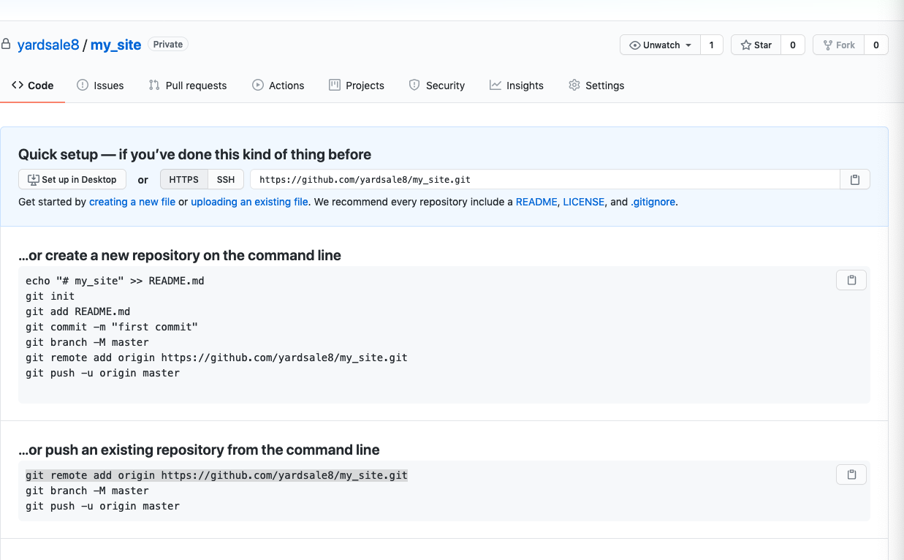
Exercise Visit the GitHub repo
Question: Why didn’t anything change?

Slide 19
Commits are local!
Committing changes only affects the local repository

Slide 20
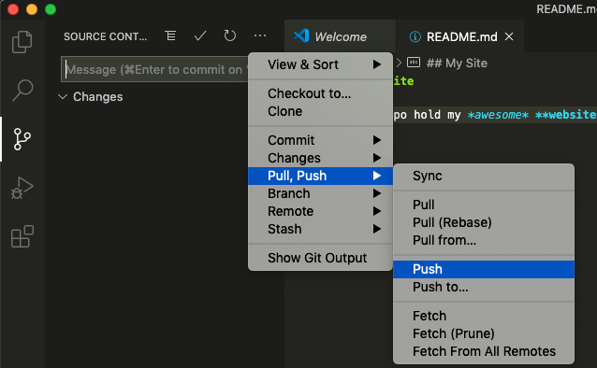
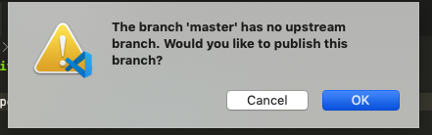
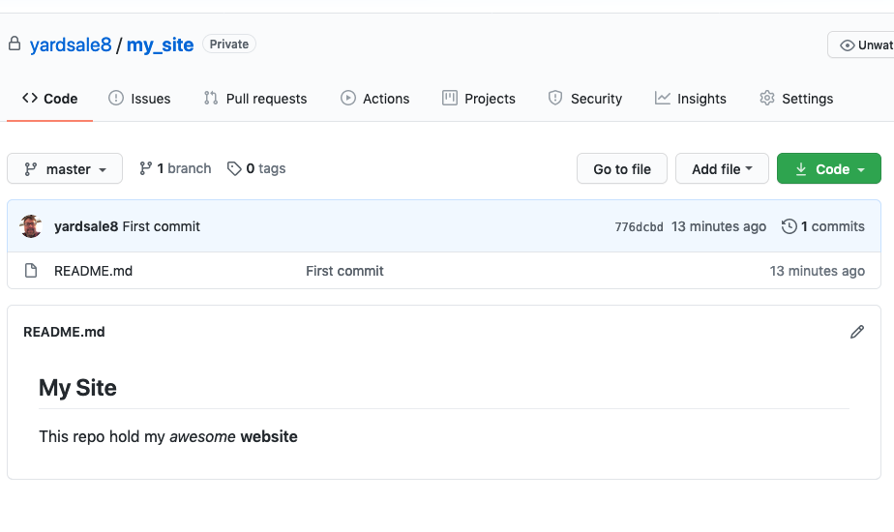
First Commit Step 3 – Pushing Changes to GitHub

Slide 21
Most Basic Git Workflow
Modify a file
Stage the file
Adds a snapshot to the staging area
Commit your changes
Staging area → permanent snapshot

Slide 22
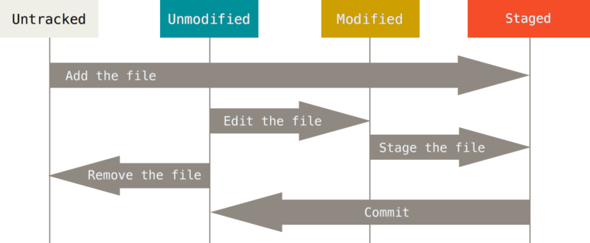
A Files Lifecycle
Click +
code file_name
Click +
git rm FILE
Click ☑️
Image source: https://git-scm.com/book/en/v2/book/01-introduction/images/areas.png
Shared under Creative Commons Attribution 3.0 Unported License.

Slide 23
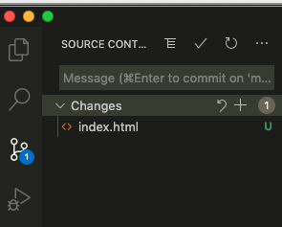
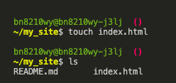
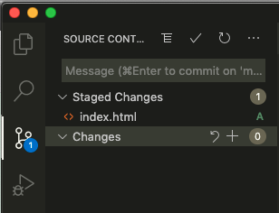

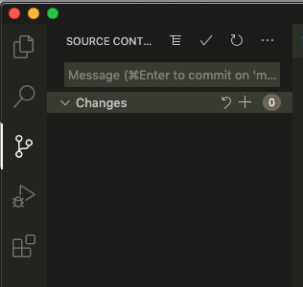
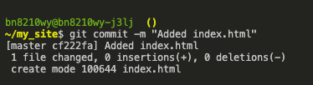
Command line git
1) Make a local folder/file
2) Stage the file with git add index.html
3) Commit the changes

Slide 24
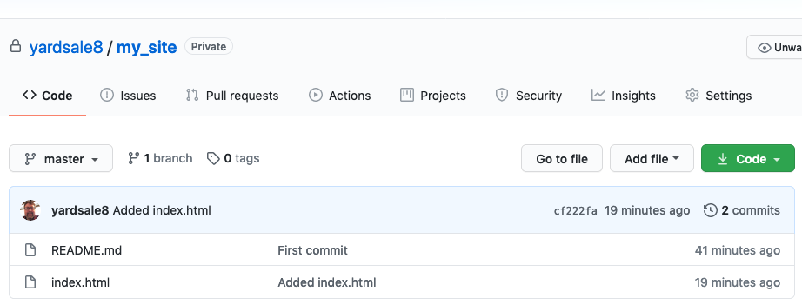
Important Remember to Push Changes to GitHub

