Slide 1
HTML Lab
Activities adapted from msuweb.montclair.edu/~maciakl/labs/HTML LAB.pdf

Slide 2
Completed in 5.1.1
Perform the following in the terminal
Created a GitHub repo
Created a folder called my_website
Connected the two
Use touch to make a blank file named index.HTML
Added, committed, and pushed this file to GitHub

Slide 3
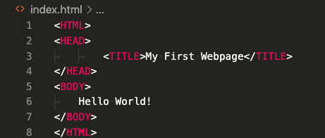
Your First Website
Insert the following text:

Slide 4
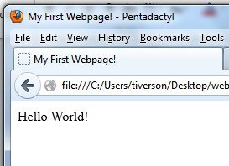
View the Site
Open your favorite browser
I’ll use Firefox
In the browser
File > Open File > Desktop > website.html
Title
Contents of Body

Slide 5
Main Parts of a Page
<HTML></HTML>
Starts and ends the page
<TITLE></TITLE>
Page title
Must be in the header
<HEAD></HEAD>
Contains meta-info about the page
<BODY></BODY>
Page content

Slide 6
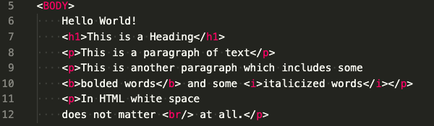
More HTML

Slide 7
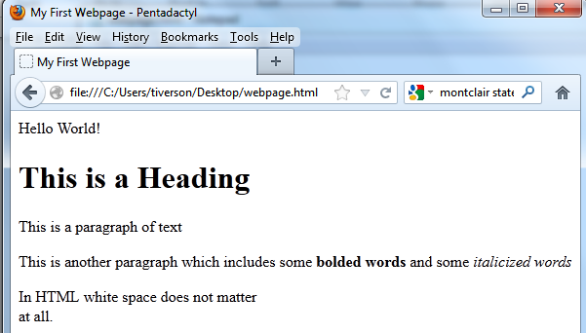

Slide 8
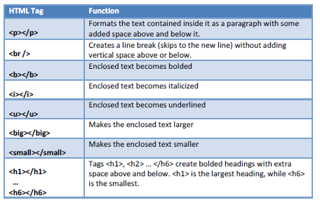
Types of Effects

Slide 9
Important Points
HTML tags come in pairs
“open” and “close”
like parentheses
All tags are a single word
Upper/lower case doesn’t matter
Sometimes extra information is included in tag!

Slide 10
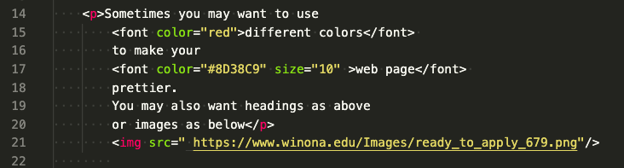
Example: Extra Information
Insert the following into the body:

Slide 11
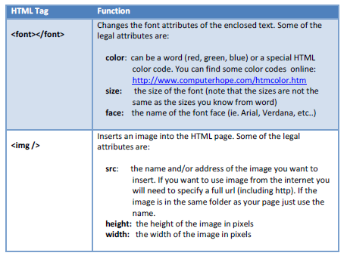
Extra Information for Font and IMG

Slide 12

Links
Add the following lines to the body of your page
Address
Text

Slide 13
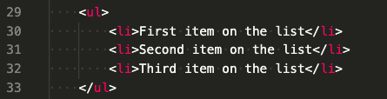
Bulleted Lists
Add the following to your page
Starts List
List Item
Ends List

Slide 14
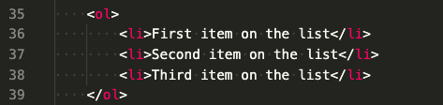
Numbered List
Add the following to your page

Slide 15
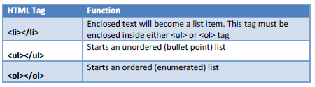
List Info

Slide 16
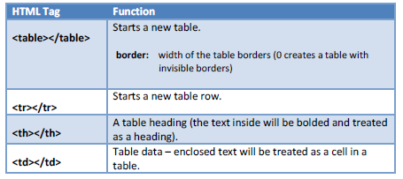
Table Information

Slide 17
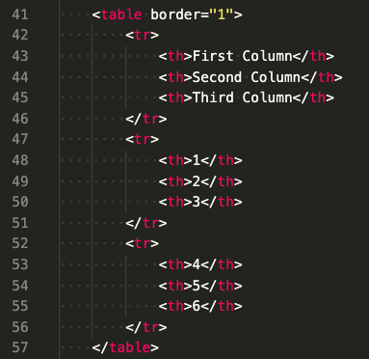
Table Example
Add the following to your page

Slide 18
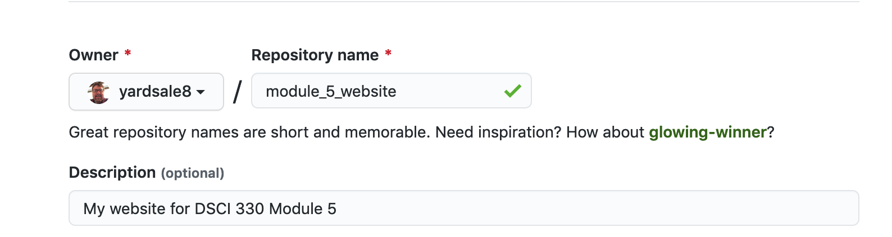
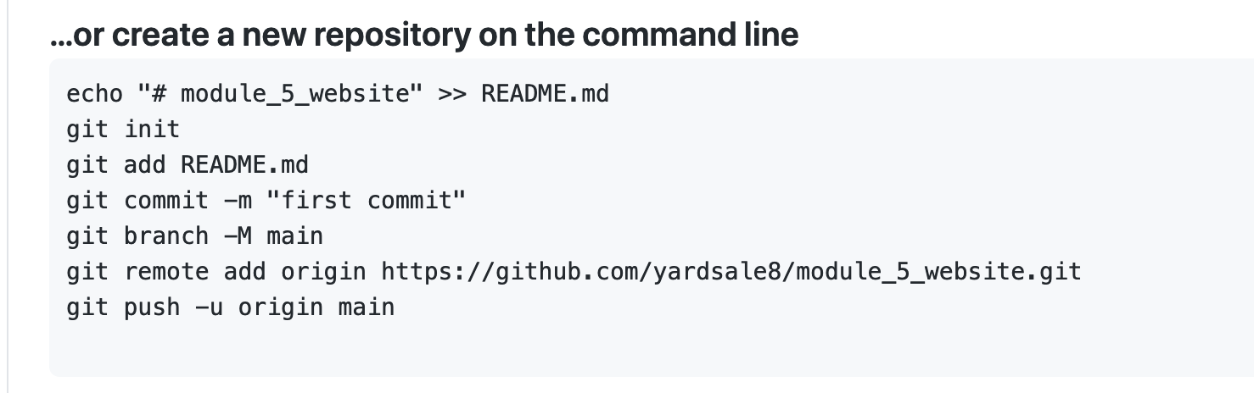
Create a GitHub repo and initialize locally

Slide 19
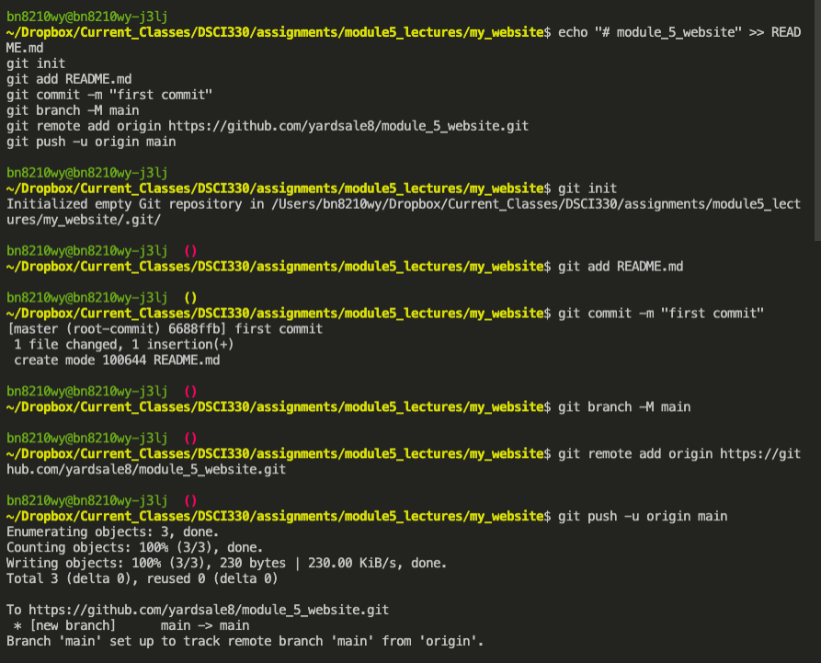
Weird!

Slide 20
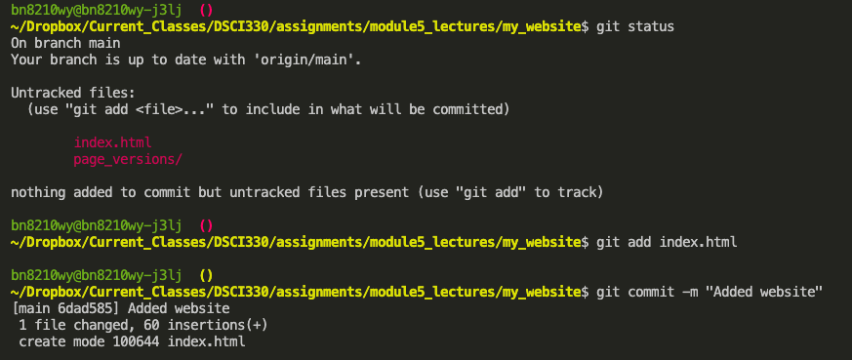
Add and commit your page

Slide 21
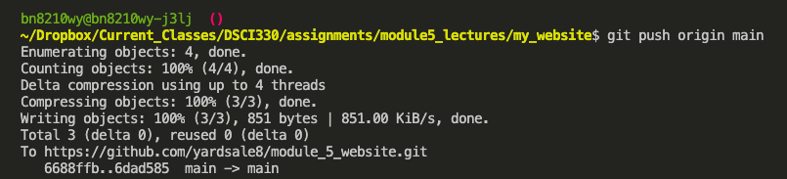
Push

Slide 22
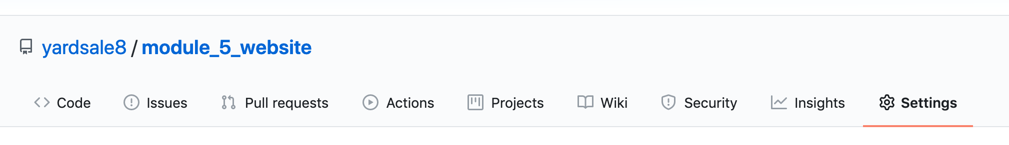
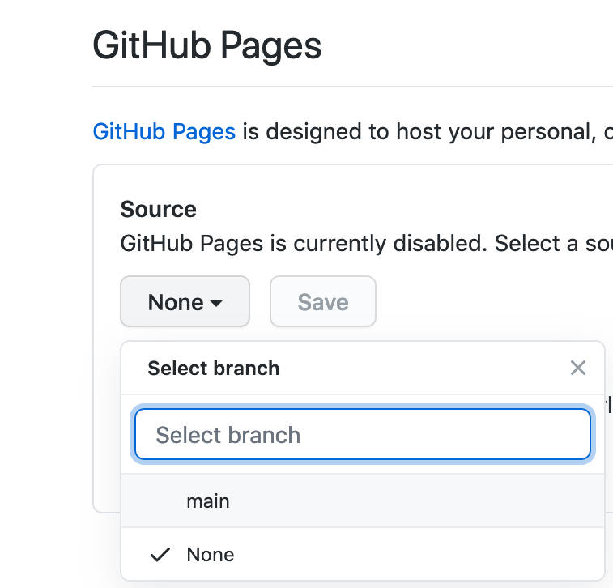
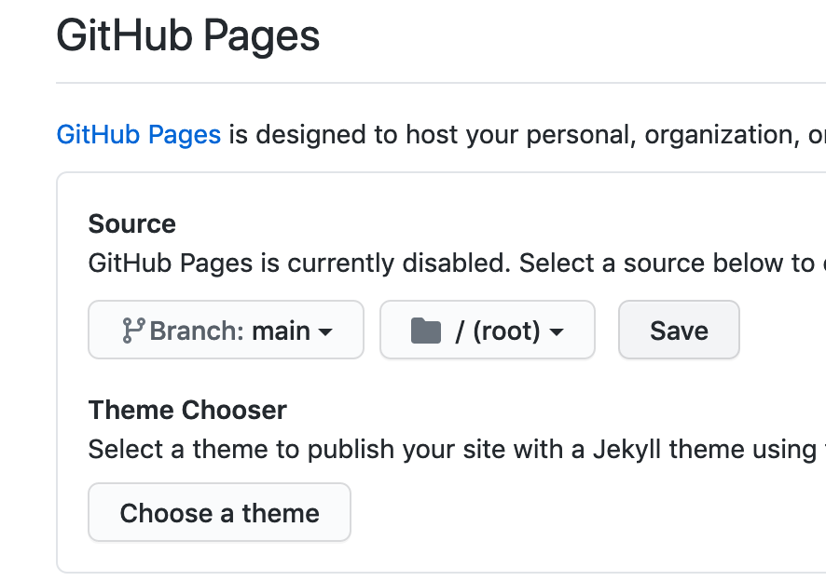
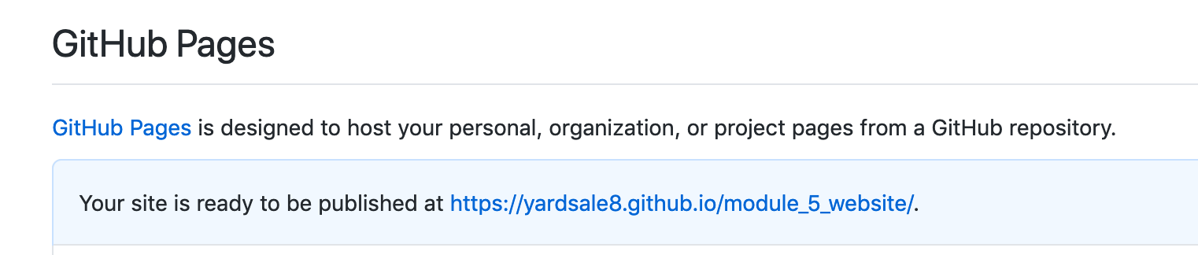
Publishing with GitHub Pages

Slide 23
Assignment for Friday
Personalize your website!
All the information needs to be about you.
Must contain
Few lines of text
Some formatting (e.g. bold, underline, colors, size)
At least one image
At least one working link
At least one list (either number list or bullet point list)
Bonus Points
Using tables
Interesting visual design
Publish your site to GitHub repo.

