Slide 1
step
half
climb higher

Slide 2
music
education
one step at a time

Slide 3
Music practice can be unfocused, filled with self-doubt, lonely, and disconnected from your goals and dreams.
half step helps you climb higher by providing bite-sized tasks, near-peer support, and progress tracking.

Slide 4
simple
visualize new music learning goal
medium
view your progress toward goal
complex
find someone on the same step to meet and learn with

Slide 5
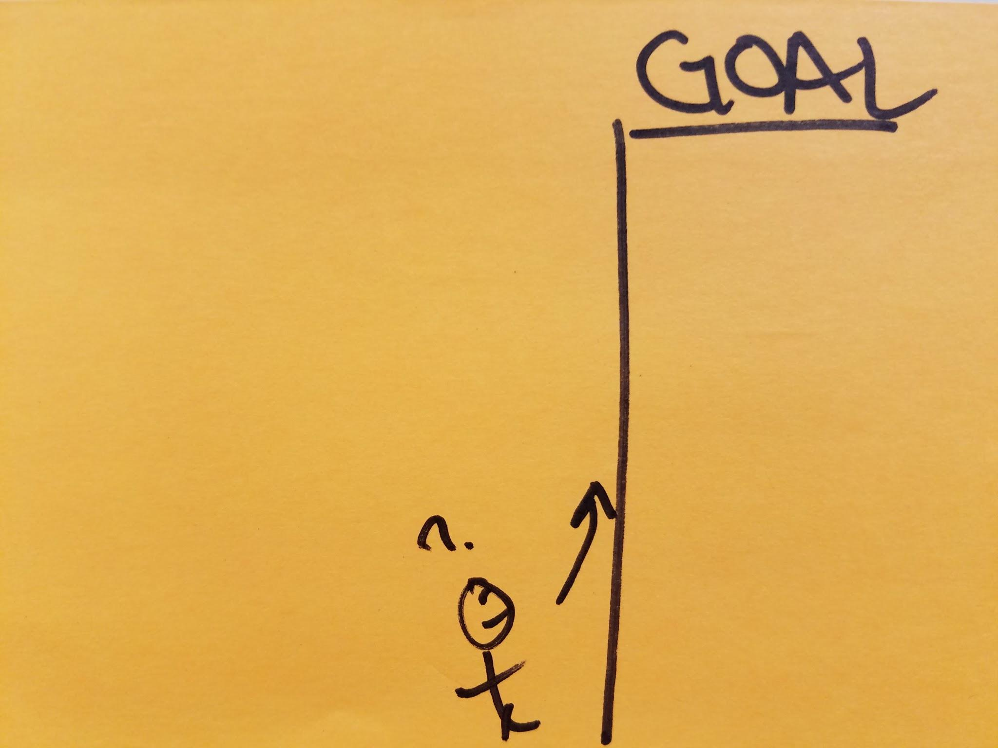
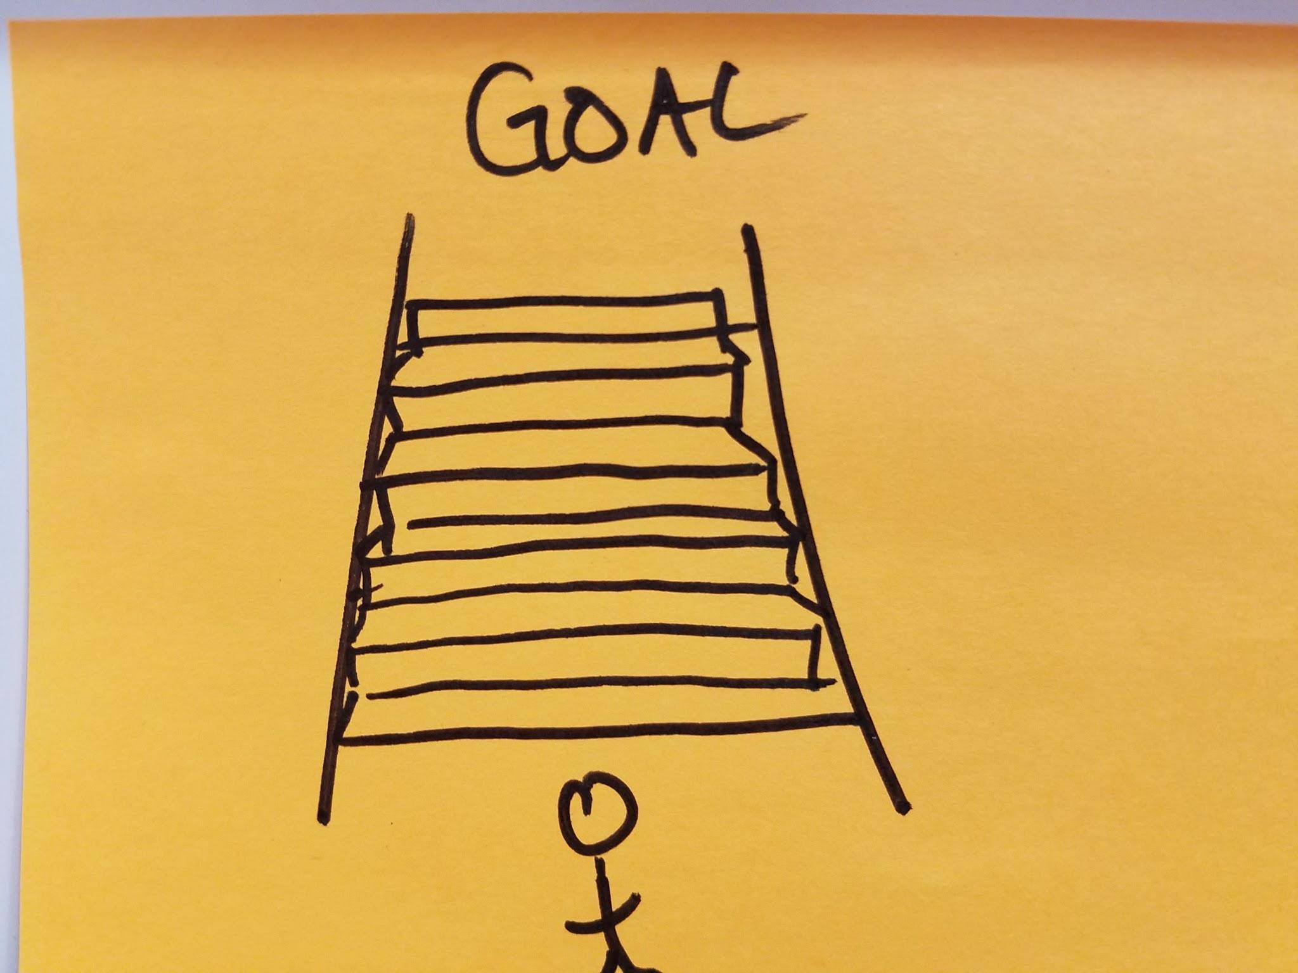
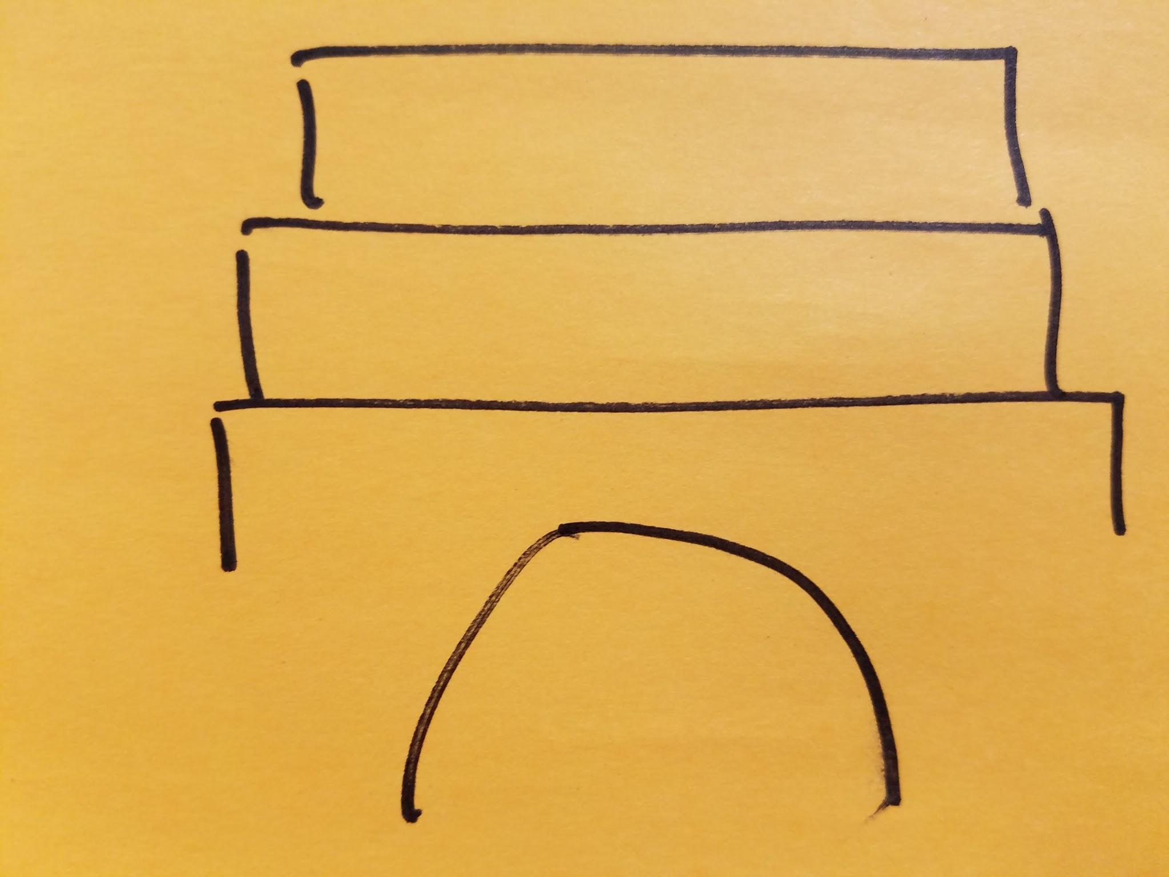
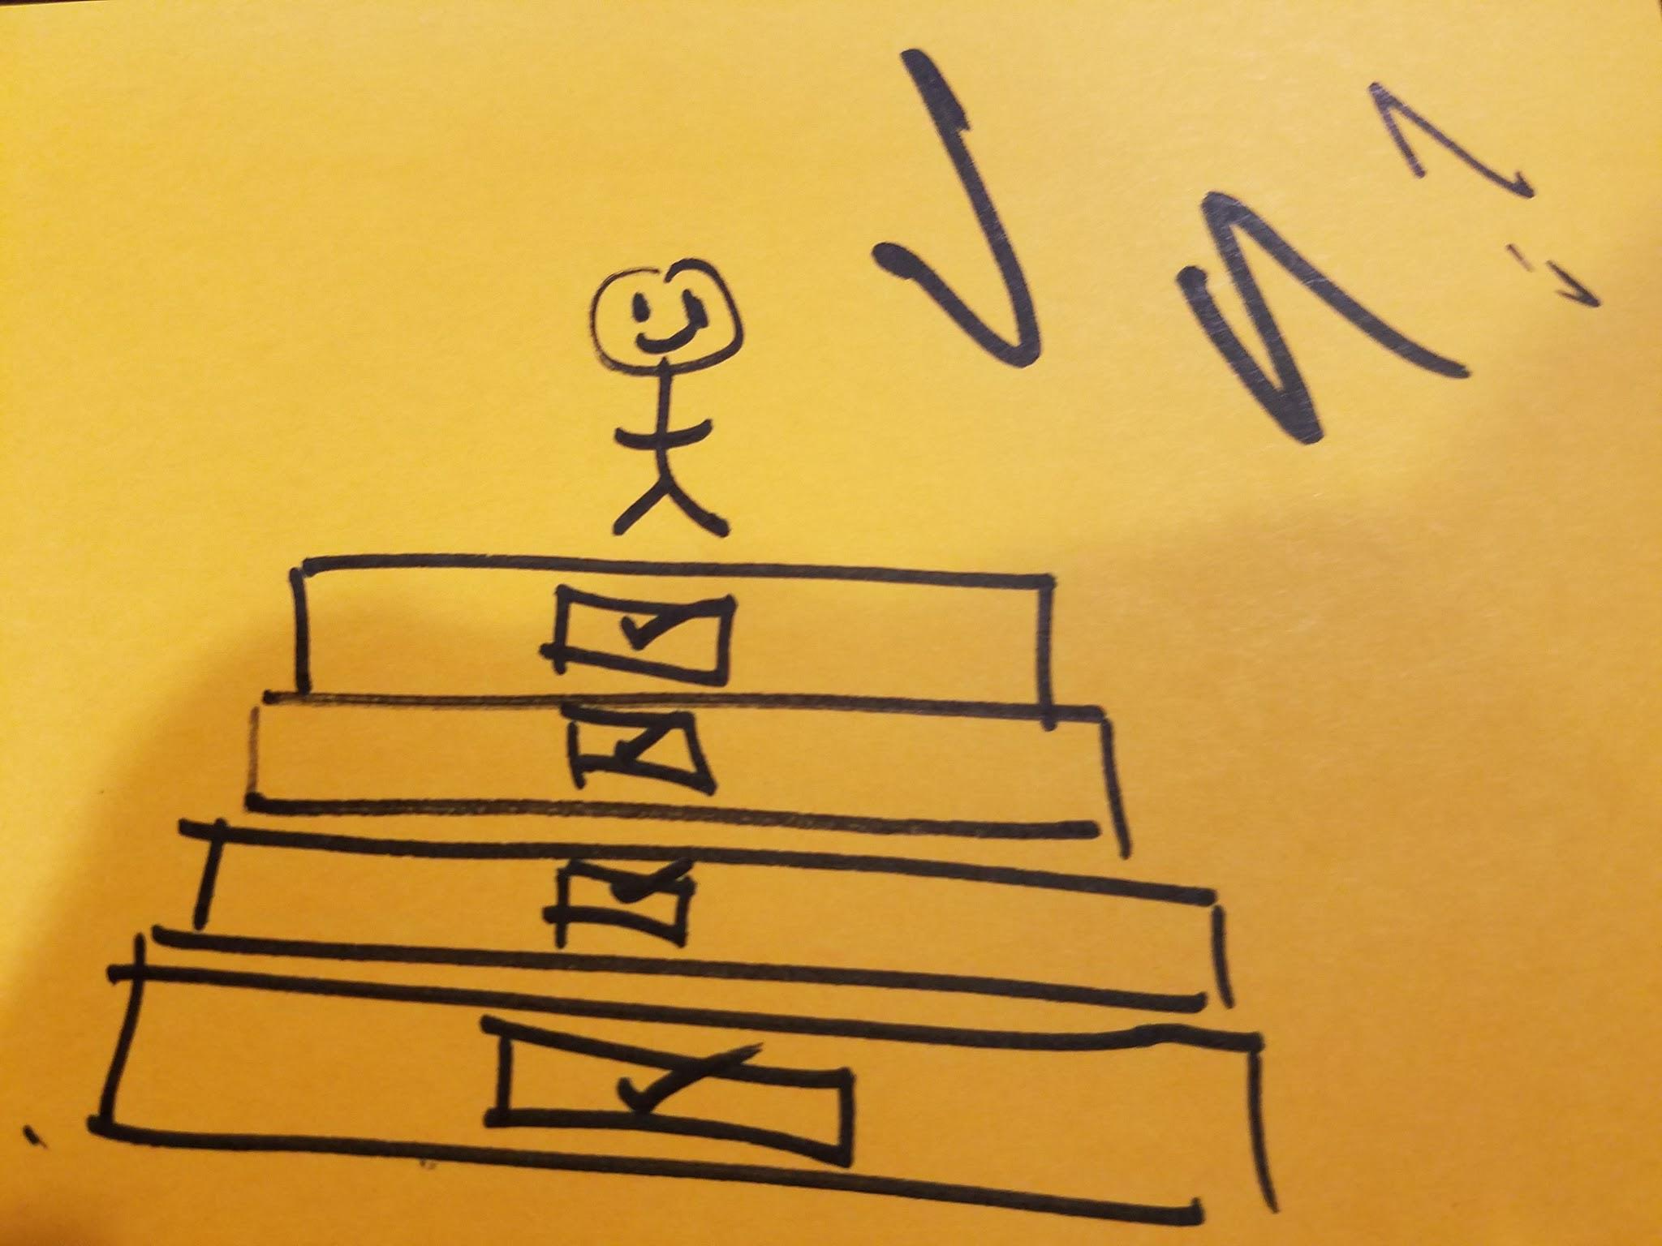
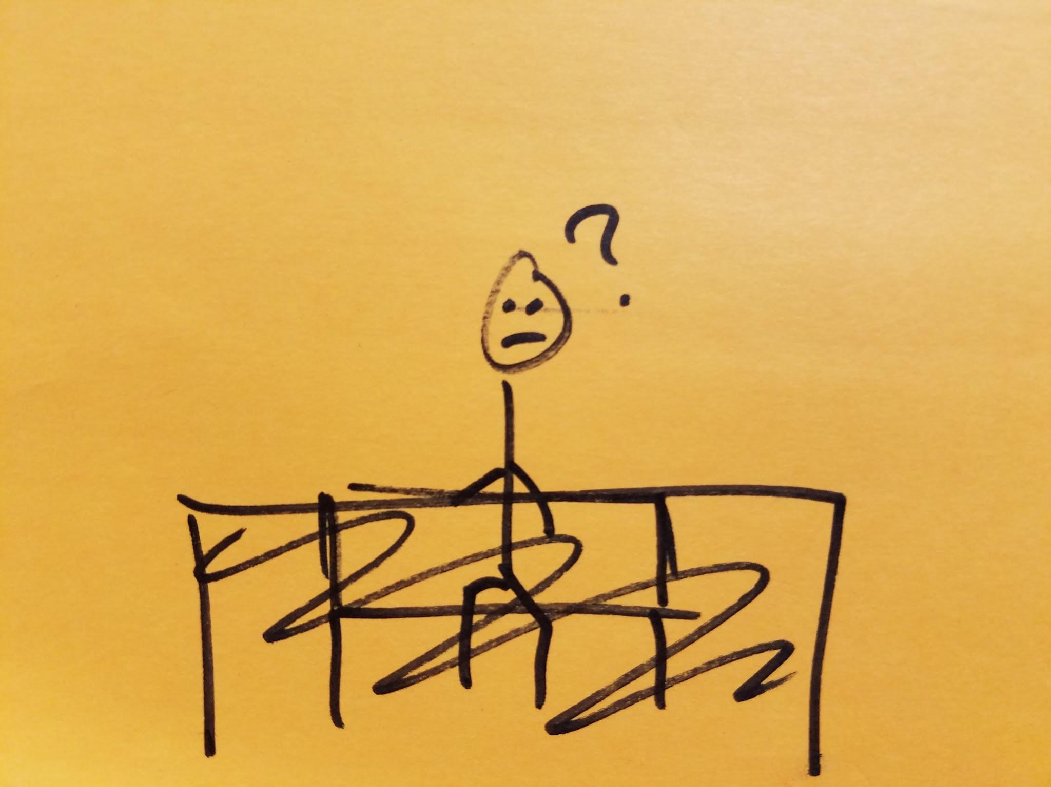
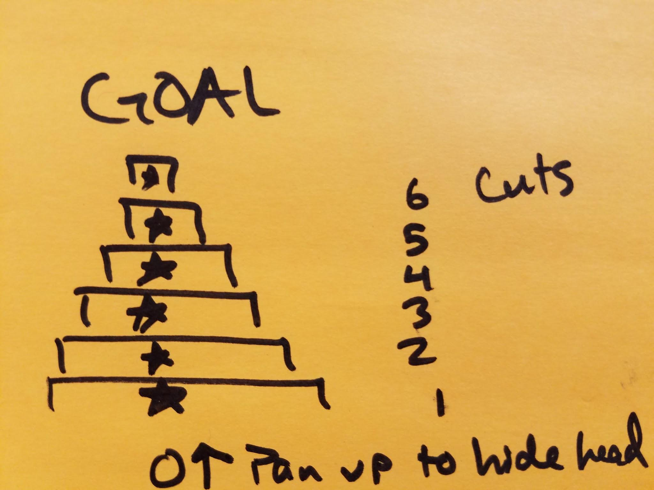
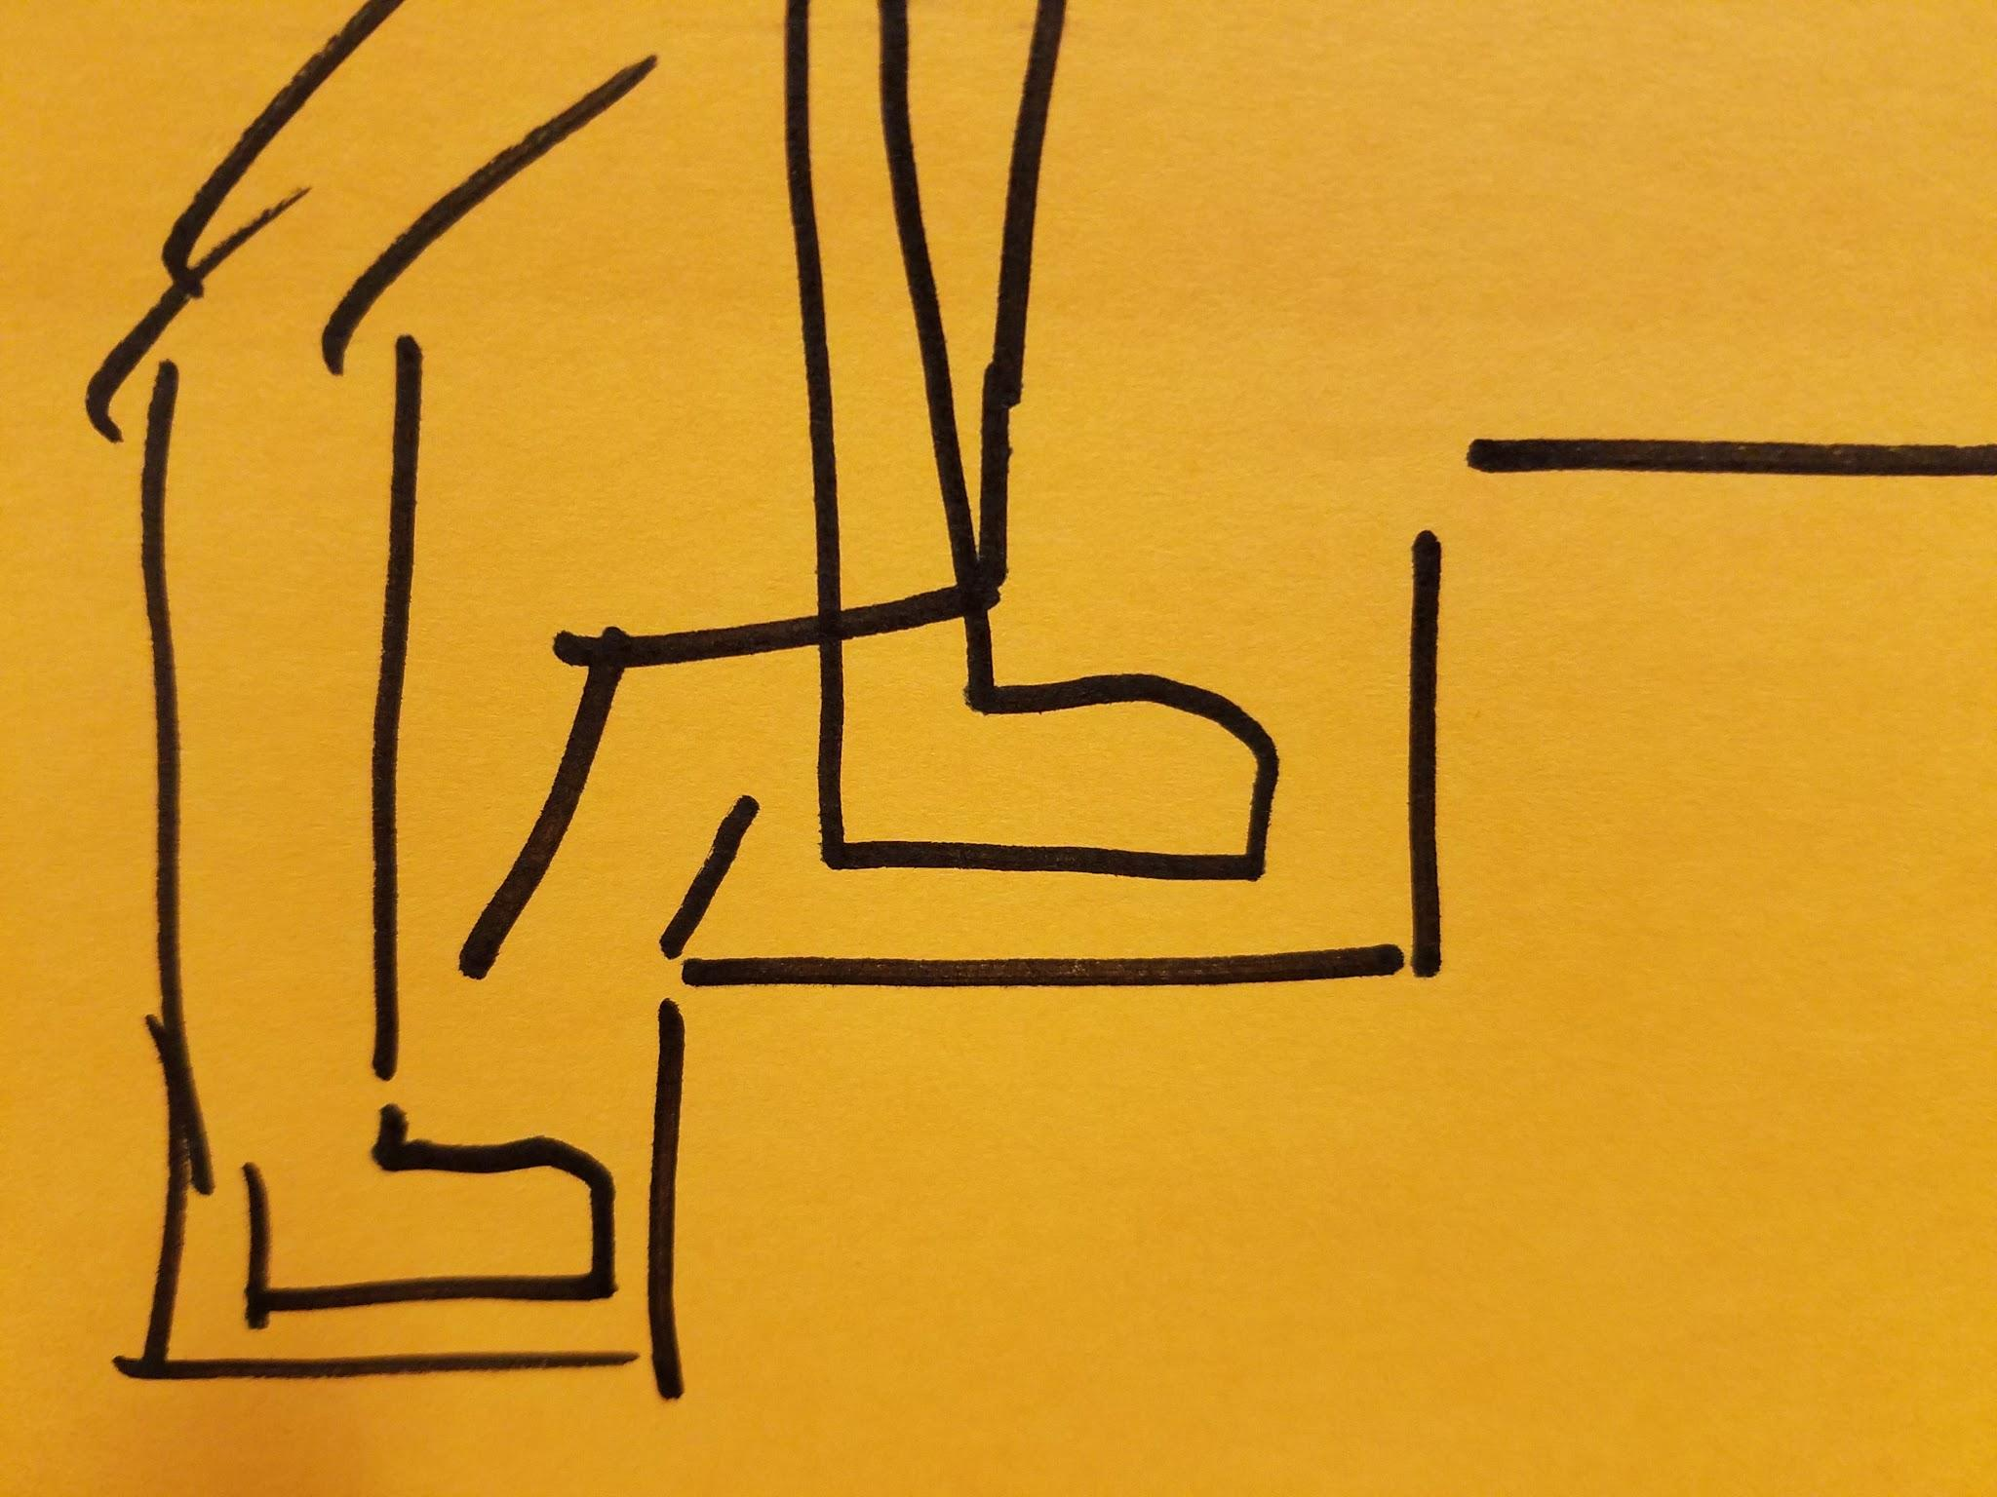
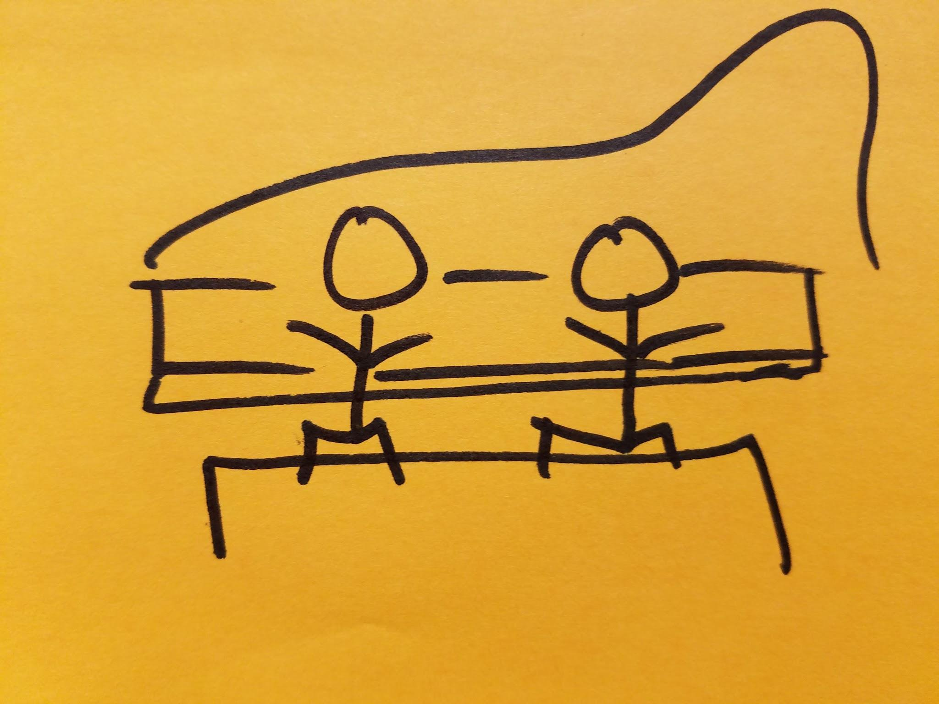
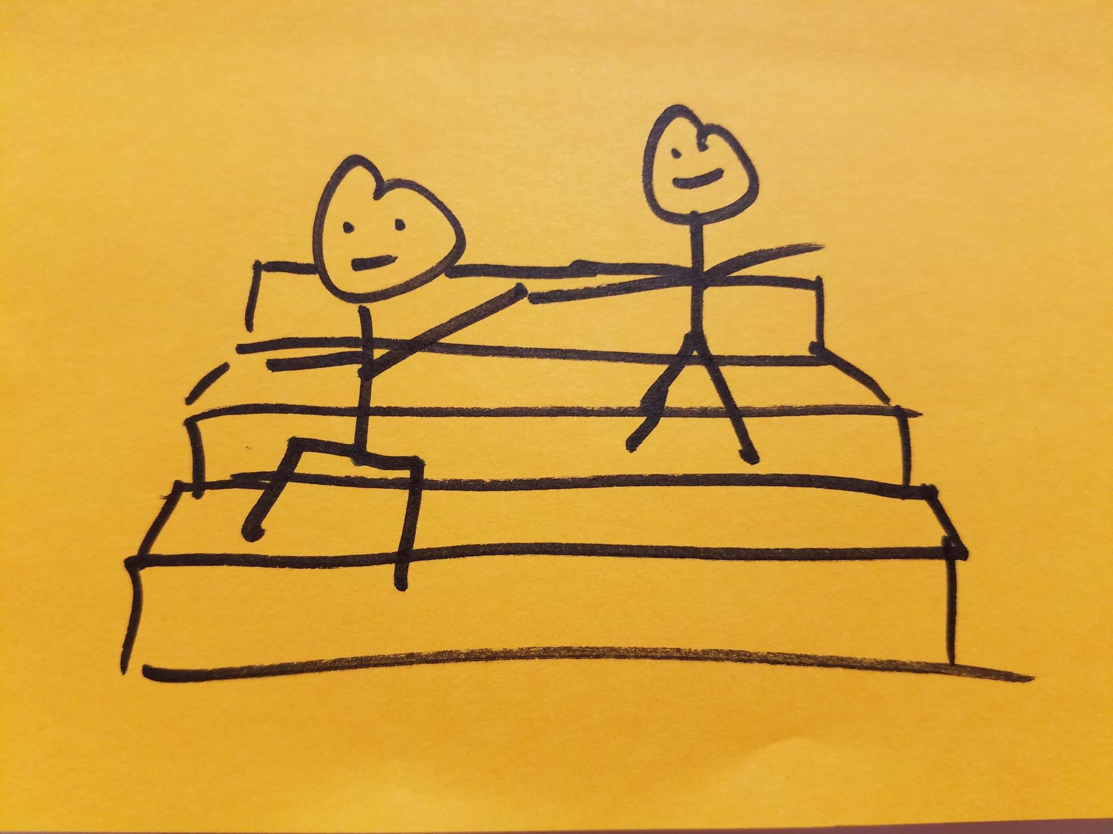
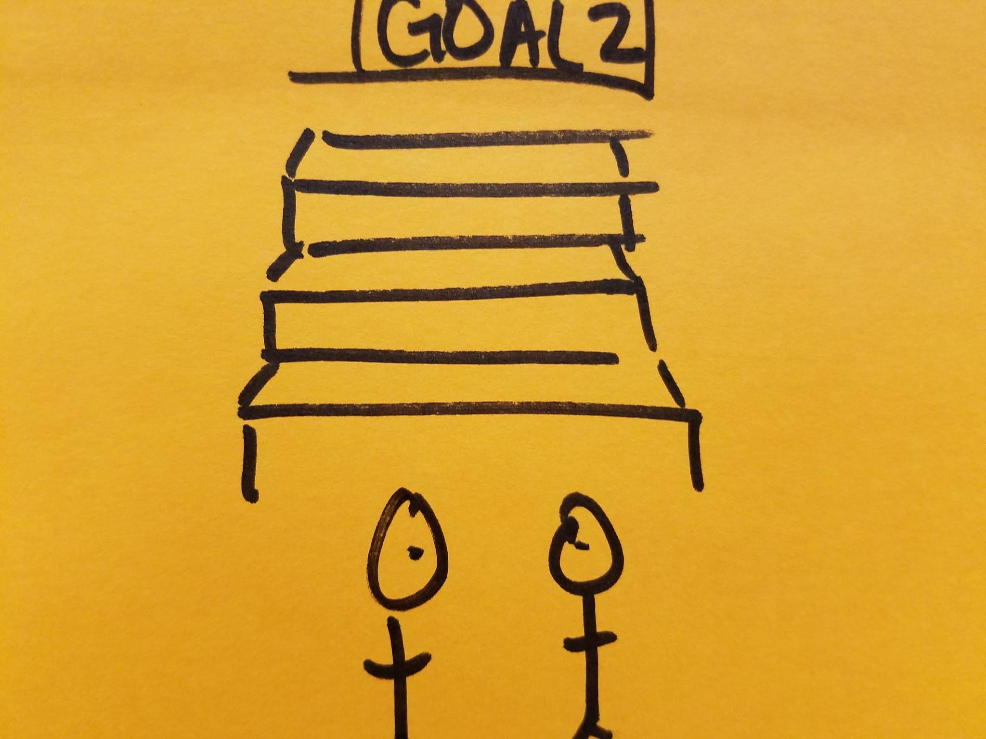
simple
medium
complex

Slide 6
step
half
climb higher
https://vimeo.com/239084250

Slide 7
step
half
climb higher
Notes:
<iframe src="https://player.vimeo.com/video/239084250" width="640" height="360" frameborder="0" webkitallowfullscreen mozallowfullscreen allowfullscreen></iframe>
<p><a href="https://vimeo.com/239084250">half step</a> from <a href="https://vimeo.com/user72985346">Khoi Le</a> on <a href="https://vimeo.com">Vimeo</a>.</p>
https://vimeo.com/239084250

