Slide 1
step
half
climb higher

Slide 2
learn
m u s i c
one step at a time

Slide 3
Music practice can be unfocused, filled with self-doubt, lonely, and disconnected from your goals and dreams.
half step helps you climb higher by providing bite-sized tasks, near-peer support, and progress tracking.

Slide 4
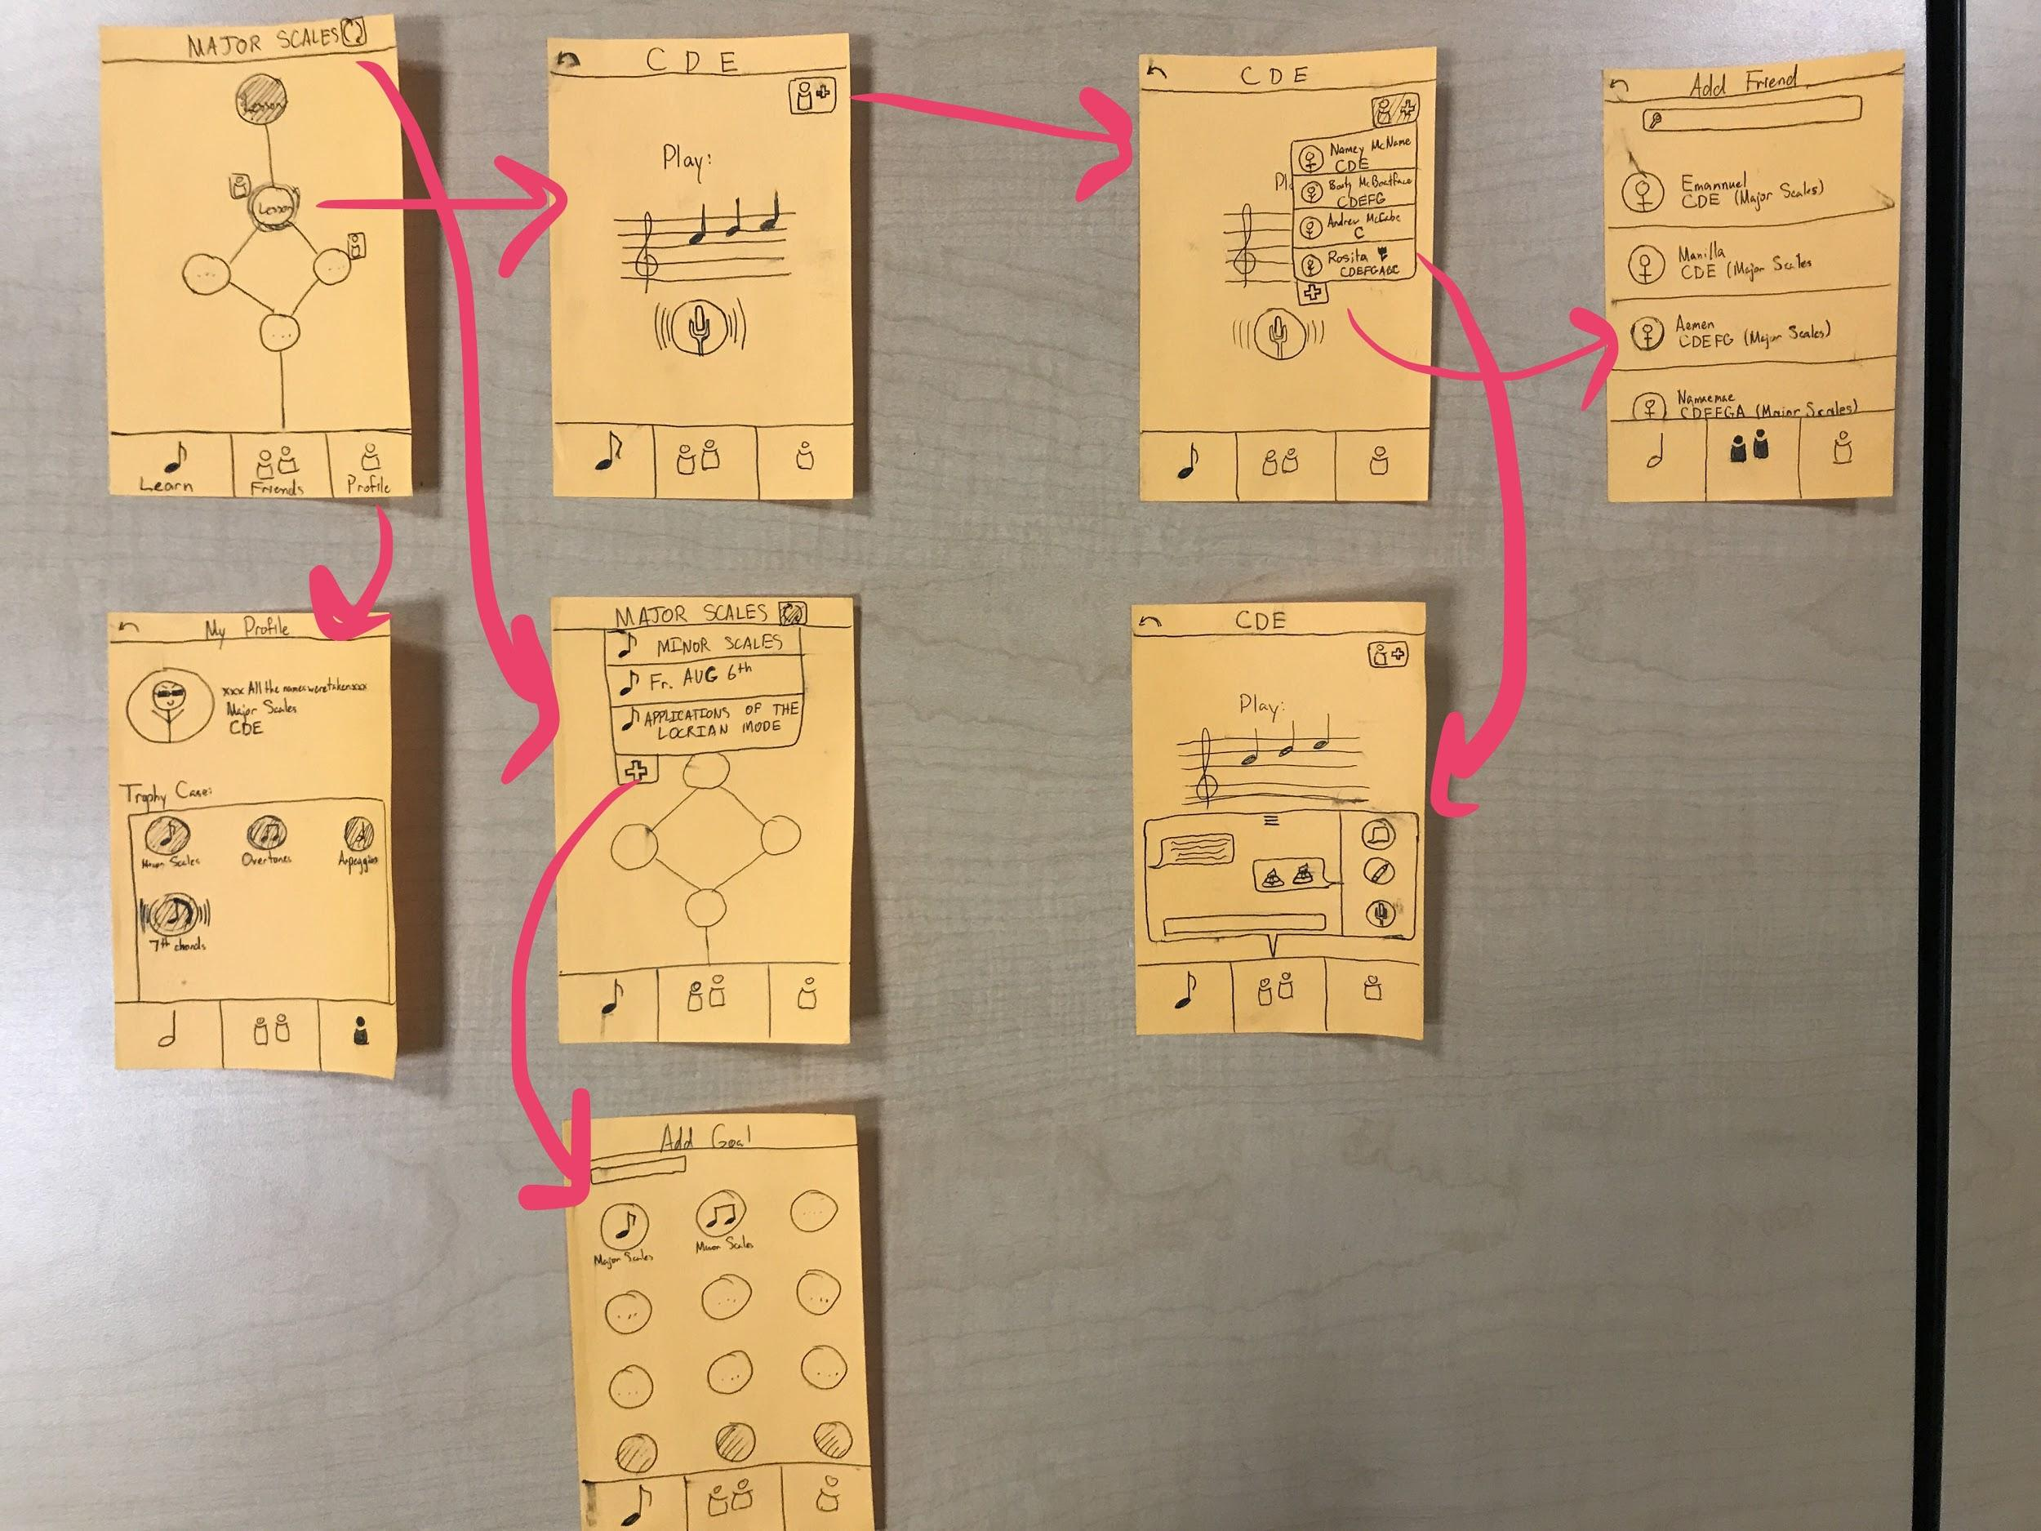
mobile
most portable, easy to manage
UI simple, easy to navigate
people more likely to regularly use
Notes:
Selected INterface and rational Low-fi prototype structure (1 slide – mainly images)

Slide 5
simple
complete current lesson
medium
add new music learning goal
complex
find someone on the same step to meet and learn with

Slide 6
complete lesson
Notes:
Selected INterface and rational Low-fi prototype structure (1 slide – mainly images)

Slide 7
new goal
Notes:
Selected INterface and rational Low-fi prototype structure (1 slide – mainly images)

Slide 8
find a friend on the same step
Notes:
Selected INterface and rational Low-fi prototype structure (1 slide – mainly images)

Slide 9
sat participants down with prototype slides
asked participants to complete tasks in a non-leading manner
debrief and follow-up interview
experiment

Slide 10
georgina - experienced musician
nysterio - never played music
marsdena - serious jazz vocalist
bartholomew - former vocalist
participants

Slide 11
difficulty using friend functionality
uncomfortable sharing practice progress
wanted to learn from their idols practice habits
disliked trophy case
results
Notes:
Selected INterface and rational Low-fi prototype structure (1 slide – mainly images)

Slide 12
find a friend on the same step
Notes:
Selected INterface and rational Low-fi prototype structure (1 slide – mainly images)

Slide 13
difficulty using friend functionality
uncomfortable sharing practice progress
wanted to learn from their idols practice habits
disliked trophy case
results
Notes:
Selected INterface and rational Low-fi prototype structure (1 slide – mainly images)

Slide 14
profile
Notes:
Selected INterface and rational Low-fi prototype structure (1 slide – mainly images)

Slide 15
friends interface (icons, flow)
balancing privacy and sharing
creating a culture of openness about practice
accomplishment display
prospective changes
Notes:
Selected INterface and rational Low-fi prototype structure (1 slide – mainly images)

Slide 16
Questions?

