Slide 1
Jade
A Note-Taking Canvas

Slide 2
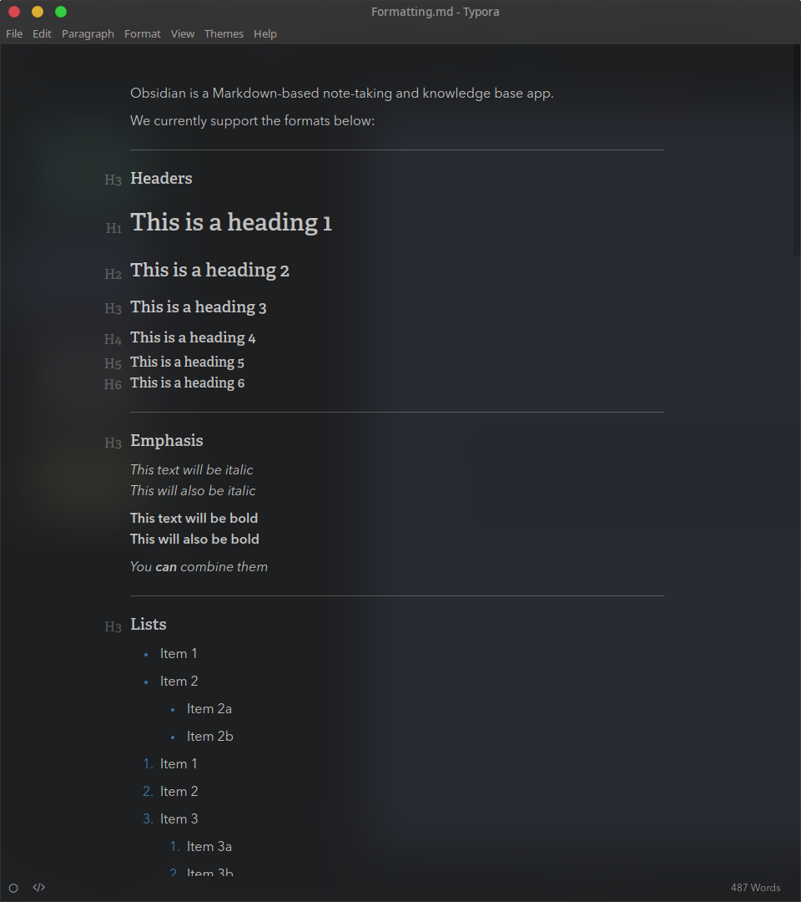
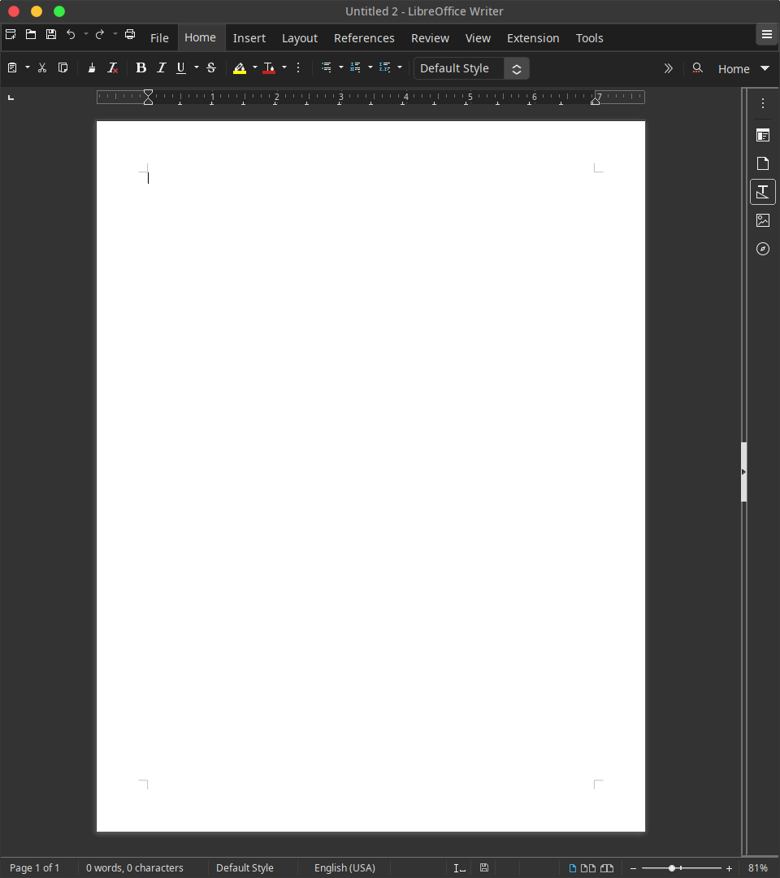
Most text-based note-taking applications, no matter how fancy they are, miss the expressiveness of free drawing, which is more intuitive and sometimes the only way to express thoughts effectively.

Slide 3
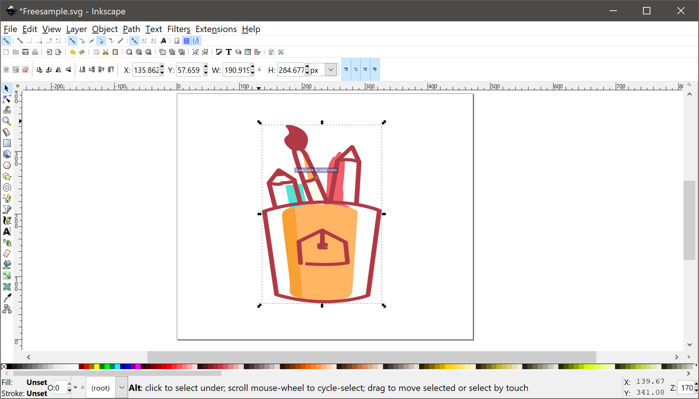
And most graphics manipulation applications are too complicated for instant note-taking.

Slide 4
What if we combine the benefits of both?

Slide 5
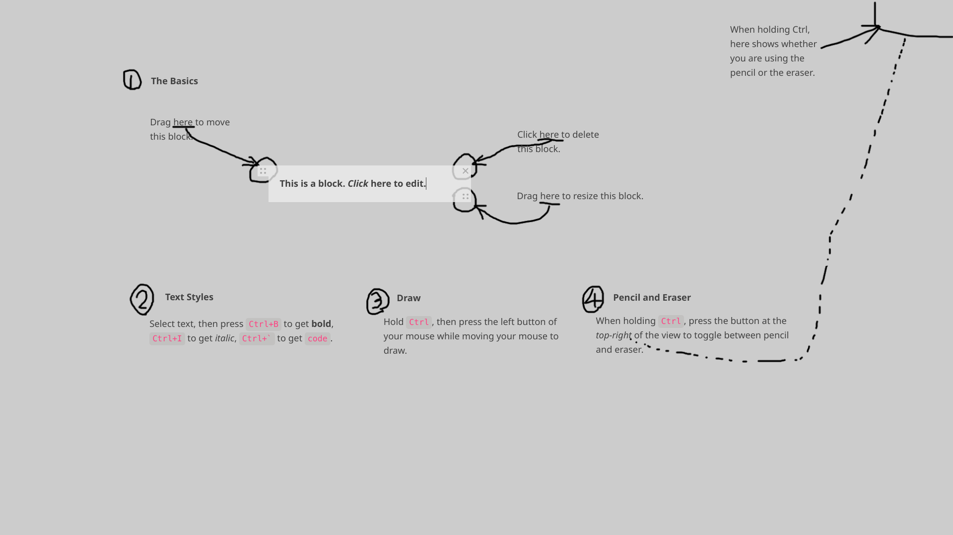
The result is — Jade!

Slide 6
Spatial Arrangement
We can arrange text blocks in a 2D space.
Rich-Text Editing
We can format text based on its semantic meaning.
Free-Form Drawing
We can draw when text is not enough to convey our ideas.

Slide 7
And it’s easy to use!
Looks good by default, zero configuration.

Slide 8
Technical Details
Use Slate.js for to build a custom rich-text editor.
Use HTML Canvas to build a drawing layer.
Use TypeScript.
Use styled-jsx to write normal CSS in JS.
Use webpack to bundle code. (a custom solution, not using create-react-app)
The application is front-end only, data is stored in localStorage.

Slide 9
Usage
npm install
npm run start — Start the development server, it opens the browser automatically.
npm run build — Build the bundle.

