Slide 1

THOUGHT BUBBLE
Value​ ​Proposition,​ ​Problem/Solution​ ​Overview
Three​ ​Tasks
Video​ ​Storyboard

Slide 2
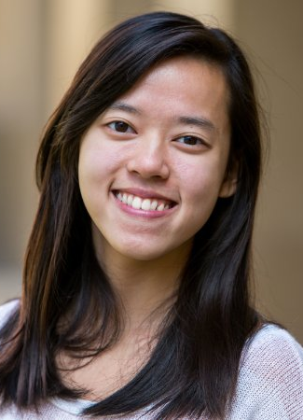
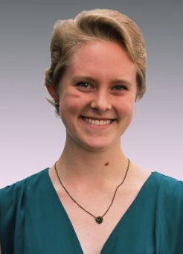
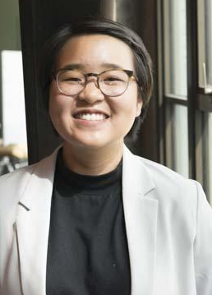
TEAM MEMBERS
Po Tsui
Bonnie Nortz
Jenny Kim
Grace Hong

Slide 3
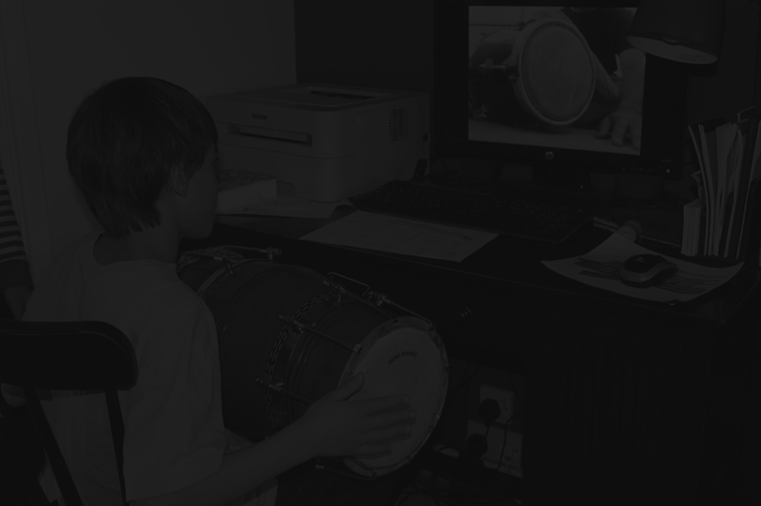
ASK QUESTIONS, SHARE STORIES, EXPAND YOUR BUBBLE
VALUE PROPOSITION
“People oftentimes find it difficult to talk about and ask others questions regarding identity or personal experience, out of fear of not knowing the correct way of asking sensitively or worry for offending/indirectly hurting others.”
“We propose a solution that will allow people to be forthcoming about identities and experiences they’re willing to share, guide their friends in framing questions they’ve been wanting to ask, and facilitate a larger conversation across multiple identities.”

Slide 4
THREE TASKS
TASK 1 | ASK QUESTIONS TO YOUR FRIENDS ANONYMOUSLY
(SIMPLE)
(SIMPLE)
TASK 2 | ANSWER QUESTIONS
(MODERATE)
TASK 3 | CRITIQUE QUESTIONS

Slide 5
STORYBOARD & CONCEPT VIDEO
http://tinyurl.com/y9mrnwbj
https://youtu.be/n3b3R5LFtZ4

