Slide 1


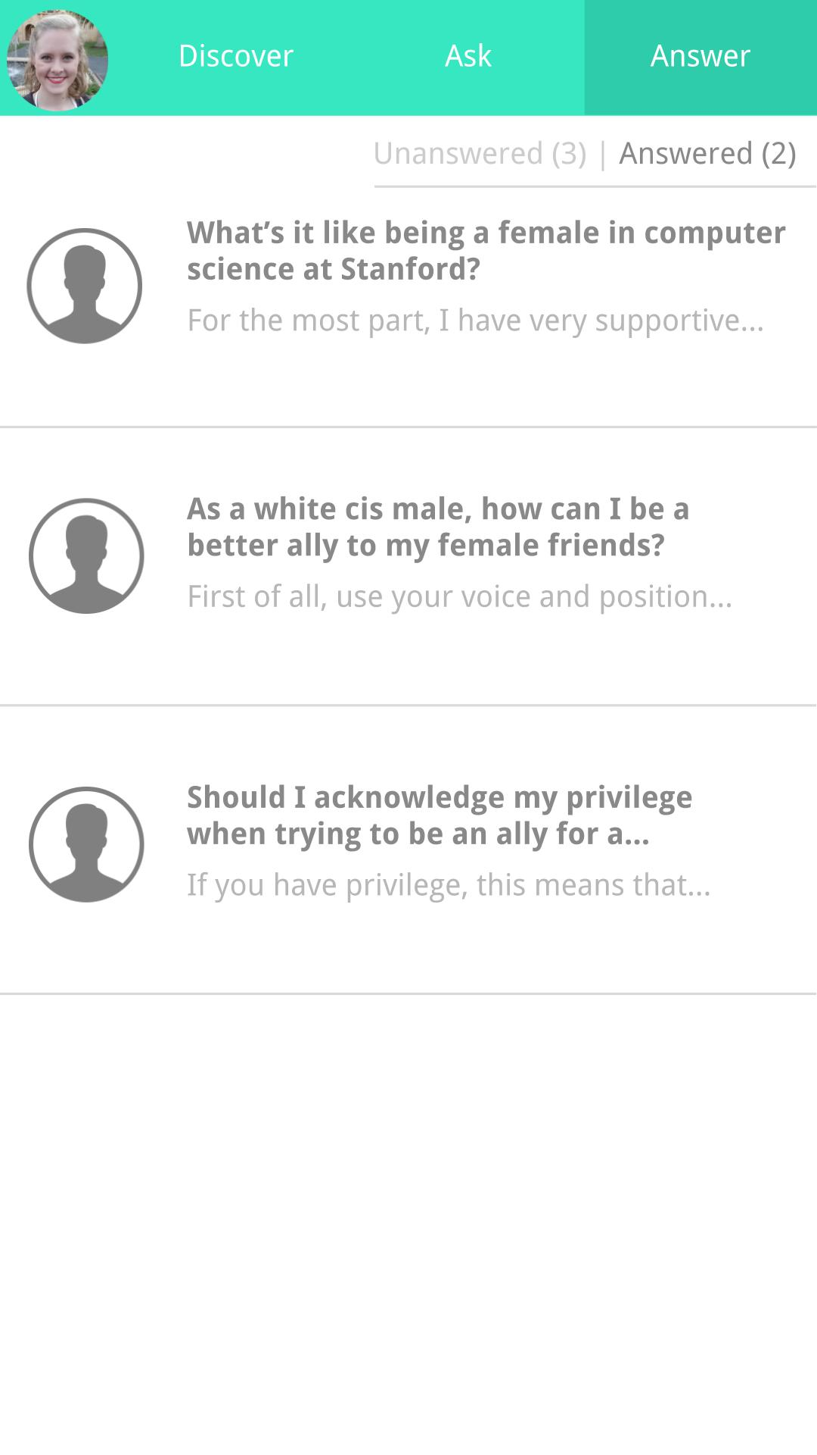
Get help talking
about the
tough questions.
Expand your bubble.

