Slide 1

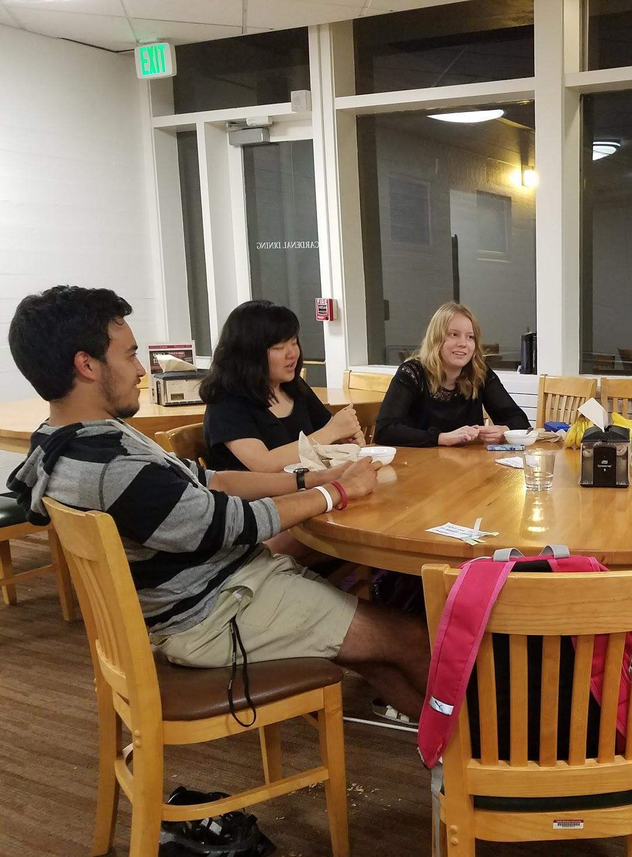
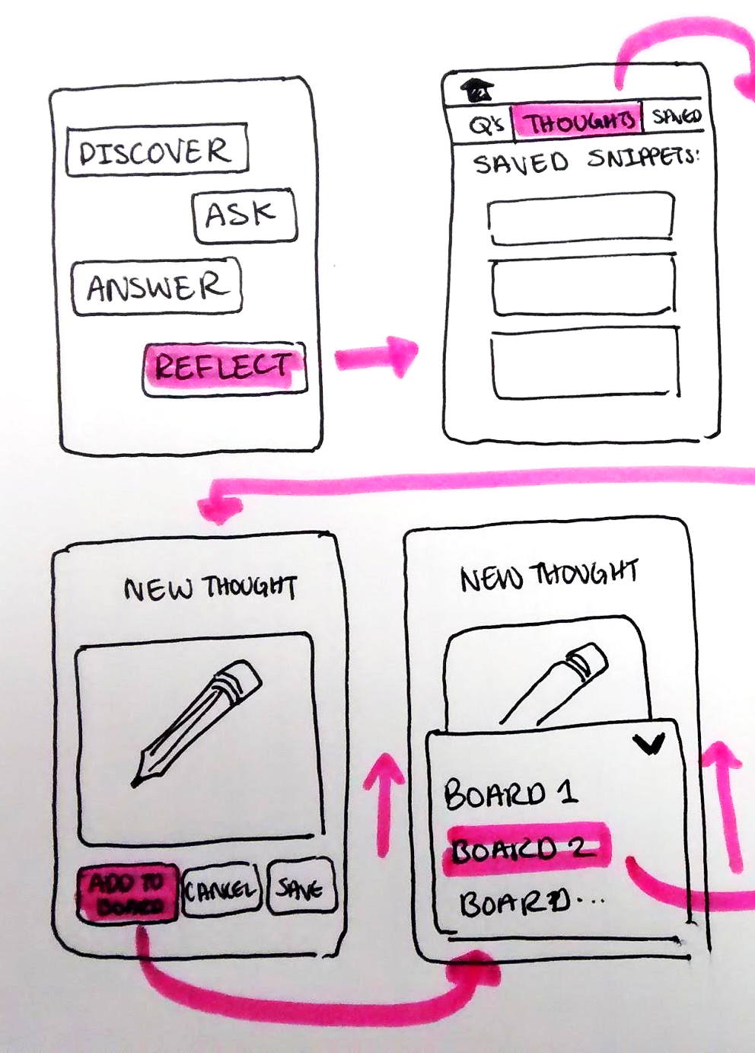

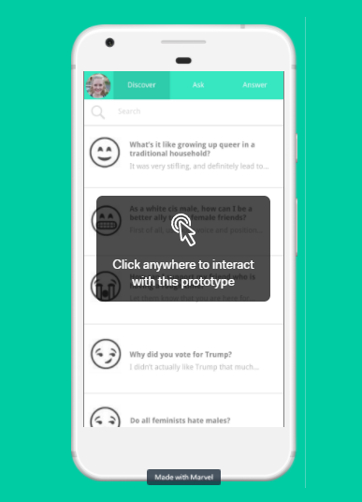
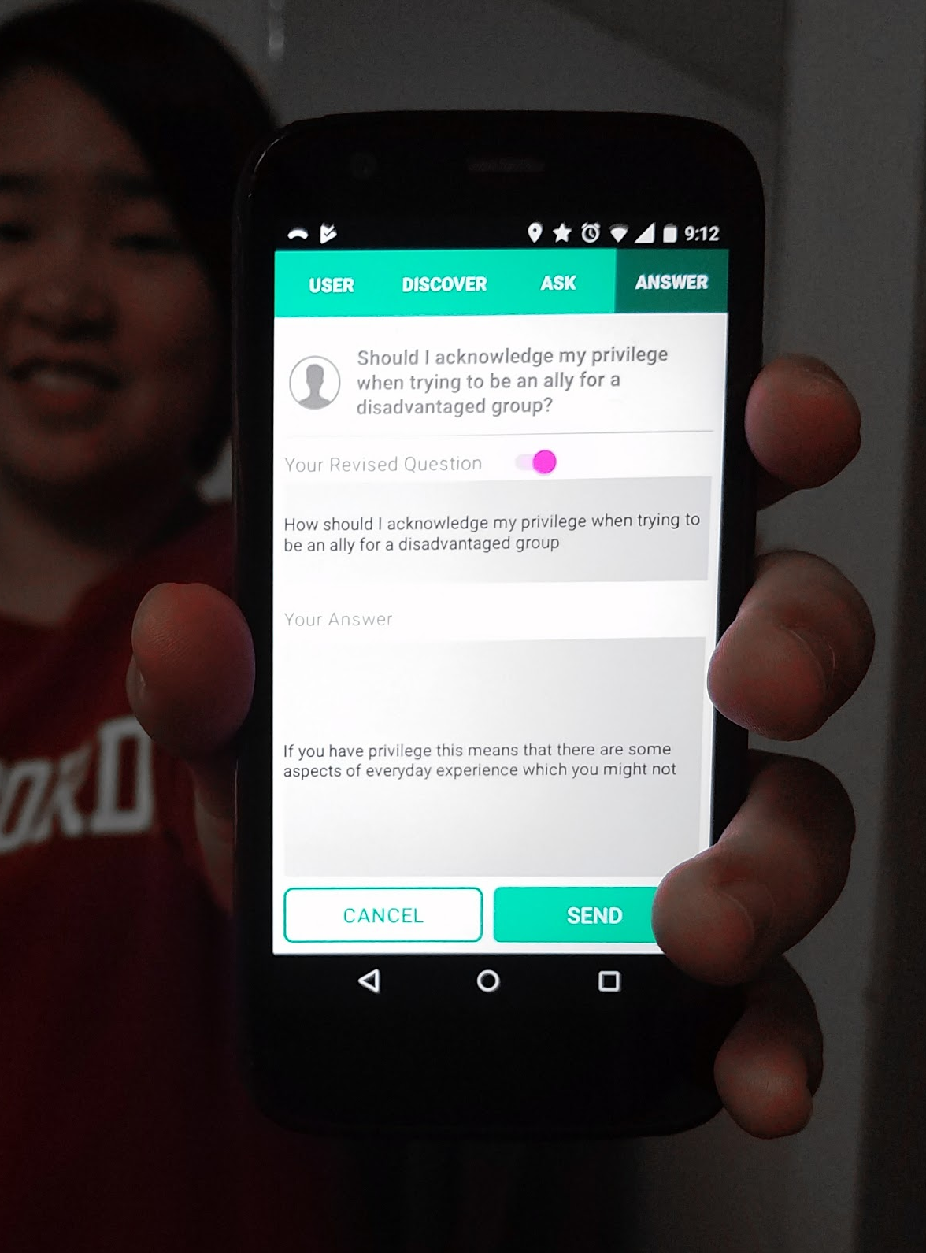

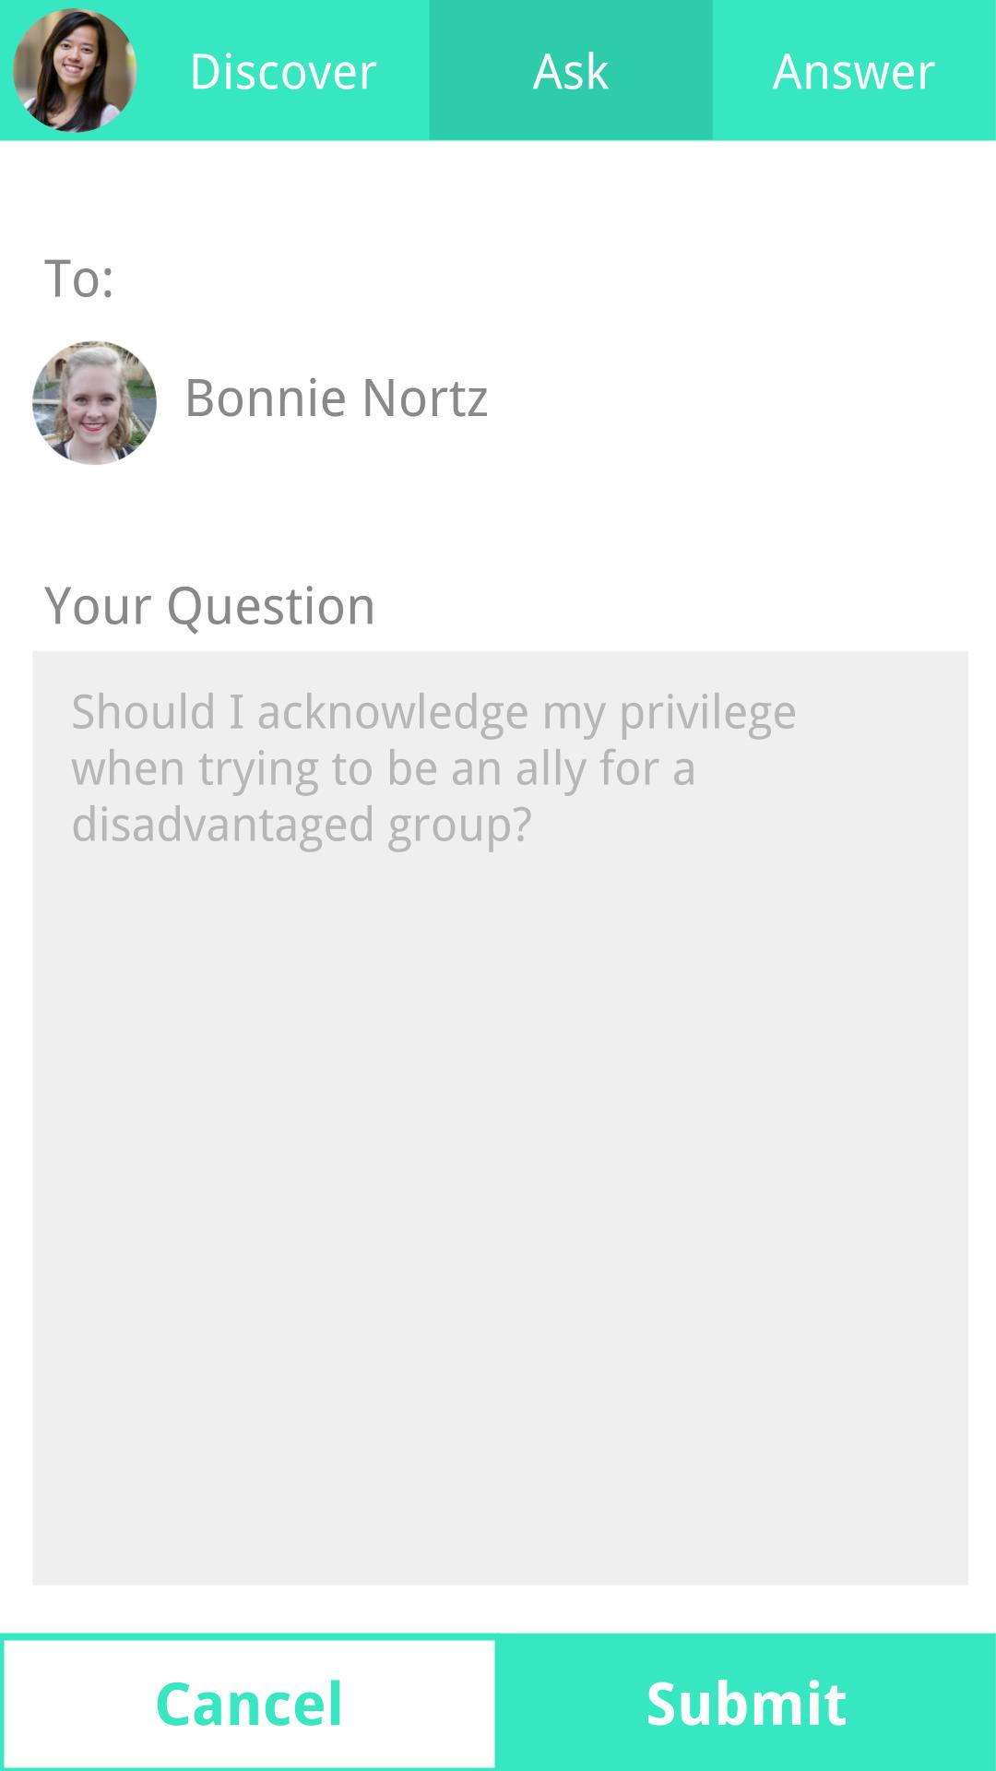
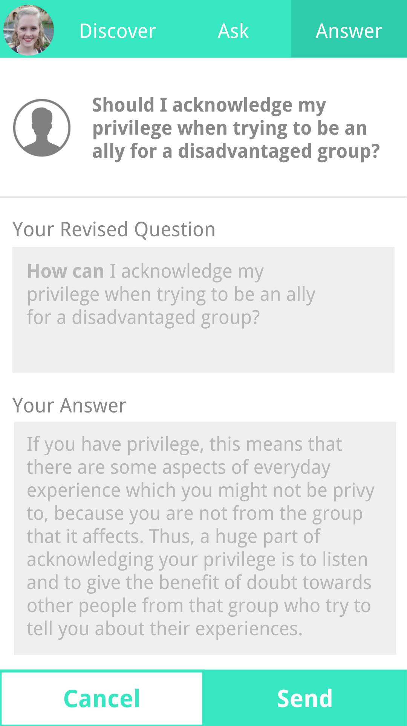
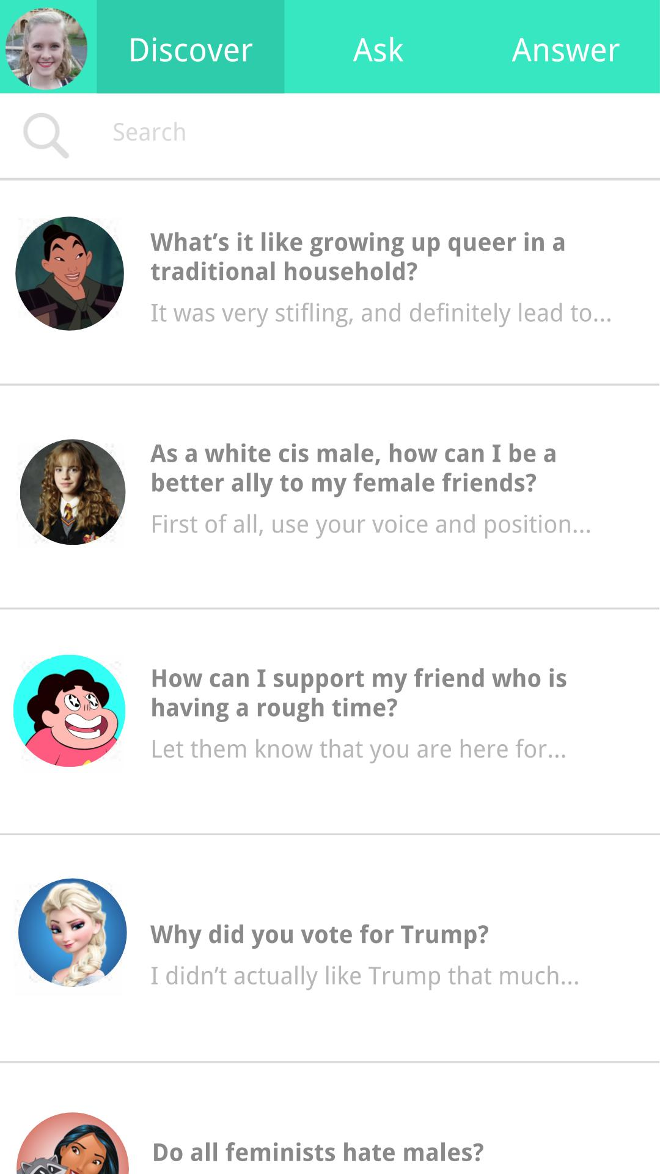
GET HELP TALKING ABOUT THE TOUGH QUESTIONS.
EXPAND YOUR BUBBLE.
Grace Hong • Jenny Kim • Bonnie Nortz • Po Tsui
PROBLEM
PROCESS
SOLUTION
Everyone has questions
they’re too afraid to ask.
Thought Bubble is
an anonymous question platform for friends.
By facilitating
open and honest dialogues,
we foster empathy, awareness, and cross-community conversations
Do Asian parents accept gay kids?
Why did you
vote for Trump?
Needfinding
Lo-fi Prototype
What does
FLI mean?
Do Asian parents
accept gay kids?
Med-fi Prototype
Hi-fi Prototype
KEY FEATURES
ask questions
give answers
discover new perspectives
https://web.stanford.edu/class/cs147/projects/education/thoughtbubble/ • CS147 Autumn 2017

