Slide 1
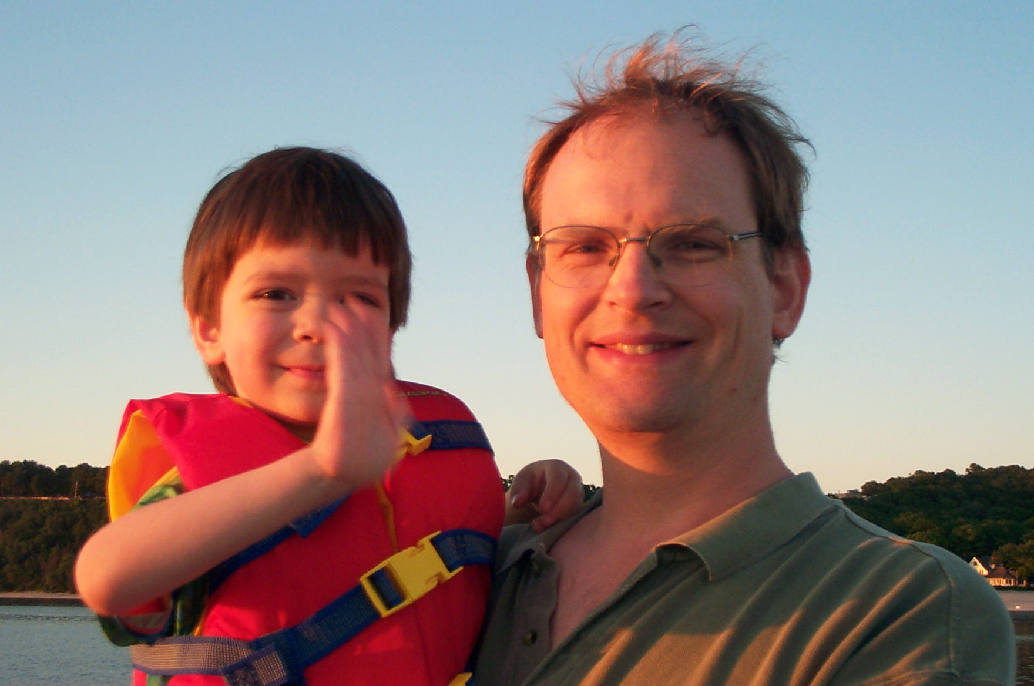
AI
Andrew W. Moore Carnegie Mellon University
awm@cs.cmu.edu (Questions welcome about anything)

Slide 2
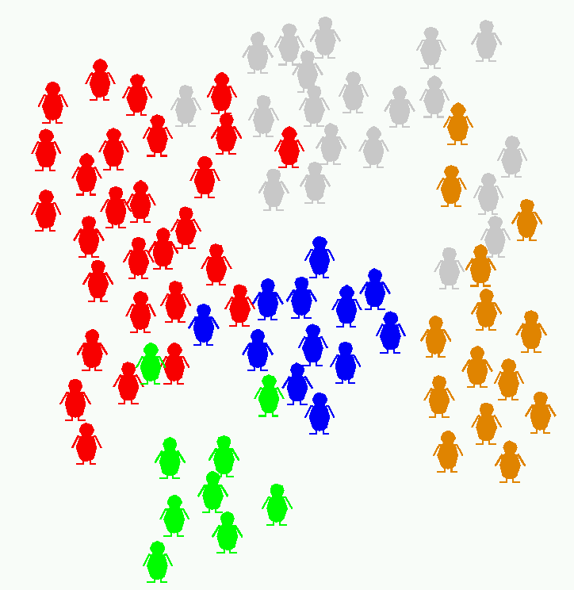
An AI cocktail party

Slide 3
An AI cocktail party
How does intelligence work?

Slide 4
An AI cocktail party
How can we put professional decision-makers out of work?
How does intelligence work?

Slide 5
An AI cocktail party
How can we put professional decision-makers out of work?
These people have produced some fun questions to play with!
How does intelligence work?

Slide 6
An AI cocktail party
How can we put professional decision-makers out of work?
How can we actually apply this profitably?
These people have produced some fun questions to play with!
How does intelligence work?

Slide 7
An AI cocktail party
How can we put professional decision-makers out of work?
How can we actually apply this profitably?
Revolution. 5 years from now. A new age dawns. Paradigm shift. The one thing they missed up to now is...
These people have produced some fun questions to play with!
How does intelligence work?

Slide 8
Why do AI research?
Old fashioned answer:
  Make programs that behave like the brain behaves

Slide 9
Why do AI research?
New fashioned answer:
  Make programs that behave like the brain should behave

Slide 10
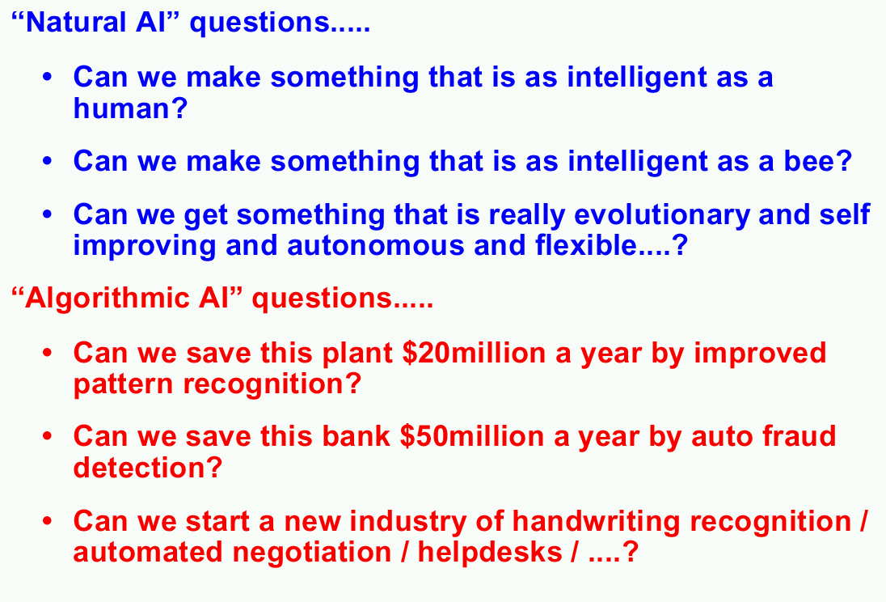

Slide 11
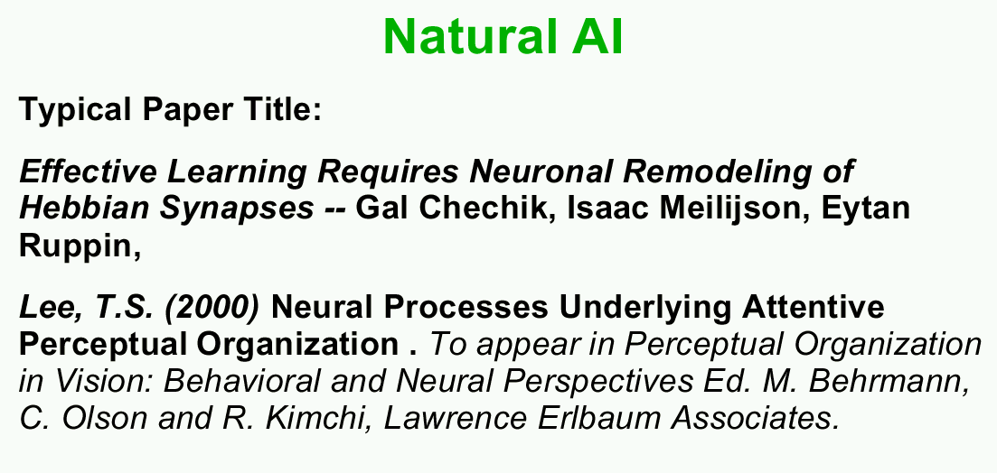

Slide 12
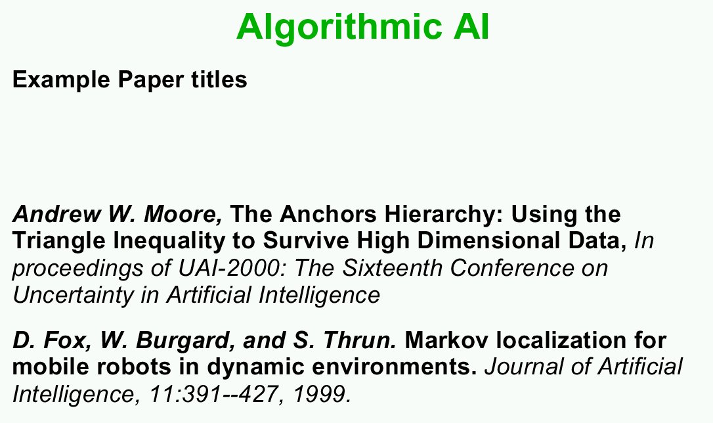

Slide 13
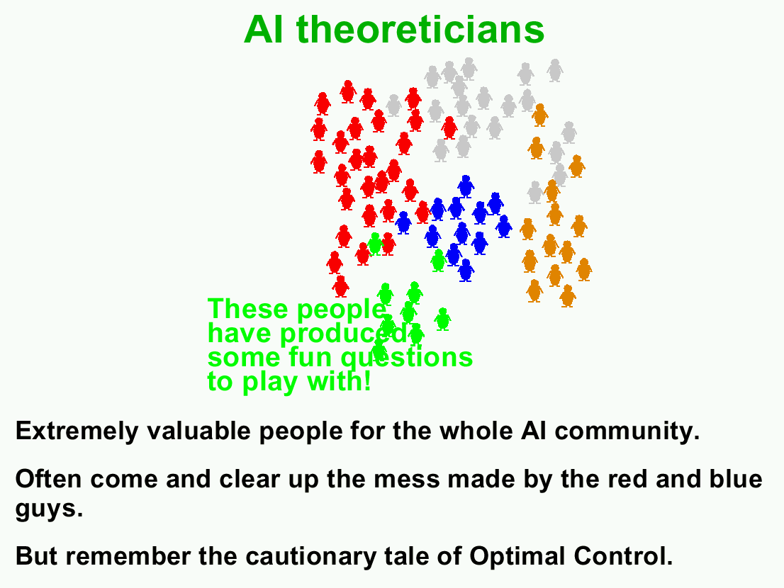

Slide 14
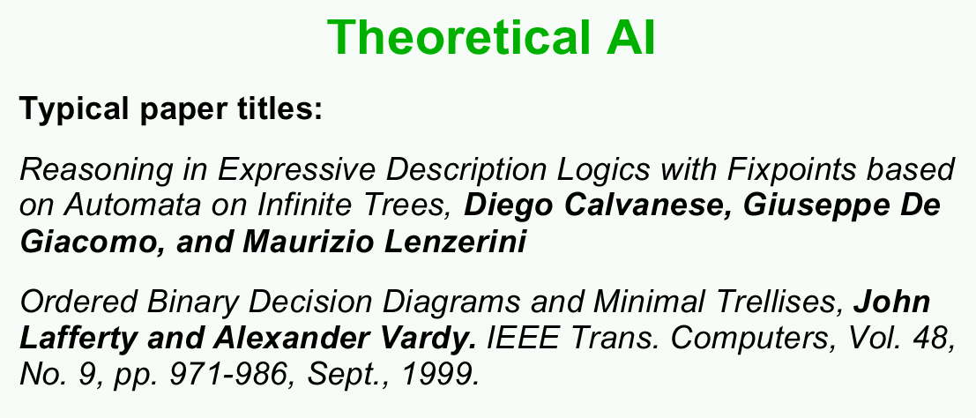

Slide 15
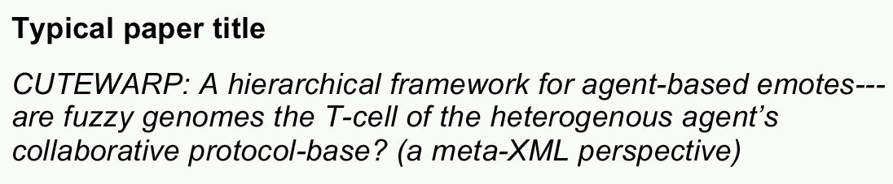
Snake-Oil A.I.

Slide 16
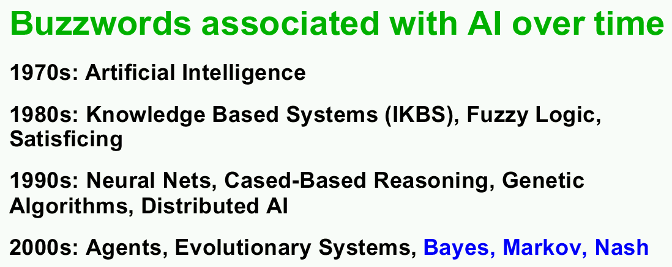

Slide 18
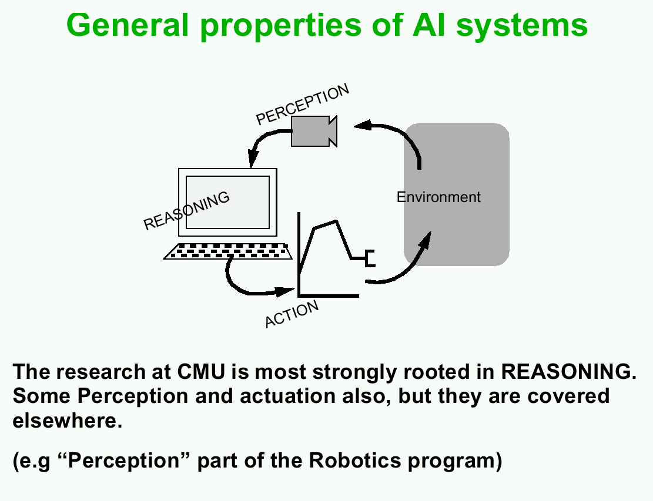

Slide 19
