Slide 1
Bayesian Networks:
Independencies and Inference
Scott Davies and Andrew Moore
Note to other teachers and users of these slides. Andrew and Scott would be delighted if you found this source material useful in giving your own lectures. Feel free to use these slides verbatim, or to modify them to fit your own needs. PowerPoint originals are available. If you make use of a significant portion of these slides in your own lecture, please include this message, or the following link to the source repository of Andrew’s tutorials: http://www.cs.cmu.edu/~awm/tutorials . Comments and corrections gratefully received.

Slide 2
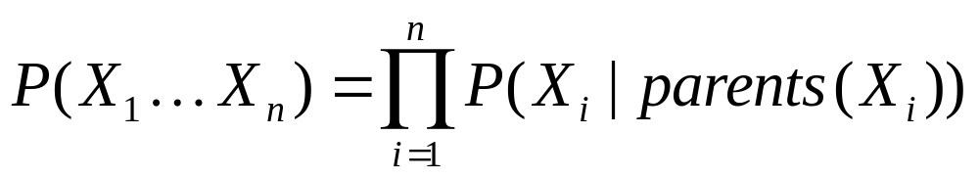
What Independencies does a Bayes Net Model?
In order for a Bayesian network to model a probability distribution, the following must be true by definition:
  Each variable is conditionally independent of all its non-descendants in the graph given the value of all its parents.
This implies
But what else does it imply?

Slide 3
What Independencies does a Bayes Net Model?
Example:
Given Y, does learning the value of Z tell us
nothing new about X?
I.e., is P(X|Y, Z) equal to P(X | Y)?
Yes. Since we know the value of all of X’s parents (namely, Y), and Z is not a descendant of X, X is conditionally independent of Z.
Also, since independence is symmetric,
P(Z|Y, X) = P(Z|Y).
Z
Y
X

Slide 4
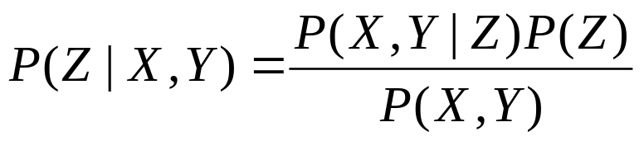
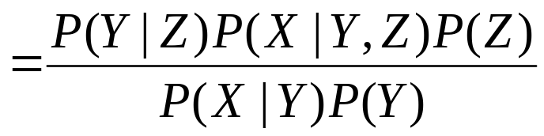
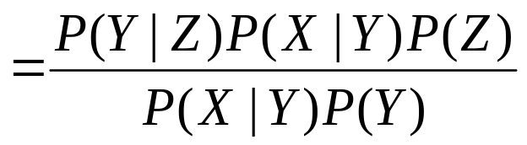
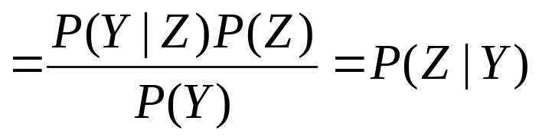
Quick proof that independence is symmetric
Assume: P(X|Y, Z) = P(X|Y)
Then:
(Bayes’s Rule)
(Chain Rule)
(By Assumption)
(Bayes’s Rule)

Slide 5
What Independencies does a Bayes Net Model?
Let I<X,Y,Z> represent X and Z being conditionally independent given Y.
I<X,Y,Z>? Yes, just as in previous example: All X’s parents given, and Z is not a descendant.
Y
X
Z

Slide 6
What Independencies does a Bayes Net Model?
Z
U
V
X
I<X,{U},Z>? No.
I<X,{U,V},Z>? Yes.
Maybe I<X, S, Z> iff S acts a cutset between X and Z in an undirected version of the graph…?

Slide 7
Things get a little more confusing
X
Z
Y
X has no parents, so we’re know all its parents’ values trivially
Z is not a descendant of X
So, I<X,{},Z>, even though there’s a undirected path from X to Z through an unknown variable Y.
What if we do know the value of Y, though? Or one of its descendants?

Slide 8
The “Burglar Alarm” example
Burglar
Earthquake
Alarm
Phone Call
Your house has a twitchy burglar alarm that is also sometimes triggered by earthquakes.
Earth arguably doesn’t care whether your house is currently being burgled
While you are on vacation, one of your neighbors calls and tells you your home’s burglar alarm is ringing. Uh oh!

Slide 9
Things get a lot more confusing
Burglar
Earthquake
Alarm
Phone Call
But now suppose you learn that there was a medium-sized earthquake in your neighborhood. Oh, whew! Probably not a burglar after all.
Earthquake “explains away” the hypothetical burglar.
But then it must not be the case that
I<Burglar,{Phone Call}, Earthquake>, even though
I<Burglar,{}, Earthquake>!

Slide 10
d-separation to the rescue
Fortunately, there is a relatively simple algorithm for determining whether two variables in a Bayesian network are conditionally independent: d-separation.
Definition: X and Z are d-separated by a set of evidence variables E iff every undirected path from X to Z is “blocked”, where a path is “blocked” iff one or more of the following conditions is true: ...

Slide 11
A path is “blocked” when...
There exists a variable V on the path such that
  it is in the evidence set E
  the arcs putting V in the path are “tail-to-tail”
Or, there exists a variable V on the path such that
  it is in the evidence set E
  the arcs putting V in the path are “tail-to-head”
Or, ...
V
V

Slide 12
A path is “blocked” when… (the funky case)
… Or, there exists a variable V on the path such that
  it is NOT in the evidence set E
  neither are any of its descendants
  the arcs putting V on the path are “head-to-head”
V

Slide 13
d-separation to the rescue, cont’d
Theorem [Verma & Pearl, 1998]:
  If a set of evidence variables E d-separates X and Z in a Bayesian network’s graph, then I<X, E, Z>.
d-separation can be computed in linear time using a depth-first-search-like algorithm.
Great! We now have a fast algorithm for automatically inferring whether learning the value of one variable might give us any additional hints about some other variable, given what we already know.
  “Might”: Variables may actually be independent when they’re not d-separated, depending on the actual probabilities involved

Slide 14
d-separation example
A
B
I<C, {}, D>?
I<C, {A}, D>?
I<C, {A, B}, D>?
I<C, {A, B, J}, D>?
I<C, {A, B, E, J}, D>?
C
D
E
F
G
H
I
J

Slide 15
Bayesian Network Inference
Inference: calculating P(X|Y) for some variables or sets of variables X and Y.
Inference in Bayesian networks is #P-hard!
Inputs: prior probabilities of .5
I1
I2
I3
I4
I5
Reduces to
O
P(O) must be
(#sat. assign.)*(.5^#inputs)
How many satisfying assignments?

Slide 16
Bayesian Network Inference
But…inference is still tractable in some cases.
Let’s look a special class of networks: trees / forests in which each node has at most one parent.

Slide 17
Decomposing the probabilities
Suppose we want P(X_{i} | E) where E is some set of evidence variables.
Let’s split E into two parts:
  E_{i}⁻ is the part consisting of assignments to variables in the subtree rooted at X_{i}
  E_{i}⁺ is the rest of it
X_{i}

Slide 18
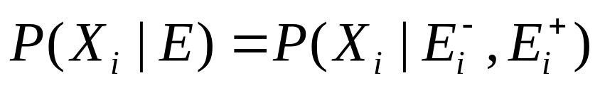
Decomposing the probabilities, cont’d
X_{i}

Slide 19
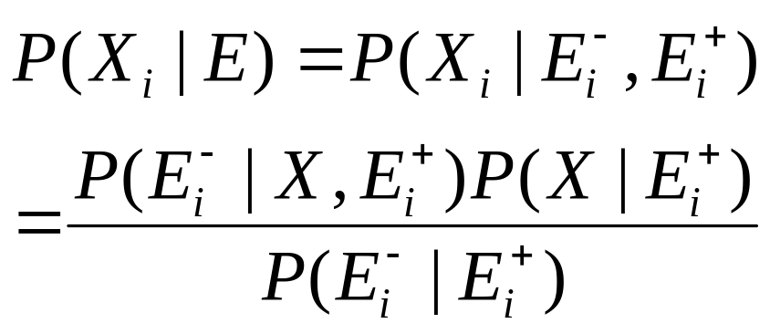
Decomposing the probabilities, cont’d
X_{i}

Slide 20
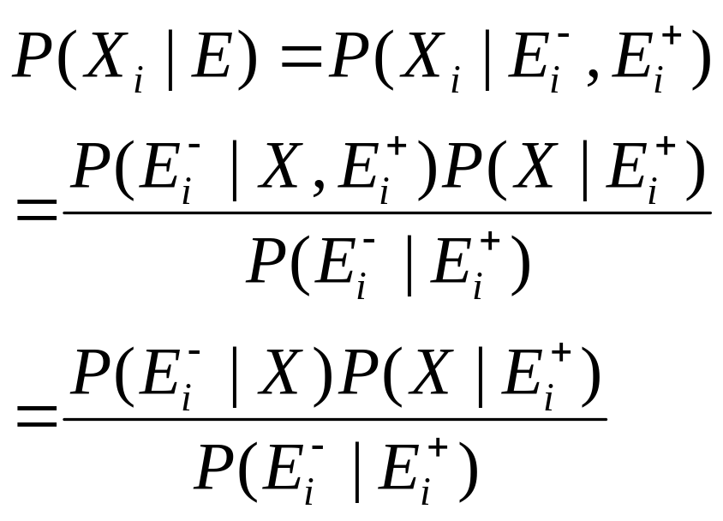
Decomposing the probabilities, cont’d
X_{i}

Slide 21
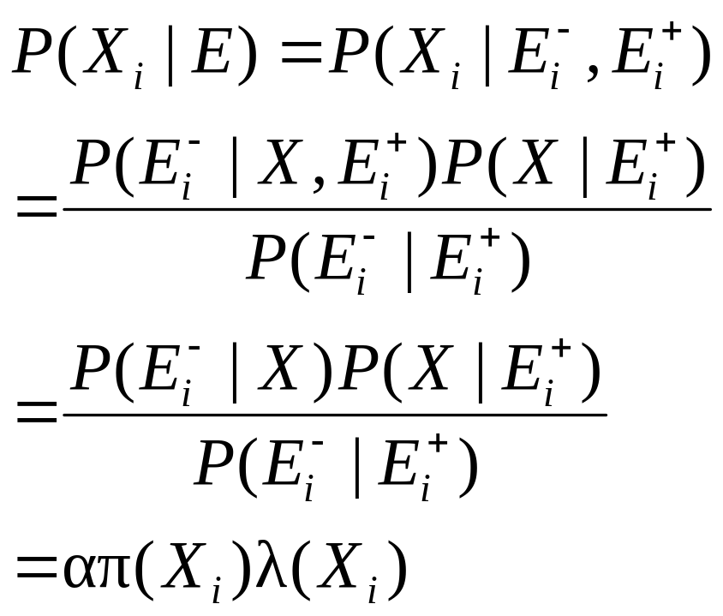
Decomposing the probabilities, cont’d
X_{i}
Where:
α is a constant independent of X_{i}
π(X_{i}) = P(X_{i} |E_{i}⁺)
λ(X_{i}) = P(E_{i}⁻| X_{i})

Slide 22
Using the decomposition for inference
We can use this decomposition to do inference as follows. First, compute λ(X_{i}) = P(E_{i}⁻| X_{i}) for all X_{i} recursively, using the leaves of the tree as the base case.
If X_{i} is a leaf:
  If X_{i} is in E: λ(X_{i}) = 1 if X_{i} matches E, 0 otherwise
  If X_{i} is not in E: E_{i}⁻ is the null set, so
    P(E_{i}⁻| X_{i}) = 1 (constant)

Slide 23
Quick aside: “Virtual evidence”
For theoretical simplicity, but without loss of generality, let’s assume that all variables in E (the evidence set) are leaves in the tree.
Why can we do this WLOG:
Equivalent to
X_{i}
X_{i}
Observe X_{i}
X_{i}’
Observe X_{i}’
Where P(X_{i}’| X_{i}) =1 if X_{i}’=X_{i}, 0 otherwise

Slide 24
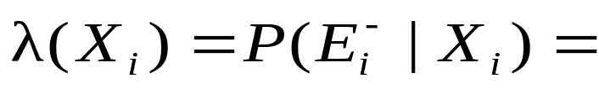
Calculating λ(X_{i}) for non-leaves
X_{i}
Suppose X_{i} has one child, X_{c}.
Then:
X_{c}

Slide 25
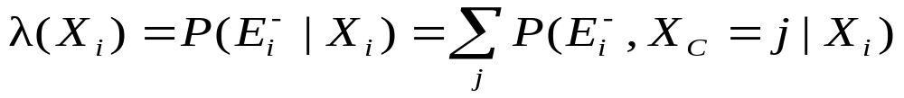
Calculating λ(X_{i}) for non-leaves
X_{i}
Suppose X_{i} has one child, X_{c}.
Then:
X_{c}

Slide 26
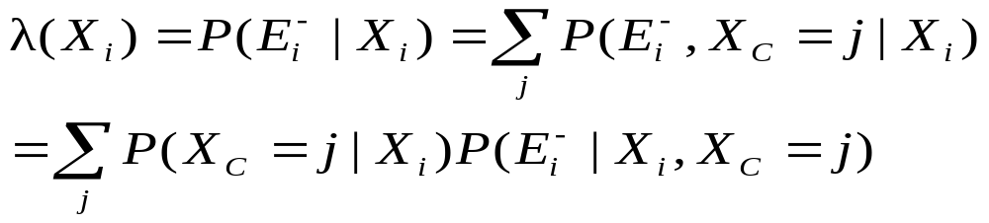
Calculating λ(X_{i}) for non-leaves
X_{i}
Suppose X_{i} has one child, X_{c}.
Then:
X_{c}

Slide 27
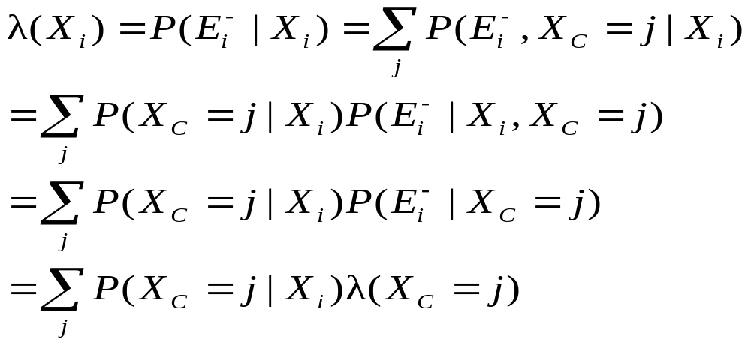
Calculating λ(X_{i}) for non-leaves
X_{i}
Suppose X_{i} has one child, X_{c}.
Then:
X_{c}

Slide 28
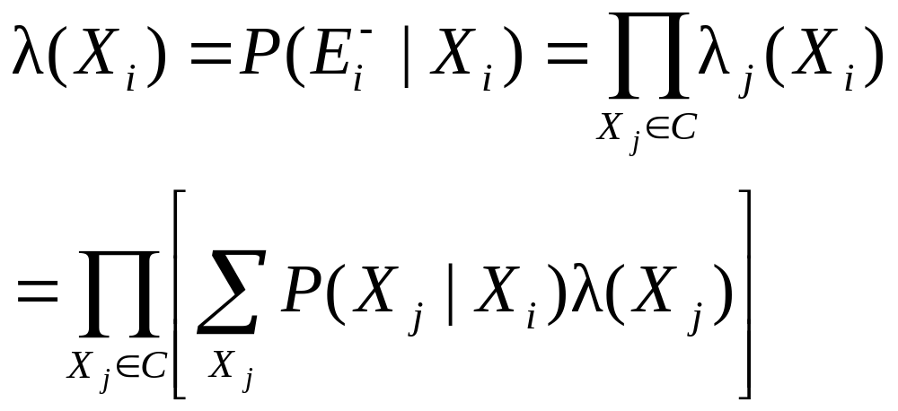
Calculating λ(X_{i}) for non-leaves
Now, suppose X_{i} has a set of children, C.
Since X_{i} d-separates each of its subtrees, the contribution of each subtree to λ(X_{i}) is independent:
where λ_{j}(X_{i}) is the contribution to P(E_{i}⁻| X_{i}) of the part of the evidence lying in the subtree rooted at one of X_{i}’s children X_{j}.

Slide 29
We are now λ-happy
So now we have a way to recursively compute all the λ(X_{i})’s, starting from the root and using the leaves as the base case.
If we want, we can think of each node in the network as an autonomous processor that passes a little “λ message” to its parent.
λ
λ
λ
λ
λ
λ

Slide 30
The other half of the problem
Remember, P(X_{i}|E) = απ(X_{i})λ(X_{i}). Now that we have all the λ(X_{i})’s, what about the π(X_{i})’s?
π(X_{i}) = P(X_{i} |E_{i}⁺).
What about the root of the tree, X_{r}? In that case, E_{r}⁺ is the null set, so π(X_{r}) = P(X_{r}). No sweat. Since we also know λ(X_{r}), we can compute the final P(X_{r}).
So for an arbitrary X_{i} with parent X_{p}, let’s inductively assume we know π(X_{p}) and/or P(X_{p}|E). How do we get π(X_{i})?

Slide 31
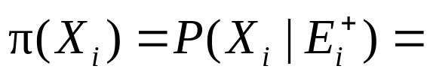
Computing π(X_{i})
X_{p}
X_{i}

Slide 32
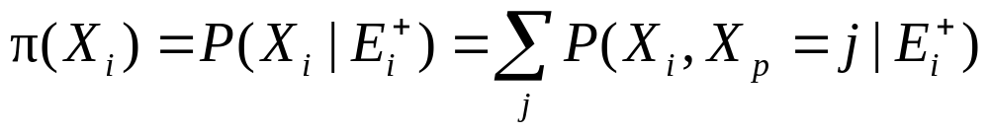
Computing π(X_{i})
X_{p}
X_{i}

Slide 33
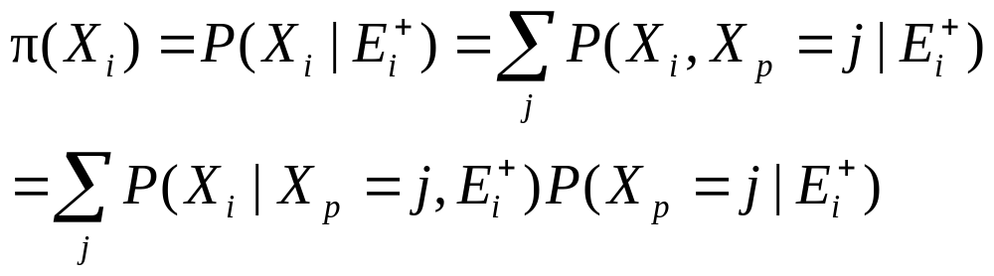
Computing π(X_{i})
X_{p}
X_{i}

Slide 34
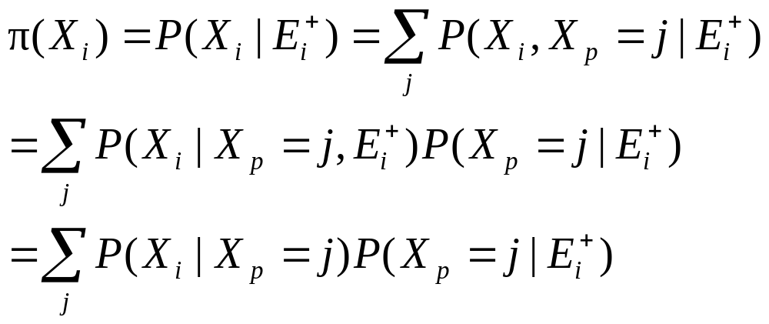
Computing π(X_{i})
X_{p}
X_{i}

Slide 35
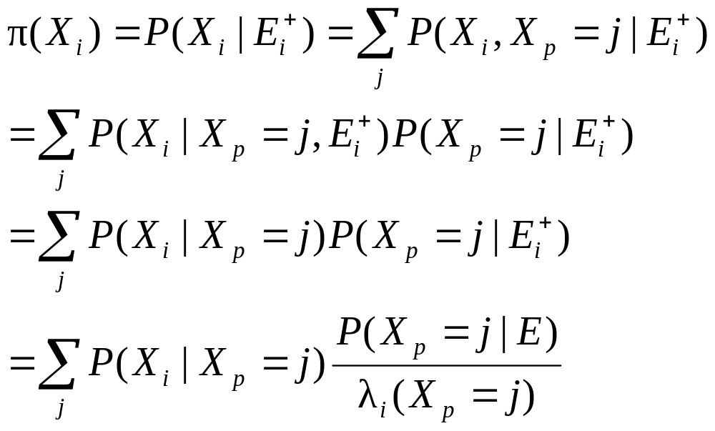
Computing π(X_{i})
X_{p}
X_{i}

Slide 36
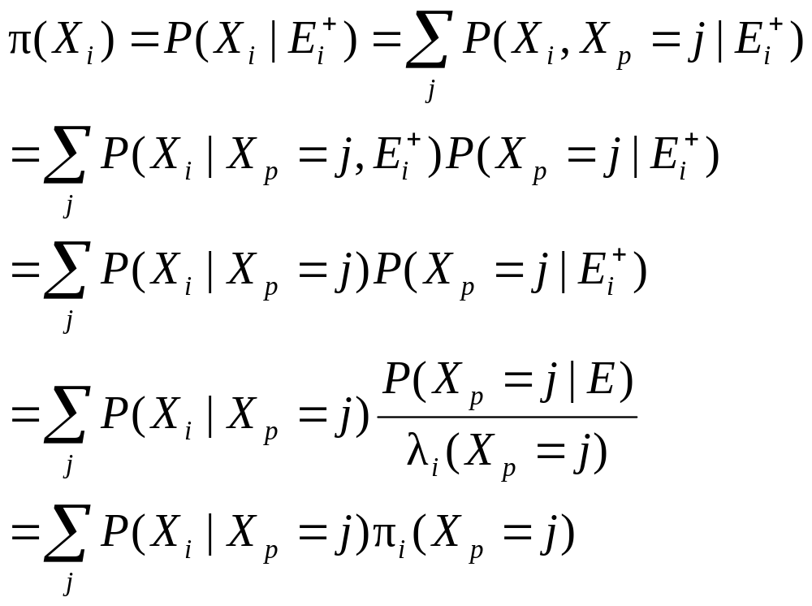
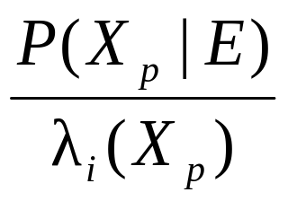
Computing π(X_{i})
X_{p}
X_{i}
Where π_{i}(X_{p}) is defined as

Slide 37
We’re done. Yay!
Thus we can compute all the π(X_{i})’s, and, in turn, all the P(X_{i}|E)’s.
Can think of nodes as autonomous processors passing λ and π messages to their neighbors
λ
λ
π
π
λ
λ
λ
λ
π
π
π
π

Slide 38
Conjunctive queries
What if we want, e.g., P(A, B | C) instead of just marginal distributions P(A | C) and P(B | C)?
Just use chain rule:
  P(A, B | C) = P(A | C) P(B | A, C)
  Each of the latter probabilities can be computed using the technique just discussed.

Slide 39
Polytrees
Technique can be generalized to polytrees: undirected versions of the graphs are still trees, but nodes can have more than one parent

Slide 40
Dealing with cycles
Can deal with undirected cycles in graph by
  clustering variables together
  Conditioning
A
A
B
C
BC
D
D
Set to 0
Set to 1

Slide 41
Join trees
Arbitrary Bayesian network can be transformed via some evil graph-theoretic magic into a join tree in which a similar method can be employed.
A
ABC
B
C
BCD
BCD
E
D
G
DF
F
In the worst case the join tree nodes must take on exponentially
many combinations of values, but often works well in practice

