Slide 1
Bayes Nets for representing and reasoning about uncertainty
Andrew W. Moore
Associate Professor
School of Computer Science
Carnegie Mellon University
www.cs.cmu.edu/~awm
awm@cs.cmu.edu
412-268-7599
Note to other teachers and users of these slides. Andrew would be delighted if you found this source material useful in giving your own lectures. Feel free to use these slides verbatim, or to modify them to fit your own needs. PowerPoint originals are available. If you make use of a significant portion of these slides in your own lecture, please include this message, or the following link to the source repository of Andrew’s tutorials: http://www.cs.cmu.edu/~awm/tutorials . Comments and corrections gratefully received.

Slide 2
What we’ll discuss
Recall the numerous and dramatic benefits of Joint Distributions for describing uncertain worlds
Reel with terror at the problem with using Joint Distributions
Discover how Bayes Net methodology allows us to built Joint Distributions in manageable chunks
Discover there’s still a lurking problem…
…Start to solve that problem

Slide 3
Why this matters
In Andrew’s opinion, the most important technology in the Machine Learning / AI field to have emerged in the last 10 years.
A clean, clear, manageable language and methodology for expressing what you’re certain and uncertain about
Already, many practical applications in medicine, factories, helpdesks:
    P(this problem | these symptoms)
    anomalousness of this observation
    choosing next diagnostic test | these observations

Slide 4
Why this matters
In Andrew’s opinion, the most important technology in the Machine Learning / AI field to have emerged in the last 10 years.
A clean, clear, manageable language and methodology for expressing what you’re certain and uncertain about
Already, many practical applications in medicine, factories, helpdesks:
    P(this problem | these symptoms)
    anomalousness of this observation
    choosing next diagnostic test | these observations
Active Data Collection
Inference
Anomaly Detection

Slide 5
Ways to deal with Uncertainty
Three-valued logic: True / False / Maybe
Fuzzy logic (truth values between 0 and 1)
Non-monotonic reasoning (especially focused on Penguin informatics)
Dempster-Shafer theory (and an extension known as quasi-Bayesian theory)
Possibabilistic Logic
Probability

Slide 6
Discrete Random Variables
A is a Boolean-valued random variable if A denotes an event, and there is some degree of uncertainty as to whether A occurs.
Examples
A = The US president in 2023 will be male
A = You wake up tomorrow with a headache
A = You have Ebola

Slide 7
Probabilities
We write P(A) as “the fraction of possible worlds in which A is true”
We could at this point spend 2 hours on the philosophy of this.
But we won’t.

Slide 8
Visualizing A
Event space of all possible worlds
Worlds in which A is true
P(A) = Area of
reddish oval
Its area is 1
Worlds in which A is False

Slide 9
Interpreting the axioms
0 <= P(A) <= 1
P(True) = 1
P(False) = 0
P(A or B) = P(A) + P(B) - P(A and B)
The area of A can’t get any smaller than 0
And a zero area would mean no world could ever have A true

Slide 10
Interpreting the axioms
0 <= P(A) <= 1
P(True) = 1
P(False) = 0
P(A or B) = P(A) + P(B) - P(A and B)
The area of A can’t get any bigger than 1
And an area of 1 would mean all worlds will have A true

Slide 11
Interpreting the axioms
0 <= P(A) <= 1
P(True) = 1
P(False) = 0
P(A or B) = P(A) + P(B) - P(A and B)
A
B

Slide 12
Interpreting the axioms
0 <= P(A) <= 1
P(True) = 1
P(False) = 0
P(A or B) = P(A) + P(B) - P(A and B)
A
P(A or B)
B
P(A and B)
B
Simple addition and subtraction

Slide 13
These Axioms are Not to be Trifled With
There have been attempts to do different methodologies for uncertainty
    Fuzzy Logic
    Three-valued logic
    Dempster-Shafer
    Non-monotonic reasoning
But the axioms of probability are the only system with this property:
If you gamble using them you can’t be unfairly exploited by an opponent using some other system [di Finetti 1931]

Slide 14
Theorems from the Axioms
0 <= P(A) <= 1, P(True) = 1, P(False) = 0
P(A or B) = P(A) + P(B) - P(A and B)
    From these we can prove:
    P(not A) = P(~A) = 1-P(A)
How?

Slide 15
Side Note
I am inflicting these proofs on you for two reasons:
  These kind of manipulations will need to be second nature to you if you use probabilistic analytics in depth
  Suffering is good for you

Slide 16
Another important theorem
0 <= P(A) <= 1, P(True) = 1, P(False) = 0
P(A or B) = P(A) + P(B) - P(A and B)
    From these we can prove:
    P(A) = P(A ^ B) + P(A ^ ~B)
How?

Slide 17
Conditional Probability
P(A|B) = Fraction of worlds in which B is true that also have A true
H = “Have a headache”
F = “Coming down with Flu”
P(H) = 1/10
P(F) = 1/40
P(H|F) = 1/2
“Headaches are rare and flu is rarer, but if you’re coming down with ‘flu there’s a 50-50 chance you’ll have a headache.”
F
H

Slide 18
Conditional Probability
P(H|F) = Fraction of flu-inflicted worlds in which you have a headache
= #worlds with flu and headache
------------------------------------
#worlds with flu
= Area of “H and F” region
------------------------------
Area of “F” region
= P(H ^ F)
-----------
P(F)
F
H
H = “Have a headache”
F = “Coming down with Flu”
P(H) = 1/10
P(F) = 1/40
P(H|F) = 1/2

Slide 19
Definition of Conditional Probability
P(A ^ B)
P(A|B) = -----------
P(B)
Corollary: The Chain Rule
P(A ^ B) = P(A|B) P(B)

Slide 20
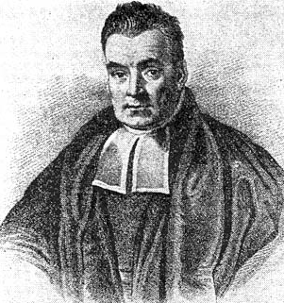
Bayes Rule
P(A ^ B) P(A|B) P(B)
P(B|A) = ----------- = ---------------
P(A) P(A)
This is Bayes Rule
Bayes, Thomas (1763) An essay towards solving a problem in the doctrine of chances. Philosophical Transactions of the Royal Society of London, 53:370-418

Slide 21
Using Bayes Rule to Gamble
$1.00
R R B B
R B B
The “Win” envelope has a dollar and four beads in it
The “Lose” envelope has three beads and no money
Trivial question: someone draws an envelope at random and offers to sell it to you. How much should you pay?

Slide 22
Using Bayes Rule to Gamble
$1.00
The “Win” envelope has a dollar and four beads in it
The “Lose” envelope has three beads and no money
Interesting question: before deciding, you are allowed to see one bead drawn from the envelope.
  Suppose it’s black: How much should you pay?
  Suppose it’s red: How much should you pay?

Slide 23
Calculation…
$1.00

Slide 24
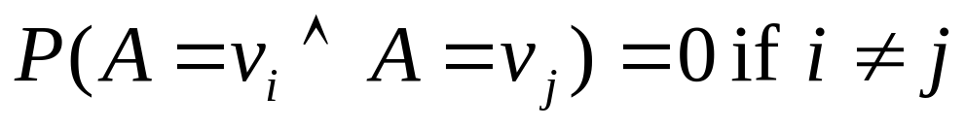
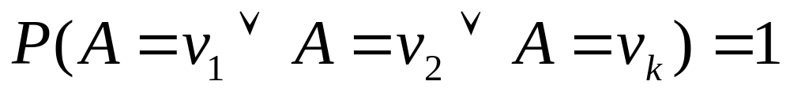
Multivalued Random Variables
Suppose A can take on more than 2 values
A is a random variable with arity k if it can take on exactly one value out of {v₁,v₂, .. v_{k}}
Thus…

Slide 25
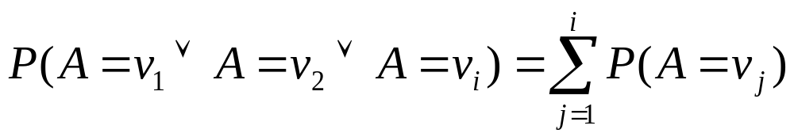
An easy fact about Multivalued Random Variables:
Using the axioms of probability…
      0 <= P(A) <= 1, P(True) = 1, P(False) = 0
      P(A or B) = P(A) + P(B) - P(A and B)
And assuming that A obeys…
It’s easy to prove that

Slide 26
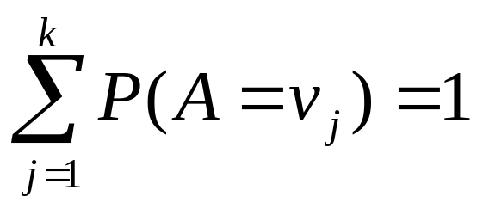
An easy fact about Multivalued Random Variables:
Using the axioms of probability…
      0 <= P(A) <= 1, P(True) = 1, P(False) = 0
      P(A or B) = P(A) + P(B) - P(A and B)
And assuming that A obeys…
It’s easy to prove that
And thus we can prove

Slide 27
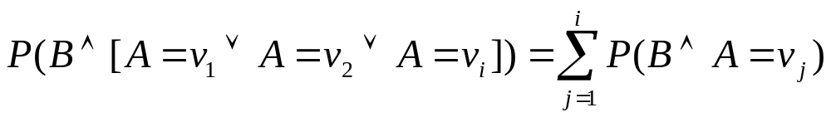
Another fact about Multivalued Random Variables:
Using the axioms of probability…
      0 <= P(A) <= 1, P(True) = 1, P(False) = 0
      P(A or B) = P(A) + P(B) - P(A and B)
And assuming that A obeys…
It’s easy to prove that

Slide 28
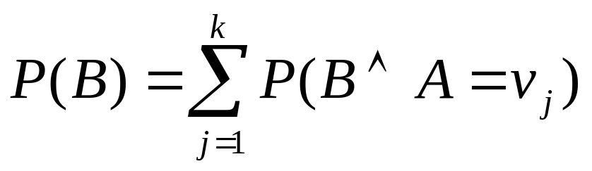
Another fact about Multivalued Random Variables:
Using the axioms of probability…
      0 <= P(A) <= 1, P(True) = 1, P(False) = 0
      P(A or B) = P(A) + P(B) - P(A and B)
And assuming that A obeys…
It’s easy to prove that
And thus we can prove

Slide 29
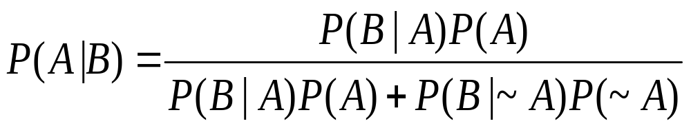
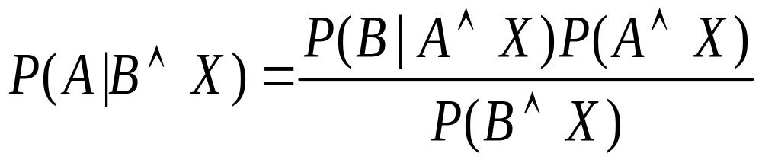
More General Forms of Bayes Rule

Slide 30
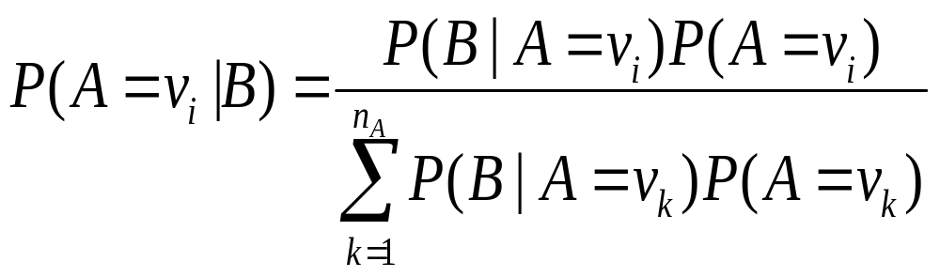
More General Forms of Bayes Rule

Slide 31
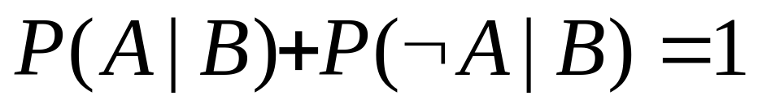
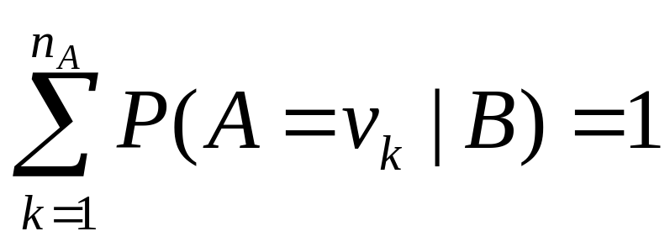
Useful Easy-to-prove facts

Slide 32
The Joint Distribution
Example: Boolean variables A, B, C
Recipe for making a joint distribution of M variables:

Slide 33
The Joint Distribution
Example: Boolean variables A, B, C
Recipe for making a joint distribution of M variables:
Make a truth table listing all combinations of values of your variables (if there are M Boolean variables then the table will have 2^{M} rows).
A | B | C
0 | 0 | 0
0 | 0 | 1
0 | 1 | 0
0 | 1 | 1
1 | 0 | 0
1 | 0 | 1
1 | 1 | 0
1 | 1 | 1

Slide 34
The Joint Distribution
Example: Boolean variables A, B, C
Recipe for making a joint distribution of M variables:
Make a truth table listing all combinations of values of your variables (if there are M Boolean variables then the table will have 2^{M} rows).
For each combination of values, say how probable it is.
A | B | C | Prob
0 | 0 | 0 | 0.30
0 | 0 | 1 | 0.05
0 | 1 | 0 | 0.10
0 | 1 | 1 | 0.05
1 | 0 | 0 | 0.05
1 | 0 | 1 | 0.10
1 | 1 | 0 | 0.25
1 | 1 | 1 | 0.10

Slide 35
The Joint Distribution
Example: Boolean variables A, B, C
Recipe for making a joint distribution of M variables:
Make a truth table listing all combinations of values of your variables (if there are M Boolean variables then the table will have 2^{M} rows).
For each combination of values, say how probable it is.
If you subscribe to the axioms of probability, those numbers must sum to 1.
A | B | C | Prob
0 | 0 | 0 | 0.30
0 | 0 | 1 | 0.05
0 | 1 | 0 | 0.10
0 | 1 | 1 | 0.05
1 | 0 | 0 | 0.05
1 | 0 | 1 | 0.10
1 | 1 | 0 | 0.25
1 | 1 | 1 | 0.10
A
0.05
0.10
0.05
0.10
0.25
0.05
C
B
0.10
0.30

Slide 36
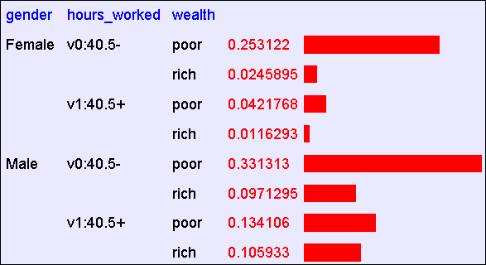
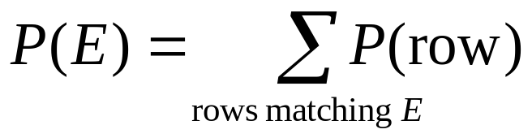
Using the Joint
Once you have the JD you can ask for the probability of any logical expression involving your attribute

Slide 37
Using the Joint
P(Poor Male) = 0.4654

Slide 38
Using the Joint
P(Poor) = 0.7604

Slide 39
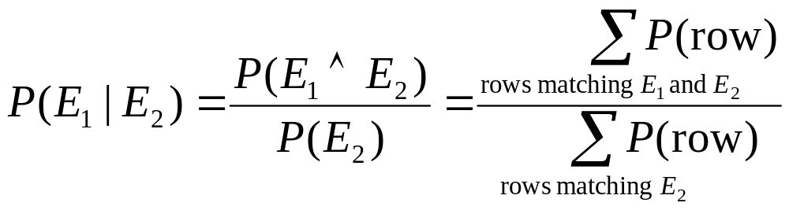
Inference with the Joint

Slide 40
Inference with the Joint
P(Male | Poor) = 0.4654 / 0.7604 = 0.612

Slide 41
Joint distributions
Good news
  Once you have a joint distribution, you can ask important questions about stuff that involves a lot of uncertainty
Bad news
  Impossible to create for more than about ten attributes because there are so many numbers needed when you build the damn thing.

Slide 42
Using fewer numbers
Suppose there are two events:
  M: Manuela teaches the class (otherwise it’s Andrew)
  S: It is sunny
The joint p.d.f. for these events contain four entries.
If we want to build the joint p.d.f. we’ll have to invent those four numbers. OR WILL WE??
  We don’t have to specify with bottom level conjunctive events such as P(~M^S) IF…
  …instead it may sometimes be more convenient for us to specify things like: P(M), P(S).
But just P(M) and P(S) don’t derive the joint distribution. So you can’t answer all questions.

Slide 43
Using fewer numbers
Suppose there are two events:
  M: Manuela teaches the class (otherwise it’s Andrew)
  S: It is sunny
The joint p.d.f. for these events contain four entries.
If we want to build the joint p.d.f. we’ll have to invent those four numbers. OR WILL WE??
  We don’t have to specify with bottom level conjunctive events such as P(~M^S) IF…
  …instead it may sometimes be more convenient for us to specify things like: P(M), P(S).
But just P(M) and P(S) don’t derive the joint distribution. So you can’t answer all questions.
What extra assumption can you make?

Slide 44
Independence
“The sunshine levels do not depend on and do not influence who is teaching.”
This can be specified very simply:
      P(S ⏐ M) = P(S)
This is a powerful statement!
It required extra domain knowledge. A different kind of knowledge than numerical probabilities. It needed an understanding of causation.

Slide 45
Independence
From P(S ⏐ M) = P(S), the rules of probability imply: (can you prove these?)
P(~S ⏐ M) = P(~S)
P(M ⏐ S) = P(M)
P(M ^ S) = P(M) P(S)
P(~M ^ S) = P(~M) P(S), (PM^~S) = P(M)P(~S),
P(~M^~S) = P(~M)P(~S)

Slide 46
Independence
From P(S ⏐ M) = P(S), the rules of probability imply: (can you prove these?)
P(~S ⏐ M) = P(~S)
P(M ⏐ S) = P(M)
P(M ^ S) = P(M) P(S)
P(~M ^ S) = P(~M) P(S), (PM^~S) = P(M)P(~S),
P(~M^~S) = P(~M)P(~S)
And in general:
P(M=u ^ S=v) = P(M=u) P(S=v)
for each of the four combinations of
u=True/False
v=True/False

Slide 47
Independence
We’ve stated:
    P(M) = 0.6
    P(S) = 0.3
    P(S ⏐ M) = P(S)
From these statements, we can derive the full joint pdf.
M | S | Prob
T | T
T | F
F | T
F | F
And since we now have the joint pdf, we can make any queries we like.

Slide 48
A more interesting case
  M : Manuela teaches the class
  S : It is sunny
  L : The lecturer arrives slightly late.
Assume both lecturers are sometimes delayed by bad weather. Andrew is more likely to arrive late than Manuela.

Slide 49
A more interesting case
  M : Manuela teaches the class
  S : It is sunny
  L : The lecturer arrives slightly late.
Assume both lecturers are sometimes delayed by bad weather. Andrew is more likely to arrive late than Manuela.
Let’s begin with writing down knowledge we’re happy about:
P(S ⏐ M) = P(S), P(S) = 0.3, P(M) = 0.6
Lateness is not independent of the weather and is not independent of the lecturer.

Slide 50
A more interesting case
  M : Manuela teaches the class
  S : It is sunny
  L : The lecturer arrives slightly late.
Assume both lecturers are sometimes delayed by bad weather. Andrew is more likely to arrive late than Manuela.
Let’s begin with writing down knowledge we’re happy about:
P(S ⏐ M) = P(S), P(S) = 0.3, P(M) = 0.6
Lateness is not independent of the weather and is not independent of the lecturer.
We already know the Joint of S and M, so all we need now is
P(L ⏐ S=u, M=v)
in the 4 cases of u/v = True/False.

Slide 51
A more interesting case
  M : Manuela teaches the class
  S : It is sunny
  L : The lecturer arrives slightly late.
Assume both lecturers are sometimes delayed by bad weather. Andrew is more likely to arrive late than Manuela.
P(L ⏐ M ^ S) = 0.05
P(L ⏐ M ^ ~S) = 0.1
P(L ⏐ ~M ^ S) = 0.1
P(L ⏐ ~M ^ ~S) = 0.2
P(S ⏐ M) = P(S)
P(S) = 0.3
P(M) = 0.6
Now we can derive a full joint p.d.f. with a “mere” six numbers instead of seven*
*Savings are larger for larger numbers of variables.

Slide 52
A more interesting case
  M : Manuela teaches the class
  S : It is sunny
  L : The lecturer arrives slightly late.
Assume both lecturers are sometimes delayed by bad weather. Andrew is more likely to arrive late than Manuela.
P(L ⏐ M ^ S) = 0.05
P(L ⏐ M ^ ~S) = 0.1
P(L ⏐ ~M ^ S) = 0.1
P(L ⏐ ~M ^ ~S) = 0.2
P(S ⏐ M) = P(S)
P(S) = 0.3
P(M) = 0.6
Question: Express
P(L=x ^ M=y ^ S=z)
in terms that only need the above expressions, where x,y and z may each be True or False.

Slide 53
A bit of notation
P(L ⏐ M ^ S) = 0.05
P(L ⏐ M ^ ~S) = 0.1
P(L ⏐ ~M ^ S) = 0.1
P(L ⏐ ~M ^ ~S) = 0.2
P(S ⏐ M) = P(S)
P(S) = 0.3
P(M) = 0.6
P(M)=0.6
P(s)=0.3
S
M
P(L⏐M^S)=0.05
P(L⏐M^~S)=0.1
P(L⏐~M^S)=0.1
P(L⏐~M^~S)=0.2
L

Slide 54
A bit of notation
P(L ⏐ M ^ S) = 0.05
P(L ⏐ M ^ ~S) = 0.1
P(L ⏐ ~M ^ S) = 0.1
P(L ⏐ ~M ^ ~S) = 0.2
P(S ⏐ M) = P(S)
P(S) = 0.3
P(M) = 0.6
Read the absence of an arrow between S and M to mean “it would not help me predict M if I knew the value of S”
This kind of stuff will be thoroughly formalized later
P(M)=0.6
P(s)=0.3
S
M
P(L⏐M^S)=0.05
P(L⏐M^~S)=0.1
P(L⏐~M^S)=0.1
P(L⏐~M^~S)=0.2
L
Read the two arrows into L to mean that if I want to know the value of L it may help me to know M and to know S.

Slide 55
An even cuter trick
Suppose we have these three events:
M : Lecture taught by Manuela
L : Lecturer arrives late
R : Lecture concerns robots
Suppose:
Andrew has a higher chance of being late than Manuela.
Andrew has a higher chance of giving robotics lectures.
What kind of independence can we find?
How about:
  P(L ⏐ M) = P(L) ?
  P(R ⏐ M) = P(R) ?
  P(L ⏐ R) = P(L) ?

Slide 56
Conditional independence
Once you know who the lecturer is, then whether they arrive late doesn’t affect whether the lecture concerns robots.
P(R ⏐ M,L) = P(R ⏐ M) and
P(R ⏐ ~M,L) = P(R ⏐ ~M)
We express this in the following way:
“R and L are conditionally independent given M”
M
..which is also notated by the following diagram.
Given knowledge of M, knowing anything else in the diagram won’t help us with L, etc.
L
R

Slide 57
Conditional Independence formalized
R and L are conditionally independent given M if
for all x,y,z in {T,F}:
P(R=x ⏐ M=y ^ L=z) = P(R=x ⏐ M=y)
More generally:
Let S1 and S2 and S3 be sets of variables.
Set-of-variables S1 and set-of-variables S2 are conditionally independent given S3 if for all assignments of values to the variables in the sets,
P(S₁’s assignments ⏐ S₂’s assignments & S₃’s assignments)=
P(S1’s assignments ⏐ S3’s assignments)

Slide 58
Example:
“Shoe-size is conditionally independent of Glove-size given height weight and age”
means
forall s,g,h,w,a
P(ShoeSize=s|Height=h,Weight=w,Age=a)
=
P(ShoeSize=s|Height=h,Weight=w,Age=a,GloveSize=g)
R and L are conditionally independent given M if
for all x,y,z in {T,F}:
P(R=x ⏐ M=y ^ L=z) = P(R=x ⏐ M=y)
More generally:
Let S1 and S2 and S3 be sets of variables.
Set-of-variables S1 and set-of-variables S2 are conditionally independent given S3 if for all assignments of values to the variables in the sets,
P(S₁’s assignments ⏐ S₂’s assignments & S₃’s assignments)=
P(S1’s assignments ⏐ S3’s assignments)

Slide 59
Example:
“Shoe-size is conditionally independent of Glove-size given height weight and age”
does not mean
forall s,g,h
P(ShoeSize=s|Height=h)
=
P(ShoeSize=s|Height=h, GloveSize=g)
R and L are conditionally independent given M if
for all x,y,z in {T,F}:
P(R=x ⏐ M=y ^ L=z) = P(R=x ⏐ M=y)
More generally:
Let S1 and S2 and S3 be sets of variables.
Set-of-variables S1 and set-of-variables S2 are conditionally independent given S3 if for all assignments of values to the variables in the sets,
P(S₁’s assignments ⏐ S₂’s assignments & S₃’s assignments)=
P(S1’s assignments ⏐ S3’s assignments)

Slide 60
Conditional independence
M
L
R
We can write down P(M). And then, since we know L is only directly influenced by M, we can write down the values of P(L⏐M) and P(L⏐~M) and know we’ve fully specified L’s behavior. Ditto for R.
  P(M) = 0.6
  P(L ⏐ M) = 0.085
  P(L ⏐ ~M) = 0.17
  P(R ⏐ M) = 0.3
  P(R ⏐ ~M) = 0.6
‘R and L conditionally independent given M’

Slide 61
Conditional independence
M
L
R
  P(M) = 0.6
  P(L ⏐ M) = 0.085
  P(L ⏐ ~M) = 0.17
  P(R ⏐ M) = 0.3
  P(R ⏐ ~M) = 0.6
Conditional Independence:
P(R⏐M,L) = P(R⏐M),
P(R⏐~M,L) = P(R⏐~M)
Again, we can obtain any member of the Joint prob dist that we desire:
P(L=x ^ R=y ^ M=z) =

Slide 62
Assume five variables
  T: The lecture started by 10:35
  L: The lecturer arrives late
  R: The lecture concerns robots
  M: The lecturer is Manuela
  S: It is sunny
T only directly influenced by L (i.e. T is conditionally independent of R,M,S given L)
L only directly influenced by M and S (i.e. L is conditionally independent of R given M & S)
R only directly influenced by M (i.e. R is conditionally independent of L,S, given M)
M and S are independent

Slide 63
Making a Bayes net
T: The lecture started by 10:35
L: The lecturer arrives late
R: The lecture concerns robots
M: The lecturer is Manuela
S: It is sunny
S
M
L
R
T
Step One: add variables.
Just choose the variables you’d like to be included in the net.

Slide 64
Making a Bayes net
T: The lecture started by 10:35
L: The lecturer arrives late
R: The lecture concerns robots
M: The lecturer is Manuela
S: It is sunny
S
M
L
R
T
Step Two: add links.
The link structure must be acyclic.
If node X is given parents Q₁,Q₂,..Q_{n} you are promising that any variable that’s a non-descendent of X is conditionally independent of X given {Q₁,Q₂,..Q_{n}}

Slide 65
Making a Bayes net
T: The lecture started by 10:35
L: The lecturer arrives late
R: The lecture concerns robots
M: The lecturer is Manuela
S: It is sunny
S
M
P(M)=0.6
P(s)=0.3
P(R⏐M)=0.3
P(R⏐~M)=0.6
P(L⏐M^S)=0.05
P(L⏐M^~S)=0.1
P(L⏐~M^S)=0.1
P(L⏐~M^~S)=0.2
L
R
P(T⏐L)=0.3
P(T⏐~L)=0.8
T
Step Three: add a probability table for each node.
The table for node X must list P(X|Parent Values) for each possible combination of parent values

Slide 66
Making a Bayes net
T: The lecture started by 10:35
L: The lecturer arrives late
R: The lecture concerns robots
M: The lecturer is Manuela
S: It is sunny
S
M
P(M)=0.6
P(s)=0.3
P(R⏐M)=0.3
P(R⏐~M)=0.6
P(L⏐M^S)=0.05
P(L⏐M^~S)=0.1
P(L⏐~M^S)=0.1
P(L⏐~M^~S)=0.2
L
R
P(T⏐L)=0.3
P(T⏐~L)=0.8
T
Two unconnected variables may still be correlated
Each node is conditionally independent of all non-descendants in the tree, given its parents.
You can deduce many other conditional independence relations from a Bayes net. See the next lecture.

Slide 67
Bayes Nets Formalized
A Bayes net (also called a belief network) is an augmented directed acyclic graph, represented by the pair V , E where:
  V is a set of vertices.
  E is a set of directed edges joining vertices. No loops of any length are allowed.
Each vertex in V contains the following information:
  The name of a random variable
  A probability distribution table indicating how the probability of this variable’s values depends on all possible combinations of parental values.

Slide 68
Building a Bayes Net
Choose a set of relevant variables.
Choose an ordering for them
Assume they’re called X₁ .. X_{m} (where X₁ is the first in the ordering, X₁ is the second, etc)
For i = 1 to m:
  Add the X_{i} node to the network
  Set Parents(X_{i} ) to be a minimal subset of {X₁…X_{i-1}} such that we have conditional independence of X_{i} and all other members of {X₁…X_{i-1}} given Parents(X_{i} )
  Define the probability table of
  P(X_{i} =k ⏐ Assignments of Parents(X_{i} ) ).

Slide 69
Example Bayes Net Building
Suppose we’re building a nuclear power station.
There are the following random variables:
  GRL : Gauge Reads Low.
  CTL : Core temperature is low.
  FG : Gauge is faulty.
  FA : Alarm is faulty
  AS : Alarm sounds
If alarm working properly, the alarm is meant to sound if the gauge stops reading a low temp.
If gauge working properly, the gauge is meant to read the temp of the core.

Slide 70
Computing a Joint Entry
How to compute an entry in a joint distribution?
E.G: What is P(S ^ ~M ^ L ~R ^ T)?
P(s)=0.3
S
M
P(M)=0.6
P(R⏐M)=0.3
P(R⏐~M)=0.6
P(L⏐M^S)=0.05
P(L⏐M^~S)=0.1
P(L⏐~M^S)=0.1
P(L⏐~M^~S)=0.2
L
P(T⏐L)=0.3
P(T⏐~L)=0.8
R
T

Slide 71
Computing with Bayes Net
P(s)=0.3
S
M
P(M)=0.6
P(R⏐M)=0.3
P(R⏐~M)=0.6
P(L⏐M^S)=0.05
P(L⏐M^~S)=0.1
P(L⏐~M^S)=0.1
P(L⏐~M^~S)=0.2
L
P(T⏐L)=0.3
P(T⏐~L)=0.8
R
T
P(T ^ ~R ^ L ^ ~M ^ S) =
P(T ⏐ ~R ^ L ^ ~M ^ S) * P(~R ^ L ^ ~M ^ S) =
P(T ⏐ L) * P(~R ^ L ^ ~M ^ S) =
P(T ⏐ L) * P(~R ⏐ L ^ ~M ^ S) * P(L^~M^S) =
P(T ⏐ L) * P(~R ⏐ ~M) * P(L^~M^S) =
P(T ⏐ L) * P(~R ⏐ ~M) * P(L⏐~M^S)*P(~M^S) =
P(T ⏐ L) * P(~R ⏐ ~M) * P(L⏐~M^S)*P(~M | S)*P(S) =
P(T ⏐ L) * P(~R ⏐ ~M) * P(L⏐~M^S)*P(~M)*P(S).

Slide 72
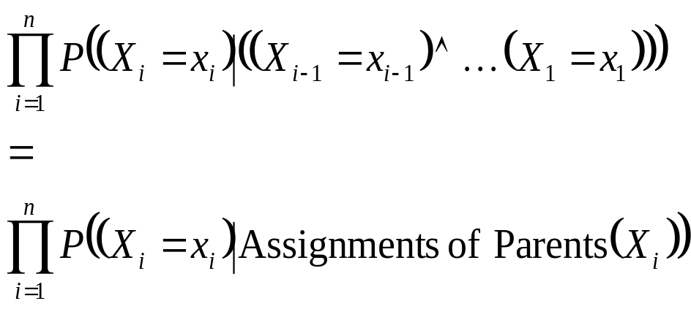
The general case
P(X₁⁼x₁ ^ X₂=x₂ ^ ….X_{n-1}=x_{n-1} ^ X_{n}=x_{n}) =
P(X_{n}=x_{n} ^ X_{n-1}=x_{n-1} ^ ….X₂=x₂ ^ X₁=x₁) =
P(X_{n}=x_{n} ⏐ X_{n-1}=x_{n-1} ^ ….X₂=x₂ ^ X₁=x₁) * P(X_{n-1}=x_{n-1} ^…. X₂=x₂ ^ X₁=x₁) =
P(X_{n}=x_{n} ⏐ X_{n-1}=x_{n-1} ^ ….X₂=x₂ ^ X₁=x₁) * P(X_{n-1}=x_{n-1} ⏐…. X₂=x₂ ^ X₁=x₁) *
P(X_{n-2}=x_{n-2} ^…. X₂=x₂ ^ X₁=x₁) =
:
:
=
So any entry in joint pdf table can be computed. And so any conditional probability can be computed.

Slide 73
Where are we now?
We have a methodology for building Bayes nets.
We don’t require exponential storage to hold our probability table. Only exponential in the maximum number of parents of any node.
We can compute probabilities of any given assignment of truth values to the variables. And we can do it in time linear with the number of nodes.
So we can also compute answers to any questions.
P(s)=0.3
S
M
P(M)=0.6
P(R⏐M)=0.3
P(R⏐~M)=0.6
P(L⏐M^S)=0.05
P(L⏐M^~S)=0.1
P(L⏐~M^S)=0.1
P(L⏐~M^~S)=0.2
L
P(T⏐L)=0.3
P(T⏐~L)=0.8
R
T
E.G. What could we do to compute P(R ⏐ T,~S)?

Slide 74
Where are we now?
Step 1: Compute P(R ^ T ^ ~S)
Step 2: Compute P(~R ^ T ^ ~S)
Step 3: Return
P(R ^ T ^ ~S)
-------------------------------------
P(R ^ T ^ ~S)+ P(~R ^ T ^ ~S)
We have a methodology for building Bayes nets.
We don’t require exponential storage to hold our probability table. Only exponential in the maximum number of parents of any node.
We can compute probabilities of any given assignment of truth values to the variables. And we can do it in time linear with the number of nodes.
So we can also compute answers to any questions.
P(s)=0.3
S
M
P(M)=0.6
P(R⏐M)=0.3
P(R⏐~M)=0.6
P(L⏐M^S)=0.05
P(L⏐M^~S)=0.1
P(L⏐~M^S)=0.1
P(L⏐~M^~S)=0.2
L
P(T⏐L)=0.3
P(T⏐~L)=0.8
R
T
E.G. What could we do to compute P(R ⏐ T,~S)?

Slide 75
Where are we now?
Step 1: Compute P(R ^ T ^ ~S)
Step 2: Compute P(~R ^ T ^ ~S)
Step 3: Return
P(R ^ T ^ ~S)
-------------------------------------
P(R ^ T ^ ~S)+ P(~R ^ T ^ ~S)
Sum of all the rows in the Joint that match R ^ T ^ ~S
We have a methodology for building Bayes nets.
We don’t require exponential storage to hold our probability table. Only exponential in the maximum number of parents of any node.
We can compute probabilities of any given assignment of truth values to the variables. And we can do it in time linear with the number of nodes.
So we can also compute answers to any questions.
Sum of all the rows in the Joint that match ~R ^ T ^ ~S
P(s)=0.3
S
M
P(M)=0.6
P(R⏐M)=0.3
P(R⏐~M)=0.6
P(L⏐M^S)=0.05
P(L⏐M^~S)=0.1
P(L⏐~M^S)=0.1
P(L⏐~M^~S)=0.2
L
P(T⏐L)=0.3
P(T⏐~L)=0.8
R
T
E.G. What could we do to compute P(R ⏐ T,~S)?

Slide 76
Where are we now?
4 joint computes
Step 1: Compute P(R ^ T ^ ~S)
Step 2: Compute P(~R ^ T ^ ~S)
Step 3: Return
P(R ^ T ^ ~S)
-------------------------------------
P(R ^ T ^ ~S)+ P(~R ^ T ^ ~S)
Sum of all the rows in the Joint that match R ^ T ^ ~S
We have a methodology for building Bayes nets.
We don’t require exponential storage to hold our probability table. Only exponential in the maximum number of parents of any node.
We can compute probabilities of any given assignment of truth values to the variables. And we can do it in time linear with the number of nodes.
So we can also compute answers to any questions.
Sum of all the rows in the Joint that match ~R ^ T ^ ~S
4 joint computes
Each of these obtained by the “computing a joint probability entry” method of the earlier slides
P(s)=0.3
S
M
P(M)=0.6
P(R⏐M)=0.3
P(R⏐~M)=0.6
P(L⏐M^S)=0.05
P(L⏐M^~S)=0.1
P(L⏐~M^S)=0.1
P(L⏐~M^~S)=0.2
L
P(T⏐L)=0.3
P(T⏐~L)=0.8
R
T
E.G. What could we do to compute P(R ⏐ T,~S)?

Slide 77
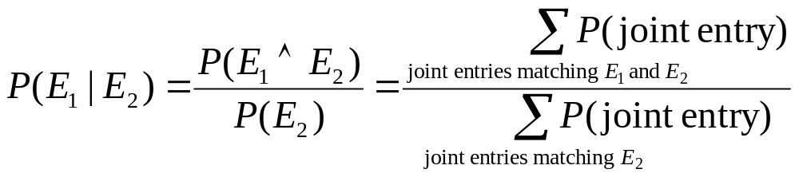
The good news
We can do inference. We can compute any conditional probability:
P( Some variable ⏐ Some other variable values )

Slide 78
The good news
We can do inference. We can compute any conditional probability:
P( Some variable ⏐ Some other variable values )
Suppose you have m binary-valued variables in your Bayes Net and expression E₂ mentions k variables.
How much work is the above computation?

Slide 79
The sad, bad news
Conditional probabilities by enumerating all matching entries in the joint are expensive:
Exponential in the number of variables.

Slide 80
The sad, bad news
Conditional probabilities by enumerating all matching entries in the joint are expensive:
Exponential in the number of variables.
But perhaps there are faster ways of querying Bayes nets?
In fact, if I ever ask you to manually do a Bayes Net inference, you’ll find there are often many tricks to save you time.
So we’ve just got to program our computer to do those tricks too, right?

Slide 81
The sad, bad news
Conditional probabilities by enumerating all matching entries in the joint are expensive:
Exponential in the number of variables.
But perhaps there are faster ways of querying Bayes nets?
In fact, if I ever ask you to manually do a Bayes Net inference, you’ll find there are often many tricks to save you time.
So we’ve just got to program our computer to do those tricks too, right?
Sadder and worse news:
General querying of Bayes nets is NP-complete.

Slide 82
Bayes nets inference algorithms
A poly-tree is a directed acyclic graph in which no two nodes have more than one path between them.
X₁
X₂
X₁
X₂
S
M
S
M
L
X₃
L
X₃
R
X₄
R
X₄
X₅
X₅
T
T
A poly tree Not a poly tree
(but still a legal Bayes net)
If net is a poly-tree, there is a linear-time algorithm (see a later Andrew lecture).
The best general-case algorithms convert a general net to a poly-tree (often at huge expense) and calls the poly-tree algorithm.
Another popular, practical approach (doesn’t assume poly-tree): Stochastic Simulation.

Slide 83
Sampling from the Joint Distribution
P(s)=0.3
S
M
P(M)=0.6
P(R⏐M)=0.3
P(R⏐~M)=0.6
P(L⏐M^S)=0.05
P(L⏐M^~S)=0.1
P(L⏐~M^S)=0.1
P(L⏐~M^~S)=0.2
L
P(T⏐L)=0.3
P(T⏐~L)=0.8
R
T
It’s pretty easy to generate a set of variable-assignments at random with the same probability as the underlying joint distribution.
How?

Slide 84
Sampling from the Joint Distribution
P(s)=0.3
S
M
P(M)=0.6
P(R⏐M)=0.3
P(R⏐~M)=0.6
P(L⏐M^S)=0.05
P(L⏐M^~S)=0.1
P(L⏐~M^S)=0.1
P(L⏐~M^~S)=0.2
L
P(T⏐L)=0.3
P(T⏐~L)=0.8
R
T
1. Randomly choose S. S = True with prob 0.3
2. Randomly choose M. M = True with prob 0.6
3. Randomly choose L. The probability that L is true depends on the assignments of S and M. E.G. if steps 1 and 2 had produced S=True, M=False, then probability that L is true is 0.1
4. Randomly choose R. Probability depends on M.
5. Randomly choose T. Probability depends on L

Slide 85
A general sampling algorithm
Let’s generalize the example on the previous slide to a general Bayes Net.
As in Slides 16-17 , call the variables X₁ .. X_{n}, where Parents(X_{i}) must be a subset of {X₁ .. X_{i-1}}.
For i=1 to n:
  Find parents, if any, of X_{i}. Assume n(i) parents. Call them X_{p(i,1)}, X_{p(i,2)}, …X_{p(i,n(i))}.
  Recall the values that those parents were randomly given: x_{p(i,1)}, x_{p(i,2)}, …x_{p(i,n(i))}.
  Look up in the lookup-table for: P(X_{i}=True ⏐ X_{p(i,1)}=x_{p(i,1)},X_{p(i,2)}=x_{p(i,2)}…X_{p(i,n(i))}=x_{p(i,n(i))})
  Randomly set x_{i}=True according to this probability
x₁, x₂,…x_{n} are now a sample from the joint distribution of X₁, X₂,…X_{n}.

Slide 86
Stochastic Simulation Example
Someone wants to know P(R = True ⏐ T = True ^ S = False )
We’ll do lots of random samplings and count the number of occurrences of the following:
  N_{c} : Num. samples in which T=True and S=False.
  N_{s} : Num. samples in which R=True, T=True and S=False.
  N : Number of random samplings
Now if N is big enough:
N_{c} /N is a good estimate of P(T=True and S=False).
N_{s} /N is a good estimate of P(R=True ,T=True , S=False).
P(R⏐T^~S) = P(R^T^~S)/P(T^~S), so N_{s} / N_{c} can be a good estimate of P(R⏐T^~S).

Slide 87
General Stochastic Simulation
Someone wants to know P(E₁ ⏐ E₂ )
We’ll do lots of random samplings and count the number of occurrences of the following:
  N_{c} : Num. samples in which E₂
  N_{s} : Num. samples in which E₁ and E₂
  N : Number of random samplings
Now if N is big enough:
N_{c} /N is a good estimate of P(E₂).
N_{s} /N is a good estimate of P(E₁ , E₂).
P(E₁ ⏐ E₂) = P(E₁^ E₂)/P(E₂), so N_{s} / N_{c} can be a good estimate of P(E₁⏐ E₂).

Slide 88
Likelihood weighting
Problem with Stochastic Sampling:
  With lots of constraints in E, or unlikely events in E, then most of the simulations will be thrown away, (they’ll have no effect on Nc, or Ns).
Imagine we’re part way through our simulation.
  In E2 we have the constraint Xi = v
  We’re just about to generate a value for Xi at random. Given the values assigned to the parents, we see that P(Xi = v ⏐ parents) = p .
  Now we know that with stochastic sampling:
  we’ll generate “Xi = v” proportion p of the time, and proceed.
  And we’ll generate a different value proportion 1-p of the time, and the simulation will be wasted.
Instead, always generate Xi = v, but weight the answer by weight “p” to compensate.

Slide 89
Likelihood weighting
Set N_{c} :=0, N_{s} :=0
Generate a random assignment of all variables that matches E₂. This process returns a weight w.
Define w to be the probability that this assignment would have been generated instead of an unmatching assignment during its generation in the original algorithm.Fact: w is a product of all likelihood factors involved in the generation.
N_{c} := N_{c} + w
If our sample matches E₁ then N_{s} := N_{s} + w
Go to 1
Again, N_{s} / N_{c} estimates P(E₁ ⏐ E₂ )

Slide 90
Case Study I
Pathfinder system. (Heckerman 1991, Probabilistic Similarity Networks, MIT Press, Cambridge MA).
Diagnostic system for lymph-node diseases.
60 diseases and 100 symptoms and test-results.
14,000 probabilities
Expert consulted to make net.
  8 hours to determine variables.
  35 hours for net topology.
  40 hours for probability table values.
Apparently, the experts found it quite easy to invent the causal links and probabilities.
Pathfinder is now outperforming the world experts in diagnosis. Being extended to several dozen other medical domains.

Slide 91
Questions
What are the strengths of probabilistic networks compared with propositional logic?
What are the weaknesses of probabilistic networks compared with propositional logic?
What are the strengths of probabilistic networks compared with predicate logic?
What are the weaknesses of probabilistic networks compared with predicate logic?
(How) could predicate logic and probabilistic networks be combined?

Slide 92
What you should know
The meanings and importance of independence and conditional independence.
The definition of a Bayes net.
Computing probabilities of assignments of variables (i.e. members of the joint p.d.f.) with a Bayes net.
The slow (exponential) method for computing arbitrary, conditional probabilities.
The stochastic simulation method and likelihood weighting.

