Slide 1
Bayes Net Structure Learning
Note to other teachers and users of these slides. Andrew would be delighted if you found this source material useful in giving your own lectures. Feel free to use these slides verbatim, or to modify them to fit your own needs. PowerPoint originals are available. If you make use of a significant portion of these slides in your own lecture, please include this message, or the following link to the source repository of Andrew’s tutorials: http://www.cs.cmu.edu/~awm/tutorials . Comments and corrections gratefully received.
Andrew W. Moore
Associate Professor
School of Computer Science
Carnegie Mellon University
www.cs.cmu.edu/~awm
awm@cs.cmu.edu
412-268-7599

Slide 2
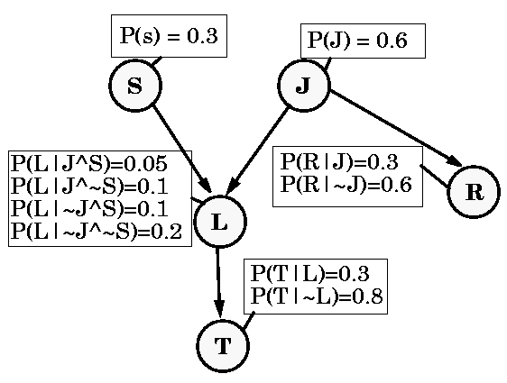
Reminder: A Bayes Net

Slide 3
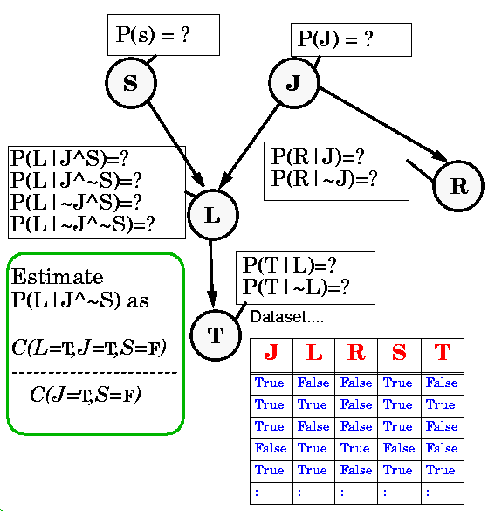
Estimating Probability Tables

Slide 4
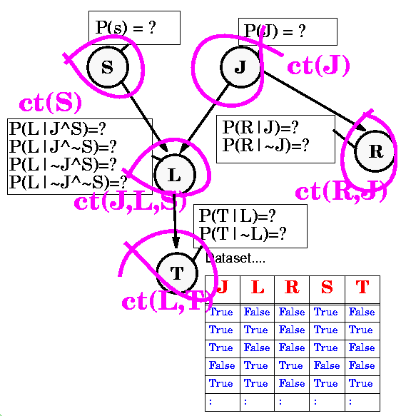
Estimating Probability Tables

Slide 5
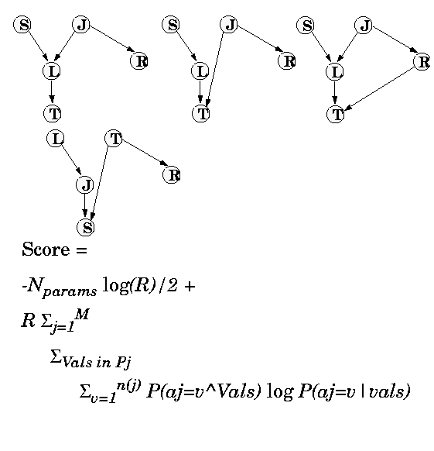
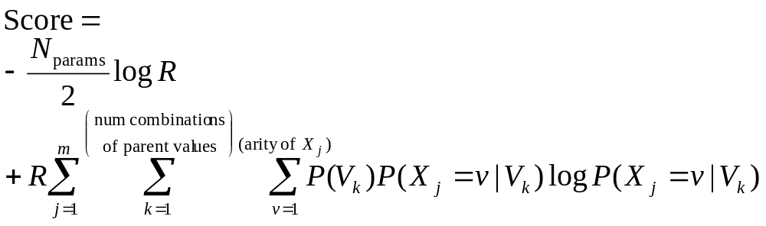
Scoring a structure
(Which of these fits the data best?)
N. Friedman and Z. Yakhini, On the sample complexity of learning Bayesian networks, Proceedings of the 12th conference on Uncertainty in Artificial Intelligence, Morgan Kaufmann, 1996

Slide 6
Scoring a structure
Number of non-redundant parameters defining the net
Sums over all the rows in the prob-ability table for X_{j}
#Attributes
#Records
The parent values in the k’th row of X_{j}’s probability table
All these values estimated from data

Slide 7
Scoring a structure
This is called a BIC (Bayes Information Criterion) estimate
This part is a penalty for too many parameters
This part is the training set log-likelihood
BIC asymptotically tries to get the structure right. (There’s a lot of heavy emotional debate about whether this is the best scoring criterion)
All these values estimated from data

Slide 8
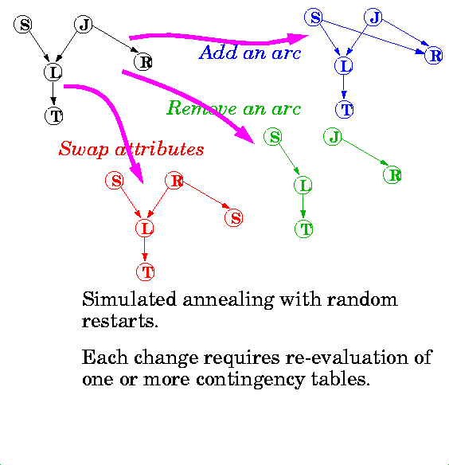
Searching for structure with best score

Slide 9
Learning Methods until today
Predict
category
Dec Tree, Sigmoid Perceptron, Sigmoid N.Net, Gauss/Joint BC, Gauss Naïve BC, N.Neigh
Inputs
Classifier
Density
Estimator
Prob-
ability
Joint DE, Naïve DE, Gauss/Joint DE, Gauss Naïve DE
Inputs
Predict
real no.
Linear Regression, Quadratic Regression, Perceptron, Neural Net, N.Neigh, Kernel, LWR
Inputs
Regressor

Slide 10
Learning Methods added today
Predict
category
Dec Tree, Sigmoid Perceptron, Sigmoid N.Net, Gauss/Joint BC, Gauss Naïve BC, N.Neigh
Inputs
Classifier
Density
Estimator
Prob-
ability
Joint DE, Naïve DE, Gauss/Joint DE, Gauss Naïve DE, Bayes Net Structure Learning (Note, can be extended to permit mixed categorical/real values)
Inputs
Predict
real no.
Linear Regression, Quadratic Regression, Perceptron, Neural Net, N.Neigh, Kernel, LWR
Inputs
Regressor

Slide 11
But also, for free…
Predict
category
Dec Tree, Sigmoid Perceptron, Sigmoid N.Net, Gauss/Joint BC, Gauss Naïve BC, N.Neigh, Bayes Net Based BC
Inputs
Classifier
Density
Estimator
Prob-
ability
Joint DE, Naïve DE, Gauss/Joint DE, Gauss Naïve DE, Bayes Net Structure Learning
Inputs
Predict
real no.
Linear Regression, Quadratic Regression, Perceptron, Neural Net, N.Neigh, Kernel, LWR
Inputs
Regressor

Slide 12
And a new operation…
Inference
Engine Learn
Joint DE, Bayes Net Structure Learning
Inputs
P(E₁|E₂)
Predict
category
Dec Tree, Sigmoid Perceptron, Sigmoid N.Net, Gauss/Joint BC, Gauss Naïve BC, N.Neigh, Bayes Net Based BC
Inputs
Classifier
Density
Estimator
Prob-
ability
Joint DE, Naïve DE, Gauss/Joint DE, Gauss Naïve DE, Bayes Net Structure Learning
Inputs
Predict
real no.
Linear Regression, Quadratic Regression, Perceptron, Neural Net, N.Neigh, Kernel, LWR
Inputs
Regressor

