Slide 1
Eight more Classic Machine Learning algorithms
Note to other teachers and users of these slides. Andrew would be delighted if you found this source material useful in giving your own lectures. Feel free to use these slides verbatim, or to modify them to fit your own needs. PowerPoint originals are available. If you make use of a significant portion of these slides in your own lecture, please include this message, or the following link to the source repository of Andrew’s tutorials: http://www.cs.cmu.edu/~awm/tutorials . Comments and corrections gratefully received.
Andrew W. Moore
Associate Professor
School of Computer Science
Carnegie Mellon University
www.cs.cmu.edu/~awm
awm@cs.cmu.edu
412-268-7599

Slide 2
8: Polynomial Regression
So far we’ve mainly been dealing with linear regression
X₁ | X₂ | Y
3 | 2 | 7
1 | 1 | 3
: | : | :
X=
y=
3 | 2
1 | 1
: | :
7
3
:
x₁=(3,2)..
y₁=7..
Z=
1 | 3 | 2
1 | 1 | 1
: |  | :
y=
7
3
:
β=(Z^{T}Z)⁻¹(Z^{T}y)
y^{est} = β₀+ β₁ x₁+ β₂ x₂
z₁=(1,3,2)..
z_{k}=(1,x_{k1},x_{k2})
y₁=7..

Slide 3
Quadratic Regression
It’s trivial to do linear fits of fixed nonlinear basis functions
X₁ | X₂ | Y
3 | 2 | 7
1 | 1 | 3
: | : | :
X=
y=
3 | 2
1 | 1
: | :
7
3
:
x₁=(3,2)..
y₁=7..
1 | 3 | 2 | 9 | 6 | 4
1 | 1 | 1 | 1 | 1 | 1
: |  |  |  |  | :
y=
Z=
7
3
:
β=(Z^{T}Z)⁻¹(Z^{T}y)
y^{est} = β₀+ β₁ x₁+ β₂ x₂+
β₃ x₁² + β₄ x₁x₂ + β₅ x₂²
z=(1 , x₁, x₂ , x₁², x₁x₂,x₂²,)

Slide 4
Quadratic Regression
It’s trivial to do linear fits of fixed nonlinear basis functions
Each component of a z vector is called a term.
Each column of the Z matrix is called a term column
How many terms in a quadratic regression with m inputs?
1 constant term
m linear terms
(m+1)-choose-2 = m(m+1)/2 quadratic terms
(m+2)-choose-2 terms in total = O(m²)
Note that solving β=(Z^{T}Z)⁻¹(Z^{T}y) is thus O(m⁶)
X₁ | X₂ | Y
3 | 2 | 7
1 | 1 | 3
: | : | :
X=
y=
3 | 2
1 | 1
: | :
7
3
:
x₁=(3,2)..
y₁=7..
1 | 3 | 2 | 9 | 6 | 4
1 | 1 | 1 | 1 | 1 | 1
: |  |  |  |  | :
y=
Z=
7
3
:
β=(Z^{T}Z)⁻¹(Z^{T}y)
y^{est} = β₀+ β₁ x₁+ β₂ x₂+
β₃ x₁² + β₄ x₁x₂ + β₅ x₂²
z=(1 , x₁, x₂ , x₁², x₁x₂,x₂²,)

Slide 5
Q^{th}-degree polynomial Regression
X₁ | X₂ | Y
3 | 2 | 7
1 | 1 | 3
: | : | :
X=
y=
3 | 2
1 | 1
: | :
7
3
:
x₁=(3,2)..
y₁=7..
1 | 3 | 2 | 9 | 6 | …
1 | 1 | 1 | 1 | 1 | …
: |  |  |  |  | …
7
3
:
y=
Z=
β=(Z^{T}Z)⁻¹(Z^{T}y)
y^{est} = β₀+
β₁ x₁+…
z=(all products of powers of inputs in which sum of powers is q or less,)

Slide 6
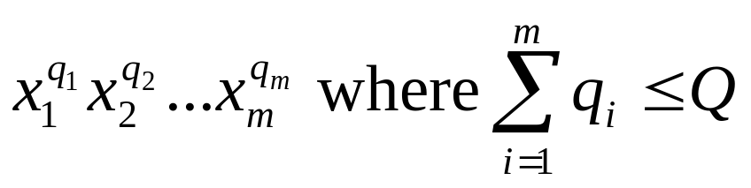
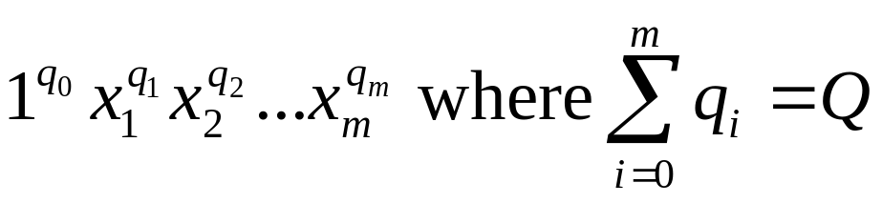
m inputs, degree Q: how many terms?
= the number of unique terms of the form
= the number of unique terms of the form
= the number of lists of non-negative integers [q₀,q₁,q₂,..q_{m}] in which Σq_{i} = Q
= the number of ways of placing Q red disks on a row of squares of length Q+m = (Q+m)-choose-Q
Q=11, m=4
q₀=2
q₁=2
q₂=0
q₃=4
q₄=3

Slide 7
7: Radial Basis Functions (RBFs)
X₁ | X₂ | Y
3 | 2 | 7
1 | 1 | 3
: | : | :
X=
y=
3 | 2
1 | 1
: | :
7
3
:
x₁=(3,2)..
y₁=7..
… | … | … | … | … | …
… | … | … | … | … | …
… | … | … | … | … | …
7
3
:
y=
Z=
β=(Z^{T}Z)⁻¹(Z^{T}y)
y^{est} = β₀+
β₁ x₁+…
z=(list of radial basis function evaluations)

Slide 8
1-d RBFs
y
c₁
c₁
c₁
x
y^{est} = β₁ φ₁(x) + β₂ φ₂(x) + β₃ φ₃(x)
where
φ_{i}(x) = KernelFunction( | x - c_{i} | / KW)

Slide 9
Example
y
c₁
c₁
c₁
x
y^{est} = 2φ₁(x) + 0.05φ₂(x) + 0.5φ₃(x)
where
φ_{i}(x) = KernelFunction( | x - c_{i} | / KW)

Slide 10
RBFs with Linear Regression
KW also held constant (initialized to be large enough that there’s decent overlap between basis functions*
*Usually much better than the crappy overlap on my diagram
All c_{i} ’s are held constant (initialized randomly or on a grid in m-dimensional input space)
y
c₁
c₁
c₁
x
y^{est} = 2φ₁(x) + 0.05φ₂(x) + 0.5φ₃(x)
where
φ_{i}(x) = KernelFunction( | x - c_{i} | / KW)

Slide 11
RBFs with Linear Regression
KW also held constant (initialized to be large enough that there’s decent overlap between basis functions*
*Usually much better than the crappy overlap on my diagram
All c_{i} ’s are held constant (initialized randomly or on a grid in m-dimensional input space)
y
c₁
c₁
c₁
x
y^{est} = 2φ₁(x) + 0.05φ₂(x) + 0.5φ₃(x)
where
φ_{i}(x) = KernelFunction( | x - c_{i} | / KW)
then given Q basis functions, define the matrix Z such that Z_{kj} = KernelFunction( | x_{k} - c_{i} | / KW) where x_{k} is the kth vector of inputs
And as before, β=(Z^{T}Z)⁻¹(Z^{T}y)

Slide 12
RBFs with NonLinear Regression
Allow the c_{i} ’s to adapt to the data (initialized randomly or on a grid in m-dimensional input space)
KW allowed to adapt to the data.
(Some folks even let each basis function have its own KW_{j},permitting fine detail in dense regions of input space)
y
c₁
c₁
c₁
x
y^{est} = 2φ₁(x) + 0.05φ₂(x) + 0.5φ₃(x)
where
φ_{i}(x) = KernelFunction( | x - c_{i} | / KW)
But how do we now find all the β_{j}’s, c_{i} ’s and KW ?

Slide 13
RBFs with NonLinear Regression
Allow the c_{i} ’s to adapt to the data (initialized randomly or on a grid in m-dimensional input space)
KW allowed to adapt to the data.
(Some folks even let each basis function have its own KW_{j},permitting fine detail in dense regions of input space)
y
c₁
c₁
c₁
x
y^{est} = 2φ₁(x) + 0.05φ₂(x) + 0.5φ₃(x)
where
φ_{i}(x) = KernelFunction( | x - c_{i} | / KW)
But how do we now find all the β_{j}’s, c_{i} ’s and KW ?
Answer: Gradient Descent

Slide 14
RBFs with NonLinear Regression
Allow the c_{i} ’s to adapt to the data (initialized randomly or on a grid in m-dimensional input space)
KW allowed to adapt to the data.
(Some folks even let each basis function have its own KW_{j},permitting fine detail in dense regions of input space)
y
c₁
c₁
c₁
x
y^{est} = 2φ₁(x) + 0.05φ₂(x) + 0.5φ₃(x)
where
φ_{i}(x) = KernelFunction( | x - c_{i} | / KW)
But how do we now find all the β_{j}’s, c_{i} ’s and KW ?
Answer: Gradient Descent
(But I’d like to see, or hope someone’s already done, a hybrid, where the c_{i} ’s and KW are updated with gradient descent while the β_{j}’s use matrix inversion)

Slide 15
Radial Basis Functions in 2-d
Two inputs.
Outputs (heights sticking out of page) not shown.
Center
Sphere of significant influence of center
x₂
x₁

Slide 16
Happy RBFs in 2-d
Blue dots denote coordinates of input vectors
Center
Sphere of significant influence of center
x₂
x₁

Slide 17
Crabby RBFs in 2-d
What’s the problem in this example?
Blue dots denote coordinates of input vectors
Center
Sphere of significant influence of center
x₂
x₁

Slide 18
More crabby RBFs
And what’s the problem in this example?
Blue dots denote coordinates of input vectors
Center
Sphere of significant influence of center
x₂
x₁

Slide 19
Hopeless!
Even before seeing the data, you should understand that this is a disaster!
Center
Sphere of significant influence of center
x₂
x₁

Slide 20
Unhappy
Even before seeing the data, you should understand that this isn’t good either..
Center
Sphere of significant influence of center
x₂
x₁

Slide 21
6: Robust Regression
y
x

Slide 22
Robust Regression
This is the best fit that Quadratic Regression can manage
y
x

Slide 23
Robust Regression
…but this is what we’d probably prefer
y
x

Slide 24

LOESS-based Robust Regression
After the initial fit, score each datapoint according to how well it’s fitted…
y
You are a very good datapoint.
x

Slide 25
LOESS-based Robust Regression
After the initial fit, score each datapoint according to how well it’s fitted…
y
You are a very good datapoint.
You are not too shabby.
x

Slide 26
LOESS-based Robust Regression
After the initial fit, score each datapoint according to how well it’s fitted…
But you are pathetic.
y
You are a very good datapoint.
You are not too shabby.
x

Slide 27
Robust Regression
For k = 1 to R…
Let (x_{k},y_{k}) be the kth datapoint
Let y^{est}_{k} be predicted value of y_{k}
Let w_{k} be a weight for datapoint k that is large if the datapoint fits well and small if it fits badly:
    w_{k} = KernelFn([y_{k}- y^{est}_{k}]²)
y
x

Slide 28
Robust Regression
For k = 1 to R…
Let (x_{k},y_{k}) be the kth datapoint
Let y^{est}_{k} be predicted value of y_{k}
Let w_{k} be a weight for datapoint k that is large if the datapoint fits well and small if it fits badly:
    w_{k} = KernelFn([y_{k}- y^{est}_{k}]²)
y
x
Then redo the regression using weighted datapoints.
I taught you how to do this in the “Instance-based” lecture (only then the weights depended on distance in input-space)
Guess what happens next?

Slide 29
Robust Regression
For k = 1 to R…
Let (x_{k},y_{k}) be the kth datapoint
Let y^{est}_{k} be predicted value of y_{k}
Let w_{k} be a weight for datapoint k that is large if the datapoint fits well and small if it fits badly:
    w_{k} = KernelFn([y_{k}- y^{est}_{k}]²)
y
x
Then redo the regression using weighted datapoints.
I taught you how to do this in the “Instance-based” lecture (only then the weights depended on distance in input-space)
Repeat whole thing until converged!

Slide 30
Robust Regression---what we’re doing
What regular regression does:
Assume y_{k} was originally generated using the following recipe:
y_{k} = β₀+ β₁ x_{k}+ β₂ x_{k}² +N(0,σ²)
Computational task is to find the Maximum Likelihood β₀ , β₁ and β₂

Slide 31
Robust Regression---what we’re doing
What LOESS robust regression does:
Assume y_{k} was originally generated using the following recipe:
With probability p:
y_{k} = β₀+ β₁ x_{k}+ β₂ x_{k}² +N(0,σ²)
But otherwise
y_{k} ~ N(μ,σ_{huge}²)
Computational task is to find the Maximum Likelihood β₀ , β₁ , β₂ , p, μ and σ_{huge}

Slide 32
Robust Regression---what we’re doing
What LOESS robust regression does:
Assume y_{k} was originally generated using the following recipe:
With probability p:
y_{k} = β₀+ β₁ x_{k}+ β₂ x_{k}² +N(0,σ²)
But otherwise
y_{k} ~ N(μ,σ_{huge}²)
Computational task is to find the Maximum Likelihood β₀ , β₁ , β₂ , p, μ and σ_{huge}
Mysteriously, the reweighting procedure does this computation for us.
Your first glimpse of two spectacular letters:
E.M.

Slide 33
5: Regression Trees
“Decision trees for regression”

Slide 34
A regression tree leaf
Predict age = 47
Mean age of records matching this leaf node

Slide 35
A one-split regression tree
Gender?
Female
Male
Predict age = 39
Predict age = 36

Slide 36
Choosing the attribute to split on
Gender | Rich? | Num. Children | Num. Beany Babies | Age
Female | No | 2 | 1 | 38
Male | No | 0 | 0 | 24
Male | Yes | 0 | 5+ | 72
: | : | : | : | :
We can’t use information gain.
What should we use?

Slide 37
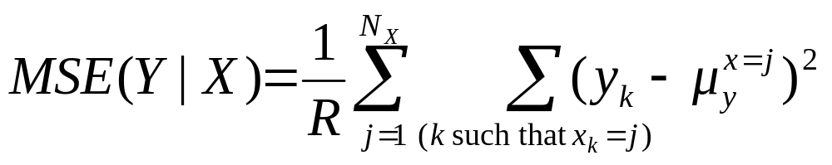
Choosing the attribute to split on
Gender | Rich? | Num. Children | Num. Beany Babies | Age
Female | No | 2 | 1 | 38
Male | No | 0 | 0 | 24
Male | Yes | 0 | 5+ | 72
: | : | : | : | :
MSE(Y|X) = The expected squared error if we must predict a record’s Y value given only knowledge of the record’s X value
If we’re told x=j, the smallest expected error comes from predicting the mean of the Y-values among those records in which x=j. Call this mean quantity μ_{y}^{x=j}
Then…

Slide 38
Choosing the attribute to split on
Gender | Rich? | Num. Children | Num. Beany Babies | Age
Female | No | 2 | 1 | 38
Male | No | 0 | 0 | 24
Male | Yes | 0 | 5+ | 72
: | : | : | : | :
Regression tree attribute selection: greedily choose the attribute that minimizes MSE(Y|X)
Guess what we do about real-valued inputs?
Guess how we prevent overfitting
MSE(Y|X) = The expected squared error if we must predict a record’s Y value given only knowledge of the record’s X value
If we’re told x=j, the smallest expected error comes from predicting the mean of the Y-values among those records in which x=j. Call this mean quantity μ_{y}^{x=j}
Then…

Slide 39
Pruning Decision
…property-owner = Yes
Do I deserve to live?
Gender?
Female
Male
Predict age = 39
Predict age = 36
# property-owning females = 56712
Mean age among POFs = 39
Age std dev among POFs = 12
# property-owning males = 55800
Mean age among POMs = 36
Age std dev among POMs = 11.5
Use a standard Chi-squared test of the null-hypothesis “these two populations have the same mean” and Bob’s your uncle.

Slide 40
Linear Regression Trees
…property-owner = Yes
Also known as “Model Trees”
Gender?
Female
Male
Predict age =
26 + 6 * NumChildren - 2 * YearsEducation
Predict age =
24 + 7 * NumChildren - 2.5 * YearsEducation
Leaves contain linear functions (trained using linear regression on all records matching that leaf)
Split attribute chosen to minimize MSE of regressed children.
Pruning with a different Chi-squared

Slide 41
Linear Regression Trees
…property-owner = Yes
Also known as “Model Trees”
Gender?
Female
Male
Detail: You typically ignore any categorical attribute that has been tested on higher up in the tree during the regression. But use all untested attributes, and use real-valued attributes even if they’ve been tested above
Predict age =
26 + 6 * NumChildren - 2 * YearsEducation
Predict age =
24 + 7 * NumChildren - 2.5 * YearsEducation
Leaves contain linear functions (trained using linear regression on all records matching that leaf)
Split attribute chosen to minimize MSE of regressed children.
Pruning with a different Chi-squared

Slide 42
Test your understanding
Assuming regular regression trees, can you sketch a graph of the fitted function y^{est(}x) over this diagram?
y
x

Slide 43
Test your understanding
Assuming linear regression trees, can you sketch a graph of the fitted function y^{est(}x) over this diagram?
y
x

Slide 44
4: GMDH (c.f. BACON, AIM)
Group Method Data Handling
A very simple but very good idea:
Do linear regression
Use cross-validation to discover whether any quadratic term is good. If so, add it as a basis function and loop.
Use cross-validation to discover whether any of a set of familiar functions (log, exp, sin etc) applied to any previous basis function helps. If so, add it as a basis function and loop.
Else stop

Slide 45
GMDH (c.f. BACON, AIM)
Group Method Data Handling
A very simple but very good idea:
Do linear regression
Use cross-validation to discover whether any quadratic term is good. If so, add it as a basis function and loop.
Use cross-validation to discover whether any of a set of familiar functions (log, exp, sin etc) applied to any previous basis function helps. If so, add it as a basis function and loop.
Else stop
Typical learned function:
age^{est} = height - 3.1 sqrt(weight) +
4.3 income / (cos (NumCars))

Slide 46
3: Cascade Correlation
A super-fast form of Neural Network learning
Begins with 0 hidden units
Incrementally adds hidden units, one by one, doing ingeniously little recomputation between each unit addition

Slide 47
Cascade beginning
Begin with a regular dataset
Nonstandard notation:
X^{(i)} is the i’th attribute
x^{(i)}_{k} is the value of the i’th attribute in the k’th record
X⁽⁰⁾ | X⁽¹⁾ | … | X^{(m)} | Y
x⁽⁰⁾₁ | x⁽¹⁾₁ | … | x^{(m)}₁ | y₁
x⁽⁰⁾₂ | x⁽¹⁾₂ | … | x^{(m)}₂ | y₂
: | : | : | : | :

Slide 48
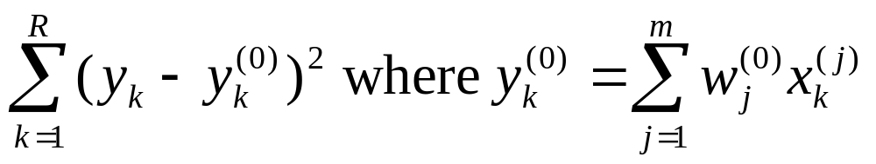
Cascade first step
Begin with a regular dataset
Find weights w⁽⁰⁾_{i} to best fit Y.
I.E. to minimize
X⁽⁰⁾ | X⁽¹⁾ | … | X^{(m)} | Y
x⁽⁰⁾₁ | x⁽¹⁾₁ | … | x^{(m)}₁ | y₁
x⁽⁰⁾₂ | x⁽¹⁾₂ | … | x^{(m)}₂ | y₂
: | : | : | : | :

Slide 49
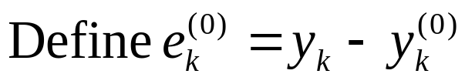
Consider our errors…
Begin with a regular dataset
Find weights w⁽⁰⁾_{i} to best fit Y.
I.E. to minimize
X⁽⁰⁾ | X⁽¹⁾ | … | X^{(m)} | Y | Y⁽⁰⁾ | E⁽⁰⁾
x⁽⁰⁾₁ | x⁽¹⁾₁ | … | x^{(m)}₁ | y₁ | y⁽⁰⁾₁ | e⁽⁰⁾₁
x⁽⁰⁾₂ | x⁽¹⁾₂ | … | x^{(m)}₂ | y₂ | y⁽⁰⁾₂ | e⁽⁰⁾₂
: | : | : | : | : | : | :

Slide 50
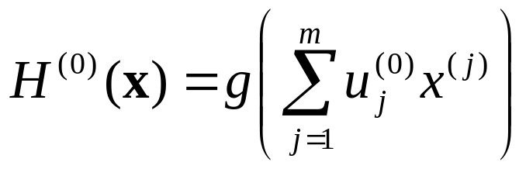
Create a hidden unit…
Find weights u⁽⁰⁾_{i} to define a new basis function H⁽⁰⁾(x) of the inputs.
Make it specialize in predicting the errors in our original fit:
Find {u⁽⁰⁾_{i} } to maximize correlation between H⁽⁰⁾(x) and E⁽⁰⁾ where
X⁽⁰⁾ | X⁽¹⁾ | … | X^{(m)} | Y | Y⁽⁰⁾ | E⁽⁰⁾ | H⁽⁰⁾
x⁽⁰⁾₁ | x⁽¹⁾₁ | … | x^{(m)}₁ | y₁ | y⁽⁰⁾₁ | e⁽⁰⁾₁ | h⁽⁰⁾₁
x⁽⁰⁾₂ | x⁽¹⁾₂ | … | x^{(m)}₂ | y₂ | y⁽⁰⁾₂ | e⁽⁰⁾₂ | h⁽⁰⁾₂
: | : | : | : | : | : | : | :

Slide 51
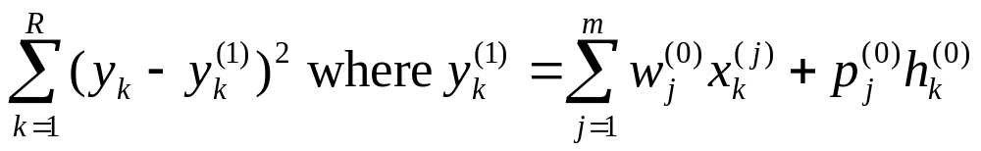
Cascade next step
Find weights w⁽¹⁾_{i} p⁽¹⁾₀ to better fit Y.
I.E. to minimize
X⁽⁰⁾ | X⁽¹⁾ | … | X^{(m)} | Y | Y⁽⁰⁾ | E⁽⁰⁾ | H⁽⁰⁾ | Y⁽¹⁾
x⁽⁰⁾₁ | x⁽¹⁾₁ | … | x^{(m)}₁ | y₁ | y⁽⁰⁾₁ | e⁽⁰⁾₁ | h⁽⁰⁾₁ | y⁽¹⁾₁
x⁽⁰⁾₂ | x⁽¹⁾₂ | … | x^{(m)}₂ | y₂ | y⁽⁰⁾₂ | e⁽⁰⁾₂ | h⁽⁰⁾₂ | y⁽¹⁾₂
: | : | : | : | : | : | : | : | :

Slide 52
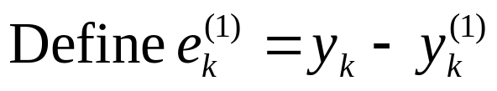
Now look at new errors
Find weights w⁽¹⁾_{i} p⁽¹⁾₀ to better fit Y.
X⁽⁰⁾ | X⁽¹⁾ | … | X^{(m)} | Y | Y⁽⁰⁾ | E⁽⁰⁾ | H⁽⁰⁾ | Y⁽¹⁾ | E⁽¹⁾
x⁽⁰⁾₁ | x⁽¹⁾₁ | … | x^{(m)}₁ | y₁ | y⁽⁰⁾₁ | e⁽⁰⁾₁ | h⁽⁰⁾₁ | y⁽¹⁾₁ | e⁽¹⁾₁
x⁽⁰⁾₂ | x⁽¹⁾₂ | … | x^{(m)}₂ | y₂ | y⁽⁰⁾₂ | e⁽⁰⁾₂ | h⁽⁰⁾₂ | y⁽¹⁾₂ | e⁽¹⁾₂
: | : | : | : | : | : | : | : | : | :

Slide 53
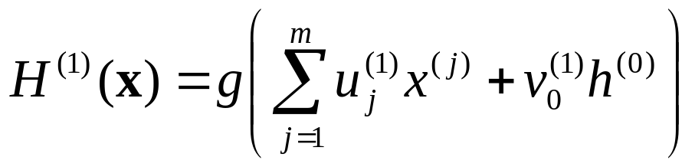
Create next hidden unit…
Find weights u⁽¹⁾_{i} v⁽¹⁾₀ to define a new basis function H⁽¹⁾(x) of the inputs.
Make it specialize in predicting the errors in our original fit:
Find {u⁽¹⁾_{i ,} v⁽¹⁾₀} to maximize correlation between H⁽¹⁾(x) and E⁽¹⁾ where
X⁽⁰⁾ | X⁽¹⁾ | … | X^{(m)} | Y | Y⁽⁰⁾ | E⁽⁰⁾ | H⁽⁰⁾ | Y⁽¹⁾ | E⁽¹⁾ | H⁽¹⁾
x⁽⁰⁾₁ | x⁽¹⁾₁ | … | x^{(m)}₁ | y₁ | y⁽⁰⁾₁ | e⁽⁰⁾₁ | h⁽⁰⁾₁ | y⁽¹⁾₁ | e⁽¹⁾₁ | h⁽¹⁾₁
x⁽⁰⁾₂ | x⁽¹⁾₂ | … | x^{(m)}₂ | y₂ | y⁽⁰⁾₂ | e⁽⁰⁾₂ | h⁽⁰⁾₂ | y⁽¹⁾₂ | e⁽¹⁾₂ | h⁽¹⁾₂
: | : | : | : | : | : | : | : | : | : | :

Slide 54
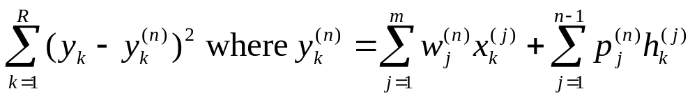
Cascade n’th step
Find weights w^{(n)}_{i} p^{(n)}_{j} to better fit Y.
I.E. to minimize
X⁽⁰⁾ | X⁽¹⁾ | … | X^{(m)} | Y | Y⁽⁰⁾ | E⁽⁰⁾ | H⁽⁰⁾ | Y⁽¹⁾ | E⁽¹⁾ | H⁽¹⁾ | … | Y^{(n)}
x⁽⁰⁾₁ | x⁽¹⁾₁ | … | x^{(m)}₁ | y₁ | y⁽⁰⁾₁ | e⁽⁰⁾₁ | h⁽⁰⁾₁ | y⁽¹⁾₁ | e⁽¹⁾₁ | h⁽¹⁾₁ | … | y^{(n)}₁
x⁽⁰⁾₂ | x⁽¹⁾₂ | … | x^{(m)}₂ | y₂ | y⁽⁰⁾₂ | e⁽⁰⁾₂ | h⁽⁰⁾₂ | y⁽¹⁾₂ | e⁽¹⁾₂ | h⁽¹⁾₂ | … | y^{(n)}₂
: | : | : | : | : | : | : | : | : | : | : | : | :

Slide 55
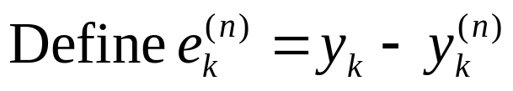
Now look at new errors
Find weights w^{(n)}_{i} p^{(n)}_{j} to better fit Y.
I.E. to minimize
X⁽⁰⁾ | X⁽¹⁾ | … | X^{(m)} | Y | Y⁽⁰⁾ | E⁽⁰⁾ | H⁽⁰⁾ | Y⁽¹⁾ | E⁽¹⁾ | H⁽¹⁾ | … | Y^{(n)} | E^{(n)}
x⁽⁰⁾₁ | x⁽¹⁾₁ | … | x^{(m)}₁ | y₁ | y⁽⁰⁾₁ | e⁽⁰⁾₁ | h⁽⁰⁾₁ | y⁽¹⁾₁ | e⁽¹⁾₁ | h⁽¹⁾₁ | … | y^{(n)}₁ | e^{(n)}₁
x⁽⁰⁾₂ | x⁽¹⁾₂ | … | x^{(m)}₂ | y₂ | y⁽⁰⁾₂ | e⁽⁰⁾₂ | h⁽⁰⁾₂ | y⁽¹⁾₂ | e⁽¹⁾₂ | h⁽¹⁾₂ | … | y^{(n)}₂ | e^{(n)}₂
: | : | : | : | : | : | : | : | : | : | : | : | : | :

Slide 56
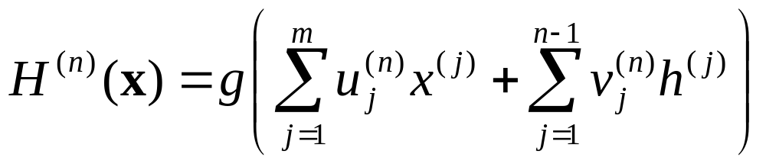
Create n’th hidden unit…
Find weights u^{(n)}_{i} v^{(n)}_{i} to define a new basis function H^{(n)}(x) of the inputs.
Make it specialize in predicting the errors in our previous fit:
Find {u^{(n)}_{i ,} v^{(n)}_{j}} to maximize correlation between H^{(n)}(x) and E^{(n)} where
X⁽⁰⁾ | X⁽¹⁾ | … | X^{(m)} | Y | Y⁽⁰⁾ | E⁽⁰⁾ | H⁽⁰⁾ | Y⁽¹⁾ | E⁽¹⁾ | H⁽¹⁾ | … | Y^{(n)} | E^{(n)} | H^{(n)}
x⁽⁰⁾₁ | x⁽¹⁾₁ | … | x^{(m)}₁ | y₁ | y⁽⁰⁾₁ | e⁽⁰⁾₁ | h⁽⁰⁾₁ | y⁽¹⁾₁ | e⁽¹⁾₁ | h⁽¹⁾₁ | … | y^{(n)}₁ | e^{(n)}₁ | h^{(n)}₁
x⁽⁰⁾₂ | x⁽¹⁾₂ | … | x^{(m)}₂ | y₂ | y⁽⁰⁾₂ | e⁽⁰⁾₂ | h⁽⁰⁾₂ | y⁽¹⁾₂ | e⁽¹⁾₂ | h⁽¹⁾₂ | … | y^{(n)}₂ | e^{(n)}₂ | h^{(n)}₂
: | : | : | : | : | : | : | : | : | : | : | : | : | : | :
Continue until satisfied with fit…

Slide 57
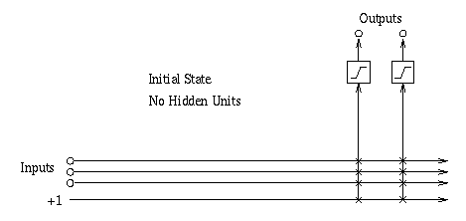
Visualizing first iteration

Slide 58
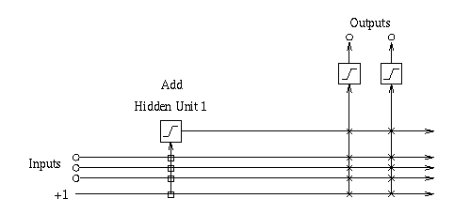
Visualizing second iteration

Slide 59
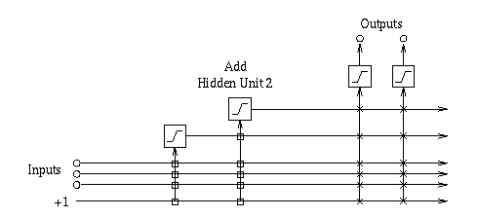
Visualizing third iteration

Slide 60
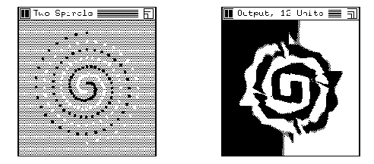
Example: Cascade Correlation for Classification

Slide 61
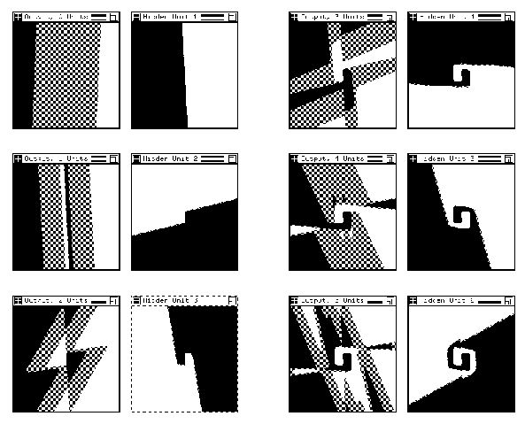
Training two spirals: Steps 1-6

Slide 62
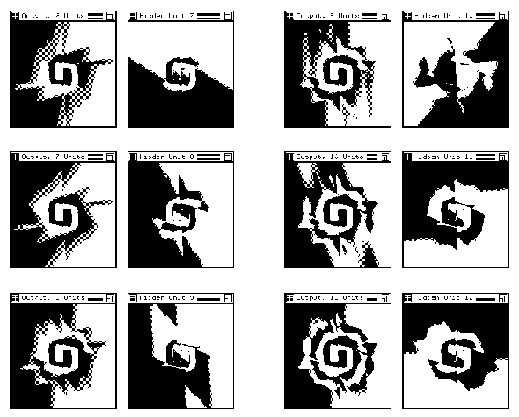
Training two spirals: Steps 2-12

Slide 63
If you like Cascade Correlation…
See Also
Projection Pursuit
  In which you add together many non-linear non-parametric scalar functions of carefully chosen directions
  Each direction is chosen to maximize error-reduction from the best scalar function
ADA-Boost
  An additive combination of regression trees in which the n+1’th tree learns the error of the n’th tree

Slide 64
2: Multilinear Interpolation
Consider this dataset. Suppose we wanted to create a continuous and piecewise linear fit to the data
y
x

Slide 65
Multilinear Interpolation
Create a set of knot points: selected X-coordinates (usually equally spaced) that cover the data
y
q₁
q₂
q₃
q₄
q₅
x

Slide 66
Multilinear Interpolation
We are going to assume the data was generated by a noisy version of a function that can only bend at the knots. Here are 3 examples (none fits the data well)
y
q₁
q₂
q₃
q₄
q₅
x

Slide 67
How to find the best fit?
Idea 1: Simply perform a separate regression in each segment for each part of the curve
What’s the problem with this idea?
y
q₁
q₂
q₃
q₄
q₅
x

Slide 68
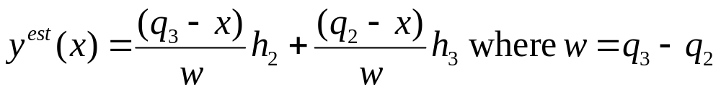
How to find the best fit?
Let’s look at what goes on in the red segment
h₂
y
h₃
q₁
q₂
q₃
q₄
q₅
x

Slide 69
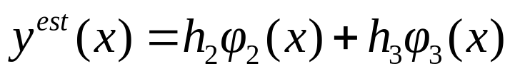
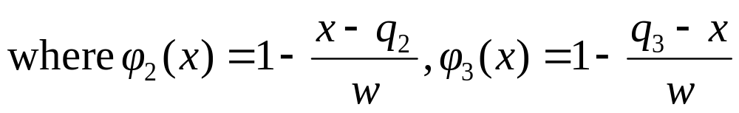
How to find the best fit?
In the red segment…
h₂
y
φ₂(x)
h₃
q₁
q₂
q₃
q₄
q₅
x

Slide 70
How to find the best fit?
In the red segment…
h₂
y
φ₂(x)
h₃
q₁
q₂
q₃
q₄
q₅
φ₃(x)
x

Slide 71
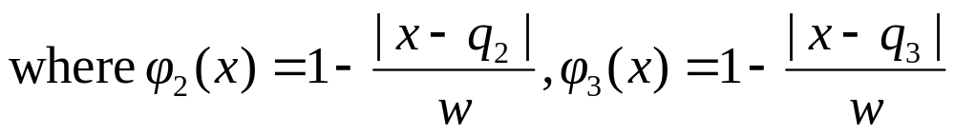
How to find the best fit?
In the red segment…
h₂
y
φ₂(x)
h₃
q₁
q₂
q₃
q₄
q₅
φ₃(x)
x

Slide 72
How to find the best fit?
In the red segment…
h₂
y
φ₂(x)
h₃
q₁
q₂
q₃
q₄
q₅
φ₃(x)
x

Slide 73
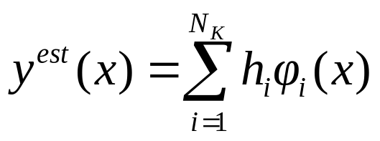
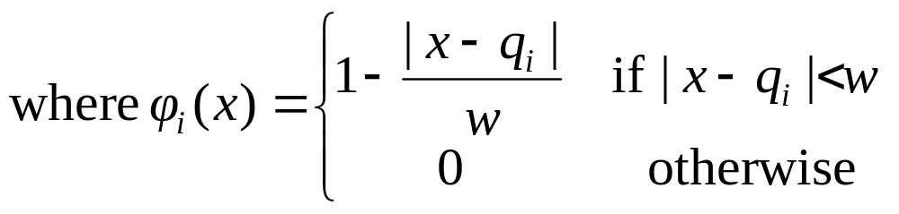
How to find the best fit?
In general
h₂
y
φ₂(x)
h₃
q₁
q₂
q₃
q₄
q₅
φ₃(x)
x

Slide 74
How to find the best fit?
In general
h₂
And this is simply a basis function regression problem!
We know how to find the least squares h_{ii}s!
y
φ₂(x)
h₃
q₁
q₂
q₃
q₄
q₅
φ₃(x)
x

Slide 75
In two dimensions…
Blue dots show locations of input vectors (outputs not depicted)
x₂
x₁

Slide 76
In two dimensions…
Each purple dot is a knot point. It will contain the height of the estimated surface
Blue dots show locations of input vectors (outputs not depicted)
x₂
x₁

Slide 77
In two dimensions…
Each purple dot is a knot point. It will contain the height of the estimated surface
But how do we do the interpolation to ensure that the surface is continuous?
Blue dots show locations of input vectors (outputs not depicted)
9
3
7
8
x₂
x₁

Slide 78
In two dimensions…
Each purple dot is a knot point. It will contain the height of the estimated surface
But how do we do the interpolation to ensure that the surface is continuous?
To predict the value here…
Blue dots show locations of input vectors (outputs not depicted)
9
3
7
8
x₂
x₁

Slide 79
In two dimensions…
Each purple dot is a knot point. It will contain the height of the estimated surface
But how do we do the interpolation to ensure that the surface is continuous?
To predict the value here…
First interpolate its value on two opposite edges…
Blue dots show locations of input vectors (outputs not depicted)
9
7
3
7
8
7.33
x₂
x₁

Slide 80
In two dimensions…
Each purple dot is a knot point. It will contain the height of the estimated surface
But how do we do the interpolation to ensure that the surface is continuous?
To predict the value here…
First interpolate its value on two opposite edges…
Then interpolate between those two values
Blue dots show locations of input vectors (outputs not depicted)
9
7
3
7.05
7
8
7.33
x₂
x₁

Slide 81
In two dimensions…
Each purple dot is a knot point. It will contain the height of the estimated surface
But how do we do the interpolation to ensure that the surface is continuous?
To predict the value here…
First interpolate its value on two opposite edges…
Then interpolate between those two values
Blue dots show locations of input vectors (outputs not depicted)
9
7
3
7.05
7
Notes:
This can easily be generalized to m dimensions.
It should be easy to see that it ensures continuity
The patches are not linear
8
7.33
x₂
x₁

Slide 82
Doing the regression
Given data, how do we find the optimal knot heights?
Happily, it’s simply a two-dimensional basis function problem.
(Working out the basis functions is tedious, unilluminating, and easy)
What’s the problem in higher dimensions?
9
3
7
8
x₂
x₁

Slide 83
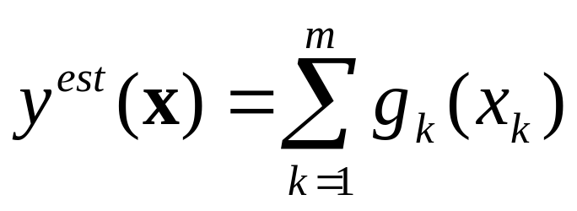
1: MARS
Multivariate Adaptive Regression Splines
Invented by Jerry Friedman (one of Andrew’s heroes)
Simplest version:
    Let’s assume the function we are learning is of the following form:
Instead of a linear combination of the inputs, it’s a linear combination of non-linear functions of individual inputs

Slide 84
MARS
Instead of a linear combination of the inputs, it’s a linear combination of non-linear functions of individual inputs
Idea: Each g_{k} is one of these
y
q₁
q₂
q₃
q₄
q₅
x

Slide 85
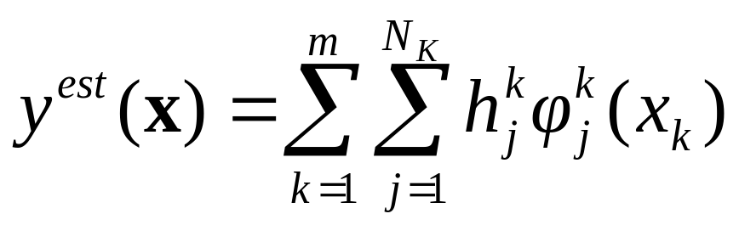
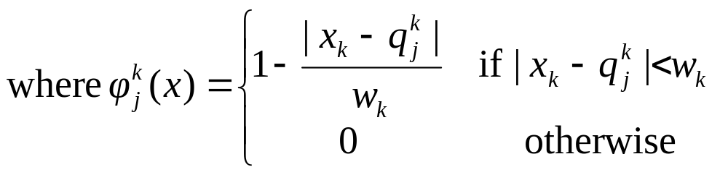
MARS
Instead of a linear combination of the inputs, it’s a linear combination of non-linear functions of individual inputs
q^{k}_{j} : The location of the j’th knot in the k’th dimension
h^{k}_{j} : The regressed height of the j’th knot in the k’th dimension
w^{k}: The spacing between knots in the kth dimension
y
q₁
q₂
q₃
q₄
q₅
x

Slide 86
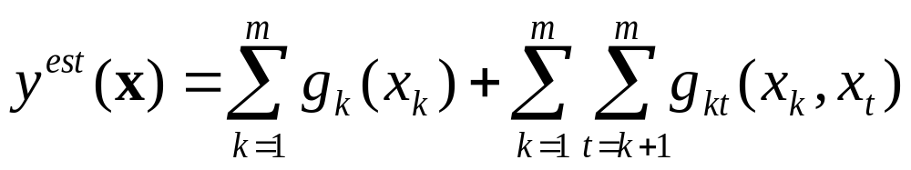
That’s not complicated enough!
Okay, now let’s get serious. We’ll allow arbitrary “two-way interactions”:
The function we’re learning is allowed to be a sum of non-linear functions over all one-d and 2-d subsets of attributes
Can still be expressed as a linear combination of basis functions
Thus learnable by linear regression
Full MARS: Uses cross-validation to choose a subset of subspaces, knot resolution and other parameters.

Slide 87
If you like MARS…
…See also CMAC (Cerebellar Model Articulated Controller) by James Albus (another of Andrew’s heroes)
  Many of the same gut-level intuitions
  But entirely in a neural-network, biologically plausible way
    (All the low dimensional functions are by means of lookup tables, trained with a delta-rule and using a clever blurred update and hash-tables)

Slide 88
Where are we now?
Inference
Engine Learn
Joint DE, Bayes Net Structure Learning
Inputs
P(E₁|E₂)
Predict
category
Dec Tree, Sigmoid Perceptron, Sigmoid N.Net, Gauss/Joint BC, Gauss Naïve BC, N.Neigh, Bayes Net Based BC, Cascade Correlation
Inputs
Classifier
Density
Estimator
Prob-
ability
Joint DE, Naïve DE, Gauss/Joint DE, Gauss Naïve DE, Bayes Net Structure Learning
Inputs
Predict
real no.
Linear Regression, Polynomial Regression, Perceptron, Neural Net, N.Neigh, Kernel, LWR, RBFs, Robust Regression, Cascade Correlation, Regression Trees, GMDH, Multilinear Interp, MARS
Inputs
Regressor

Slide 89
What You Should Know
For each of the eight methods you should be able to summarize briefly what they do and outline how they work.
You should understand them well enough that given access to the notes you can quickly re-understand them at a moments notice
But you don’t have to memorize all the details
In the right context any one of these eight might end up being really useful to you one day! You should be able to recognize this when it occurs.

Slide 90
Citations
Radial Basis Functions
T. Poggio and F. Girosi, Regularization Algorithms for Learning That Are Equivalent to Multilayer Networks, Science, 247, 978--982, 1989
LOESS
W. S. Cleveland, Robust Locally Weighted Regression and Smoothing Scatterplots, Journal of the American Statistical Association, 74, 368, 829-836, December, 1979
GMDH etc
http://www.inf.kiev.ua/GMDH-home/
P. Langley and G. L. Bradshaw and H. A. Simon, Rediscovering Chemistry with the BACON System, Machine Learning: An Artificial Intelligence Approach, R. S. Michalski and J. G. Carbonnell and T. M. Mitchell, Morgan Kaufmann, 1983
Regression Trees etc
L. Breiman and J. H. Friedman and R. A. Olshen and C. J. Stone, Classification and Regression Trees, Wadsworth, 1984
J. R. Quinlan, Combining Instance-Based and Model-Based Learning, Machine Learning: Proceedings of the Tenth International Conference, 1993
Cascade Correlation etc
S. E. Fahlman and C. Lebiere. The cascade-correlation learning architecture. Technical Report CMU-CS-90-100, School of Computer Science, Carnegie Mellon University, Pittsburgh, PA, 1990. http://citeseer.nj.nec.com/fahlman91cascadecorrelation.html
J. H. Friedman and W. Stuetzle, Projection Pursuit Regression, Journal of the American Statistical Association, 76, 376, December, 1981
MARS
J. H. Friedman, Multivariate Adaptive Regression Splines, Department for Statistics, Stanford University, 1988, Technical Report No. 102

